Slide 1
Final Mini Project Demonstration
Project Title : Stock price prediction using Deep learning and sentiment analysis
Project Guide : Prof. Badri Prasad
Project Team : Darshil Shah PES1UG19CS131
Nittuu Churru LUNDBC
MAHI LUNDBC

Slide 2
Project Abstract and Scope
This project mainly details with the uncertainty of the stock market and tries to bring a precedent in the field by predicting values and indices using advanced computations such as Machine Learning and sentiment analysis.
Using ARIMA and LSTM model, we try to predict the values numerically i.e. based on price action
But the stock market is a human operated index and involvement of sentiments is likely in such a field
We will take the previous days’ news in consideration, we find the sentiment score for that and add/subtract it with the numerically predicted value using ARIMA and LSTM
The algorithm for doing the same has been explained for the same in the following slides

Slide 3
Technologies Used
LSTM: Long Short-Term Memory (LSTM) Cells, based on RNN, were proposed. LSTMs consist of an extra cell state that works as a memory unit. The decision of updating the cell state and the content of updating is decided by gates in the LSTM cell.
ARIMA: ARIMA is mainly used for non-stationary time series analysis
VADER: VADER is a module in python using which we can perform Sentiment analysis, we calculate compound scores of text and we will add or subtract them from the price as will be explained later.
Notes:
3

Slide 4
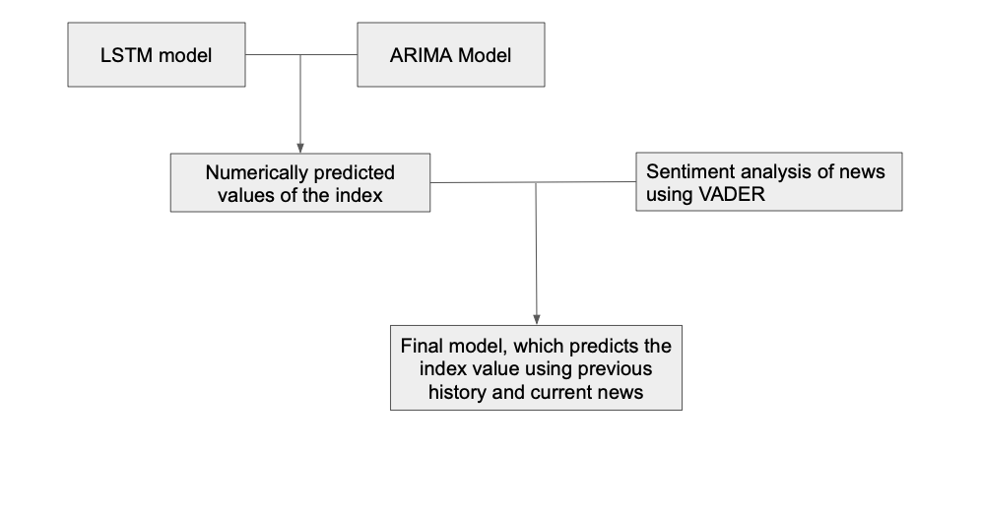
Implementation
Notes:
4

Slide 5
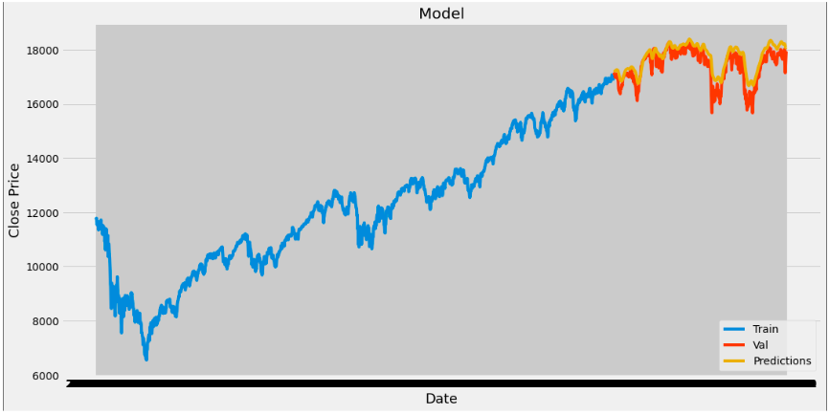
Project Demo
Graph using only LSTM
Notes:
5

Slide 6
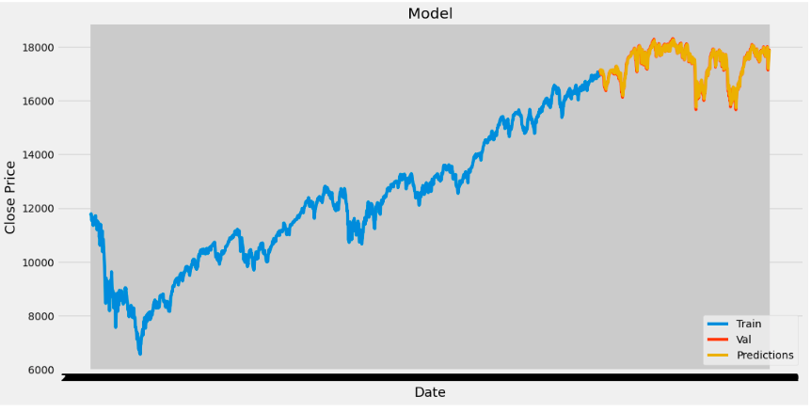
Graph using LSTM + ARIMA

Slide 7
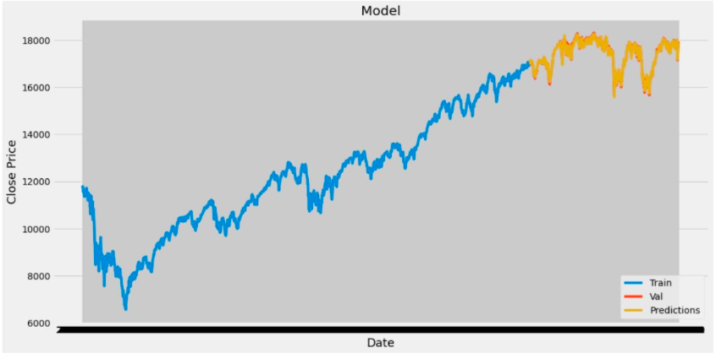
Graph using LSTM + ARIMA + sentiment analysis

Slide 8
Conclusion and Future Work
Summarize the key points.
Provide a glimpse of Future work.
Notes:
8

Slide 9
References
Xinyi Li1 , Yinchuan Li2,1 , Hongyang Yang1 , Liuqing Yang1 , Xiao-Yang Liu1 , “DP-LSTM: Differential Privacy-inspired LSTM for Stock Prediction Using Financial News ” Phil. Trans. Roy. Soc. London, vol. A247, pp. 529–551, April 1955. (references)
Siyuan Liu, Guangzhong Liao, Yifan Ding, " Stock Transaction Prediction Modeling and Analysis Based on LSTM ", 2018 13th IEEE Conference on Industrial Electronics and Applications(ICIEA), DOI:10.1109/ICIEA.2018.8398183K. Elissa, “Title of paper if known,” unpublished.
Tingwei Gao, Yueting Chai , Yi Liu, "Applying long short term memory neural networks for predicting stock closing price", 2017 8th IEEE International Conference on Software Engineering and Service Science (ICSESS), DOI: 10.1109/ICSESS.2017.8342981Y. Yorozu, M. Hirano, K. Oka, and Y. Tagawa, “Electron spectroscopy studies on magneto-optical media and plastic substrate interface,” IEEE Translate. J. Magn. Japan, vol. 2, pp. 740–741, August 1987 [Digests 9th Annual Conf. Magnetics Japan, p. 301, 1982].
[6] Abadi, Martin, et al. “Deep learning with differential privacy.”
Proceedings of the 2016 ACM SIGSAC Conference on Computer and
Communications Security, ACM, 2016.
Notes:
9

Slide 10
Thank You

