Slide 1
SOA, Bhubaneswar
Internet Addresses
All devices connected to the Internet are called nodes and nodes that are computers are called hosts.
Each node/host is identified by a unique number called an Internet address (IP Address).
Types:
IPv4 addresses: An IPv4 address is normally written as four unsigned bytes, each ranging from 0 to 255, with the most significant byte first i.e. 152.19.134.132. This notation is called the dotted quad format (dotted decimal format).
IPv6 addresses: An IPv6 address is normally written as eight blocks of four hexadecimal digits separated by colons i.e. 2400:CB00:2048:0001:0000:0000:6CA2:C665 == 2400:CB00:2048:1:0:0:6CA2:C665 == 2400:CB00:2048:1::6CA2:C665.

Slide 2
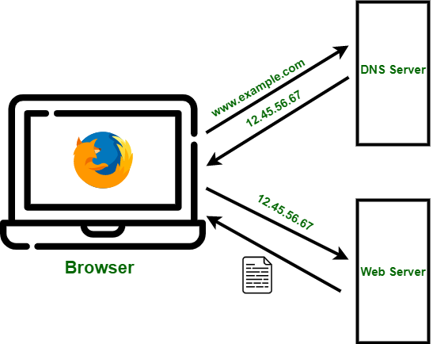
SOA, Bhubaneswar
Domain Name System (DNS)
IP addresses are great for computers; however, an IP address, which can have as many as 12 decimal digits, is beyond the capacity of most humans to remember.
To overcome this issue Domain Name System (DNS) is introduced. DNS associates hostnames that humans can remember (such as google.com) with IP addresses that computers can remember (such as 10.5.2.3).
Each server have at least one hostname; if one name maps to multiple IP addresses. It is then the responsibility of the DNS server to randomly choose machines to respond to each request.
Check Your DNS Server
nslookup www.google.com
cmd ➔ ipconfig/all (ifconfig/all)
https://www.top10vpn.com/tools/what-is-my-dns-server/
ipconfig /displaydns
chrome://net-internals/#dns

Slide 3
SOA, Bhubaneswar
The InetAddress Class
A program that prints the IP address of www.google.com
import java.net.*;
public class GoogleByName {
public static void main (String[] args) {
try {
InetAddress address = InetAddress.getByName("www.google.com");
System.out.println(address);
} catch (UnknownHostException ex) {
System.out.println("Could not find www.oreilly.com");
}
}
}
The java.net.InetAddress class is Java’s high-level representation of an IP address, both IPv4 and IPv6.
There are no public constructors in the InetAddress class. Instead, InetAddress has static factory methods that connect to a DNS server to resolve a hostname.
The most common is InetAddress.getByName().
It methods makes a connection to the local DNS server to look up the name and the numeric address. If the DNS server can’t find the address, this method throws an UnknownHostException.
You can also do Reverse Lookup with this method
InetAddress.getBy Name(): InetAddress address = InetAddress.getByName("208.201.239.100"); System.out.println(address.getHostName());

Slide 4
SOA, Bhubaneswar
Factory Methods of InetAddress Class
public static InetAddress getLocalHost() | This method returns the instance of InetAddress containing the local hostname and address.
public static InetAddress getByName( String host ) | This method returns the instance of InetAddress containing IP and Host name of host represented by host argument.
public static InetAddress[] getAllByName( String hostName ) | This method returns the array of the instance of InetAddress class which contains IP addresses.
public static InetAddress getByAddress( byte IPAddress[] ) | This method returns an InetAddress object created from the raw IP address.
public static InetAddress getByAddress( String hostName, byte IPAddress[] ) | This method creates and returns an InetAddress based on the provided hostname and IP address.
Get Local Host Address
import java.net.*;
public class MyLocalAddress {
public static void main (String[] args) {
try {
InetAddress address = InetAddress.getLocalHost();
System.out.println(address);
} catch (UnknownHostException ex) {
System.out.println("Could not find this computer's address.");
}
}
}

Slide 5
SOA, Bhubaneswar
Instance Methods of InetAddress Class
InetAddress class has plenty of instance methods that can be called using the object.
Determining whether an IP address is v4 or v6
import java.net.*;
public class AddressTests {
public static int getVersion(InetAddress ia) {
byte[] address = ia.getAddress();
if (address.length == 4) return 4;
else if (address.length == 16) return 6;
else return -1;
}
}
getAddress() | This method returns the raw IP address of this InetAddress object, in bytes.
getCanonicalHostName() | This method returns the fully qualified domain name for this IP address.
getHostAddress() | This method gets the IP address in string form.
isAnyLocalAddress() | This method utility routine to check if the InetAddress is an unpredictable address.
isLoopbackAddress() | This method used to check if the InetAddress represents a loopback address.
isMulticastAddress() | This method checks whether the site has multiple servers.
isReachable(int timeout) | This method tests whether that address is reachable.
isReachable(NetworkInterface netif, int ttl, int timeout) | This method tests whether that address is reachable.
toString() | This method converts and returns an IP address in string form

Slide 6
SOA, Bhubaneswar
Inet4Address and Inet6Address
Java uses two classes, Inet4Address and Inet6Address,
public final class Inet4Address extends InetAddress
public final class Inet6Address extends InetAddress
Inet6Address is similar, but it does add one new method not present in the superclass public boolean isIPv4CompatibleAddress().
This method returns true if and only if the address is essentially an IPv4 address stuffed into an IPv6 container - which means only the last four bytes are nonzero.
That is, the address has the form 0:0:0:0:0:0:0:xxxx. If this is the case, you can pull off the last four bytes from the array returned by getBytes() and use this data to create an Inet4Ad address instead.

Slide 7
SOA, Bhubaneswar
The NetworkInterface Class
Network Interface: A network interface can be thought of as a point at which your computer connects to the network. It is not necessarily a piece of hardware but can also be implemented in software. For example, a loopback interface which is used for testing purposes.
The NetworkInterface class represents a local IP address. The NetworkInterface class provides methods to enumerate all the local addresses, regardless of interface, and to create InetAddress objects from them. These InetAddress objects can then be used to create sockets, server sockets, and so forth.
Factory Methods
You can ask for a NetworkInterface by IP address, by name, or by enumeration.
public static NetworkInterface getByName(String name) throws SocketException
The getByName() method returns a NetworkInterface object representing the network interface with the particular name. If there’s no interface with that name, it returns null.

Slide 8
SOA, Bhubaneswar
The NetworkInterface Class
getName() : Returns the name of this network interface.
getInetAddresses() : Returns an enumeration of all Inetaddresses bound to this network interface, if security manager allows it.
getInterfaceAddresses() : Returns a list of all interface addresses on this interface.
getSubInterfaces() : Returns an enumeration of all the sub or virtual interfaces of this network interface. For example, eth0:2 is a sub interface of eth0.
getParent() : In case of a sub interface, this method returns the parent interface. If this is not a subinterface, this method will return null.
getDisplayName() : This method returns the name of network interface in a readable string format.
getByName() : Finds and returns the network interface with the specified name, or null if none exists.
Check if the Interface “eth0” available in the system or not
try {
NetworkInterface ni = NetworkInterface.getByName("eth0");
if (ni == null) {
System.err.println("No such interface: eth0");
}
} catch (SocketException ex) {
System.err.println("Could not list sockets.");
}

