Slide 1
Gaze Tracking
Group Members
Nityam Dixit
Devyash Shah
Kush Patel
Kavan Gondalia

Slide 2
Introduction
Gaze tracking is essential in mobile apps providing insights for use authentication and communication.
We have covered corneal reflection and pupil tracking
Current gaze tracking technology can be expensive and require specialized equipment, making it inaccessible for some potential users.

Slide 3
Existing Body of Work
"Eye-tracking: A comprehensive guide to methods, paradigms, and measures" by Holmqvist, Kenneth et al. (2011).
A High-Level Description and Performance Evaluation of Pupil Invisible by pupil labs.
“NVGaze”: Gaze direction Tracking system developed by NVIDIA.
https://www.researchgate.net/publication/254913339_Eye_Tracking_A_Comprehensive_Guide_To_Methods_And_Measures

Slide 4
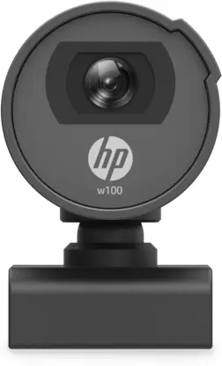
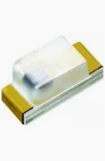
Hardware
We used a HP w100 Webcam.
Specifications:
0.3 MP Image Resolution
Manual Adjustable Lens
60 - 100 cm Focus range
Along with that, we used a 0603 Flat Top Infrared LED
940nm 4W 100mA SMD

Slide 5
First Approach
We implemented U-net as the part of our first approach.
We used Adam Optimizer.
Loss Function used is Binary Cross Entropy for training and IOU accuracy as metric.
Input shape of model is (480,640,3) and the output shape is (480,640,1).
Total parameters that are trainable are 1,941,105.

Slide 6
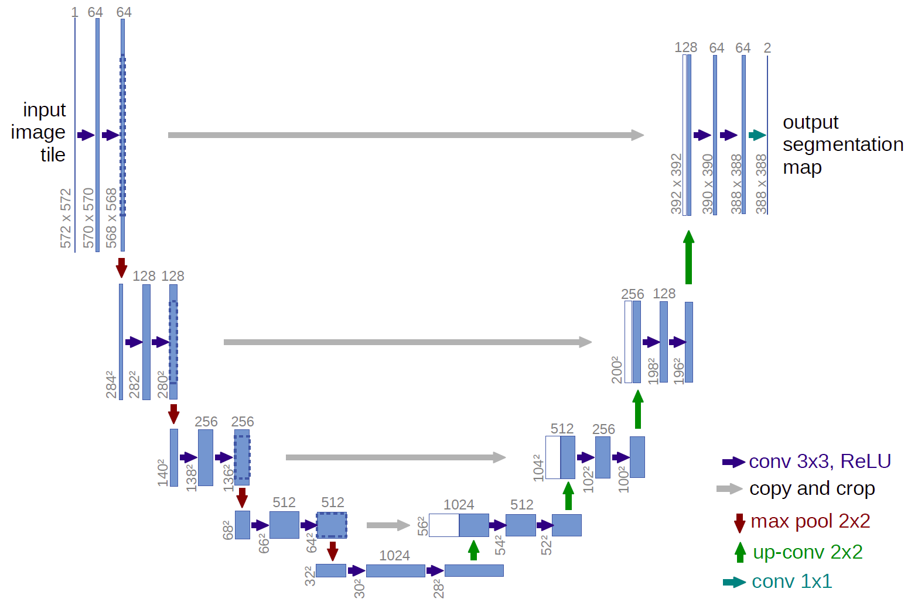
First Approach
https://lmb.informatik.uni-freiburg.de/people/ronneber/u-net/u-net-architecture.png

Slide 7
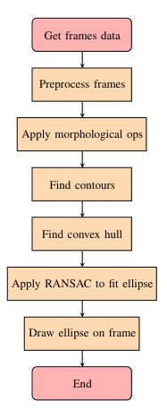
Second Approach
RANSAC (Random Sample Consensus), a robust algorithm for fitting models to data in the presence of outliers.
Comparison between the results of the RANSAC-based approach and Unet

Slide 8
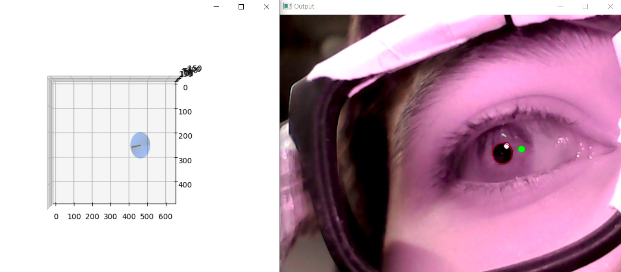
Results

Slide 9
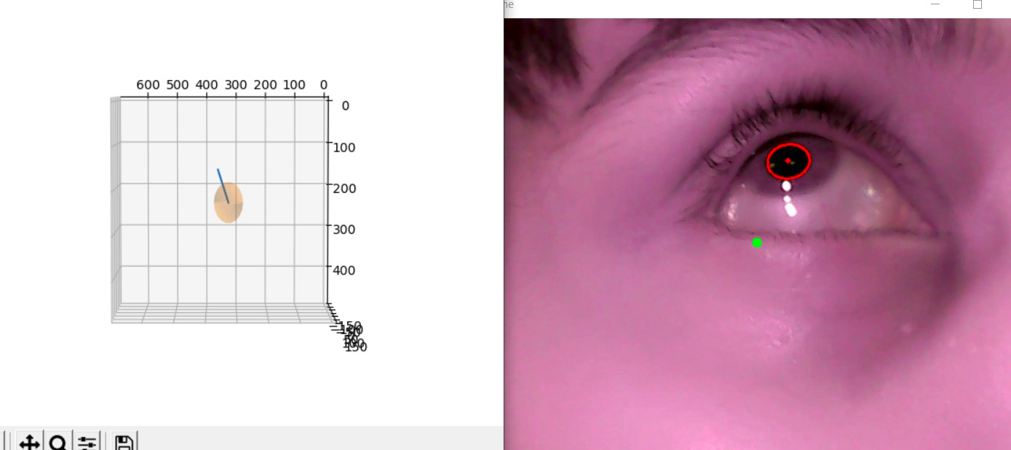
Results

Slide 10
Fitting Algorithms
U-Net
RANSAC

Slide 11
Vision and Future
Work Distribution:
Research and hardware: Nityam, Kavan
Code and Implementation: All

Slide 12
Reference
Holmqvist, K., Nyström, M., Andersson, R., Dewhurst, R., Jarodzka, H., & Van de Weijer, J. (2011). Eye-tracking: A comprehensive guide to methods, paradigms, and measures. Oxford University Press.
Krafka, K., Khosla, A., Kellnhofer, P., Kannan, H., Bhandarkar, S., Matusik, W., & Torralba, A. (2016). WebGazer: Scalable webcam eye tracking using user interactions. In Proceedings of the 25th International Joint Conference on Artificial Intelligence (IJCAI) (pp. 3839-3845).
Baltrusaitis, T., Robinson, P., & Morency, L. P. (2016). Real-time eye tracking and blink detection with USB cameras. Behavior research methods, 48(1), 265-274.
Chauhan, R., Pujari, A. K., Raman, B., & Rajesh, R. (2018). Pupil detection for wearable eye-tracking using SIFT features. In 2018 IEEE 15th India Council International Conference (INDICON) (pp. 1-5). IEEE.
@miscDESELAERS2020, author = Deselaers, Johannes, title = Deep Learning Pupil Center Localization, year = 2020, howpublished = https: //www.diva-portal.org/smash/get/diva2:1509851/FULLTEXT01.pdf

