Slide 1



GAZE TRACKING
Group Members
Nityam Dixit
Kush Patel
Kavan Gondalia
Devyash Shah

Slide 2

Gaze tracking technology has become increasingly popular in recent years.
This technology has many potential applications, including marketing research and augmented reality.
Current gaze tracking technology can be expensive and require specialized equipment, making it inaccessible for some potential users.

Slide 3
EXISTING BODY OF WORK
"Eye-tracking: A comprehensive guide to methods, paradigms, and measures" by Holmqvist, Kenneth et al. (2011)
A High-Level Description and Performance Evaluation of Pupil Invisible by pupil labs

Slide 4
APPROACH
Acquire a high-resolution infrared camera that can capture the movements of the pupil
Prepare it to track different types of eye movements
Calibrate the system by asking participants to look at specific points on a screen and recording the corresponding positions of their pupils. This will allow the software to map the movements of the pupil to specific locations on the screen.

Slide 5
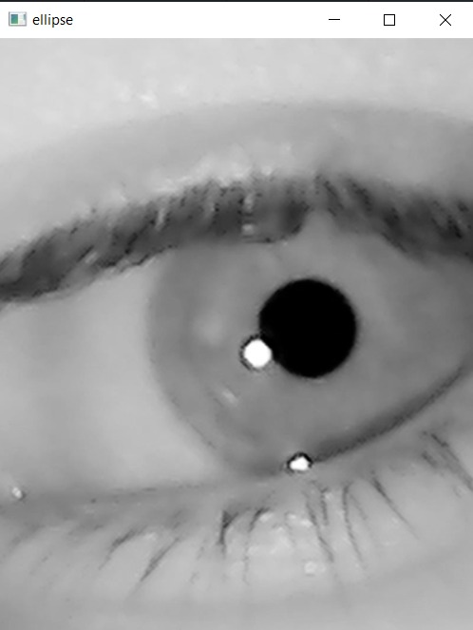

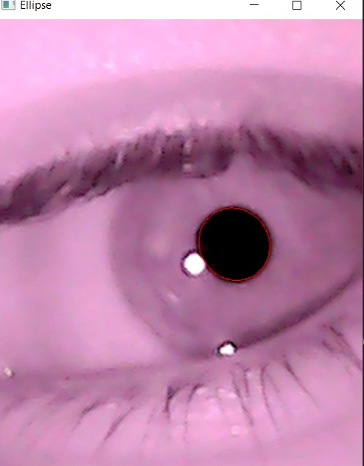
INITIAL RESULTS
IR-Image
Threshold
Fitting

Slide 6
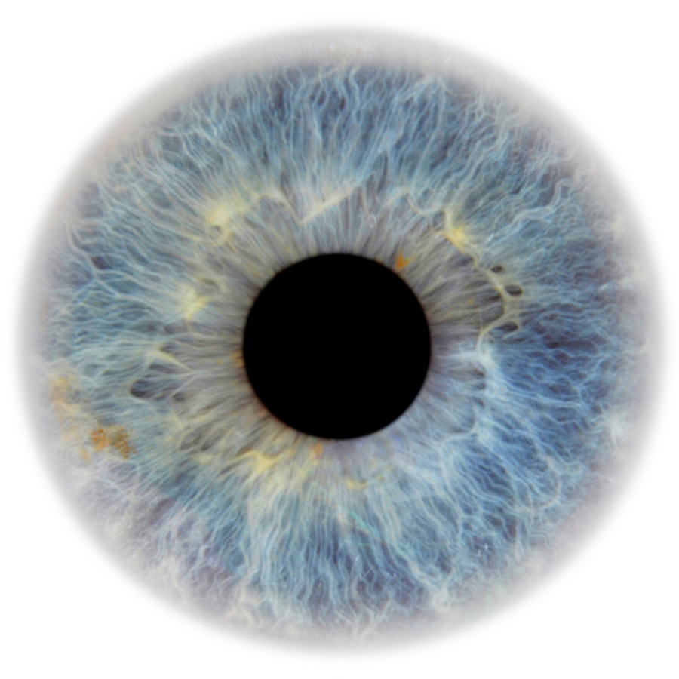
VISION AND FUTURE
Work Distribution
Research and hardware: Nityam, Kavan
Code and Implementation: All
Future works
Adding a world frame and mapping the gaze in a world coordinate system. Impove accuracy by developing an better calibration techniques

Slide 7
REFERENCES
Holmqvist, K., Nyström, M., Andersson, R., Dewhurst, R., Jarodzka, H., & Van de Weijer, J. (2011). Eye-tracking: A comprehensive guide to methods, paradigms, and measures. Oxford University Press.
Krafka, K., Khosla, A., Kellnhofer, P., Kannan, H., Bhandarkar, S., Matusik, W., & Torralba, A. (2016). WebGazer: Scalable webcam eye tracking using user interactions. In Proceedings of the 25th International Joint Conference on Artificial Intelligence (IJCAI) (pp. 3839-3845).
Baltrusaitis, T., Robinson, P., & Morency, L. P. (2016). Real-time eye tracking and blink detection with USB cameras. Behavior research methods, 48(1), 265-274.
Chauhan, R., Pujari, A. K., Raman, B., & Rajesh, R. (2018). Pupil detection for wearable eye-tracking using SIFT features. In 2018 IEEE 15th India Council International Conference (INDICON) (pp. 1-5). IEEE.

