Slide 1
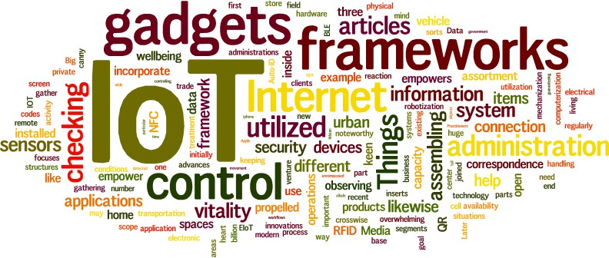

CS578: Internet of Things
Introduction to IoT
Definitions, Characteristics, Applications
“I have no special talent. I am only passionately curious.” – Albert Einstein

Slide 2
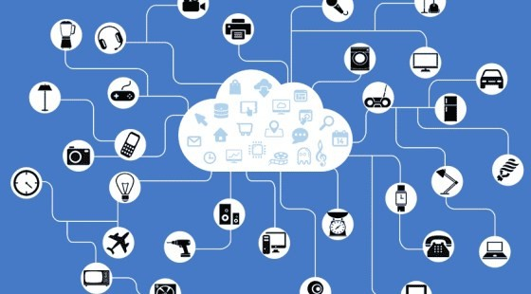
What is IoT?
Internet of Things (IoT) is the network of smart physical objects
physical objects (e.g. devices, vehicles, buildings, etc.) embedded with sensors/actuators,
computation unit, memory unit, power source, and network connectivity,
which enables the physical object to collect and exchange data,
analyze the collected data to extract new insight and respond accordingly.
Goal of IoT is to “connect the unconnected”
“Things” or “objects” that were not supposed to be connected to the Internet
IoT did the technology transition in traditional computer networks

Slide 3
Cont…
Unifications of technologies:
Embedded systems,
Low power and low rate network,
Internet,
Big data,
Data analytics,
Cloud computing,
Edge Intelligence
Software defined networks,
Network and data security
Etc.
Alternate Definition:
“The Internet of Things (IoT) is the network of physical objects that contain embedded technology to communicate and sense or interact with their internal states or the external environment.” – Gartner Research*
* https://www.gartner.com/en/information-technology/glossary/internet-of-things

Slide 4
Brief History of IoT
The term "Internet of things" was likely coined by Kevin Ashton of Procter & Gamble, later MIT's Auto-ID Center, in 1999.
“In the 20th century, computers were brains without senses — they only knew what we told them.” Now in the 21st century, computers are sensing things for themselves! – Kevin Ashton
Early 1980s at the Carnegie Melon University, a group of students created a way to get their campus Coca-Cola vending machine to report on its contents through a network in order to save them the trek if the machine was out of Coke.
In 1990, John Romkey, developer of the first TCP/IP stack for IBM PC in 1983,
connected a toaster to the internet for the first time.
In 1991, a group of students at the University of Cambridge used a web camera to report on coffee available in their computer labs coffee pot.
At the beginning of the 21st Century, LG Electronics introduced the world’s first refrigerator connected to the internet

Slide 5
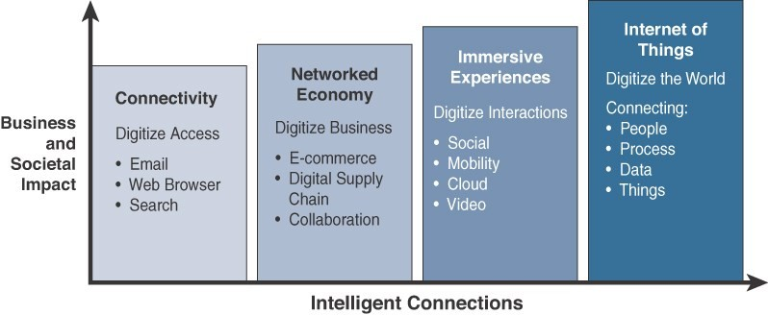
Cont…
The popularity of the term IoT did not accelerate until 2010/2011 and reached mass market in 2013-14.
Definition of the IoT has evolved over time.
2010 onwards
Early 2000
Post 1993
1990
Evolutionary Phases of the Internet

Slide 6
Benefits of IoT
Automation
Machines can assemble parts with more precision and speed, resulting in fewer errors during assembly
Robots can very rapidly detect faults that may not be detected by the human eye
Predictive Maintenance
Continuous monitoring of systems and processes to identify key indicators of problems before they
result in downtime or system failure
Process / Efficiency Improvement
Process improvement affects every aspect of an operation’s bottom line
Cost Reduction
When an organization can improve system uptime, automate processes, reduce the risk of failure and gain insights that support better decision making, and reduce resource usage, the result is efficiency and cost savings
Improved/ New Insights
IoT systems often act as the eyes and ears on remote, hard-to-reach, or widely distributed equipment and processes.
Adaptability
The ability to adapt to new business requirements, customer needs, and changing conditions, or scale the deployment in response to business growth or customer requirements

Slide 7
IoT vs. WSN
Wireless Sensor Network (WSN):
WSN refers to a group of specialized dedicated sensors with a communications infrastructure.
WSN is primarily used for monitoring and recording the physical environment conditions like temperature, sound, pollution levels, humidity, wind, and so on.
It is designed to acquire, process, transfer, and provide data/information extracted from the physical world.
In a WSN, there is no direct connection to the internet. Instead, the various sensors connect to some kind of router or central node.
WSN: Resource constraint sensor nodes + wireless network to connect the nodes + gather some data by sensing the environment.
IoT: WSN + Internet + App + Cloud computing + Data Analytics + etc…

Slide 8
IoT vs. M2M
Machine-to-Machine (M2M): It is a concept where two or more than two machines communicate with each other without human interaction using a wired or wireless mechanism.
Basis of | IoT | M2M
Connection type | via (IP) Network and using various communication types. | Mainly point-to-point
Communication protocol | IP based protocol | Proprietary protocols
Internet | Internet connection is required | not dependent on the Internet
Data Sharing | Data is shared with other applications (if required) | Data is shared with only the communicating parties.
Open API | Supports Open API integrations. | There is no support for Open API’s
Scalability | More devices, more scalable due to cloud based architecture | Limited devices, less scalable than IoT
App. Example | Smart home, Smart wearables, etc. | Sensor telemetry, ATMs in Bank

Slide 9
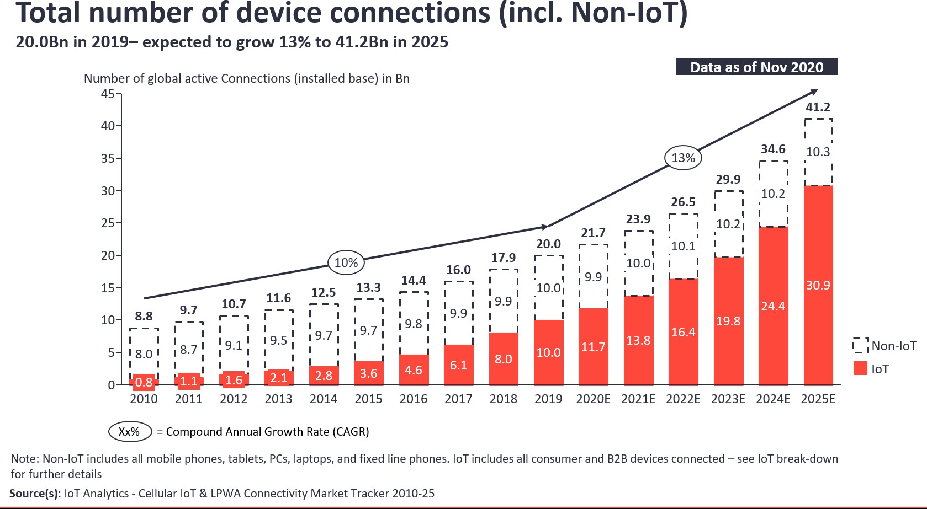
Growth of IoT Devices
IoT Analytics’ prediction
Source: https://iot-analytics.com/state-of-the-iot-2020-12-billion-iot-connections-surpassing-non-iot-for-the-first-time/

Slide 10
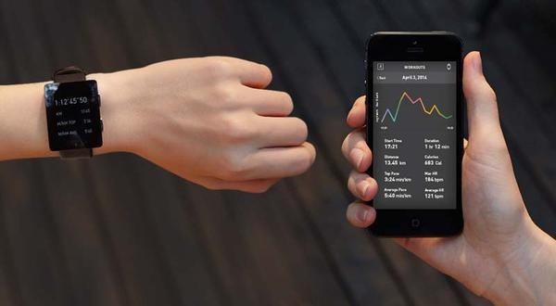
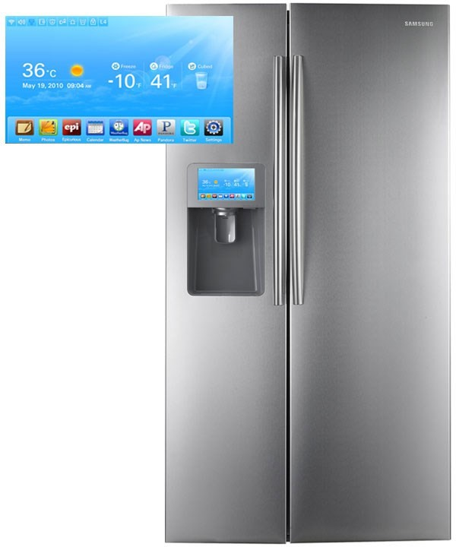
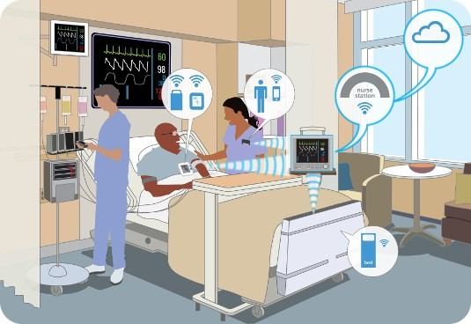
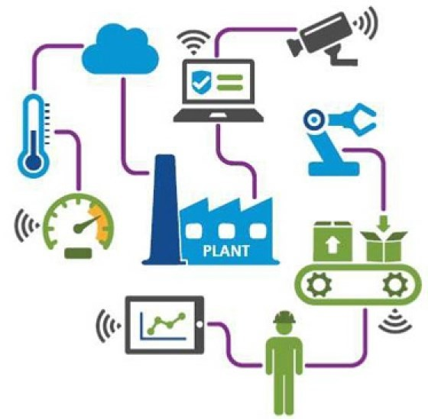
Where is IoT?
Wearable
Tech Devices
Smart Appliances
It’s everywhere!
Industry Automation
and Monitoring
Healthcare

Slide 11


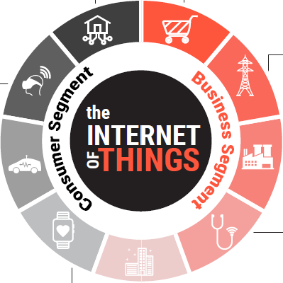







Global IoT Market Share
14%
Smart Homes
Retail
< 2%
3%
Wearables
Smart Utilities
& Energy
4%
7%
Industrial IoT
Connected Cars
24%
20%*
Personal Health
20%*
Healthcare
Smart Cities
26%
Source: https://growthenabler.com/flipbook/pdf/IOT%20Report.pdf

Slide 12
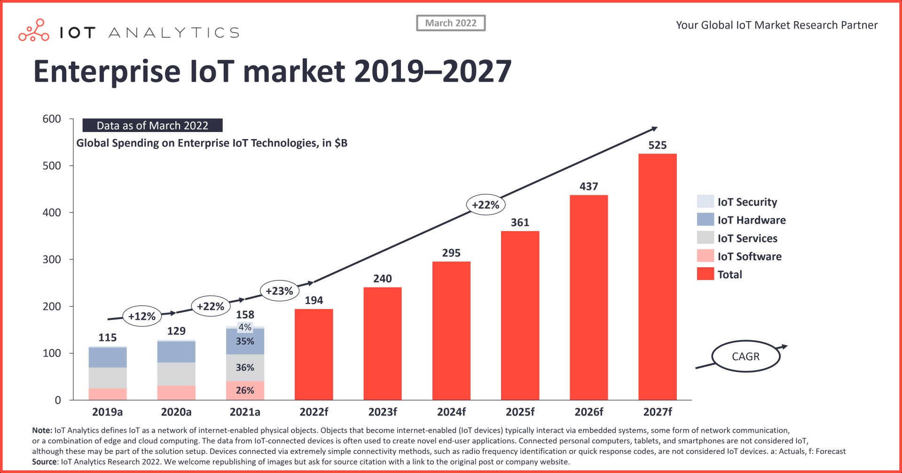
Global Spending on IoT
Source: https://iot-analytics.com/iot-market-size/

Slide 13
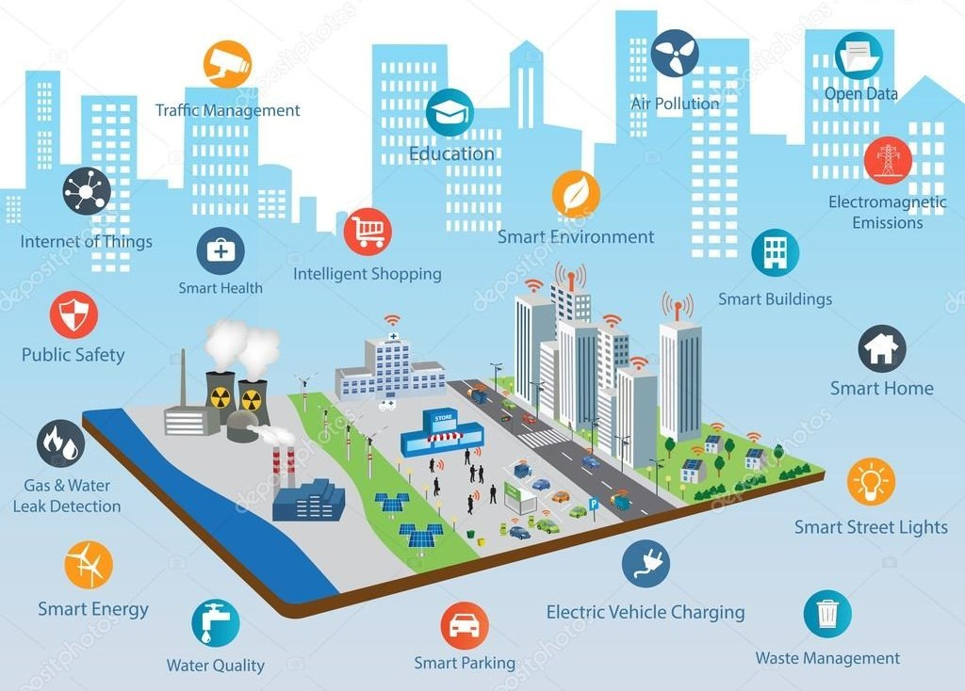
Smart City
Source: https://depositphotos.com/126025652/stock-illustration-smart-city-concept-and-internet.html

Slide 14

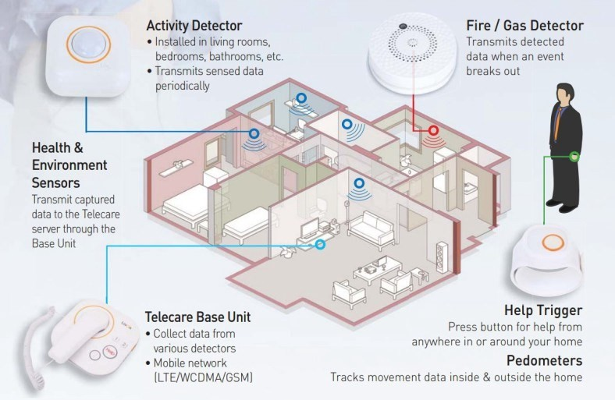
Smart Home
Source: https://medium.com/@globalindnews/north-america-accounted-for-major-share-in-the-global-smart-home-healthcare-market-in-2015-cc9cc1974ac5

Slide 15
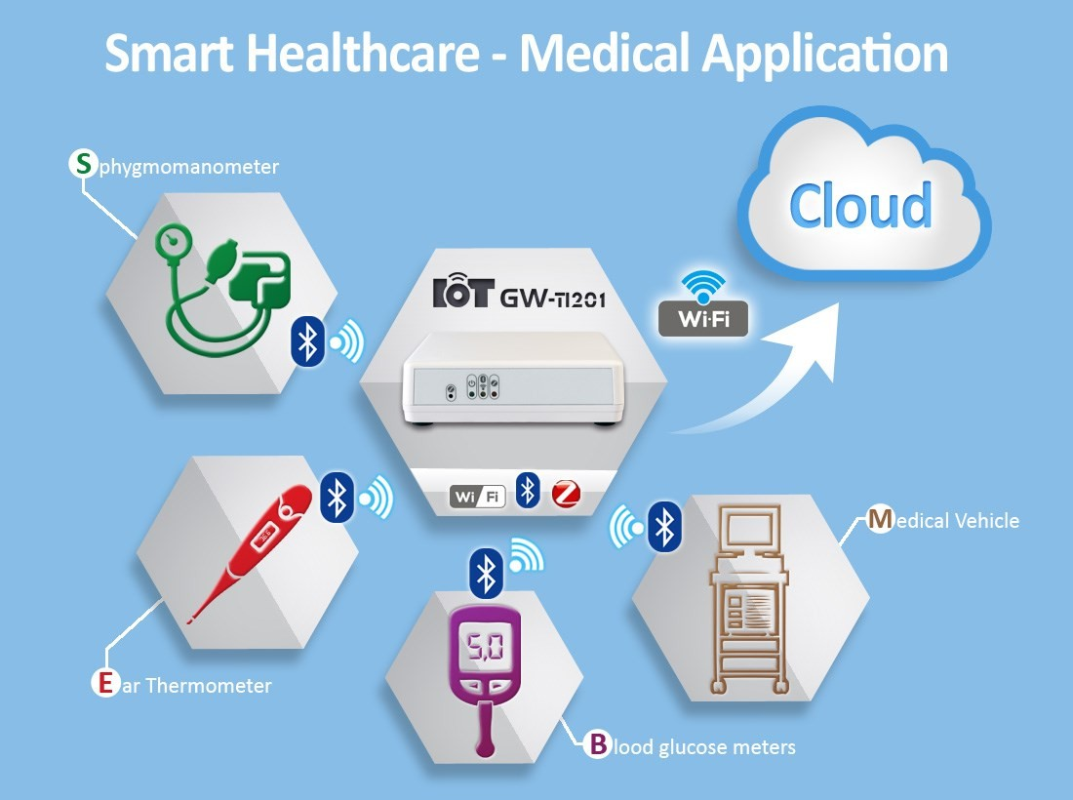
Smart Healthcare
Source: http://iot.fit-foxconn.com/

Slide 16
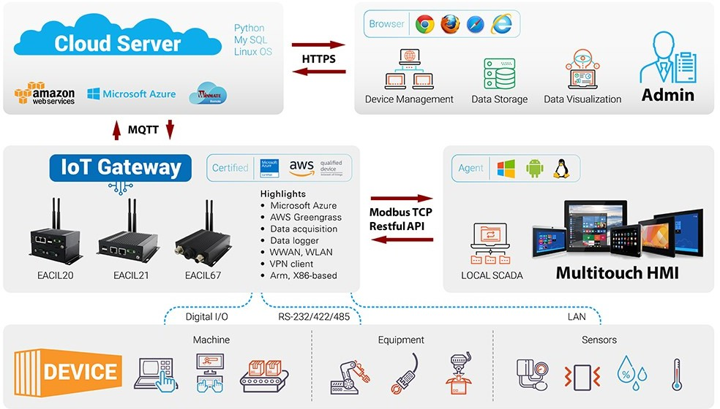
Industrial IoT
Source: https://www.winmate.com/Solutions/Solutions_IoT.asp

Slide 17
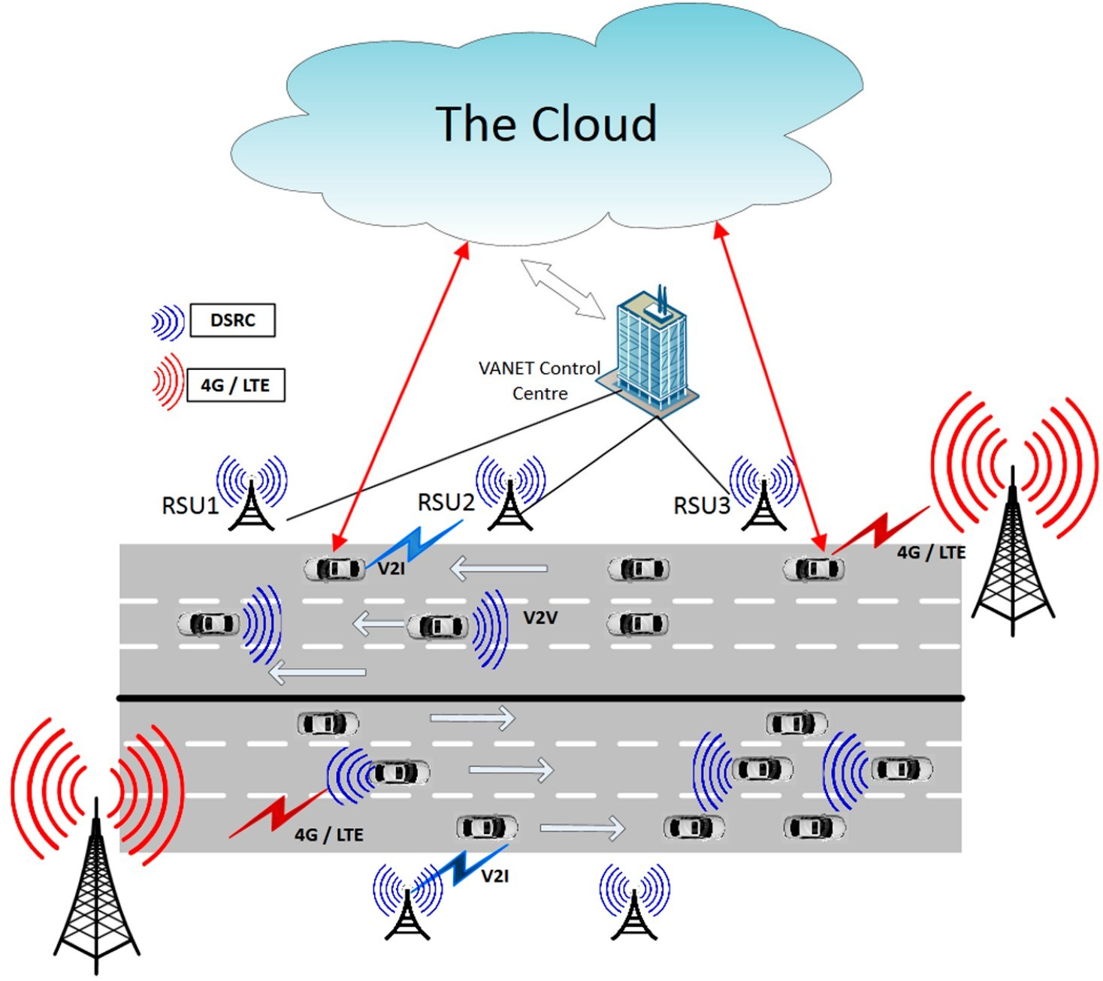
Connected Cars
Source: Vehicular K. Ziadi, M. Rajarajan, “Internet: Security & Privacy Challenges and Opportunities”,
Future Internet 2015, 7(3), 257-275.

Slide 18
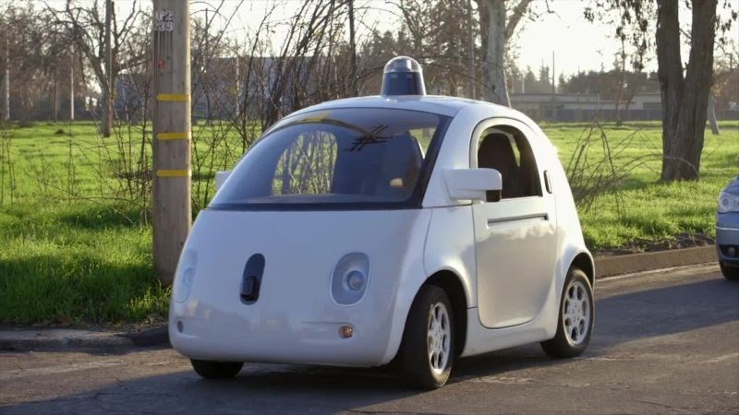
Google’s Self-Driving Car
Source: https://www.google.com/

Slide 19
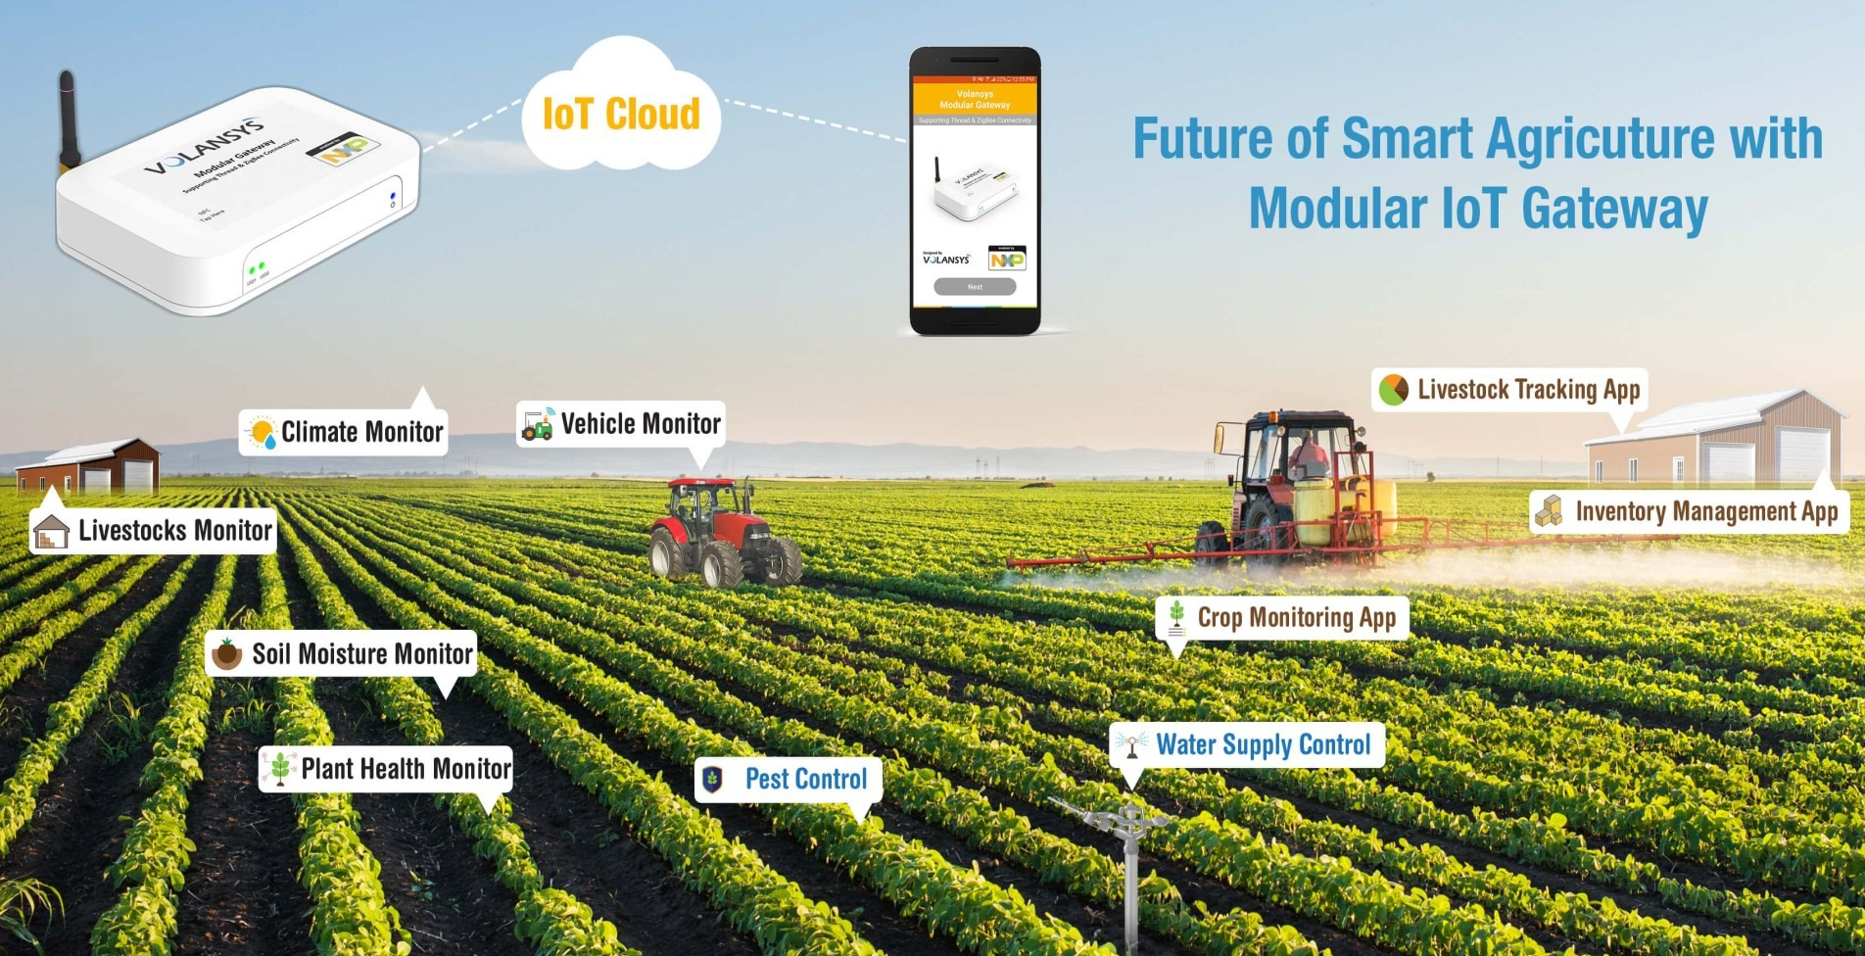
Smart Agriculture
Source: https://in.pinterest.com/pin/515380751093603767/?lp=true

Slide 20
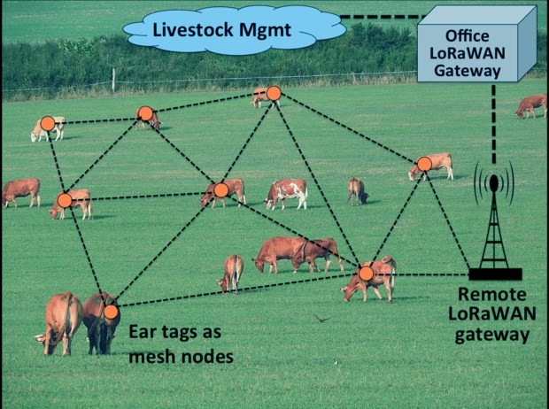
Livestock Management
Source: https://data-flair.training/blogs/iot-applications-in-agriculture/
20

Slide 21
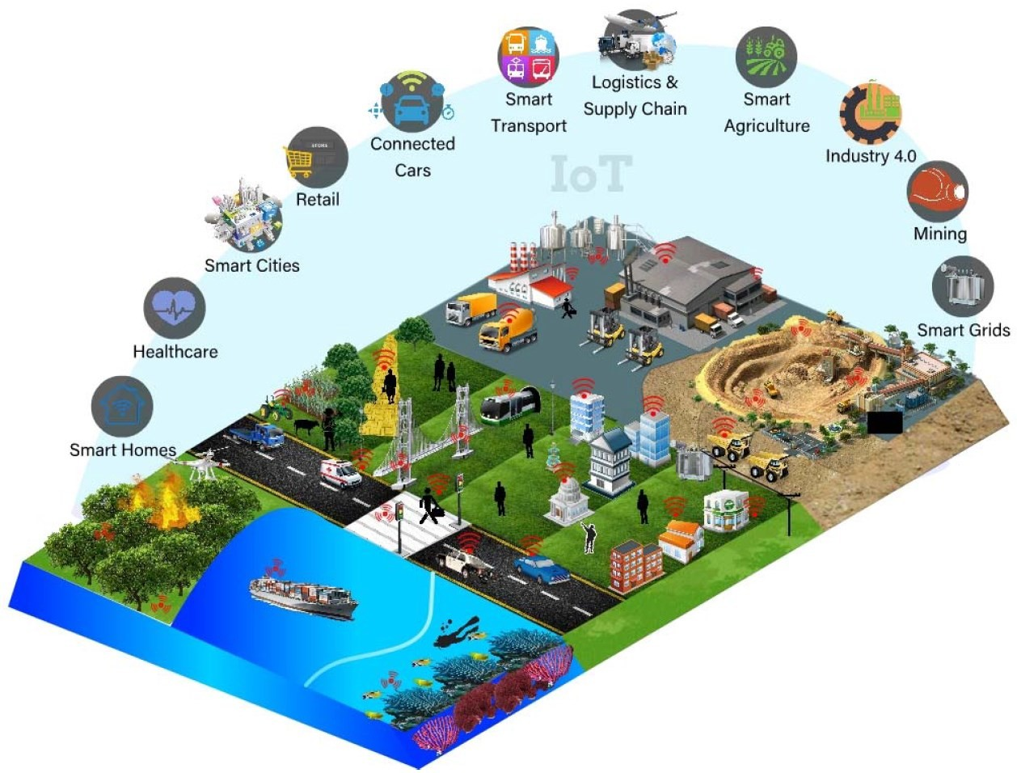
Many More ….
Source: Rajiv Ranjan et. al., “Integrating the IoT and Data Science” IEEE Cloud Computing, 2018

Slide 22







Main Challenges in IoT
Sensors Scale Privacy
Security
Limited resources
Limited types of sensors
millions of devices are connected to form IoT
which personal data to share with whom
how to control
“things” becomes connected, so security becomes complex
Low Power Network
Big data and Data analytics
Devices should remain connected to the Internet for years
High network latency
massive amount of sensor data
different sources and various forms
extract intelligence form the heaps of data
Interoperability
various protocol, various architecture
unavailability of standardized platform
different technology leads to interoperability issue
Recent IoT standards are minimizing this problem

Slide 23
Lessons Learned
Learned about what is IoT
Learned the genesis of IoT
Understand the benefits of IoT
Learned about the market share of IoT
Understand the real world applications of IoT
Understand various challenges IoT implementation is facing

Slide 24

Figures and slide materials are taken from the following Books:
David Hanes et al., “IoT Fundamentals: Networking Technologies, Protocols, and Use Cases for the Internet of Things”, 1st Edition, 2018, Pearson India.
Mayur Ramgir, “Internet of Things: Architecture, Implementation and Security”,
1st Edition, 2020, Pearson India.

