Slide 1

ByteMap
Team String Quartet: 6.170 Fall 2013
Carrie Cai, Ido Efrati, Cynthia Jing, Nitya Subramanian

Slide 2
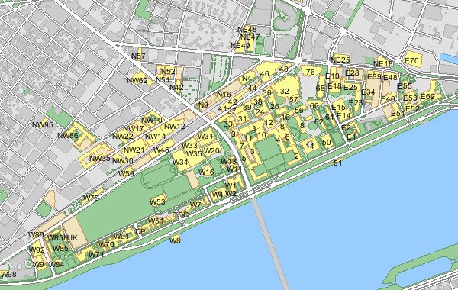

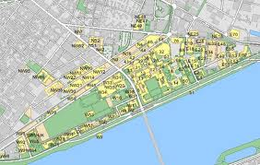



SO HUNGRY!
Let me check my email to see if anyone emailed out to the free-food mailing list!
Ugh, too many emails to sort through, I guess I’ll just take the nanoquiz hungry ☹
Free food in Lobby 10? Yum!
SO HUNGRY! Let me check ByteMap, a site that keeps track of free food on campus!
ByteMap
Free-food:
10,000 Unread Messages
FREE FOOD: Lobby 10
Meet Ben, a hungry MIT student running late to 6.170…
Now meet Alyssa, an MIT student even later for 6.170…

Slide 3

Concepts & Features
concepts
map
Notes:
map: interactive representation of MIT campus
offering: instance of (transiently) available food
pin: graphical representation of offering

Slide 4

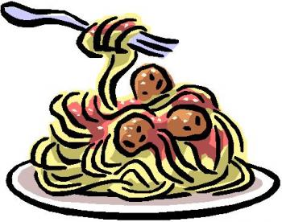

Concepts & Features
concepts
map
offering
Notes:
map: interactive representation of MIT campus
offering: instance of (transiently) available food
pin: graphical representation of offering

Slide 5
Concepts & Features
concepts
map
offering
pin
Notes:
map: interactive representation of MIT campus
offering: instance of (transiently) available food
pin: graphical representation of offering

Slide 6
Concepts & Features
concepts
map
offering
pin
features
grabs data from “free-food” email-list
notifies users of nearby offerings
Notes:
map: interactive representation of MIT campus
offering: instance of (transiently) available food
pin: graphical representation of offering

Slide 7
Risks and Concerns
design risks
faulty “pins” put off users
free banquet here!

Slide 8
Risks and Concerns
design risks
faulty “pins” put off users
implementation risks
push notifications
Client
Server
Client
Client

Slide 9
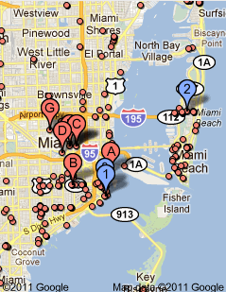
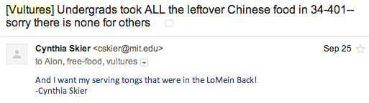
Risks and Concerns
design risks
faulty “pins” put off users
implementation risks
push notifications
development risks
complicated map APIs
getting content from emails

