Slide 1
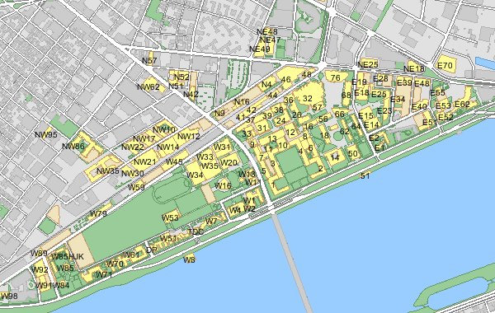
Concepts & Features
concepts
map
Notes:
map: interactive representation of MIT campus
offering: instance of (transiently) available food
pin: graphical representation of offering

Slide 2
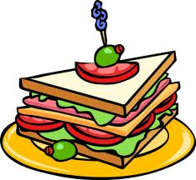
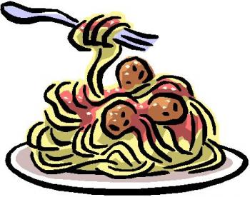
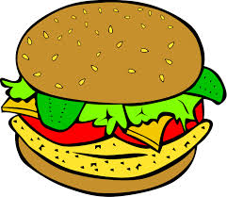
Concepts & Features
concepts
map
offering
Notes:
map: interactive representation of MIT campus
offering: instance of (transiently) available food
pin: graphical representation of offering

Slide 3
Concepts & Features
concepts
map
offering
pin
Notes:
map: interactive representation of MIT campus
offering: instance of (transiently) available food
pin: graphical representation of offering

Slide 4
Concepts & Features
concepts
map
offering
pin
features
grabs data from “free-food” email-list
notifies users of nearby offerings
Notes:
map: interactive representation of MIT campus
offering: instance of (transiently) available food
pin: graphical representation of offering

Slide 5
Risks and Concerns
design risks
faulty “pins” put off users
free banquet here!

Slide 6
Risks and Concerns
design risks
faulty “pins” put off users
implementation risks
push notifications
Client
Server
Client
Client

Slide 7
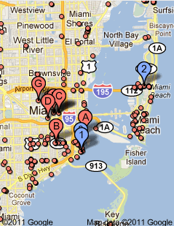
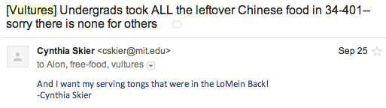
Risks and Concerns
design risks
faulty “pins” put off users
implementation risks
push notifications
development risks
complicated map APIs
getting content from emails

