Slide 1
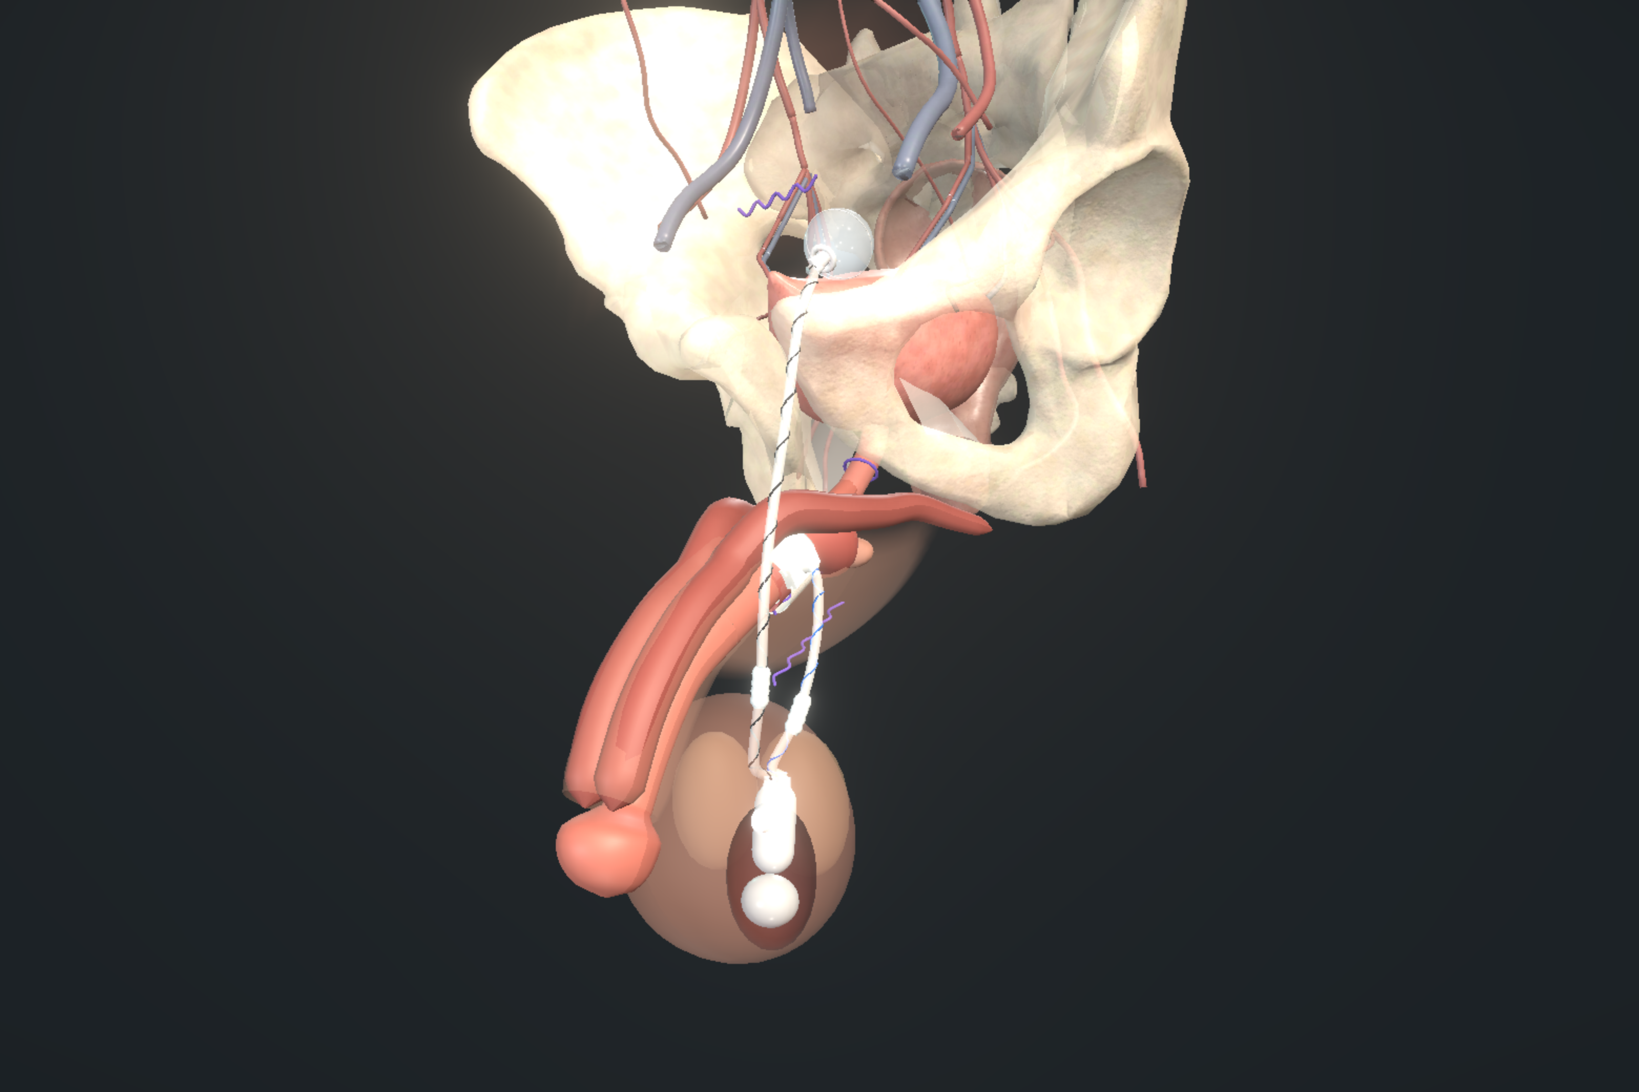
RIGICON ADVANCED TRAINING EVENT
Tips and tricks for primary implantation and revision surgery
Artificial urinary sphincter surgery: patient selection, difficult bladders and difficult urethras
Artificial Urinary Sphincter (AUS) Implantation · The Municipal Hotel, Liverpool · 22–23 October 2026
Mr Andrew Baird
Mr Mohamed Abu Yousif
Nity G
Consultant Urologist
Consultant Urologist
ST5 Urology Registrar
Royal Liverpool University Hospital
Royal Liverpool University Hospital
Northwest (Mersey)
Notes:
SLIDE 1: Tips and tricks for primary implantation and revision surgery
SHORT VERSION
Today is about choosing the right patient, protecting the urethra, and planning for the lifetime of the device.
READ ALOUD
Hello, and thank you for joining us. I'm Nity G, an ST5 urology registrar, presenting with Mr Andrew Baird and Mr Mohamed Abu Yousif.
We are discussing tips and tricks for primary artificial urinary sphincter implantation and revision surgery.
The operation matters, but the decisions before and after it matter too. We will work through patient selection, bladder function, the urethra, preparation, the operation and follow-up.
We will use four fictional cases to make those decisions practical. Throughout, we will separate published evidence, device instructions and our own approach.
NEXT
Let us start with the decision we need to make before booking an operation.
FIGURE CREDIT
Image: UroOps 3D teaching schematic of the implanted device, captured from https://uroops3d.com/lab/aus on 10 October 2026, with clinical review pending. It is not a record of an actual operation. No personal operative experience or local outcomes are asserted.

Slide 2
IN THIS SECTION
01
The decision before theatre
Decide before theatre
02
Evidence and device boundaries
03
Leakage mechanism and patient goals
04
Timing after prostate treatment
Can this patient obtain useful continence while storing and emptying safely and operating the device?
05
Pump use over time
06
Flexible cystoscopy before implantation
07
Urodynamics: BAUS, EAU and AUA
08
Interpreting an imperfect study
09
Consent: improvement and lifetime burden
Decide before theatre
The bladder
The urethra
Preparation without ritual
The operation
After the implant
Notes:
SLIDE 2: Decide before theatre
SHORT VERSION
Before an implant, ask whether the patient can become meaningfully drier, store urine safely, empty his bladder and use the pump.
READ ALOUD
The first section is about the decision before theatre.
A severe stress leak is a reason to assess someone for surgery. It does not, by itself, tell us that an implant will give a good result.
We need to answer four questions. Will this improve the activity that matters to him? Can his bladder store urine safely? Can he empty it? Can he find and operate the pump?
Those questions explain the investigations and counselling that follow.
NEXT
The next slide turns those questions into four possible decisions.

Slide 3
DECIDE BEFORE THEATRE
01 / 36
The decision before theatre
Severe leakage is only the starting point
Implant
Optimise
Investigate
Reconsider
Stress leak shown, safe bladder, good emptying, can work the pump
A treatable bladder or emptying problem is the bigger issue
Not sure why he leaks, what the tests mean, or the anatomy
Safe bladder function or using the device alone is unlikely
BAUS25 · AUA24 · ICS16
Notes:
SLIDE 3: The decision before theatre
SHORT VERSION
Our four choices are: implant, treat another problem first, investigate further, or reconsider the plan.
READ ALOUD
A device can work properly and still leave the patient disappointed. He may remain limited by urgency, poor emptying, or difficulty using the pump.
The first option is to implant when the stress leak is established, storage is safe, emptying is reliable and the pump is usable.
The second is to optimise. That means treating a problem that is currently more important than the stress leak.
The third is to investigate when the symptoms, measurements or anatomy do not yet make sense.
The fourth is to reconsider when safe function or independent device use seems unlikely. These are decisions to discuss with the patient, rather than a scoring system.
NEXT
Before using evidence to make those decisions, we should be clear about what each source can tell us.

Slide 4
DECIDE BEFORE THEATRE
02 / 36
Evidence and device boundaries
Source | What it can tell us
Guidelines and consensus | A recommended clinical pathway
Clinical studies | Results in one group of patients
Manufacturer IFU | How the device may be used, and its warnings
Expert or local practice | A practical choice, with the uncertainty stated
BAUS 2025 · AUA amendment 2024 · EAU 2026. Meeting abstracts are not guidelines. One device’s results do not transfer to another.
BAUS25 · EAU26 · AUA24 · ICS16 · AP23 · CCIFU · AUASTATUS26 · DEVICE26
Notes:
SLIDE 4: Evidence and device boundaries
SHORT VERSION
Guidelines, clinical studies, device instructions and personal practice answer different questions. We should name which one we are using.
READ ALOUD
Thank you to Rigicon for organising the meeting. We should still examine each clinical claim on its own evidence.
Guidelines recommend a pathway. Some recommendations come from trials, and others from expert consensus where trials are missing.
A clinical study tells us what happened in a particular group of patients, with a particular device and a particular definition of success.
The manufacturer's instructions tell us how that device may be used and what precautions apply. They do not prove that it performs better than another device.
Our own practice may be useful, but we should identify it as practice rather than present it as a proven rule.
In this talk we compare the British, European and American guidance, and keep device-specific evidence separate.
NEXT
We start the assessment with the leak the patient actually experiences.
TERMS IF NEEDED
BAUS: British Association of Urological Surgeons. EAU: European Association of Urology. AUA: American Urological Association. IFU: the manufacturer's instructions for use.

Slide 5
DECIDE BEFORE THEATRE
03 / 36
Leakage mechanism and patient goals
Describe the leak
Agree what improvement is worth it
Stress leak shown on examination
Is it still improving? What has been tried?
Urgency, night-time symptoms and emptying
A validated symptom score
Pad use, pad weight and activity
The activity the patient wants back
Pad count is useful, but 2–4 pads a day covers a wide range of weights (2026 data). Weigh the pads when unsure.
BAUS25 · EAU26 · AUA24 · PAD26
Notes:
SLIDE 5: Leakage mechanism and patient goals
SHORT VERSION
Establish what causes the leakage, measure it when needed, and ask what improvement would matter to the patient.
READ ALOUD
I would start by asking him to describe a bad day. Does he leak when he stands, walks or coughs? Does an urgent need to pass urine come first? What happens at night?
Stress leakage means leakage with effort or movement. Urgency leakage follows a sudden, difficult-to-defer urge. Both can occur in the same patient.
We should demonstrate the stress leak where possible, rather than rely on the word "mixed" to explain everything.
Pad count gives a rough idea, but people use and change pads differently. A 24-hour pad weight helps when severity is uncertain.
Finally, ask what he wants back. That might be work, exercise, a social activity, or fewer pads. That gives us a meaningful goal for consent.
NEXT
Once we understand the leakage and the goal, we can discuss timing and the choice of operation.

Slide 6
DECIDE BEFORE THEATRE
04 / 36
Timing after prostate treatment
Guidance | At six months | At twelve months
BAUS | At least six months’ recovery for severe SUI | At least twelve months for mild–moderate SUI
AUA | Surgery may be offered for bothersome, non-improving SUI despite conservative care | Offer surgery for persisting bothersome SUI
Severity by 24-hour pad weight: the Nitti classification BAUS uses
Mild
Moderate
Severe
Under 100 g in 24 hours
100 to 400 g in 24 hours
Over 400 g in 24 hours
MASTER 2026: at 24 months the sling was still non-inferior, but further surgery was 11% after sling vs 2% after AUS. Selected patients.
AUA24 · BAUS25 · EAU26 · MASTER22 · MASTER26
Notes:
SLIDE 6: Timing after prostate treatment
SHORT VERSION
Allow recovery after prostate treatment, but review persistent bothersome leakage. A sling and an AUS are not interchangeable choices.
READ ALOUD
We should avoid operating while continence is still improving, but also avoid letting conservative treatment continue without review.
The BAUS pathway shown here allows at least six months of recovery for severe leakage and at least twelve months for mild or moderate leakage.
The pad-weight bands on this slide are under 100 grams in 24 hours for mild, 100 to 400 grams for moderate, and over 400 grams for severe leakage.
The AUA allows surgery from six months when bothersome leakage is not improving despite conservative treatment, and recommends offering surgery for persisting bothersome leakage at one year.
A sling may suit selected men with milder leakage. Severe leakage and previous radiotherapy make its results less favourable.
In MASTER, the sling met the trial's non-inferiority threshold at 24 months. That does not mean identical outcomes for every patient. Further surgery occurred in eleven per cent after a sling and two per cent after an AUS.
NEXT
Before choosing any device, we need to see whether he can actually operate it.
TERMS IF NEEDED
Non-inferiority: the trial tested whether the sling was worse by more than a pre-agreed margin on its main outcome. It does not mean the operations are identical.
REFERENCE LINKS (not spoken)
https://www.auanet.org/documents/Guidelines/PDF/2024%20Guidelines/IPT%20Unabridged%20Final%206-18-24.pdf
https://pubmed.ncbi.nlm.nih.gov/42648940/

Slide 7
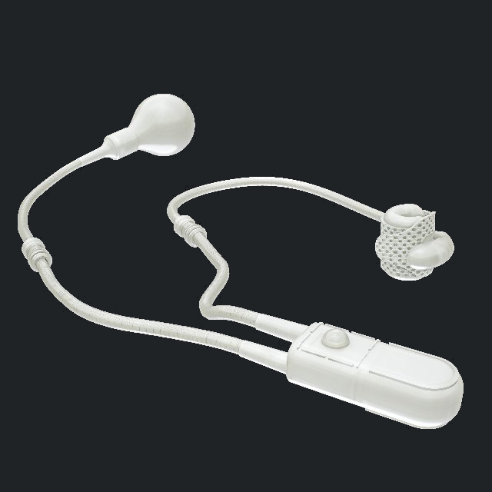
DECIDE BEFORE THEATRE
05 / 36
Pump use over time
Pump assessment
Watch the patient operate a demonstration pump
Check reach, strength and understanding
Agree a position he can reach before surgery
Assess frailty as well as future pump use
Rigicon ContiClassic, manufacturer illustration.
AUA24 · ICS16 · CCIFU · FRAIL26
Notes:
SLIDE 7: Pump use over time
SHORT VERSION
Give him a demonstration pump and watch him use it. Check reach, hand function, understanding and likely future ability.
READ ALOUD
Asking "Can you use a pump?" is not enough. Put a demonstration pump in his hand and watch what happens.
Check whether he can reach the planned position, including when sitting. Then check grip, pinch strength and whether he understands the sequence.
He needs to understand normal cycling and how to obtain help if the device must be deactivated. He should know to tell another clinician about the AUS before catheterisation or instrumentation.
Think beyond the day of surgery. Arthritis, tremor, cognitive problems and general frailty may affect future use.
The frailty study in the source material found an association with complications and later revision. It used billing-code measures, so it supports considering frailty but does not give us a validated pump-use test.
NEXT
After assessing the person, we look for urethral and bladder problems that could change the operation.
TERMS IF NEEDED
AUS: artificial urinary sphincter. Cycling: squeezing the pump to open the cuff for voiding, followed by the device's normal refill.
FIGURE CREDIT
Image source: Rigicon ContiClassic IFU, CC-IFU REV.03, 12 October 2023, printed page 1 (PDF page 4). https://www.rigicon.com/files/e-labeling/ContiClassic-IFU.pdf . Manufacturer illustration, shown for component identification, without a comparative superiority claim.
REFERENCE LINKS (not spoken)
https://www.auanet.org/documents/Guidelines/PDF/2024%20Guidelines/IPT%20Unabridged%20Final%206-18-24.pdf

Slide 8
DECIDE BEFORE THEATRE
06 / 36
Flexible cystoscopy before implantation
Guidance
Findings that change the plan
AUA recommends cystourethroscopy before SUI surgery
Stricture, bladder-neck contracture or anastomotic narrowing
BAUS: VUDS for every candidate; cystoscopy when a narrowing is suspected, or with standard UDS where video is unavailable
Erosion, foreign material or stones
Looking in advance is our preference, not a rule
Tumour, or anything that means repeated scopes
A 2026 AUA abstract (IP09-22) looks at testing again; results not published. Current guidance stands.
BAUS25 · AUA24 · EAU26 · EAUSTR26 · AUAUDS26
Notes:
SLIDE 8: Flexible cystoscopy before implantation
SHORT VERSION
Cystoscopy looks for pathology that could change the plan. If we find a narrowing, we assess and discuss it before proceeding.
READ ALOUD
Cystoscopy lets us inspect the urethra and bladder before an incontinence operation.
The AUA recommends this before stress-incontinence surgery. The BAUS pathway in this deck uses video-urodynamics for surgical candidates, with cystoscopy when narrowing is suspected, or alongside standard urodynamics where video is unavailable.
We are looking for a urethral stricture, narrowing at the bladder neck or surgical join, previous erosion, foreign material, stones or a tumour. These findings may change what we do and when we do it.
Our preference is to look in advance so that a surprise can be discussed before the day of implantation.
A narrowing deserves a planned assessment and treatment discussion. Diagnostic cystoscopy should not automatically turn into an unplanned dilation. We need to understand the site, the extent, the symptoms and the emptying first.
NEXT
The next investigation is urodynamics, where the guidelines take different positions.
TERMS IF NEEDED
Cystoscopy: looking inside with a scope. A stricture is a scarred narrowing. An anastomosis is the surgical join between the bladder and urethra after radical prostatectomy.
REFERENCE LINKS (not spoken)
https://www.auanet.org/documents/Guidelines/PDF/2024%20Guidelines/IPT%20Unabridged%20Final%206-18-24.pdf
https://doi.org/10.1111/bju.16726

Slide 9
DECIDE BEFORE THEATRE
07 / 36
Urodynamics: BAUS, EAU and AUA
Guideline | Position | Clinical implication
BAUS | Video-urodynamics for surgical candidates | Follow the investigation pathway
EAU | UDS before invasive treatment, weak recommendation | Its own text still allows selective testing
AUA | UDS when it would change the diagnosis or counselling | Say what question the test should answer
The three guidelines differ. The 2026 AUA abstract (IP09-22) is conference material; results not published.
BAUS25 · EAU26 · AUA24 · ICS16 · AUASTATUS26 · AUAUDS26
Notes:
SLIDE 9: Urodynamics: BAUS, EAU and AUA
SHORT VERSION
Name the guideline you are following, and state what uncertainty urodynamics is meant to resolve.
READ ALOUD
Urodynamics measures how the bladder stores urine and how the patient empties it. Video-urodynamics adds imaging during the test.
BAUS recommends video-urodynamics for surgical candidates. EAU recommends invasive urodynamics when considering invasive treatment, but grades that recommendation as weak and also describes selective testing. AUA uses it when it would help diagnosis or counselling.
The practical questions are straightforward. Is the stress leak established? Are urgency or unsafe filling pressures important? Is emptying reliable?
Before requesting the test, say what result would change the plan. When interpreting it, be clear which guideline pathway you are using.
The AUA conference abstract mentioned in this deck does not provide verified full results for us to use as a reason to change that pathway.
NEXT
Whatever testing strategy we choose, we still have to interpret an imperfect study.
REFERENCE LINKS (not spoken)
https://uroweb.org/guidelines/management-of-non-neurogenic-male-luts/chapter/disease-management
https://doi.org/10.1111/bju.16726

Slide 10
DECIDE BEFORE THEATRE
08 / 36
Interpreting an imperfect study
1
Main symptom, and a stress leak shown
2
Urine, bladder diary, free flow and repeated residual
3
Urethral anatomy and future access
4
The urodynamic strategy your guideline recommends
5
Is storage safe? Can he empty? Is the outlet stable?
A small capacity may just be leakage. A weak contraction in the lab needs the real voiding history.
BAUS25 · AUA24 · ICS16 · UDS14
Notes:
SLIDE 10: Interpreting an imperfect study
SHORT VERSION
Read the traces alongside the patient's usual symptoms and voiding. One abnormal laboratory number does not explain the whole problem.
READ ALOUD
A small measured capacity does not always mean a stiff bladder. A man who leaks throughout filling may simply never store much urine during the test.
Similarly, a weak void in the laboratory may not reflect his usual voiding at home. Compare it with the bladder diary, free flow and repeated measurements of urine left behind.
Check that the pressure traces are technically credible, that the abdominal pressure has been subtracted properly, and why filling stopped.
The study cited here illustrates another limitation: some men did not show the stress leak with the catheter in place but did leak after it was removed. Failure to reproduce the leak during that part of the test does not settle the diagnosis.
Bring the findings together: symptoms, demonstrated leakage, urine tests, diary, flow, residual and urethral anatomy. Then decide whether storage, emptying and the outlet are safe.
NEXT
Once the assessment makes sense, we can explain the likely benefit and the lifetime burden to the patient.
TERMS IF NEEDED
Residual: urine left in the bladder after voiding. Compliance: how easily the bladder stretches as it fills.

Slide 11
DECIDE BEFORE THEATRE
09 / 36
Consent: improvement and lifetime burden
AMS 800: zero-pad use
ContiClassic: device survival
60%
93.2%
61 / 101 at 12 months after activation
AUSCO 2026: 115 primary implants
12-month Kaplan–Meier estimate
First 116 recipients, mixed indications
Manufacturer-funded, no comparison group, missing data, one year of follow-up.
Abstract only, no comparison group. A working device is not the same as a dry patient.
These two numbers do not compare the devices. The regret data say: counsel about leakage and future surgery.
AUSCO26 · CCSAFETY · AUA24 · RT22 · FRAIL26 · REGRET26 · DEVICE26 · REPORT26
Notes:
SLIDE 11: Consent: improvement and lifetime burden
SHORT VERSION
Explain improvement and future operations. These two percentages measure different things and cannot compare the devices.
READ ALOUD
Consent should cover residual stress leakage, persistent urgency, infection, erosion, mechanical failure and the possibility of another operation.
The first number concerns the AMS 800. In AUSCO, 61 of 101 men with that outcome recorded used no pads at twelve months after activation. The study was manufacturer-funded, had no comparison group and had missing outcomes.
The second number concerns ContiClassic. The estimated device-survival rate at twelve months was 93.2 per cent in the early series of 116 recipients. That means device survival, not a 93.2 per cent dry rate.
The populations, endpoints and study designs differ. These figures therefore cannot tell us which device is better.
The practical consent message is that an AUS may improve continence, but it does not promise complete dryness or freedom from future surgery. We should discuss that lifetime burden from the start.
NEXT
That completes the assessment before theatre. We now turn to the bladder and our first fictional case.

Slide 12
IN THIS SECTION
10
Case 1: six pads and urgency
The bladder
11
Urgency treatment and emptying
12
Case 2: weak contraction and residual urine
13
Catheterisation with a cuff in place
Separate overactivity, weak contraction and poor compliance, because each leads to a different decision.
14
Detrusor overactivity and poor compliance
Decide before theatre
The bladder
The urethra
Preparation without ritual
The operation
After the implant
Notes:
SLIDE 12: The bladder
SHORT VERSION
Keep three bladder problems separate: involuntary contractions, weak emptying, and rising pressure during filling.
READ ALOUD
This section separates three problems that are easy to group together as "bladder dysfunction".
An overactive bladder causes urgency symptoms. Detrusor overactivity is an involuntary bladder contraction seen during the test.
A weak contraction raises a different question: can the patient empty reliably?
Poor compliance means the pressure rises as the bladder fills. That is a storage-safety problem, even if the patient becomes drier.
Each problem changes the decision in a different way.
NEXT
Our first fictional patient has both a stress leak and urgency.

Slide 13
THE BLADDER
10 / 36
Case 1: six pads and urgency
FICTIONAL CASE 01
Implant now or optimise first?
Stress leak after prostatectomy, shown on examination
Urgency leakage and detrusor overactivity
YOUR CALL
Safe storage pressures and good emptying
IMPLANT
OPTIMISE
INVESTIGATE
RECONSIDER
Goal: walk without soaking his clothes
DO alone does not rule out an AUS. The ContiClassic label requires bladder problems to be controlled or resolved first.
DO24 · OAB11 · DOFAIL23 · CCIFU
Notes:
SLIDE 13: Case 1: six pads and urgency
SHORT VERSION
Detrusor overactivity alone does not automatically exclude an AUS, but urgency and device-specific instructions need a separate plan.
READ ALOUD
This fictional patient uses six pads on an active day. We can demonstrate a stress leak. He also has urgency leakage and involuntary bladder contractions on the study, but his filling pressures and emptying are reassuring.
The question for the room is: would you implant now, or treat the bladder first?
[Pause for an answer.]
Detrusor overactivity alone is not an automatic reason to refuse general AUS surgery. But treating the stress leak does not guarantee that the urgency will settle.
Our approach is to address the storage symptoms, agree a separate urgency goal and reassess.
For ContiClassic, the instructions specifically require the relevant bladder condition to be treated and controlled or resolved before implantation. General AUS evidence does not override the instructions for the particular device.
NEXT
How can we treat urgency without creating a new emptying problem?
TERMS IF NEEDED
Detrusor means the bladder muscle. Overactive bladder describes symptoms; detrusor overactivity describes what happens on the pressure trace.
REFERENCE LINKS (not spoken)
https://www.rigicon.com/files/e-labeling/ContiClassic-IFU.pdf

Slide 14
THE BLADDER
11 / 36
Urgency treatment and emptying
1
Fix the reversible causes first
2
Choose the drug with his memory and his residual in mind
3
Before botulinum toxin, plan for retention and for repeat injections through a cuff
4
Urgency after an AUS is a separate outcome; agree that beforehand
No one order of treatments has been shown to be best around a cuff.
BAUS25 · AUAOAB24 · OAB11 · CCIFU
Notes:
SLIDE 14: Urgency treatment and emptying
SHORT VERSION
Treat urgency in steps, while checking cognition, residual urine and any future need for catheterisation or repeat access.
READ ALOUD
Start with reversible contributors such as fluid habits, caffeine, constipation, infection and medication. Bladder training and medication may then help.
When choosing a drug, consider cognition and how well he empties. Improving urgency while causing troublesome retention is not a good trade.
If botulinum toxin is being considered, discuss the possibility of retention before treatment. Could he catheterise if needed, and what would repeated bladder access mean once a cuff is present?
Urgency can remain after a technically successful AUS. That is why it needs its own treatment goal and its own place in consent.
New or severe urgency after surgery also needs assessment for causes such as infection, retained urine or a device problem, rather than simply adding another drug.
NEXT
The next patient has the opposite concern: poor emptying before we add a cuff.
TERMS IF NEEDED
Residual urine is the urine left behind after voiding. Botulinum toxin treatment can reduce bladder overactivity but may make emptying more difficult.

Slide 15
THE BLADDER
12 / 36
Case 2: weak contraction and residual urine
FICTIONAL CASE 02
Would a reliable emptying plan change your answer?
Stress leakage with slow voiding
Urine left behind, again and again
YOUR CALL
Weak contraction and abdominal straining
IMPLANT
INVESTIGATE
RECONSIDER
Could still be a narrowing, or a test that inhibited him
The weak-bladder studies do not prove safety in unresolved retention. No residual number decides it.
DU23 · AUA24 · ICSUDS17 · CCIFU
Notes:
SLIDE 15: Case 2: weak contraction and residual urine
SHORT VERSION
A weak contraction is a reason to investigate emptying, rather than an automatic yes or no. A reliable drainage plan is essential.
READ ALOUD
This fictional patient has stress leakage, but he also voids slowly, strains and repeatedly leaves urine behind. The laboratory study shows a weak bladder contraction.
Would that finding alone make you refuse an AUS?
[Pause for an answer.]
First check whether there is a narrowing or another explanation for poor emptying. Review medication and relevant neurological history, and compare the laboratory void with his usual voiding.
The available weak-bladder studies involve selected patients. They do not establish safety for someone with unresolved severe retention.
An AUS cuff is intended to open for voiding when the device is operated correctly. That helps explain why weak contraction is not automatically the same problem as adding fixed outlet resistance. It still does not guarantee that this man will empty.
Our answer is to investigate and establish a reliable emptying plan. If he cannot empty or manage the backup drainage plan, we need to reconsider implantation.
NEXT
If that backup plan involves a catheter, the next slide explains why a cuff changes the precautions.
TERMS IF NEEDED
Detrusor underactivity: a bladder contraction that is too weak or too short to empty effectively. A residual is the urine left after voiding.
REFERENCE LINKS (not spoken)
https://uroweb.org/guidelines/management-of-non-neurogenic-male-luts/chapter/disease-management

Slide 16
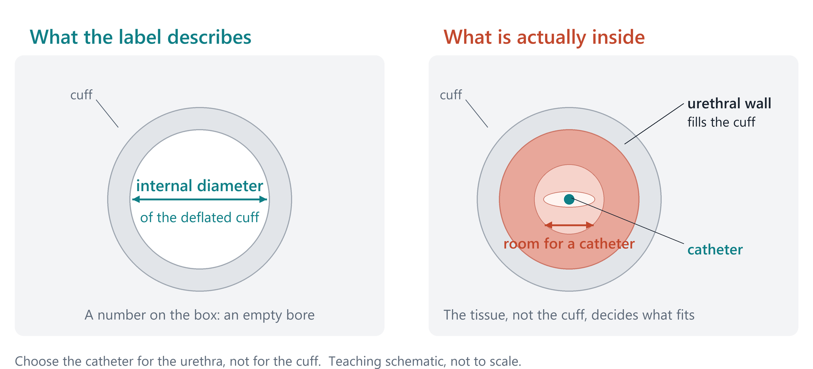
THE BLADDER
13 / 36
Catheterisation with a cuff in place
Cuff fully deflated. Device deactivated.
1
Why does he catheterise, and how often?
2
Check he can really do it, and agree the drainage route before the implant
3
Repeated or long-term catheters need a specialist plan
A 2026 survey found gaps in deactivation training. Follow the device instructions; there is no universal catheter size.
CIC23 · CATH13 · CCIFU · ICS16 · BAUSSCI26 · INSTR26
Notes:
SLIDE 16: Catheterisation with a cuff in place
SHORT VERSION
Before a catheter crosses an AUS cuff, deflate the cuff and deactivate the device. The catheter must fit the urethra, not an empty cuff diagram.
READ ALOUD
Self-catheterisation does not automatically rule out an AUS, but it changes the planning and counselling.
First ask why he needs the catheter. Is the bladder weak, is a narrowing recurring, or is there an outlet problem to address first?
Before a catheter or instrument passes through the cuff, the cuff must be fully deflated and the device deactivated, following that device's instructions. Do not force an instrument against unexplained resistance.
The picture explains a common misunderstanding. On the left, the cuff is empty and deflated. On the right, the urethral wall occupies space inside it, leaving a much smaller channel for the catheter.
So an empty cuff measurement is not a universal safe catheter size. We need to consider the patient's urethra and obtain specialist advice for difficult, repeated or prolonged drainage.
NEXT
Our final bladder distinction is safety during filling. Becoming dry does not necessarily mean the bladder is safe.
TERMS IF NEEDED
Deactivation keeps the cuff open until the device is reactivated. It is different from briefly opening it for an ordinary void.
FIGURE CREDIT
Figure: original two-panel schematic drawn for this slide on 20 October 2026 (presentation/assets/cuff-bore-schematic.png, drawn by design/cuff_bore_figure.py; provenance in assets/SOURCES.md). Diagrammatic cross-sections, not to scale; no device dimensions or catheter sizes are shown.
REFERENCE LINKS (not spoken)
https://www.rigicon.com/files/e-labeling/ContiClassic-IFU.pdf

Slide 17
THE BLADDER
14 / 36
Detrusor overactivity and poor compliance
DO: transient contraction
Poor compliance: sustained rise
Involuntary filling contraction
A separate storage-safety problem
Schematic traces, arbitrary units. Check the trace quality; check kidneys and upper tracts when storage pressure worries you.
UDS09 · ICS16 · BAUS25 · CCIFU · BAUSSCI26
Notes:
SLIDE 17: Detrusor overactivity and poor compliance
SHORT VERSION
The left trace shows a brief contraction. The right shows pressure rising throughout filling, which raises a separate safety concern.
READ ALOUD
These are schematic traces, not patient measurements.
On the left, there is a temporary rise in bladder pressure from an involuntary contraction. That is detrusor overactivity.
On the right, the pressure keeps rising as filling continues. The bladder is not accommodating the added volume easily. That is poor compliance.
Before accepting either interpretation, check the quality of the traces and the filling conditions. A printed number does not replace looking at the study.
If storage pressure is concerning, assess the bladder and consider renal function and the upper urinary tracts as indicated. Treat the storage problem and reassess before increasing outlet resistance.
The key distinction is that a patient may become drier while unsafe storage pressure remains. Continence and storage safety are separate outcomes.
NEXT
That finishes the bladder section. Next we turn to the urethra and whether the outlet is stable.
TERMS IF NEEDED
Compliance means how readily the bladder stretches during filling. Poor compliance produces a sustained pressure rise, rather than just an isolated contraction.
REFERENCE LINKS (not spoken)
https://www.rigicon.com/files/e-labeling/ContiClassic-IFU.pdf

Slide 18
IN THIS SECTION
15
Reassessment and urethral stability
The urethra
16
Case 3: radiation and recurrent VUAS
17
AUS after urethral reconstruction
18
Transcorporal placement: role and costs
Name the narrowing, prove the outlet is stable, and plan the tissue the cuff will need.
Decide before theatre
The bladder
The urethra
Preparation without ritual
The operation
After the implant
Notes:
SLIDE 18: The urethra
SHORT VERSION
Before choosing a cuff site, identify the narrowing, establish that the outlet is stable, and understand the tissue available.
READ ALOUD
We now move from the bladder to the urethra.
The first task is to identify exactly where any narrowing is and what treatment the patient has already had.
Then we ask whether the outlet is stable or whether further procedures are likely. Repeated access after implantation may change the risks and the plan.
Finally, consider the tissue available for the cuff. Previous radiotherapy, erosion or reconstruction can make that decision more difficult.
The next slides look at reassessment after narrowing, a recurrent narrowing after radiotherapy, previous reconstruction and the role of a transcorporal approach.
NEXT
We will start with the different reassessment intervals and the clinical situations they refer to.

Slide 19
THE URETHRA
15 / 36
Reassessment and urethral stability
Guideline | Interval | The relevant pathway
AUA | At least 4–6 weeks | A check scope after treating a symptomatic bladder-neck or anastomotic narrowing
EAU | 3–6 months | After a redo bladder–urethra anastomosis
BAUS | At least six months without recurrence | After treatment of post-prostatectomy narrowing
Three intervals for three situations. The pattern of recurrence, the tissue and future access decide.
BAUS25 · AUA24 · EAUSTR26 · ICS16
Notes:
15 / 36 · Reassessment and urethral stability
• BAUS: at least six months with no recurrence after treating a narrowing after prostatectomy. Consensus, not a trial.
• AUA: a check scope at least four to six weeks after treating a bladder-neck or anastomotic narrowing, as a point to reassess, not a clearance.
• EAU: three to six months after a redo anastomosis, and only for that situation.
• Treat first and implant later lets us watch for recurrence and spares a new cuff from instruments. Doing both at once is for selected expert hands.
• A man who re-narrows every few weeks is not low risk because the calendar reached a date.
• Next: our third patient brings all of this together, with radiotherapy added.

Slide 20
THE URETHRA
16 / 36
Case 3: radiation and recurrent VUAS
FICTIONAL CASE 03
Implant, stage reconstruction or reconsider the endpoint?
Radical prostatectomy and salvage radiotherapy
Severe leak whenever the narrowing is open
YOUR CALL
The anastomosis keeps narrowing
IMPLANT
STAGE
RECONSIDER
It only stays open because we keep treating it
Radiotherapy raises the risk. A 2025 study sets no waiting rule; a stable outlet and reconstruction come first.
RT22 · BAUS25 · EAUSTR26 · AUA24 · RTTIME25
Notes:
16 / 36 · Case 3: radiation and recurrent VUAS
• Prostatectomy, salvage radiotherapy, repeated treatment of a narrowing at the anastomosis. Open, he leaks; then it closes again. He wants to be dry now.
• Would you put an AUS into that? [Pause six seconds.]
• Our answer: hold off and get a reconstructive plan. The urethra does not stay open on its own; check compliance and radiation cystitis too.
• Radiotherapy roughly doubles the odds of erosion in pooled studies. That is counselling, not his personal number. The 2025 timing study sets no waiting rule.
• Reconstruction, proven stability, then an AUS may be reasonable. In a ruined outlet with an unsafe bladder, diversion can be the better life.
• Next: suppose he gets his reconstruction. What does a repaired urethra mean for the later operation?

Slide 21
THE URETHRA
17 / 36
AUS after urethral reconstruction
The reconstruction history
The next operation
Repair site and operative report
Keep the remaining tissue and its blood supply
Was the urethra cut across, or not?
Choose healthy tissue for the cuff
Prior erosion, graft or posterior reconstruction
No safe plane? Reassess, or do it in stages
2026 meta-analysis: a previous urethroplasty means more removals; repairs that cut the urethra across carry more erosion. Observational data.
URETH26 · BAUS25 · AUA24 · ICS16 · URETHMETA26
Notes:
17 / 36 · AUS after urethral reconstruction
• A previous urethroplasty is several different operations: cut across or not, graft, posterior repair, old erosion, fistula. Where is the healthy spongy tissue now?
• Keep what is left, do not free the urethra through a repair, and stage the operation if there is no safe plane.
• Davis: device removal in 56 per cent after a repair that cut the urethra across, versus 24 per cent after one that did not. The 2026 meta-analysis points the same way.
• Observational and muddied by the worst cases; it supports a detailed history and careful counselling, not blame.
• Plan the reconstruction and the continence surgery together. Next: when the plane behind the urethra is hostile, one option goes through the corpora. It has a price.

Slide 22
THE URETHRA
18 / 36
Transcorporal placement: role and costs
Selected role
Costs and limitations
A dangerous plane behind the urethra
Injury and bleeding from the erectile bodies
A move for one specific dissection problem
Effects on erections and on any future penile implant
Whether it protects from erosion is unproven
The worst urethras get it, which muddies the comparisons
The latest review suggests less erosion but more revision. Non-randomised data cannot prove protection.
TC20 · TC23 · BAUS25 · AP23 · TCSYS25
Notes:
18 / 36 · Transcorporal placement: role and costs
• Transcorporal placement passes the cuff through the erectile bodies behind the urethra, avoiding a dangerous plane and putting tough tissue under the cuff. Sensible, but not proven protection.
• The data point both ways: Redmond favoured it on the numbers; Kurtzman found more erosions and infections; the 2025 review pooled less erosion but more revision.
• Surgeons choose it for the worst urethras, so the comparison is muddied in both directions.
• Discuss bleeding, erections and any future penile implant. Size the cuff by the device method, with no home-made correction.
• If the plan is just to squeeze a failing urethra harder, look again at the diagnosis and the aim.
• Next: now a different kind of decision, the things we do before the skin is opened.

Slide 23
IN THIS SECTION
19
The fifteen-minute wash question
Preparation without ritual
20
Skin culture reduction and clinical infection
21
Urine and antibiotic disagreements
22
Contamination control during implantation
Identify the activity, the product and the evidence before debating a duration.
23
The pre-implant theatre checklist
Decide before theatre
The bladder
The urethra
Preparation without ritual
The operation
After the implant
Notes:
Section slide. Read the title, say the one-line question, move on.
Before we argue about how long anything takes, we say which activity, which product, and what evidence.

Slide 24
PREPARATION WITHOUT RITUAL
19 / 36
The fifteen-minute wash question
No AUS evidence supports a fixed 15-minute preparation
1
Washing at home
2
Skin preparation in theatre
Soap, the day before or the day of surgery
Right product, right site, contact time, fully dry
3
Hand antisepsis
4
Washout and device preparation
The team’s hands and forearms
Separate steps, each with its own rules
BAUS’s five-minute field scrub is consensus, borrowed from other implants. Product timings are for different activities.
BAUS25 · NICE · WHO09 · PREP24 · IRRIG26
Notes:
19 / 36 · The fifteen-minute wash question
• Is a fifteen-minute wash needed before an AUS? We found no evidence for a rule like that.
• First say which activity: the patient's wash, the skin preparation, the team's hands, the washout, the device dip. Each has its own instruction.
• BAUS recommends a five-minute field scrub, by consensus, borrowed openly from other implant surgery. Not fifteen minutes.
• Fifteen minutes does not make up for missed skin, the wrong product, pooled alcohol or a contaminated field. Correct and repeatable beats long.
• Next: what the studies can actually support is narrower than the folklore, and here is the best of them.

Slide 25
PREPARATION WITHOUT RITUAL
20 / 36
Skin culture reduction and clinical infection
A laboratory measure, not infections
Positive post-preparation skin cultures
No study shows fewer AUS infections
The right product, the right site and full drying still matter
Yeung 2013: 100 first genitourinary implants, 50 per arm. Skin cultures after preparation, not AUS infections; no timing tested.
YEUNG13 · PREP24 · NICE · CHLORA26 · BAUS25
Notes:
20 / 36 · Skin culture reduction and clinical infection
• Yeung: 100 men having their first genitourinary implant; positive skin cultures 8 per cent with chlorhexidine-alcohol, 32 with povidone-iodine.
• A laboratory measure, in a mix of devices. It did not show fewer AUS infections, and it tested no duration.
• The later povidone comparison showed no advantage for the intensive protocol, and never compared fifteen minutes with shorter.
• Use an alcohol-based preparation where the product allows; check allergy, permitted sites and full drying before diathermy.
• Do not remove hair routinely; clip on the day if you must. Next: skin is one disagreement. Urine and antibiotics are another.

Slide 26
PREPARATION WITHOUT RITUAL
21 / 36
Urine and antibiotic disagreements
Question | Evidence or instruction
Symptomatic infection | Treat and reassess before implantation
Asymptomatic bacteriuria | BAUS says test and treat; IDSA says do not screen or treat for an AUS alone
Prophylaxis | Give before the incision; repeat the dose if the operation is long
Postoperative antibiotics | Older observational data show no clear benefit; the ContiClassic label asks for a longer course
A 2026 AUA abstract (IP09-18) covers antibiotics after surgery; results not published. Agree the label with local microbiology policy.
IDSA19 · BAUS25 · AUAABX20 · ABX18 · CCIFU · AUAABX26
Notes:
21 / 36 · Urine and antibiotic disagreements
• Treat a symptomatic infection and reassess. Bacteria without symptoms is a different question.
• BAUS asks for a urine sample and treatment. IDSA advises against screening or treating symptomless bacteriuria for an AUS alone, on very weak evidence.
• Agree the pathway with microbiology; choose prophylaxis by policy, isolates, allergy and kidneys; give it before the incision and repeat if needed.
• Adamsky: removal 3.9 versus 4.0 per cent with and without antibiotics after surgery. The ContiClassic label describes a longer course.
• We check the current label and write a local protocol. Next: once the patient is prepared, the remaining risk is our hands and the implant.

Slide 27
PREPARATION WITHOUT RITUAL
22 / 36
Contamination control during implantation
1
Protect the implant until the field is ready
2
Limit skin contact and unnecessary handling
3
Fresh sterile gloves before touching the device, and a pause to check
4
Keep washout, device dipping and device filling separate
2026 AMS 800 cohort: infections 1 in 59 with gentamicin vs 2 in 114 without. Three events prove nothing either way.
TOUCH23 · NICE · AP23 · CCIFU · IRRIG26
Notes:
22 / 36 · Contamination control during implantation
• Get ready before opening the implant, protect a handling area, touch skin as little as possible, cut traffic and hand-offs.
• Fresh gloves before the device and after any worry: common sense, not proof. The minimal-touch series compare different eras.
• Keep wound washout, device dipping and device filling separate. NICE does not support washout just to prevent infection.
• The gentamicin cohort: one infection in 59 with, two in 114 without. Three events prove nothing either way.
• For ContiClassic, follow the verified instructions and get the operative protocol; no remembered AMS 800 recipe, no improvised bath.
• Next: all of this collapses into one checklist the whole team runs before the implant is opened.

Slide 28
PREPARATION WITHOUT RITUAL
23 / 36
The pre-implant theatre checklist
Check | Basis
Indication, infection review, prophylaxis and asepsis | Guidance-supported
Antiseptic, drying, antibiotic choice and redosing | Product and local policy
Model, sizes, pressure, preparation and drainage | Current device instructions and local plan
Clean handling pause and contamination response | Expert practice, not trial evidence
A fixed 15 minutes, the best washout, long antibiotic courses | Unresolved
NICE · BAUS25 · CCIFU · AUAABX20 · IRRIG26
Notes:
23 / 36 · The pre-implant theatre checklist
• Before opening: patient, operation, tissue worries, stop conditions; infection review, prophylaxis given, repeat-dose plan; skin preparation suitable and dry.
• Then the exact device and components, cuff sizes, planned pressure, current instructions, who prepares it, and the drainage plan.
• Decide now what happens if the urethra is injured or sterility is lost. A checklist makes that response automatic.
• The last row matters: a fixed fifteen minutes, the best washout and long antibiotic courses sit there as unresolved, not required.
• Next: into theatre. The next eight slides follow the operation in order.

Slide 29
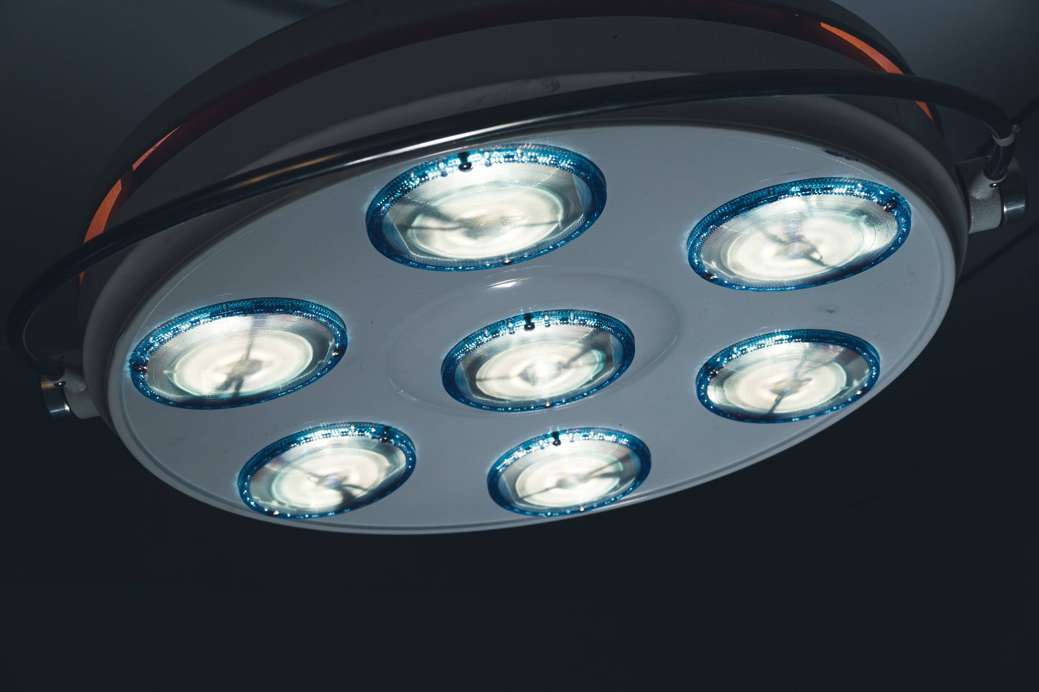
IN THIS SECTION
24
Positioning and exposure
The operation
25
Bulbar dissection and tissue preservation
26
Cuff measurement and fit
27
Urethral injury or contamination
Preserve tissue, measure what the cuff will enclose, follow the actual device protocol, and verify before closing.
28
Balloon pocket and pressure selection
29
Pump position and patient access
30
System checks and handover
Decide before theatre
The bladder
The urethra
Preparation without ritual
The operation
After the implant
Notes:
Section slide. Read the title, say the one-line question, move on.
Keep the tissue, measure what the cuff will really enclose, follow the real device protocol, check before closing.

Slide 30
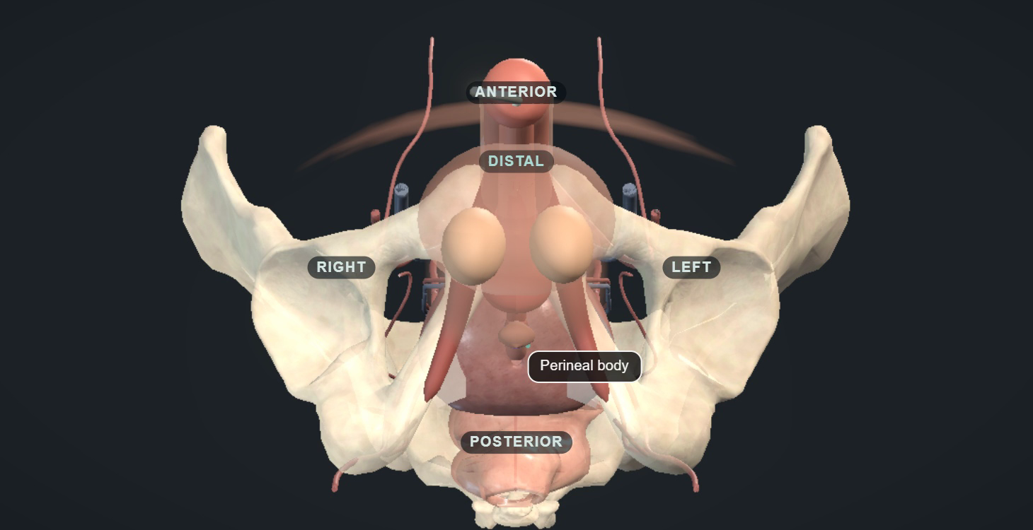
THE OPERATION
24 / 36
Positioning and exposure
The access plan
Respect hip mobility and protect pressure points
Plan the perineal, balloon and pump sites together
Review scars, mesh, previous devices and repairs
Poor exposure? Improve it before dissecting further
AUA24 · ICS16 · AP23
Notes:
24 / 36 · Positioning and exposure
• Expose the bulbar urethra while protecting pressure points and respecting stiff hips; check before he is asleep if movement is limited.
• A single cuff through a perineal incision has guideline support for the standard first implant.
• Plan balloon and pump sites now: pelvic surgery, mesh, scars and an existing penile implant change the plan. Have the notes.
• If exposure is poor, improve the incision, the retraction or the position. Pulling harder transfers the force to the urethra.
• Next: with the urethra exposed, which tissue will the cuff sit on, and how much of it do we disturb?
Animation and image: UroOps 3D, https://uroops3d.com/lab/aus . Captured 10 October 2026. © UroOps3D / UroRef / Nity G. Teaching schematic with clinical review pending. It illustrates spatial relationships, not validated anatomy, tissue perfusion or operative instructions. The clip starts and loops by itself in slide-show mode.

Slide 31
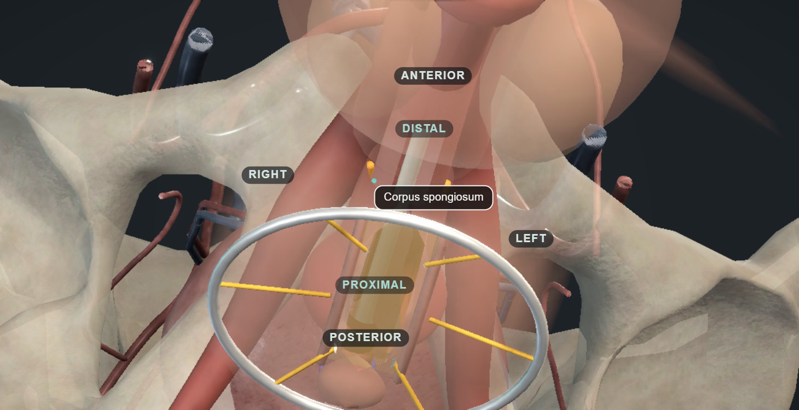
THE OPERATION
25 / 36
Bulbar dissection and tissue preservation
The cuff-bearing segment
Healthy tissue with enough spongy support
Dissect the plane behind the urethra under direct vision
Free only the length the cuff needs
Unsure of the plane or the wall? Stop and reassess
ICS16 · AP23 · CCIFU · URETH26
Notes:
25 / 36 · Bulbar dissection and tissue preservation
• The aim is a cuff round a healthy segment, not a stripped urethra. The upper bulbar urethra usually has good spongy support.
• The plane behind the urethra, against the erectile bodies, is where a slip becomes a hole. Dissect under direct vision; never pass an instrument blind.
• Keep the spongy tissue and its blood supply, free only what the cuff needs, control bleeding without burning everything.
• If the plane disappears, stop: improve the view, change the site, or get reconstructive help. Transcorporal is a planned move, not a rescue.
• Next: once the segment is chosen, we measure it, and measurement is where the most avoidable errors live.
Animation and image: UroOps 3D, https://uroops3d.com/lab/aus . Captured 10 October 2026. © UroOps3D / UroRef / Nity G. Teaching schematic with clinical review pending. It illustrates spatial relationships, not validated anatomy, tissue perfusion or operative instructions. The clip starts and loops by itself in slide-show mode.

Slide 32
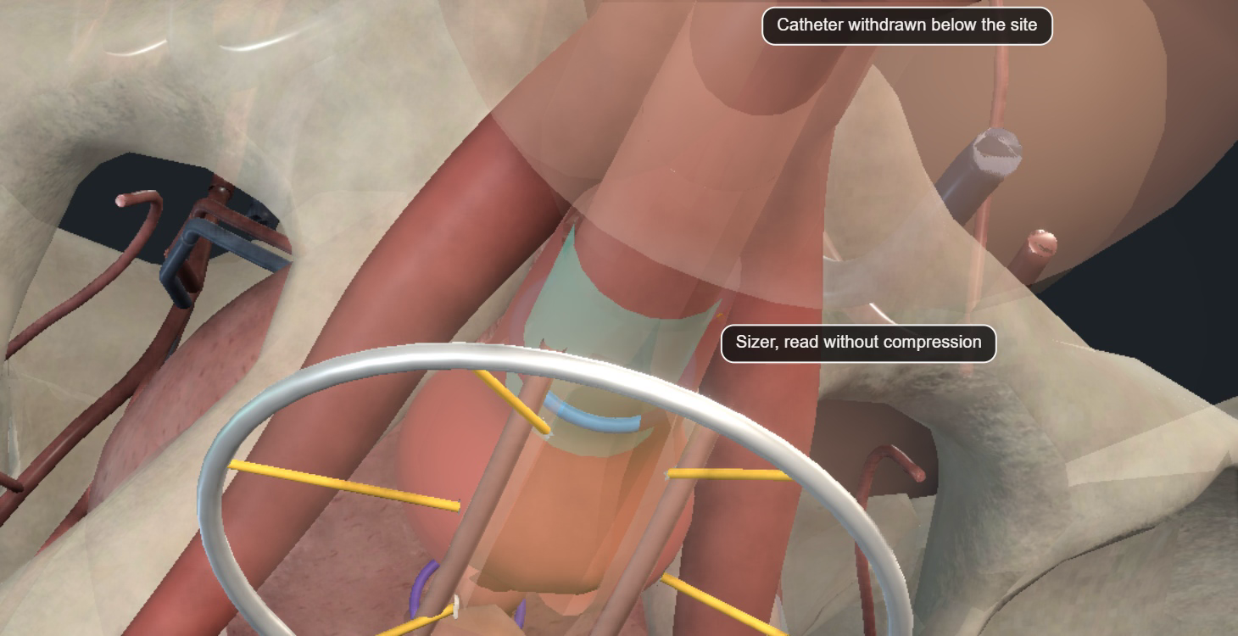
THE OPERATION
26 / 36
Cuff measurement and fit
Sizing errors
Let go of the traction; do not squash the urethra
Take the catheter out for a moment while you size the cuff
Confirm which tissue the cuff will enclose
Use the device’s own sizing method
Poor fit? Measure again; do not raise the pressure
ICS16 · CCIFU · CCSAFETY · AP23
Notes:
26 / 36 · Cuff measurement and fit
• Measurement goes wrong when you measure the wrong tissue: traction stretches, a tight tape squashes, fat and scar make it read bigger.
• Let go of the traction, confirm the plane, use the manufacturer's method, and measure again if the reading looks odd.
• Take the catheter out for a moment while you size the cuff, and put it back once the size is chosen.
• Too small: retention and damage. Too large: leakage. Neither is fixed by a higher-pressure balloon.
• Four of the eight revisions in the first ContiClassic series were sizing errors. That is why we re-measure, not which method is best.
• Next: sometimes the dissection or the measurement shows something that changes what today's operation is for.
Animation and image: UroOps 3D, https://uroops3d.com/lab/aus . Captured 10 October 2026. © UroOps3D / UroRef / Nity G. Teaching schematic with clinical review pending. It illustrates spatial relationships, not validated anatomy, tissue perfusion or operative instructions. The clip starts and loops by itself in slide-show mode.

Slide 33
THE OPERATION
27 / 36
Urethral injury or contamination
The endpoint can change
to repair and safe drainage
1
Not sure the wall is intact? Leak test or scope
2
A known urethral injury means no implant today
3
Replace contaminated single-use items and reset the clean field
An improvised antiseptic soak cannot rescue a contaminated single-use implant.
BAUS25 · AP23 · ICS16 · CCIFU
Notes:
27 / 36 · Urethral injury or contamination
• Suspect an injury when the plane is wrong, the wall looks breached, fluid leaks or the instruments were difficult. Test and scope; a negative test does not make rough dissection safe.
• A known injury changes the aim: stop the implant, define it, repair, drain, explain, and check healing before any new implant.
• Contamination: stop handling, find what was contaminated, replace single-use items, restore a clean setup, or come back another day.
• These are single-use implants. A dropped cuff does not go back in after a home-made soak. Finishing without an implant can be the right outcome.
• Next: if the cuff is safely in, two separate balloon decisions remain: where it goes, and which pressure.

Slide 34
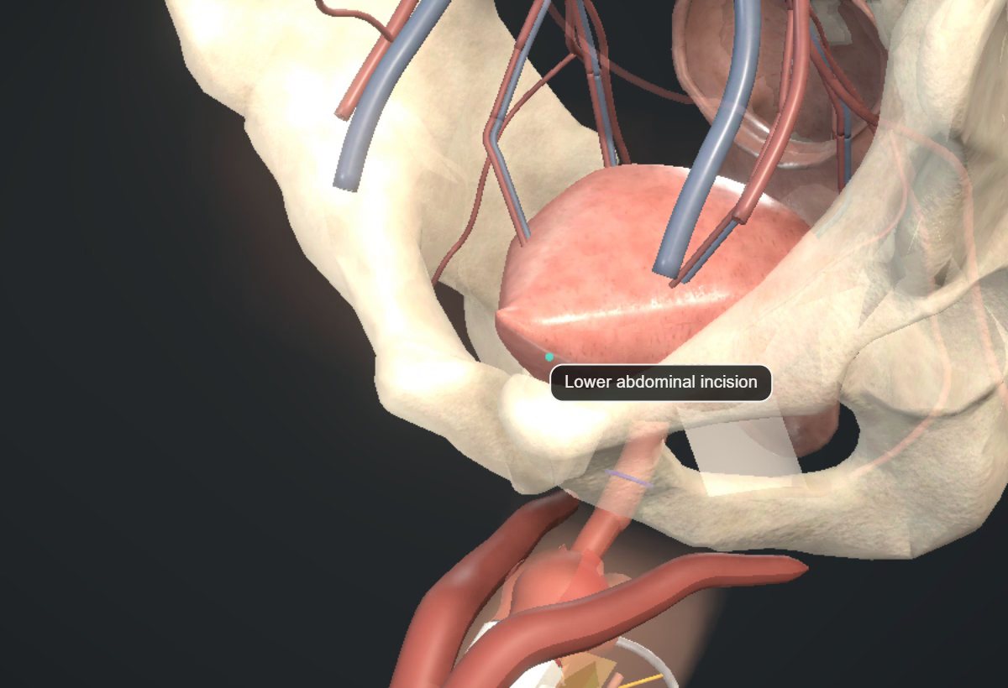
THE OPERATION
28 / 36
Balloon pocket and pressure selection
ContiClassic label
60–69 cmH₂O
AMS 800 consensus
Commonly 61–70 cmH₂O
These ranges are device-specific
A safe pocket and the right pressure are two separate decisions. Fill volumes and selection rules need the current OR protocol.
CCIFU · AP23 · ICS16
Notes:
28 / 36 · Balloon pocket and pressure selection
• The usual pocket behind the pubic bone becomes dangerous after pelvic surgery, radiotherapy, mesh or a previous implant. Never push through resistance.
• A pocket under the abdominal muscle can be right in experienced hands, with its own problems: bad position, felt through the skin, hernia.
• Pressure is a separate decision. ContiClassic lists sixty to sixty-nine; AMS 800 consensus usually sixty-one to seventy. Not interchangeable.
• The public instructions confirm saline filling but send the detail to a separate operating-room protocol; confirm volumes and selection before surgery.
• A higher pressure never covers a poor cuff fit. Next: the third component is the one the patient touches every day.
Animation and image: UroOps 3D, https://uroops3d.com/lab/aus . Captured 10 October 2026. © UroOps3D / UroRef / Nity G. Teaching schematic with clinical review pending. It illustrates spatial relationships, not validated anatomy, tissue perfusion or operative instructions. The clip starts and loops by itself in slide-show mode.

Slide 35
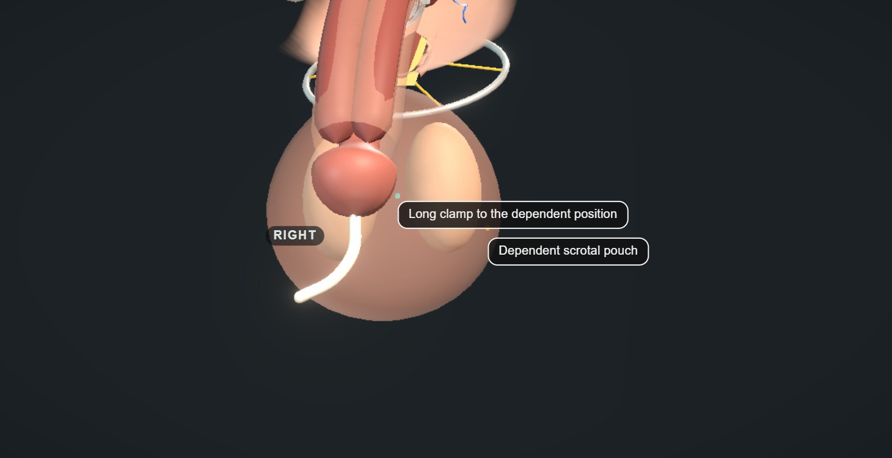
THE OPERATION
29 / 36
Pump position and patient access
A functional position
Use the accessible side agreed in clinic
Avoid crowding, tight skin and pressure on the testis
Check the orientation and tubing pull before closing
Check he can reach it at activation
AP23 · ICS16 · CCIFU
Notes:
29 / 36 · Pump position and patient access
• Where the pump sits is part of the result. He has already shown us where he can reach and which hand he uses.
• Low and easy to reach, but the pocket must fit: too much dissection lets it migrate; too little causes pain and pressure.
• Keep it clearly separate from the testis and away from thin skin. Check how it sits standing and whether the tubing pulls it up.
• Easy on a table says nothing about a swollen scrotum. Check again at activation, with him doing it.
• Next: then we finish the system, and we hand over the risk with it.
Animation and image: UroOps 3D, https://uroops3d.com/lab/aus . Captured 10 October 2026. © UroOps3D / UroRef / Nity G. Teaching schematic with clinical review pending. It illustrates spatial relationships, not validated anatomy, tissue perfusion or operative instructions. The clip starts and loops by itself in slide-show mode.

Slide 36
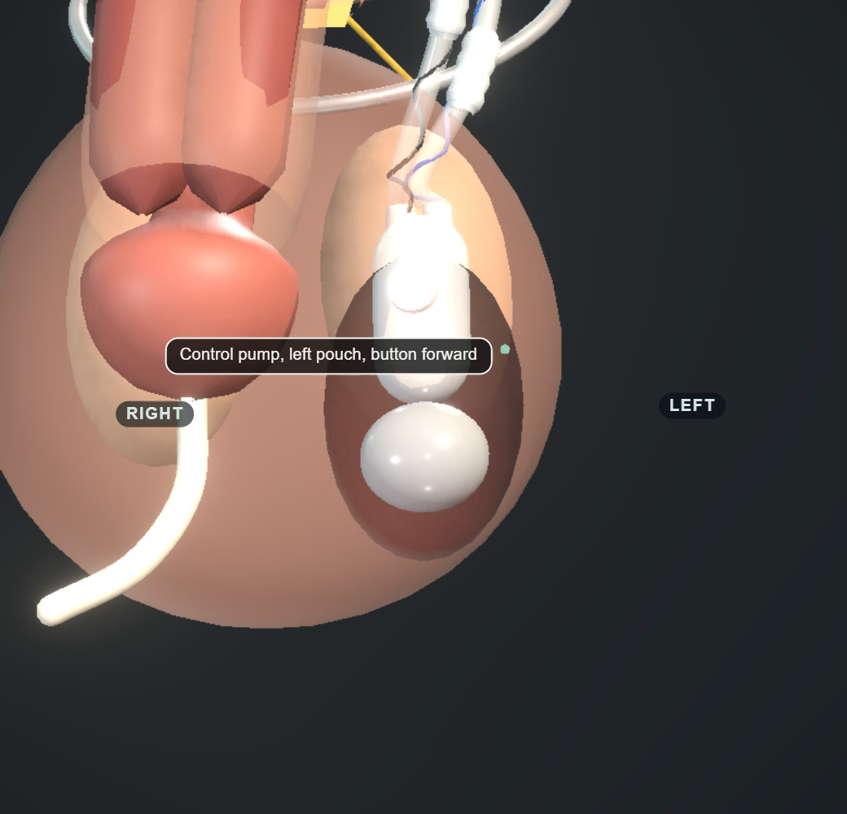
THE OPERATION
30 / 36
System checks and handover
1
Trace the tubing: no tension, bends or trapping
2
Check the connections and cycle the device
3
Confirm the cuff is open and the device is off
4
Record the device, the catheter plan and whom to call
A 2026 survey found gaps in deactivation training. Fill the device by its own protocol.
CCIFU · ICS16 · AP23 · CATH13 · INSTR26
Notes:
30 / 36 · System checks and handover
• Follow every tube: no tension, loops, kinks or trapping. Keep needles away from the components.
• Prepare and connect by the device's own protocol, cycle it, then confirm the cuff is open and the device is off. Pressing a button is not enough.
• A small catheter, placed gently, out early after a straightforward implant. No improvised "standard" size.
• Record model, cuff site and size, balloon type and position, device off, catheter plan and whom to call. The next clinician must know before any drainage.
• The 2026 survey is why we labour this: the gap in confidence about switching off is real. Next: we hand over the patient and plan aftercare.
Animation and image: UroOps 3D, https://uroops3d.com/lab/aus . Captured 10 October 2026. © UroOps3D / UroRef / Nity G. Teaching schematic with clinical review pending. It illustrates spatial relationships, not validated anatomy, tissue perfusion or operative instructions. The clip starts and loops by itself in slide-show mode.
Final configuration: point out the pump within the scrotal pouch, where the patient can reach it. The recording retains the checks and the final resting view.

Slide 37
IN THIS SECTION
31
Aftercare, activation and urgent review
After the implant
32
Case 4: leakage after three good years
33
Established benefit and unresolved questions
34
Five decisions before implantation
Hand over the risk, diagnose late leakage before revising, and say where the evidence stops.
35
Five decisions protecting the result
36
Discussion
Decide before theatre
The bladder
The urethra
Preparation without ritual
The operation
After the implant
Notes:
Section slide. Read the title, say the one-line question, move on.
Hand over the risk, work out why a late leak has come back before revising, and say where the evidence stops.

Slide 38
AFTER THE IMPLANT
31 / 36
Aftercare, activation and urgent review
Our pathway
Earlier assessment
Three doses of co-amoxiclav (Augmentin) around the operation
Retention or difficult voiding
Catheter out the next day
Back at 6 weeks to switch the device on
Worsening pain, redness, discharge or fever
Seen again 6 weeks after activation for any problems
Suspected infection or erosion needs specialist review
Follow-up at 3 months and 6 months
After a year, he contacts us if he needs to
The 2026 day-case audit and studies support selected pathways. Confirm he empties, has support, and can get seen fast.
BAUS25 · CCIFU · AUA24 · CATH13 · BAUSDAY26 · DAYMETA26 · DAYCASE26
Notes:
31 / 36 · Aftercare, activation and urgent review
• Our pathway: three doses of co-amoxiclav around the operation, catheter out the next day, then check he voids. If he cannot: assess, drain safely, no repeated blind attempts.
• Day-case works for selected men: the BAUS audit sent 88 per cent home the same day, and the meta-analysis found no significant excess of retention. Selected, not everyone.
• Pain, redness, discharge, fever or trouble voiding come back to a specialist. Infection or erosion usually means the device comes out, not antibiotics.
• Back at six weeks to switch the device on; he works it himself and we check he empties. Seen again six weeks later, then at three and six months; after a year he contacts us if he needs to.
• Device card and clear instructions: warn any clinician before a catheter or a scope. Next: our last patient did everything right for three years.

Slide 39
AFTER THE IMPLANT
32 / 36
Case 4: leakage after three good years
FICTIONAL CASE 04
What would you investigate before choosing revision?
A good result for three years
Now leaking again
YOUR CALL
Why he leaks, and how he uses the pump, still to be checked
USE
URETHRA
MECHANICS
BLADDER
Could be erosion, a mechanical fault, or the bladder
A 2026 lab study shows balloons wear with age. Find the cause; do not automatically fit a smaller cuff or a new balloon.
ATROPHY20 · BAUS25 · AUA24 · CCIFU · AUASAFER26 · PRBFAT26 · EROSION26 · SECOND26
Notes:
32 / 36 · Case 4: leakage after three good years
• Three good years, now leaking again. Would you book a smaller cuff? [Pause five seconds.]
• Separate a leak that never went away from a true return. Activity, urgency, overflow or trouble cycling? Watch his technique; check the device state.
• Urine and residual, examine the components, scope with the device off for erosion, then fluid loss, mechanics and the bladder.
• Bergeson: atrophy in eight per cent of revisions, the balloon in a third; the 2026 lab study shows balloons stiffen and thin with age. A mechanism, not a rule to replace them.
• Options run from retraining and bladder treatment to replacing a component or the whole system. Second implants: 68 per cent free of reintervention at five years.
• Next: so where does all this leave us? What is established, and what honestly is not.

Slide 40
AFTER THE IMPLANT
33 / 36
Established benefit and unresolved questions
Supported or plausible
Still uncertain
Well-chosen patients get a big improvement
The best rescue for a fragile urethra
Keeping tissue and controlling contamination make sense
The best washout fluid and preparation time
Plan for future catheters and scopes
Long-term ContiClassic results compared with AMS 800
2026 reviews and the first electronic sphincters add options; comparative and long-term evidence is still thin.
MASTER22 · TC20 · TC23 · PREP24 · CCSAFETY · DEVICE26 · UROACTIVE26
Notes:
33 / 36 · Established benefit and unresolved questions
• An AUS gives real benefit, and revision and erosion are part of what he signs up for.
• Keeping tissue, controlling contamination and planning for future instruments all make sense; the individual details often have no comparative evidence.
• We cannot name one best salvage for a fragile urethra, one best washout fluid, or a proven preparation time.
• New devices, including the first electronic sphincters, need outcome data in comparable patients before engineering becomes a clinical claim.
• Make that uncertainty visible in consent and planning. Next: the hour in ten decisions. Five belong before theatre.

Slide 41
AFTER THE IMPLANT
34 / 36
Five decisions before implantation
1
A stress leak shown, and a goal that matters to him
2
Can he use the pump now, and in five years?
3
Tests that answer: anatomy, safe storage, emptying
4
Overactive, weak, or high-pressure bladder: keep them separate
5
A stable urethra and future access plan
BAUS25 · EAU26 · AUA24 · DU23 · ICS16
Notes:
34 / 36 · Five decisions before implantation
• One: a shown stress leak and an improvement that matters to him.
• Two: watch him use a pump, and think about reach in years, not months.
• Three: investigations that answer specific questions, admitting the guidelines differ.
• Four: keep an overactive bladder, a weak bladder and poor compliance separate. Five: a stable outlet and a plan for future instruments.
• Applied to the cases: treat case one first, investigate case two, stage case three. Next: five decisions protect the result once the implant is open.

Slide 42
AFTER THE IMPLANT
35 / 36
Five decisions protecting the result
6
The right antisepsis and the right antibiotics
7
Keep the tissue; measure without distortion
8
The real device protocol, and clear reasons to stop
9
Check the device is off, the drainage plan, and teach the patient
10
A diagnosis before any revision
CCIFU · NICE · AP23 · ATROPHY20 · BAUS25
Notes:
35 / 36 · Five decisions protecting the result
• Six: preparation right for the product, the anatomy and the pathway. A fifteen-minute ritual is not a substitute.
• Seven: keep the tissue you need and measure what the cuff will actually enclose.
• Eight: the instructions for the device you are implanting, and clear conditions for stopping.
• Nine: confirm the cuff state, the drainage and that he can use the device; spell out the precautions for future catheters and scopes.
• Ten: when the leak comes back, diagnose it before choosing a smaller cuff or a higher pressure. Next: that is our ten. The last five minutes are yours.

Slide 43
AFTER THE IMPLANT
36 / 36
Discussion
1
Which bladder finding makes you defer an implant?
2
What establishes urethral stability in your practice?
3
Which preparation or salvage practice needs a trial?
Which finding would change your plan?
Notes:
36 / 36 · Discussion
• We would like these minutes on decisions, not preferences. Pick a case, say what you would do, and name the finding that would change your plan.
• Take one view on the bladder or on urethral stability, then one contrasting view. Ask: guideline requirement, device instruction, or your reading of the evidence?
• Then one question on operative practice, preparation or failure. Keep contributions short enough to allow disagreement.
• A show of hands is opinion, not evidence. Beyond the evidence we have, say exactly what is uncertain.
• Close: the useful differences are now clear, what the evidence supports, what the device requires, and where judgement stays decisive.

Slide 44
AFTER THE IMPLANT
Conclusion
1
Select the patient: a shown stress leak, a safe bladder, reliable emptying and a pump he can use
2
Protect the urethra: keep the tissue, size the cuff without distortion, follow the device’s own protocol
3
When a late leak returns, diagnose it before you revise: his technique, the urethra, the mechanics, the bladder
Mr Andrew Baird
Mr Mohamed Abu Yousif
Nity G
Consultant Urologist
Consultant Urologist
ST5 Urology Registrar
Royal Liverpool University Hospital
Royal Liverpool University Hospital
Northwest (Mersey)
Rigicon Advanced Training Event · Liverpool · 22–23 October 2026
Notes:
The closing message is simple: select carefully, protect the urethra, and diagnose the cause before revising.

Slide 45
REFERENCES
Sources 1 of 3
BAUS25
BAUS consensus, BJU Int 2025
WHO09
WHO hand hygiene guidance, 2009
EAU26
EAU male LUTS guidelines, 2026
CHLORA26
ChloraPrep UK product information, 2026
AUA24
AUA/GURS/SUFU IPT amendment, 2024
IDSA19
IDSA asymptomatic bacteriuria, 2019
EAUSTR26
EAU urethral strictures guidelines, 2026
AUAABX20
AUA antimicrobial prophylaxis, 2020
ICS16
ICS AUS consensus, NUU 2016
CCSAFETY
Wilson: ContiClassic safety, IJIR 2024
AP23
Asia-Pacific AMS 800 consensus, 2023
MASTER22
MASTER randomised trial, HTA 2022
CCIFU
Rigicon ContiClassic IFU, REV.03, 2023
UDS09
Lai: pre-AUS urodynamics, Urology 2009
ICSUDS17
ICS good urodynamic practices, 2017
OAB11
Lai: OAB and post-prostatectomy AUS, 2011
AUAOAB24
AUA/SUFU idiopathic OAB guideline, 2024
DO24
Bhatt: preoperative DO systematic review, 2024
NICE
NICE NG125: surgical site infection
DOFAIL23
Krughoff: earlier AUS failure, 2023
Notes:
Reference sources 1 of 3. Use this slide to identify the guideline, consensus or device-instruction citation requested by the audience. Keep the source types separate: a manufacturer instruction defines permitted use and precautions; it is not comparative outcome evidence. The entries are linked on the slide.

Slide 46
REFERENCES
Sources 2 of 3
DU23
Han: AUS with detrusor underactivity, 2023
YEUNG13
Yeung: GU skin preparation RCT, 2013
CIC23
Krughoff: CIC after bulbar AUS, 2023
ABX18
Adamsky: postoperative antibiotics, 2018
CATH13
Seideman: prolonged catheterisation, 2013
TOUCH23
Ziegelmann: minimal-touch AUS, 2023
UDS14
Weissbart: absent leak during UDS, 2014
LINDER15
Linder: long-term AMS 800 outcomes, 2015
RT22
Zhang: radiation meta-analysis, 2022
AUSCO26
Kaufman: AMS 800 AUSCO study, 2026
URETH26
Davis: AUS after urethroplasty, 2026
AUASTATUS26
AUA current guideline register, July 2026
TC20
Redmond: transcorporal fragile urethra, 2020
BAUSDAY26
BAUS 2026 P4-8: day-case AUS audit
TC23
Kurtzman: high-risk transcorporal AUS, 2023
BAUSSCI26
BAUS 2026 P12-7: bulbar AUS in SCI
ATROPHY20
Bergeson: urethral atrophy and revision, 2020
AUAUDS26
AUA 2026 IP09-22: pre-AUS UDS and cystoscopy
PREP24
Bourgi: AUS preparation protocols, 2024
AUAABX26
AUA 2026 IP09-18: postoperative antibiotics
Notes:
Reference sources 2 of 3. Use the linked entries for questions about bladder function, catheterisation, radiation, urethral reconstruction, preparation and established outcomes. When citing a study, name its population, endpoint and limitation rather than reading the citation list aloud. The 2026 conference entries remain conference material where full results are unavailable.

Slide 47
REFERENCES
Sources 3 of 3
AUASAFER26
AUA 2026 IP09-17: SAFER erosion management
INSTR26
AUS instrumentation knowledge survey, 2026
MASTER26
MASTER: 24-month RCT results, 2026
EROSION26
Immediate urethral repair at explantation, 2026
URETHMETA26
Prior urethroplasty: meta-analysis, 2026
DEVICE26
Emerging AUS devices review, 2026
IRRIG26
Gentamicin withdrawal: AMS 800 cohort, 2026
SECOND26
Second AUS survival: national French cohort, 2026
DAYMETA26
Day-case AUS meta-analysis: 2026 issue
TCSYS25
Transcorporal systematic review, online 2025
DAYCASE26
Day-case versus inpatient AUS: 177 men, 2026
RTTIME25
Radiation and cuff-removal timing cohort, 2025
FRAIL26
Frailty and SUI surgery: Medicare cohort, 2026
UROACTIVE26
Electronic AUS: first-in-human study, 2026
PAD26
Pad count versus 24-hour weight: 2026
REPORT26
Standardised complication reporting: 2026
PRBFAT26
PRB material fatigue: 2026 issue
REGRET26
Long-term decisional regret after AUS, 2026 issue
Notes:
Reference sources 3 of 3. These entries include recent studies, reviews and conference material. Keep the evidence limits from the teaching slides when answering questions. Early electronic-device results do not establish long-term comparative benefit, and conference abstracts do not replace current guidance or the actual device instructions.

Slide 48
BACKUP
Outcome evidence: device and endpoint
Study and population | Endpoint and result | Limits
AUSCO 2026: AMS 800 115 primary implants, 25 irradiated | 12 months after activation 91/97 ≥50% pad-weight reduction 61/101 zero pads | Prospective single-arm, funded by manufacturer. Missing data, one year, expert centres
Linder 2015: AMS 800 1,082 primary implants, 27% irradiated | Freedom from any secondary surgery KM 74% at five years 57% at ten years | Historical specialist cohort. Continence and revision-free survival differ
Wilson 2024: ContiClassic 116 recipients, mixed indications | Eight revisions 12-month KM device survival 93.2% | Early safety series. No standardised continence comparator; mixed indications
Notes:
Backup: outcome evidence. Use if asked to unpack the outcome numbers. Zero-pad use, pad-weight reduction, device survival and freedom from further surgery are different endpoints. The studies describe different devices and populations, so these rows do not form a direct comparison. Point out missing outcomes, follow-up duration, manufacturer funding and the limits of the early ContiClassic series.

Slide 49
BACKUP
Comparative and preparation evidence
Study | Finding | Limits
MASTER 2022 / 2026 Same 380 randomised men | 24-month non-inferiority retained Further surgery: sling 11%, AUS 2% | Selected trial population. Secondary outcomes favour AUS; not general equivalence
Yeung 2013 100 initial GU prosthetic procedures | Post-preparation skin culture positivity 8% versus 32% | Surrogate outcome. Mixed devices. No AUS infection or duration conclusion
Gentamicin withdrawal 2026 173 uncoated AMS 800 procedures | 90-day SSI: 1/59 versus 2/114 No significant difference detected | Sparse events, era confounding, broad systemic prophylaxis; not equivalence
Notes:
Backup: comparative and preparation evidence. MASTER follows the same 380 randomised men; explain the non-inferiority result alongside further surgery and the selected trial population. Yeung measures immediate skin cultures after preparation, not AUS infection or preparation duration. The gentamicin-withdrawal cohort has only three infections, so it cannot establish equivalence. Use the limits column when answering.

Slide 50
BACKUP
Evidence gaps
1
Routine versus selective UDS and meaningful outcomes
2
Functional eligibility in DU or chronic retention
3
Staging intervals after different reconstructions
4
Comparative protection from salvage strategies
5
Preparation, irrigation and prolonged prophylaxis
6
Independent long-term ContiClassic outcomes
7
Mechanisms and revision strategy in late leakage
Notes:
Backup: evidence gaps. Ask which unanswered question would change the audience’s practice. The gaps concern testing, weak-bladder eligibility, staging after reconstruction, salvage strategies, preparation and antibiotics, long-term ContiClassic outcomes, and the cause of late leakage. Distinguish a practical local choice from a question that comparative research still needs to answer.

Slide 51
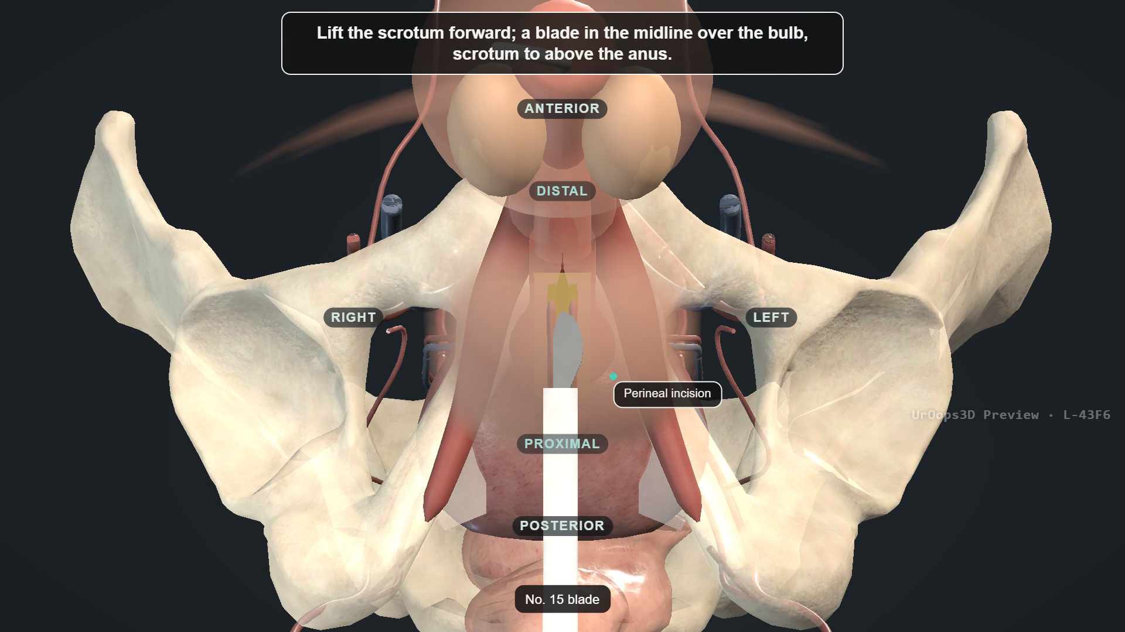
BACKUP
UroOps 3D lesson: recorded run-through
Use only if the live page fails
Starts by itself. 97 seconds, no sound. Narrate the checks and final configuration.
Notes:
Video: UroOps 3D, https://uroops3d.com/lab/aus . Captured 10 October 2026. © UroOps3D / UroRef / Nity G. Teaching schematic with clinical review pending. It illustrates spatial relationships, not validated anatomy, tissue perfusion or operative instructions.
Recorded backup: 97 seconds, silent. Describe the retained steps and the final configuration. The pump sits within the scrotal pouch.

