Slide 1
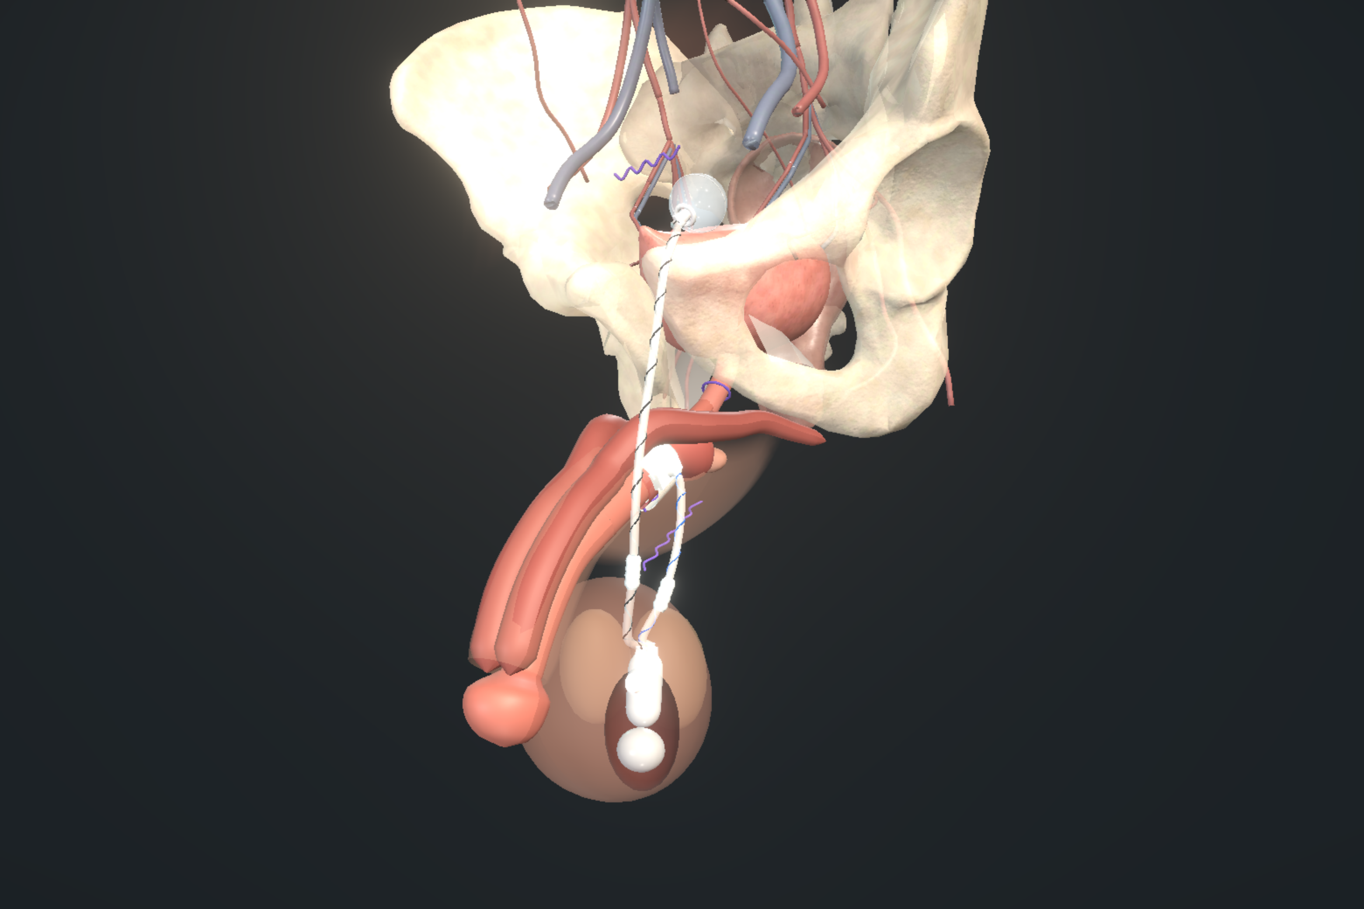
EXPERT TEACHING SESSION · 60 MINUTES
Artificial urinary sphincter surgery
Patient selection, difficult bladders and difficult urethras
[Meeting and date]
Mr Andrew Baird Urology Consultant
Mr Abu Yousif Urology Consultant
Nity G ST5 Urology Registrar
Notes:
Cover, displayed before the timed teaching session. Presenters: Mr Andrew Baird, Urology Consultant; Mr Abu Yousif, Urology Consultant; Nity G, ST5 Urology Registrar. Add the meeting and date on the slide. Add personal disclosures to teaching slide 02 before presenting.
Image: UroOps 3D teaching schematic of the implanted device, captured from https://uroops3d.com/lab/aus on 10 October 2026, with clinical review pending. It is not a record of an actual operation. No personal operative experience or local outcomes are asserted.

Slide 2
ACT
00:00 – 14:00 · 14 MINUTES
I
01
The decision before theatre
02
Evidence and device boundaries
03
Leakage mechanism and patient goals
04
Timing after prostate treatment
Decide before theatre
05
Pump use over time
06
Flexible cystoscopy before implantation
Can this patient obtain useful continence while storing and emptying safely and operating the device?
07
Urodynamics: BAUS, EAU and AUA
08
Interpreting an imperfect study
09
Consent: improvement and lifetime burden
Decide before theatre
The bladder
The urethra
Preparation without ritual
The operation
After the implant
Notes:
[Act I · Decide before theatre · 00:00 – 14:00 · 14 minutes · teaching slides 1–9]
Transition slide; it takes no time from the clock. Read the act title, say the one-line question, and move on.
SAY
"Can this patient obtain useful continence while storing and emptying safely and operating the device?"

Slide 3
ACT I · DECIDE BEFORE THEATRE
01 / 38 · 00:00 – 01:30
The decision before theatre
Severe leakage is only the starting point
Implant
Optimise
Investigate
Reconsider
SUI, safe storage, reliable emptying and usable pump
A treatable bladder or functional problem dominates
The mechanism, measurements or anatomy remain uncertain
Safe function or independent device use is unlikely
BAUS25 · AUA24 · ICS16
Notes:
[Act I · Decide before theatre · Teaching slide 01 of 38 · 00:00-01:30 · 1:30]
THIS SLIDE: The decision lens for the whole hour: implant, optimise, investigate or reconsider.
SAY
An AUS can be a technically satisfactory implant and a disappointing treatment. The cuff may coapt, the pump may cycle, and the patient may still avoid leaving the house because urgency, difficult emptying or fear of another procedure dominates his life.
Today we want to follow the decisions that separate those outcomes. We will start with what the patient actually wants, then examine the bladder and urethra that are to be operated on. We will spend time on evidence-based preparation and the small operative decisions that are difficult to rescue later.
One question will keep coming back, and it is on the slide in four words. Would we implant now, optimise first, investigate further, or reconsider whether an AUS is the right treatment? Each of those choices needs a reason, and we will keep returning to them with four fictional patients.
STUDIES ON THIS SLIDE
• BAUS25 — BAUS consensus 2025 (Bhatt et al., BJU Int). What it is: UK expert consensus after literature review and modified Delphi. What it says: Sets the UK assessment and perioperative pathway: VUDS for surgical candidates, severity-dependent recovery periods, treatment of narrowing before continence surgery, and a five-minute topical field scrub that it labels as Delphi extrapolation. Consensus supports a consistent pathway; it does not prove each interval or step is uniquely optimal.
• AUA24 — AUA/GURS/SUFU incontinence after prostate treatment, amended 2024. What it is: US guideline. What it says: Permits surgery from six months for bothersome non-improving SUI and recommends offering it at one year; cystourethroscopy before SUI surgery is expert opinion; urodynamics is conditional (Grade C) when it helps diagnosis or counselling. It also supports pump suitability, lifetime counselling and interval cystoscopy at least four to six weeks after treating BNC or VUAS.
• ICS16 — ICS AUS consensus 2015, published 2016 (Biardeau et al.). What it is: International consensus, centred on AMS 800. What it says: Covers assessment, operative principles, complications and aftercare: adequate dexterity and cognition, bladder and outlet evaluation, and device-aware instrumentation. Its technical and catheter advice is AMS-era and context-specific, not a universal ContiClassic rule.
TRANSITION → Before we use any of that evidence, we should be honest about what kind of evidence it is.

Slide 4
ACT I · DECIDE BEFORE THEATRE
02 / 38 · 01:30 – 03:00
Evidence and device boundaries
Source | What it can tell us
Guidelines and consensus | A recommended clinical pathway
Clinical studies | Outcomes in a defined population
Manufacturer IFU | Permitted use and device precautions
Expert or local practice | A practical choice with stated uncertainty
BAUS 2025 · AUA amendment 2024 · EAU 2026. Meeting abstracts are separate evidence. Device results are not interchangeable.
BAUS25 · EAU26 · AUA24 · ICS16 · AP23 · CCIFU · AUASTATUS26 · DEVICE26
Notes:
[Act I · Decide before theatre · Teaching slide 02 of 38 · 01:30-03:00 · 1:30]
THIS SLIDE: The four kinds of authority we will cite, and the boundary between devices.
SAY
Thank you to Rigicon for organising the meeting. The clinical discussion needs to stay independent of the sponsor, so device choice should follow the evidence, patient suitability and the instructions for that device.
We have useful guidance, but agreement among experts is not the same as a comparative trial. A manufacturer's instruction tells us how its product is intended to be used. It tells us nothing about whether that product outperforms another. A retrospective series can identify a concern without proving that the proposed solution prevents it.
The BAUS consensus is particularly useful because it sets out the clinical pathway. We will compare it with EAU and AUA guidance where they differ. The ICS and Asia-Pacific consensus documents are also useful, but both are centred on the AMS 800.
Our aims are to choose investigations sensibly, separate three different bladder problems, preserve a usable urethra, question preparation rituals and diagnose failure before choosing revision. Where the evidence stops, we will say so.
STUDIES ON THIS SLIDE
• BAUS25 — BAUS consensus 2025 (Bhatt et al., BJU Int). What it is: UK expert consensus after literature review and modified Delphi. What it says: Sets the UK assessment and perioperative pathway: VUDS for surgical candidates, severity-dependent recovery periods, treatment of narrowing before continence surgery, and a five-minute topical field scrub that it labels as Delphi extrapolation. Consensus supports a consistent pathway; it does not prove each interval or step is uniquely optimal.
• EAU26 — EAU non-neurogenic male LUTS guideline 2026. What it is: European guideline. What it says: Recommends structured symptom assessment, diary, pad-weight and residual measures; weakly recommends invasive urodynamics before invasive treatment while acknowledging limited outcome evidence. A weak recommendation signals uncertainty, not a valueless test.
• AUA24 — AUA/GURS/SUFU incontinence after prostate treatment, amended 2024. What it is: US guideline. What it says: Permits surgery from six months for bothersome non-improving SUI and recommends offering it at one year; cystourethroscopy before SUI surgery is expert opinion; urodynamics is conditional (Grade C) when it helps diagnosis or counselling. It also supports pump suitability, lifetime counselling and interval cystoscopy at least four to six weeks after treating BNC or VUAS.
• ICS16 — ICS AUS consensus 2015, published 2016 (Biardeau et al.). What it is: International consensus, centred on AMS 800. What it says: Covers assessment, operative principles, complications and aftercare: adequate dexterity and cognition, bladder and outlet evaluation, and device-aware instrumentation. Its technical and catheter advice is AMS-era and context-specific, not a universal ContiClassic rule.
• AP23 — Asia-Pacific AMS 800 consensus 2023 (Chung et al.). What it is: Regional expert consensus. What it says: Practical consensus on selection, investigation, troubleshooting and aftercare, including common AMS 800 pressure selection (61–70 cmH2O) and preparation. Its fill volumes and preparation sequence belong to AMS 800, not automatically to ContiClassic.
• CCIFU — Rigicon ContiClassic instructions for use, REV.03, 2023. What it is: Manufacturer labelling. What it says: Requires associated urge, overflow or instability to be treated and controlled or resolved, contraindicates irresolvable instability, warns about poor compliance and thin spongiosum, requires cuff deflation and deactivation before instrumentation, specifies four to six weeks deactivated, and describes a longer postoperative antibiotic regimen than stewardship sources. These are product instructions, not proof of efficacy. Country and lot applicability and the separate OR protocol remain unverified.
• AUASTATUS26 — AUA current guideline register, July 2026. What it is: Official register page. What it says: Still lists Incontinence after Prostate Treatment as amended in 2024; no 2026 amendment exists. Meeting abstracts and update courses are not a new guideline.
• DEVICE26 — Emerging AUS devices review 2026 (Schnell et al., Neurourol Urodyn). What it is: Narrative review. What it says: Describes new hydraulic and electronic designs while stressing the lack of robust direct comparisons and long-term outcomes. Engineering advantages are not proven clinical superiority.
TRANSITION → So let us begin where the patient begins: with the leak itself.

Slide 5
ACT I · DECIDE BEFORE THEATRE
03 / 38 · 03:00 – 04:45
Leakage mechanism and patient goals
Characterise the leak
Define useful improvement
Demonstrated stress leakage
Recovery trajectory and prior treatment
Urgency, night-time symptoms and emptying
A validated symptom and quality-of-life measure
Pad use, pad weight and activity
The activity the patient wants back
Pad count is useful; 2026 data show wide weight variability at 2–4 pads/day. Measure when severity is uncertain.
BAUS25 · EAU26 · AUA24 · PAD26
Notes:
[Act I · Decide before theatre · Teaching slide 03 of 38 · 03:00-04:45 · 1:45]
THIS SLIDE: Characterising the leak and agreeing what improvement would be worth an implant.
SAY
Start with a description of a bad day. Does he leak when standing, walking or coughing? Does an urge come before the leak? Is he dry overnight, or does night-time leakage suggest another cause? Mixed symptoms are common, but the word mixed must not replace an explanation.
Demonstrate stress leakage with a suitably filled bladder and a practical provocative test. If the history and examination disagree, investigate that disagreement. A dry examination just after he has emptied his bladder proves very little.
Pad number is easy to record, but it depends on pad capacity and the patient's changing behaviour. The 2026 pad study tells us that count tracks leakage well overall, yet two to four pads a day hides a wide range of weights. A pad-weight assessment quantifies leakage when severity or progress is uncertain, provided the collection conditions and activity are recorded. A diary helps separate urinary frequency from precautionary voiding.
Then ask what improvement would justify an implant. Walking the golf course, returning to work or managing with one precautionary pad may matter more than a label of continence. Record a validated symptom and quality-of-life measure, and keep the patient's own goal beside it.
STUDIES ON THIS SLIDE
• BAUS25 — BAUS consensus 2025 (Bhatt et al., BJU Int). What it is: UK expert consensus after literature review and modified Delphi. What it says: Sets the UK assessment and perioperative pathway: VUDS for surgical candidates, severity-dependent recovery periods, treatment of narrowing before continence surgery, and a five-minute topical field scrub that it labels as Delphi extrapolation. Consensus supports a consistent pathway; it does not prove each interval or step is uniquely optimal.
• EAU26 — EAU non-neurogenic male LUTS guideline 2026. What it is: European guideline. What it says: Recommends structured symptom assessment, diary, pad-weight and residual measures; weakly recommends invasive urodynamics before invasive treatment while acknowledging limited outcome evidence. A weak recommendation signals uncertainty, not a valueless test.
• AUA24 — AUA/GURS/SUFU incontinence after prostate treatment, amended 2024. What it is: US guideline. What it says: Permits surgery from six months for bothersome non-improving SUI and recommends offering it at one year; cystourethroscopy before SUI surgery is expert opinion; urodynamics is conditional (Grade C) when it helps diagnosis or counselling. It also supports pump suitability, lifetime counselling and interval cystoscopy at least four to six weeks after treating BNC or VUAS.
• PAD26 — Pad count versus 24-hour pad weight 2026 (Domínguez Argomedo et al., BJU Int). What it is: Retrospective analysis of prospective follow-up, 2,040 men, 8,787 paired measurements. What it says: Pad count tracked leakage well overall (Spearman rho 0.94), but two to four pads a day had considerable weight variability. Measure pad weight when the intermediate count leaves severity uncertain.
TRANSITION → Once we know what he wants back, the next question is when, and whether an AUS is the only route there.

Slide 6
ACT I · DECIDE BEFORE THEATRE
04 / 38 · 04:45 – 06:15
Timing after prostate treatment
Guidance | At six months | At twelve months
BAUS | At least six months’ recovery for severe SUI | At least twelve months for mild–moderate SUI
AUA | Surgery may be offered for bothersome, non-improving SUI despite conservative care | Offer surgery for persisting bothersome SUI
MASTER 2026: sling remained non-inferior at 24 months; further surgery 11% after sling versus 2% after AUS. Selected population.
AUA24 · BAUS25 · EAU26 · MASTER22 · MASTER26
Notes:
[Act I · Decide before theatre · Teaching slide 04 of 38 · 04:45-06:15 · 1:30]
THIS SLIDE: When to operate after prostate treatment, and where the sling trial fits.
SAY
Do not let conservative management drift on indefinitely. But do not interrupt a convincing recovery without a reason either. Establish what has been tried, whether pelvic-floor training was properly taught, and whether leakage is still improving.
BAUS allows a recovery period of at least six months for severe leakage and twelve for mild-to-moderate leakage. The AUA permits surgery from six months when bothersome stress leakage is not improving despite conservative treatment, and recommends offering it at one year when it persists. Anticipated salvage treatment, recurrence and the patient's recovery so far still belong in the decision.
A sling remains an option for selected men with less severe leakage and favourable tissues. Severe leakage and previous radiation generally move the discussion towards AUS. The AUA specifically favours AUS over slings or adjustable balloons in irradiated men seeking surgery. Containment, collecting devices and continued conservative care remain legitimate choices.
The MASTER trial supports an informed comparison. At 24 months the sling remained non-inferior on its primary continence endpoint, but further surgery was needed in eleven per cent after sling against two per cent after AUS. Non-inferiority on one endpoint does not make the procedures interchangeable in every subgroup. The trial excluded previous continence implants and unresolved narrowing, so it should not be applied to complex revision practice.
STUDIES ON THIS SLIDE
• AUA24 — AUA/GURS/SUFU incontinence after prostate treatment, amended 2024. What it is: US guideline. What it says: Permits surgery from six months for bothersome non-improving SUI and recommends offering it at one year; cystourethroscopy before SUI surgery is expert opinion; urodynamics is conditional (Grade C) when it helps diagnosis or counselling. It also supports pump suitability, lifetime counselling and interval cystoscopy at least four to six weeks after treating BNC or VUAS.
• BAUS25 — BAUS consensus 2025 (Bhatt et al., BJU Int). What it is: UK expert consensus after literature review and modified Delphi. What it says: Sets the UK assessment and perioperative pathway: VUDS for surgical candidates, severity-dependent recovery periods, treatment of narrowing before continence surgery, and a five-minute topical field scrub that it labels as Delphi extrapolation. Consensus supports a consistent pathway; it does not prove each interval or step is uniquely optimal.
• EAU26 — EAU non-neurogenic male LUTS guideline 2026. What it is: European guideline. What it says: Recommends structured symptom assessment, diary, pad-weight and residual measures; weakly recommends invasive urodynamics before invasive treatment while acknowledging limited outcome evidence. A weak recommendation signals uncertainty, not a valueless test.
• MASTER22 — MASTER trial 2022 (Constable et al., NIHR HTA). What it is: UK multicentre randomised non-inferiority trial, 380 men, sling versus AUS. What it says: At twelve months the sling met non-inferiority on the patient-reported continence endpoint (difference −3.4 points, 95% CI −11.7 to +4.8, 15-point margin). Both groups improved and several secondary outcomes favoured AUS. Prior implants and unresolved narrowing were excluded, so it says nothing about complex revision practice.
• MASTER26 — MASTER 24-month results 2026 (Constable et al., Eur Urol Focus). What it is: Extended follow-up of the same 380 randomised men. What it says: Sling remained non-inferior on the strict self-reported continence endpoint at 24 months (difference −0.6 points, 95% CI −9.2 to +8.0). Further surgery: 11% after sling versus 2% after AUS; secondary outcomes generally favoured AUS. Non-inferiority on one endpoint is not identical effectiveness.
TRANSITION → Timing assumes the patient can use the device. That is the next thing to test, and we test it rather than ask about it.

Slide 7
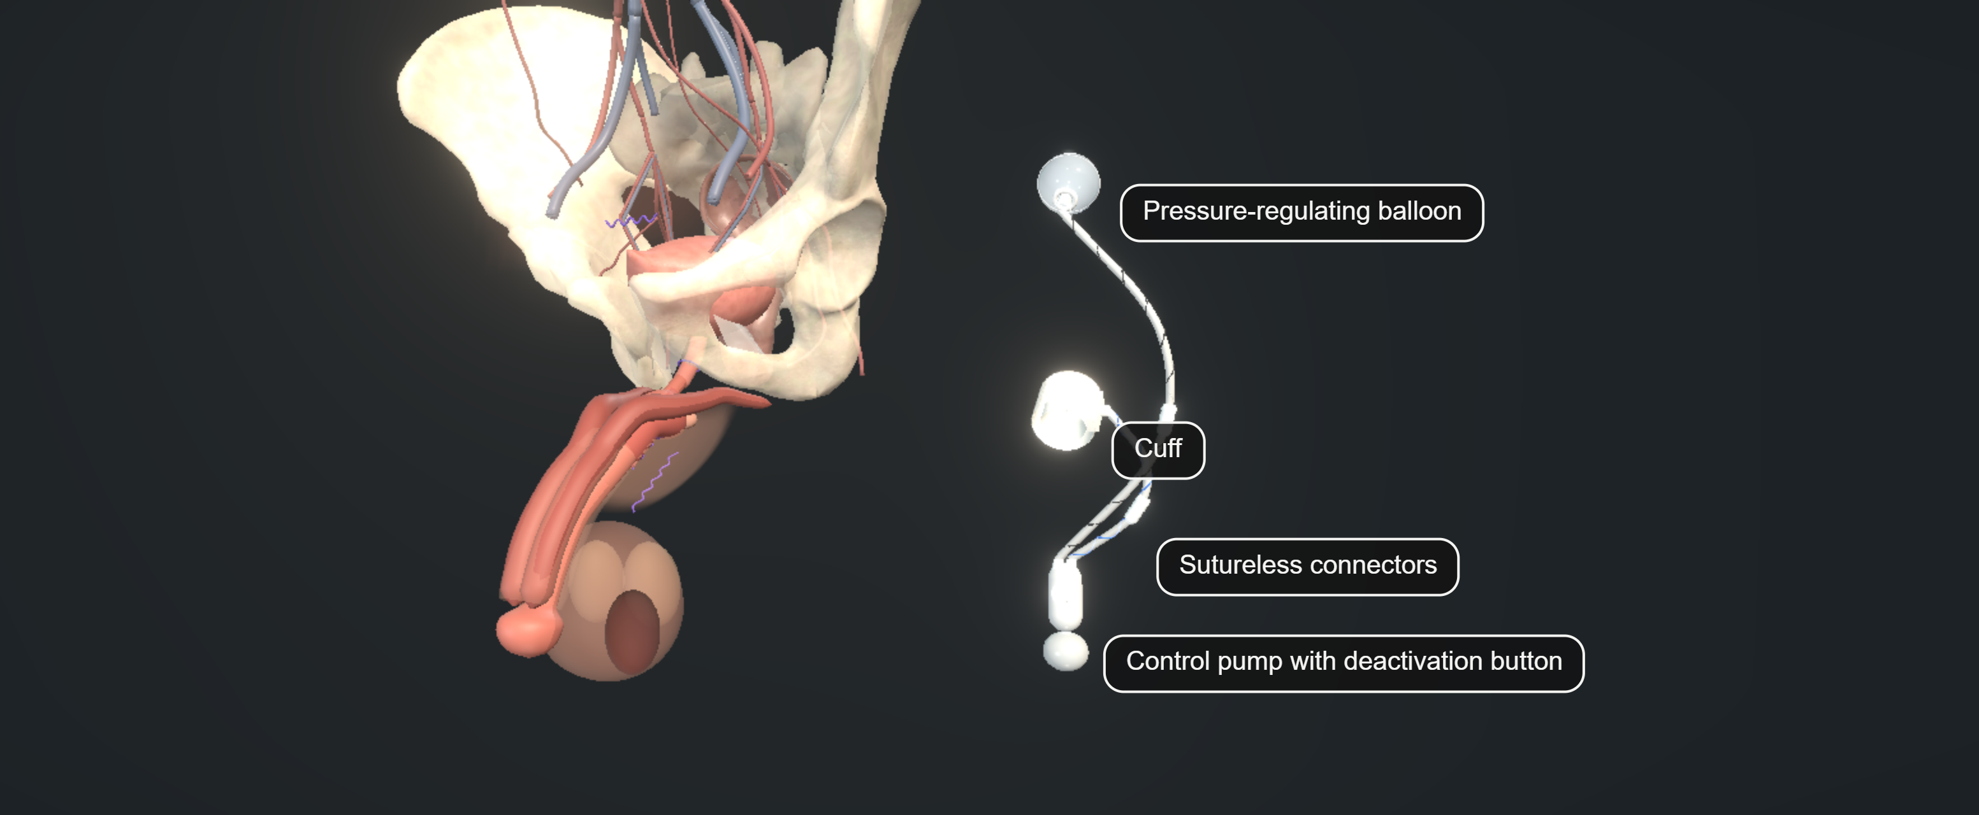
ACT I · DECIDE BEFORE THEATRE
05 / 38 · 06:15 – 07:30
Pump use over time
Pump assessment
Watch the patient operate a demonstration pump
Check reach, strength and understanding
Agree an accessible position before surgery
Assess frailty as well as future pump use
AUA24 · ICS16 · CCIFU · FRAIL26
Notes:
[Act I · Decide before theatre · Teaching slide 05 of 38 · 06:15-07:30 · 1:15]
THIS SLIDE: A demonstrated task: can this patient operate this pump now and in five years?
SAY
Ask the patient to operate a demonstration pump, and watch what happens. Arthritis, neuropathy, tremor and weak pinch may only show when he attempts the task.
Access matters as much as strength. Can he reach the proposed side of the scrotum while seated? Obesity, a high scrotum, limited hip movement or another scrotal device can make a well placed pump unusable. Agree the side with him, because his dominant hand alone does not settle it.
Check that he understands cycling, deactivation and what to tell another clinician before catheterisation. Cognitive decline and progressive disease change the long-term plan. Family support helps, but it does not automatically help a man who cannot operate the device when he is alone.
Frailty is more than an age cutoff. The 2026 Medicare cohort links claims-defined frailty to early complications and to later revision, independently of age. Balance anaesthetic burden, recovery, expected benefit and the likelihood of future revision. If safe independent use is unlikely, reconsider the treatment.
STUDIES ON THIS SLIDE
• AUA24 — AUA/GURS/SUFU incontinence after prostate treatment, amended 2024. What it is: US guideline. What it says: Permits surgery from six months for bothersome non-improving SUI and recommends offering it at one year; cystourethroscopy before SUI surgery is expert opinion; urodynamics is conditional (Grade C) when it helps diagnosis or counselling. It also supports pump suitability, lifetime counselling and interval cystoscopy at least four to six weeks after treating BNC or VUAS.
• ICS16 — ICS AUS consensus 2015, published 2016 (Biardeau et al.). What it is: International consensus, centred on AMS 800. What it says: Covers assessment, operative principles, complications and aftercare: adequate dexterity and cognition, bladder and outlet evaluation, and device-aware instrumentation. Its technical and catheter advice is AMS-era and context-specific, not a universal ContiClassic rule.
• CCIFU — Rigicon ContiClassic instructions for use, REV.03, 2023. What it is: Manufacturer labelling. What it says: Requires associated urge, overflow or instability to be treated and controlled or resolved, contraindicates irresolvable instability, warns about poor compliance and thin spongiosum, requires cuff deflation and deactivation before instrumentation, specifies four to six weeks deactivated, and describes a longer postoperative antibiotic regimen than stewardship sources. These are product instructions, not proof of efficacy. Country and lot applicability and the separate OR protocol remain unverified.
• FRAIL26 — Frailty and SUI surgery 2026 (Nik-Ahd et al., J Urol). What it is: Medicare claims cohort, 7,252 men, AUS and sling. What it says: Claims-defined frailty was associated with 30-day complications independently of age and comorbidity (adjusted RR 1.5 prefrail, 2.5 frail) and with revision or removal. Mixed procedures and a claims index; it validates no bedside pump score.
TRANSITION → With the patient assessed, we turn to the two investigations that most often change the plan. First the cystoscope.
Image: UroOps 3D, https://uroops3d.com/lab/aus . Captured 10 October 2026. © UroOps3D / UroRef / Nity G. Teaching schematic with clinical review pending. It illustrates spatial relationships, not validated anatomy, tissue perfusion or operative instructions.

Slide 8
ACT I · DECIDE BEFORE THEATRE
06 / 38 · 07:30 – 09:15
Flexible cystoscopy before implantation
Guidance
Findings that change the plan
AUA recommends cystourethroscopy before SUI surgery
Stricture, BNC or VUAS
BAUS selects cystoscopy within its VUDS pathway
Erosion, foreign material or stones
Advance inspection is a practical preference
Tumour or likely repeated instrumentation
AUA 2026 IP09-22 revisits testing; full results unverified. Existing cystoscopy guidance remains applicable.
BAUS25 · AUA24 · EAU26 · EAUSTR26 · AUAUDS26
Notes:
[Act I · Decide before theatre · Teaching slide 06 of 38 · 07:30-09:15 · 1:45]
THIS SLIDE: What a flexible cystoscopy is for, and which findings change the plan.
SAY
The AUA recommends cystourethroscopy before stress-incontinence surgery. BAUS selects cystoscopy for indications alongside its video-urodynamics pathway, or combines it with standard urodynamics where video is unavailable. EAU describes selective cystoscopy for narrowing or bladder pathology, with a weak general recommendation when the findings would change diagnosis or treatment.
Our practical preference before an AUS is to inspect the urethra and bladder in advance, so that an unexpected finding can be discussed before the day of implantation. That is our preference, because the guidelines do not agree. Repeat the assessment after any urethral treatment or new obstructive symptoms.
Look for a stricture, vesicourethral anastomotic stenosis, bladder-neck contracture, foreign material or previous cuff erosion. Bladder stones, tumour and significant radiation changes may alter treatment or predict repeated instrumentation.
With suspected narrowing, add flow and residual assessment and define the site and length. Retrograde urethrography, sometimes with a voiding study, is useful when reconstruction is being considered or the segment cannot be assessed endoscopically. And do not turn a diagnostic cystoscopy into an unplanned dilation simply to complete the examination.
STUDIES ON THIS SLIDE
• BAUS25 — BAUS consensus 2025 (Bhatt et al., BJU Int). What it is: UK expert consensus after literature review and modified Delphi. What it says: Sets the UK assessment and perioperative pathway: VUDS for surgical candidates, severity-dependent recovery periods, treatment of narrowing before continence surgery, and a five-minute topical field scrub that it labels as Delphi extrapolation. Consensus supports a consistent pathway; it does not prove each interval or step is uniquely optimal.
• AUA24 — AUA/GURS/SUFU incontinence after prostate treatment, amended 2024. What it is: US guideline. What it says: Permits surgery from six months for bothersome non-improving SUI and recommends offering it at one year; cystourethroscopy before SUI surgery is expert opinion; urodynamics is conditional (Grade C) when it helps diagnosis or counselling. It also supports pump suitability, lifetime counselling and interval cystoscopy at least four to six weeks after treating BNC or VUAS.
• EAU26 — EAU non-neurogenic male LUTS guideline 2026. What it is: European guideline. What it says: Recommends structured symptom assessment, diary, pad-weight and residual measures; weakly recommends invasive urodynamics before invasive treatment while acknowledging limited outcome evidence. A weak recommendation signals uncertainty, not a valueless test.
• EAUSTR26 — EAU urethral strictures guideline 2026. What it is: European guideline. What it says: Distinguishes anterior strictures from posterior stenosis and gives reconstruction-specific pathways, including deferring continence surgery for three to six months after redo vesicourethral anastomosis. That interval belongs to that setting, not to every dilation or urethroplasty.
• AUAUDS26 — AUA 2026 abstract IP09-22: pre-AUS urodynamics and cystoscopy. What it is: Conference abstract, title and programme verified only. What it says: Revisited the value of preoperative UDS and cystoscopy. Full methods and results were unavailable, so no numerical result or change in practice is inferred.
TRANSITION → The second investigation is where the guidelines genuinely disagree, so we will name the positions rather than blur them.

Slide 9
ACT I · DECIDE BEFORE THEATRE
07 / 38 · 09:15 – 11:00
Urodynamics: BAUS, EAU and AUA
Guideline | Position | Clinical implication
BAUS | Video-urodynamics for surgical candidates | Follow the investigation pathway
EAU | UDS before invasive treatment, weak recommendation | Interpret alongside the selective-testing narrative
AUA | UDS when diagnosis or counselling benefits | State the uncertainty the test should resolve
BAUS 2025, EAU 2026 and AUA 2024 differ. AUA 2026 IP09-22 is conference material; full results remain unverified.
BAUS25 · EAU26 · AUA24 · ICS16 · AUASTATUS26 · AUAUDS26
Notes:
[Act I · Decide before theatre · Teaching slide 07 of 38 · 09:15-11:00 · 1:45]
THIS SLIDE: Three guidelines, three positions on urodynamics. We say which one we follow.
SAY
BAUS favours video-urodynamics in the surgical pathway. EAU recommends urodynamics before invasive treatment, with weak strength, and its narrative still discusses selective testing and limited outcome evidence. The AUA permits testing when it helps diagnosis or counselling. The older ICS consensus also takes a selective approach.
The yield is greatest when stress leakage is uncertain, urgency is dominant, emptying is poor, compliance is a concern, or previous treatment has complicated the mechanism. In an uncomplicated man with demonstrable severe stress leakage, reassuring emptying and no worrying storage symptoms, urodynamics may add little under the AUA approach. BAUS and EAU still take a different position.
Before requesting the test, state the question. Is this unsafe storage, obstruction, weak contraction, or a bladder that never gets a chance to fill? Decide in advance what would change surgery or counselling.
We found no comparative trial showing that routine testing itself improves AUS outcomes for every candidate. A consensus can recommend a sensible investigation without proof that its universal use is superior. The 2026 AUA abstract revisits this question, but its full results were not available, so we quote the topic and nothing more.
STUDIES ON THIS SLIDE
• BAUS25 — BAUS consensus 2025 (Bhatt et al., BJU Int). What it is: UK expert consensus after literature review and modified Delphi. What it says: Sets the UK assessment and perioperative pathway: VUDS for surgical candidates, severity-dependent recovery periods, treatment of narrowing before continence surgery, and a five-minute topical field scrub that it labels as Delphi extrapolation. Consensus supports a consistent pathway; it does not prove each interval or step is uniquely optimal.
• EAU26 — EAU non-neurogenic male LUTS guideline 2026. What it is: European guideline. What it says: Recommends structured symptom assessment, diary, pad-weight and residual measures; weakly recommends invasive urodynamics before invasive treatment while acknowledging limited outcome evidence. A weak recommendation signals uncertainty, not a valueless test.
• AUA24 — AUA/GURS/SUFU incontinence after prostate treatment, amended 2024. What it is: US guideline. What it says: Permits surgery from six months for bothersome non-improving SUI and recommends offering it at one year; cystourethroscopy before SUI surgery is expert opinion; urodynamics is conditional (Grade C) when it helps diagnosis or counselling. It also supports pump suitability, lifetime counselling and interval cystoscopy at least four to six weeks after treating BNC or VUAS.
• ICS16 — ICS AUS consensus 2015, published 2016 (Biardeau et al.). What it is: International consensus, centred on AMS 800. What it says: Covers assessment, operative principles, complications and aftercare: adequate dexterity and cognition, bladder and outlet evaluation, and device-aware instrumentation. Its technical and catheter advice is AMS-era and context-specific, not a universal ContiClassic rule.
• AUASTATUS26 — AUA current guideline register, July 2026. What it is: Official register page. What it says: Still lists Incontinence after Prostate Treatment as amended in 2024; no 2026 amendment exists. Meeting abstracts and update courses are not a new guideline.
• AUAUDS26 — AUA 2026 abstract IP09-22: pre-AUS urodynamics and cystoscopy. What it is: Conference abstract, title and programme verified only. What it says: Revisited the value of preoperative UDS and cystoscopy. Full methods and results were unavailable, so no numerical result or change in practice is inferred.
TRANSITION → Whichever pathway you follow, the study you get back will be imperfect. Here is how we read it.

Slide 10
ACT I · DECIDE BEFORE THEATRE
08 / 38 · 11:00 – 12:45
Interpreting an imperfect study
1
Dominant symptoms and demonstrated SUI
2
Urine, bladder diary, free flow and repeated residual
3
Urethral anatomy and future access
4
The chosen guideline-based UDS strategy
5
Storage safety, emptying and outlet stability
Low capacity can reflect leakage. A weak laboratory contraction needs the real voiding history.
BAUS25 · AUA24 · ICS16 · UDS14
Notes:
[Act I · Decide before theatre · Teaching slide 08 of 38 · 11:00-12:45 · 1:45]
THIS SLIDE: A five-step way to read an imperfect urodynamic study beside the real patient.
SAY
A man who leaks throughout filling may never reach a meaningful storage challenge. A small recorded capacity can reflect leakage, urgency, discomfort, filling conditions or genuinely poor storage, and each of those leads to a different decision.
Review the actual traces, pressure subtraction, filling rate, leakage and the reason filling stopped. A compliance value calculated during artefact or substantial unrecorded leakage carries no authority just because the machine printed it. Compare it with his diary and usual voided volumes.
A catheter in place during a pressure-flow study may inhibit voiding or alter outlet behaviour. Weissbart's series is the reminder: thirty-two of 169 men did not leak with the catheter in and every one of them leaked once it came out. And a man who empties by abdominal straining through a very incompetent outlet may not behave the same after continence surgery. Repeat free flow and residual measurements under representative conditions, and explain the remaining uncertainty.
The pathway runs like this. Establish the dominant symptom and demonstrable stress leakage. Assess urine, diary, flow and residual, and evaluate the urethral anatomy. Use the chosen guideline-based urodynamic strategy, then classify storage safety, emptying and outlet stability. If a study is technically inadequate and its result would decide whether implantation is safe, investigate further. An uninterpretable trace is neither a contraindication nor reassurance.
STUDIES ON THIS SLIDE
• BAUS25 — BAUS consensus 2025 (Bhatt et al., BJU Int). What it is: UK expert consensus after literature review and modified Delphi. What it says: Sets the UK assessment and perioperative pathway: VUDS for surgical candidates, severity-dependent recovery periods, treatment of narrowing before continence surgery, and a five-minute topical field scrub that it labels as Delphi extrapolation. Consensus supports a consistent pathway; it does not prove each interval or step is uniquely optimal.
• AUA24 — AUA/GURS/SUFU incontinence after prostate treatment, amended 2024. What it is: US guideline. What it says: Permits surgery from six months for bothersome non-improving SUI and recommends offering it at one year; cystourethroscopy before SUI surgery is expert opinion; urodynamics is conditional (Grade C) when it helps diagnosis or counselling. It also supports pump suitability, lifetime counselling and interval cystoscopy at least four to six weeks after treating BNC or VUAS.
• ICS16 — ICS AUS consensus 2015, published 2016 (Biardeau et al.). What it is: International consensus, centred on AMS 800. What it says: Covers assessment, operative principles, complications and aftercare: adequate dexterity and cognition, bladder and outlet evaluation, and device-aware instrumentation. Its technical and catheter advice is AMS-era and context-specific, not a universal ContiClassic rule.
• UDS14 — Weissbart et al. 2014: absent leak during intubated urodynamics. What it is: Cohort, 169 men. What it says: Thirty-two men did not leak with the urethral test catheter in place and all leaked once it was removed, with useful later AUS outcomes. A catheter can mask real stress leakage; this does not justify skipping clinical demonstration.
TRANSITION → When the assessment is complete, we consent. And consent is where the numbers need their denominators.

Slide 11
ACT I · DECIDE BEFORE THEATRE
09 / 38 · 12:45 – 14:00
Consent: improvement and lifetime burden
AMS 800: zero-pad use
ContiClassic: device survival
60%
93.2%
61 / 101 at 12 months after activation
AUSCO 2026: 115 primary implants
12-month Kaplan–Meier estimate
First 116 recipients, mixed indications
Single-arm, manufacturer-funded study. Missing outcomes and one-year follow-up.
Abstract-level, no comparator. A standardised continence result is unverified.
These endpoints do not compare devices. Long-term regret data reinforce counselling about leakage and future surgery.
AUSCO26 · CCSAFETY · AUA24 · RT22 · FRAIL26 · REGRET26 · DEVICE26 · REPORT26
Notes:
[Act I · Decide before theatre · Teaching slide 09 of 38 · 12:45-14:00 · 1:15]
THIS SLIDE: Two honest numbers, each with its population, endpoint and time horizon.
SAY
Consent includes residual leakage, urgency, erosion, infection, mechanical failure and revision. Radiation and previous surgery change those risks, and future instrumentation needs precautions.
AUSCO gives contemporary AMS 800 context: 115 primary implants, including 25 previously irradiated men. At twelve months after activation, 61 of 101 reporting participants used zero pads. It was a manufacturer-funded, single-arm study in expert centres, and missing outcomes and one-year follow-up limit what we can infer.
The first 116-recipient ContiClassic series reported 93.2 per cent Kaplan–Meier device survival at twelve months. A standardised continence result and primary, revision or radiation subgroup outcomes could not be verified in the accessible abstract. That tells us about early device survival. It does not tell us about pad freedom, and it makes no comparison between devices.
Quote each endpoint with its population and time horizon. The patient should know what the device may improve and what happens if it has to be removed. The 2026 regret study makes that concrete: reoperation was the only independent predictor of regret, and benefit faded with time, so future surgery belongs in the conversation from the start.
STUDIES ON THIS SLIDE
• AUSCO26 — AUSCO study 2026 (Kaufman et al.): prospective AMS 800 outcomes. What it is: Prospective single-arm, manufacturer-funded, 17 sites, 115 primary implants. What it says: At twelve months after activation 91 of 97 had at least 50% pad-weight reduction and 61 of 101 reported zero pads (60.4%); nine participants had revisions. Contemporary counselling data with missing denominators, expert centres and one year of follow-up; no device comparison.
• CCSAFETY — Wilson et al.: first ContiClassic safety outcomes, IJIR 2024. What it is: Uncontrolled early device series, 116 implants, mixed indications. What it says: Eight revisions (6.9%), no reported infections and 93.2% twelve-month Kaplan–Meier device survival; four revisions were attributed to sizing errors. Device survival is not continence, there is no comparator, and only abstract-level results were accessible.
• AUA24 — AUA/GURS/SUFU incontinence after prostate treatment, amended 2024. What it is: US guideline. What it says: Permits surgery from six months for bothersome non-improving SUI and recommends offering it at one year; cystourethroscopy before SUI surgery is expert opinion; urodynamics is conditional (Grade C) when it helps diagnosis or counselling. It also supports pump suitability, lifetime counselling and interval cystoscopy at least four to six weeks after treating BNC or VUAS.
• RT22 — Zhang and Xu 2022: radiation meta-analysis. What it is: Meta-analysis of 18 observational studies. What it says: Prior radiation was associated with lower odds of complete continence and more erosion or explantation (pooled erosion OR about 2.0, 95% CI 1.15–3.45). An odds ratio is not a personal probability, and radiation is a counselling and tissue-planning factor, not an automatic exclusion.
• FRAIL26 — Frailty and SUI surgery 2026 (Nik-Ahd et al., J Urol). What it is: Medicare claims cohort, 7,252 men, AUS and sling. What it says: Claims-defined frailty was associated with 30-day complications independently of age and comorbidity (adjusted RR 1.5 prefrail, 2.5 frail) and with revision or removal. Mixed procedures and a claims index; it validates no bedside pump score.
• REGRET26 — Decisional regret after AUS 2026 (Roth et al., Eur Urol Open Sci). What it is: Retrospective single-centre survivor cohort, 91 respondents, median follow-up 82 months. What it says: Reoperation was the only independent predictor of regret (+18 points on the Decisional Regret Scale); continence benefit persisted but deteriorated over time. Counsel about residual leakage, future surgery and psychological burden.
• DEVICE26 — Emerging AUS devices review 2026 (Schnell et al., Neurourol Urodyn). What it is: Narrative review. What it says: Describes new hydraulic and electronic designs while stressing the lack of robust direct comparisons and long-term outcomes. Engineering advantages are not proven clinical superiority.
• REPORT26 — Standardised complication reporting 2026 (Roessler et al., World J Urol). What it is: Retrospective series, 227 implants, systematic complication capture. What it says: 47% early complications, mostly minor; 7.9% major; five-year explantation-free survival 73%. Includes double and transcorporal cuffs, so it is not a universal primary single-cuff rate. It shows why similar-looking percentages differ.
TRANSITION → That is the decision before theatre. Now let us put it to work with our first fictional patient, and hand the decision to you.

Slide 12
ACT
14:00 – 22:00 · 8 MINUTES
II
10
Case 1: six pads and urgency
11
Urgency treatment and emptying
12
Case 2: weak contraction and residual urine
13
Catheterisation with a cuff in place
The bladder
14
Detrusor overactivity and poor compliance
Separate overactivity, weak contraction and poor compliance, because each leads to a different decision.
Decide before theatre
The bladder
The urethra
Preparation without ritual
The operation
After the implant
Notes:
[Act II · The bladder · 14:00 – 22:00 · 8 minutes · teaching slides 10–14]
Transition slide; it takes no time from the clock. Read the act title, say the one-line question, and move on.
SAY
"Separate overactivity, weak contraction and poor compliance, because each leads to a different decision."

Slide 13
ACT II · THE BLADDER
10 / 38 · 14:00 – 15:45
Case 1: six pads and urgency
FICTIONAL CASE 01
Implant now or optimise first?
Demonstrated post-prostatectomy stress leakage
Urgency leakage and detrusor overactivity
YOUR CALL
Reassuring compliance and emptying
IMPLANT
OPTIMISE
INVESTIGATE
RECONSIDER
Goal: walk without soaking his clothes
DO alone need not exclude general AUS surgery. ContiClassic labelling requires bladder conditions to be controlled or resolved.
DO24 · OAB11 · DOFAIL23 · CCIFU
Notes:
[Act II · The bladder · Teaching slide 10 of 38 · 14:00-15:45 · 1:45]
THIS SLIDE: Case 1 tests the lens on a bladder that leaks two ways: stress and urgency.
SAY
This fictional patient uses six pads on an active day. Stress leakage is clearly demonstrated. He also has urgency leakage, and urodynamics shows detrusor overactivity, with reassuring storage pressures between contractions and adequate emptying. His urethra is patent.
Would you implant now or treat the bladder first? [Pause for eight seconds.] Both may be defensible in general AUS practice, depending on which symptom dominates, how severe the urgency is and what the device's instructions say.
Overactive bladder is a symptom syndrome, whereas detrusor overactivity is an observation during filling. One does not perfectly predict the other. A systematic review found insufficient grounds to deny stress-incontinence surgery solely because DO was present, but the studies and definitions were heterogeneous. It does not guarantee that urgency or device durability is unaffected; in one reintervention cohort, DO went with earlier reintervention.
Our approach would be to offer treatment for bothersome storage symptoms, agree a separate goal for urgency, and reassess. If stress leakage remains the dominant burden and storage is safe, AUS can remain appropriate. For ContiClassic specifically, the retrieved IFU requires these bladder conditions to be treated and controlled or resolved, and irresolvable instability is contraindicated. General reassurance about DO must not override that device boundary.
STUDIES ON THIS SLIDE
• DO24 — Bhatt et al. 2024: preoperative DO systematic review. What it is: Systematic review, 11 studies, 792 patients, AUS and sling. What it says: Did not find a statistically significant overall excess of failure sufficient to deny surgery solely because DO was present, but definitions and reporting were heterogeneous. It supports counselling about persistent storage symptoms; it does not promise urgency resolves.
• OAB11 — Lai and Boone 2011: OAB and post-prostatectomy AUS. What it is: Selected cohort, 129 first AUS after prostatectomy. What it says: Preoperative OAB did not worsen overall continence, but 71% with mixed symptoms still had OAB afterwards and 23% with pure SUI developed new OAB. Stress leakage can improve while urgency persists.
• DOFAIL23 — Krughoff and Peterson 2023: earlier AUS reintervention. What it is: Single-centre analysis of 92 men already undergoing reintervention. What it says: DO was associated with earlier reintervention (adjusted HR 1.95, 95% CI 1.22–3.1) within that selected group. It tempers reassurance; it cannot give the failure probability for all primary recipients.
• CCIFU — Rigicon ContiClassic instructions for use, REV.03, 2023. What it is: Manufacturer labelling. What it says: Requires associated urge, overflow or instability to be treated and controlled or resolved, contraindicates irresolvable instability, warns about poor compliance and thin spongiosum, requires cuff deflation and deactivation before instrumentation, specifies four to six weeks deactivated, and describes a longer postoperative antibiotic regimen than stewardship sources. These are product instructions, not proof of efficacy. Country and lot applicability and the separate OR protocol remain unverified.
TRANSITION → So how do we treat that urgency without creating the next problem, an emptying problem?

Slide 14
ACT II · THE BLADDER
11 / 38 · 15:45 – 17:15
Urgency treatment and emptying
1
Address reversible contributors and symptom burden
2
Choose medication with cognition and residual urine in mind
3
Plan retention and repeated access before botulinum toxin
4
Treat persistent urgency as a separate outcome after AUS
No universally superior treatment sequence around a cuff has been established.
BAUS25 · AUAOAB24 · OAB11 · CCIFU
Notes:
[Act II · The bladder · Teaching slide 11 of 38 · 15:45-17:15 · 1:30]
THIS SLIDE: Treating urgency in the right order, with emptying and future access in view.
SAY
Begin with the reversible contributors: fluid pattern, caffeine, constipation, infection when clinically suspected, and medications. Bladder training and an appropriate antimuscarinic or beta-3 agonist may be useful, chosen with the patient's comorbidity, interactions and residual urine in mind. We are not prescribing a universal drug sequence.
Botulinum toxin can be effective for refractory urgency, but think through its consequences before an AUS. Could this patient catheterise if needed? How would repeated cystoscopic injections be delivered safely through the future cuff? If retention develops, we have exchanged one functional problem for another. Neuromodulation can also be considered through an appropriate overactive-bladder pathway. We still need to establish that the outlet is stable and emptying is adequate.
Return to the patient's two outcomes: stress leakage and urgency leakage. Lai's cohort tells us that most men with mixed symptoms still had urgency after a successful AUS. Improvement in one is not failure because the other persists, provided that possibility was properly discussed.
But do not dismiss severe postoperative urgency as an inevitable inconvenience. Reassess it, including infection, residual urine and device function, before escalating medication.
STUDIES ON THIS SLIDE
• BAUS25 — BAUS consensus 2025 (Bhatt et al., BJU Int). What it is: UK expert consensus after literature review and modified Delphi. What it says: Sets the UK assessment and perioperative pathway: VUDS for surgical candidates, severity-dependent recovery periods, treatment of narrowing before continence surgery, and a five-minute topical field scrub that it labels as Delphi extrapolation. Consensus supports a consistent pathway; it does not prove each interval or step is uniquely optimal.
• AUAOAB24 — AUA/SUFU idiopathic OAB guideline 2024 (Cameron et al.). What it is: US guideline. What it says: Evidence-based behavioural, drug and procedural options for OAB with shared decision-making, including the retention implications of botulinum toxin. It does not establish an optimal sequence around AUS implantation.
• OAB11 — Lai and Boone 2011: OAB and post-prostatectomy AUS. What it is: Selected cohort, 129 first AUS after prostatectomy. What it says: Preoperative OAB did not worsen overall continence, but 71% with mixed symptoms still had OAB afterwards and 23% with pure SUI developed new OAB. Stress leakage can improve while urgency persists.
• CCIFU — Rigicon ContiClassic instructions for use, REV.03, 2023. What it is: Manufacturer labelling. What it says: Requires associated urge, overflow or instability to be treated and controlled or resolved, contraindicates irresolvable instability, warns about poor compliance and thin spongiosum, requires cuff deflation and deactivation before instrumentation, specifies four to six weeks deactivated, and describes a longer postoperative antibiotic regimen than stewardship sources. These are product instructions, not proof of efficacy. Country and lot applicability and the separate OR protocol remain unverified.
TRANSITION → Our second patient has the opposite bladder problem. He cannot empty well even before we add a cuff.

Slide 15
ACT II · THE BLADDER
12 / 38 · 17:15 – 19:00
Case 2: weak contraction and residual urine
FICTIONAL CASE 02
Would a reliable emptying plan change your answer?
Stress leakage with slow voiding
Repeatedly raised residual urine
YOUR CALL
Weak contraction and abdominal straining
IMPLANT
INVESTIGATE
RECONSIDER
Obstruction and test inhibition remain possible
Selected DU cohorts do not establish safety in unresolved retention. There is no universal residual cutoff.
DU23 · AUA24 · ICSUDS17 · CCIFU
Notes:
[Act II · The bladder · Teaching slide 12 of 38 · 17:15-19:00 · 1:45]
THIS SLIDE: Case 2 asks whether a weak bladder with residual urine can safely take a cuff.
SAY
Our second fictional patient has demonstrable stress leakage but voids slowly, strains and repeatedly leaves urine behind. The pressure-flow study shows a weak contraction. Is that enough to refuse him an AUS? [Pause for eight seconds.]
First exclude a narrowing, review medications and neurological history, and compare the laboratory void with his usual void. A large residual with a weak contraction still needs an explanation. A technically poor study should not define his future treatment.
Selected retrospective data suggest that men labelled as having detrusor underactivity can do reasonably well after AUS. But that study excluded early complications requiring revision, and the accessible report does not allow confident extrapolation to every patient with severe retention or an acontractile bladder.
An AUS opens during cycling, so it differs from a permanently obstructive outlet procedure. Even so, we cannot promise that a man who empties mainly by straining will empty equally well after implantation. Our initial decision is to investigate further and establish a practical emptying plan. If that becomes reliable, implantation may be reasonable. If he cannot empty or safely manage the likely rescue strategy, reconsider AUS. No universal residual or contractility number makes this decision for us.
STUDIES ON THIS SLIDE
• DU23 — Han et al. 2023: AUS with detrusor underactivity. What it is: Retrospective cohort, 78 patients, 55 with BCI below 100. What it says: Postoperative residuals did not differ significantly by DU status, although flow stayed lower. It excluded complications needing revision within three months, which weakens the safety inference. BCI below 100 is the study definition, not an eligibility cutoff.
• AUA24 — AUA/GURS/SUFU incontinence after prostate treatment, amended 2024. What it is: US guideline. What it says: Permits surgery from six months for bothersome non-improving SUI and recommends offering it at one year; cystourethroscopy before SUI surgery is expert opinion; urodynamics is conditional (Grade C) when it helps diagnosis or counselling. It also supports pump suitability, lifetime counselling and interval cystoscopy at least four to six weeks after treating BNC or VUAS.
• ICSUDS17 — ICS good urodynamic practices 2017 (Rosier et al.). What it is: Testing standard. What it says: Sets quality standards for uroflowmetry, cystometry and pressure-flow testing. It tells us to confirm a trace is credible and representative before labelling DO, DU, compliance or obstruction. It sets no AUS eligibility threshold.
• CCIFU — Rigicon ContiClassic instructions for use, REV.03, 2023. What it is: Manufacturer labelling. What it says: Requires associated urge, overflow or instability to be treated and controlled or resolved, contraindicates irresolvable instability, warns about poor compliance and thin spongiosum, requires cuff deflation and deactivation before instrumentation, specifies four to six weeks deactivated, and describes a longer postoperative antibiotic regimen than stewardship sources. These are product instructions, not proof of efficacy. Country and lot applicability and the separate OR protocol remain unverified.
TRANSITION → If his rescue plan is a catheter, we have to be clear about what catheterising through a cuff really involves.

Slide 16
ACT II · THE BLADDER
13 / 38 · 19:00 – 20:30
Catheterisation with a cuff in place
Cuff fully deflated.
Device deactivated.
1
Establish the reason and likely frequency of catheterisation
2
Test competence and agree the drainage route before implantation
3
Plan repeated or prolonged access with specialist input
2026 survey highlights deactivation training gaps. Follow the actual device instructions; no universal French-size rule applies.
CIC23 · CATH13 · CCIFU · ICS16 · BAUSSCI26 · INSTR26
Notes:
[Act II · The bladder · Teaching slide 13 of 38 · 19:00-20:30 · 1:30]
THIS SLIDE: The non-negotiable rule for any instrument through a cuff, and the planning around it.
SAY
Intermittent catheterisation does not automatically exclude an AUS, but it changes both the consent and the operation. A small, selected retrospective series supports the feasibility of bulbar AUS in some men who continue catheterisation. It does not demonstrate equivalent safety to men who never catheterise.
Clarify whether the problem is weak emptying, recurrent narrowing or an unresolved outlet that would be better treated first. Establish actual catheter competence, including access and recognition of resistance. We do not want to discover after implantation that the patient can squeeze a pump but cannot carry out the drainage plan.
Any catheterisation requires the cuff to be fully deflated and the device deactivated according to its instructions. Use the least traumatic appropriate instrument, and stop when resistance is unexplained. A deflated cuff's advertised internal diameter is not a safe catheter-size chart, because urethral tissue occupies that space. A 2026 survey of urologists found real gaps in confidence about exactly this step.
Repeated instrumentation and prolonged indwelling drainage need a specialist plan, which may include an alternative drainage route. Observational evidence links prolonged urethral catheterisation with erosion. It does not establish a universally safe duration, or prove that careful intermittent catheterisation carries the same risk.
STUDIES ON THIS SLIDE
• CIC23 — Krughoff et al. 2023: intermittent catheterisation after bulbar AUS. What it is: Retrospective selected cohort, 57 men with CIC history. What it says: Eighteen continued or started CIC after AUS; no statistically significant difference in erosion or later removal was found. Small numbers and selection mean a missed difference is possible. Feasible in carefully planned men; not equivalence to men who never catheterise.
• CATH13 — Seideman et al. 2013: prolonged catheterisation and erosion. What it is: Observational implantation and revision cohort, 200 men. What it says: Urethral catheterisation for more than 48 hours was associated with erosion (17 of 44 exposed men), alongside radiation and revision. It supports avoiding unnecessary prolonged urethral access; 48 hours is not a guaranteed safe boundary.
• CCIFU — Rigicon ContiClassic instructions for use, REV.03, 2023. What it is: Manufacturer labelling. What it says: Requires associated urge, overflow or instability to be treated and controlled or resolved, contraindicates irresolvable instability, warns about poor compliance and thin spongiosum, requires cuff deflation and deactivation before instrumentation, specifies four to six weeks deactivated, and describes a longer postoperative antibiotic regimen than stewardship sources. These are product instructions, not proof of efficacy. Country and lot applicability and the separate OR protocol remain unverified.
• ICS16 — ICS AUS consensus 2015, published 2016 (Biardeau et al.). What it is: International consensus, centred on AMS 800. What it says: Covers assessment, operative principles, complications and aftercare: adequate dexterity and cognition, bladder and outlet evaluation, and device-aware instrumentation. Its technical and catheter advice is AMS-era and context-specific, not a universal ContiClassic rule.
• BAUSSCI26 — BAUS 2026 abstract P12-7: bulbar AUS in spinal cord injury. What it is: Small retrospective conference series. What it says: Explored predominantly bulbar placement in SCI. Small, selected, no bladder-neck comparator; a specialist discussion point that keeps safe storage and an emptying plan central.
• INSTR26 — AUS instrumentation knowledge survey 2026 (Girgin, Neurourol Urodyn). What it is: Self-selected survey of 286 Turkish urologists. What it says: Found training and confidence gaps in AUS deactivation and instrumentation. It supports device cards and an urgent-contact route; its proposed catheter sizes and durations cannot become universal rules.
TRANSITION → One more bladder problem remains, and it is the one that can look like success. A dry patient can still be unsafe.

Slide 17
ACT II · THE BLADDER
14 / 38 · 20:30 – 22:00
Detrusor overactivity and poor compliance
DO: transient contraction
Poor compliance: sustained rise
Involuntary filling contraction
A separate storage-safety problem
Schematic traces only, with arbitrary units. Confirm trace quality and assess renal function or upper tracts when indicated.
UDS09 · ICS16 · BAUS25 · CCIFU · BAUSSCI26
Notes:
[Act II · The bladder · Teaching slide 14 of 38 · 20:30-22:00 · 1:30]
THIS SLIDE: Two traces, two different problems: a contraction versus a sustained pressure rise.
SAY
Poor compliance needs its own decision. It describes the pressure-volume relationship during filling, not simply the presence of an involuntary contraction. The left trace is a transient contraction; the right is a sustained rise. An apparently dry patient may be storing urine at an unacceptable pressure.
Check the trace and the circumstances. Was there a sustained rise in detrusor pressure, adequate filling and valid subtraction? Consider radiation, fibrosis, neurological disease and the effect of chronic leakage. Assess renal function and upper tracts when there is concern about high-pressure storage or impaired emptying.
Optimise the bladder and repeat the assessment that will show whether storage is acceptable. Refractory cases may need reconstructive or diversion advice before anyone increases outlet resistance. Lai's 2009 cohort made exactly this point: pad results can look good while poor compliance still threatens the upper tracts.
Our four decisions are now clearer. Implant when the leakage mechanism, storage, emptying and device suitability align. Optimise when a treatable bladder problem is dominant. Investigate when the measurements are unreliable or the mechanism uncertain. Reconsider AUS when safe storage, emptying or device operation cannot be achieved. Those categories are a clinical framework and have not been validated as a score.
STUDIES ON THIS SLIDE
• UDS09 — Lai et al. 2009: urodynamics before AUS. What it is: Selected cohort, 129 first AUS after prostatectomy, mean follow-up 34 months. What it says: Adverse preoperative urodynamic findings did not significantly worsen later pad use, but the authors warned that a good continence result with poor compliance can still expose the upper tracts to high storage pressure. It separates pad outcomes from bladder safety; it does not say abnormal UDS can be ignored.
• ICS16 — ICS AUS consensus 2015, published 2016 (Biardeau et al.). What it is: International consensus, centred on AMS 800. What it says: Covers assessment, operative principles, complications and aftercare: adequate dexterity and cognition, bladder and outlet evaluation, and device-aware instrumentation. Its technical and catheter advice is AMS-era and context-specific, not a universal ContiClassic rule.
• BAUS25 — BAUS consensus 2025 (Bhatt et al., BJU Int). What it is: UK expert consensus after literature review and modified Delphi. What it says: Sets the UK assessment and perioperative pathway: VUDS for surgical candidates, severity-dependent recovery periods, treatment of narrowing before continence surgery, and a five-minute topical field scrub that it labels as Delphi extrapolation. Consensus supports a consistent pathway; it does not prove each interval or step is uniquely optimal.
• CCIFU — Rigicon ContiClassic instructions for use, REV.03, 2023. What it is: Manufacturer labelling. What it says: Requires associated urge, overflow or instability to be treated and controlled or resolved, contraindicates irresolvable instability, warns about poor compliance and thin spongiosum, requires cuff deflation and deactivation before instrumentation, specifies four to six weeks deactivated, and describes a longer postoperative antibiotic regimen than stewardship sources. These are product instructions, not proof of efficacy. Country and lot applicability and the separate OR protocol remain unverified.
• BAUSSCI26 — BAUS 2026 abstract P12-7: bulbar AUS in spinal cord injury. What it is: Small retrospective conference series. What it says: Explored predominantly bulbar placement in SCI. Small, selected, no bladder-neck comparator; a specialist discussion point that keeps safe storage and an emptying plan central.
TRANSITION → That closes the bladder. The urethra is next, and the first job there is simply to name the narrowing correctly.

Slide 18
ACT
22:00 – 29:00 · 7 MINUTES
III
15
Three different sites of narrowing
16
Reassessment and urethral stability
17
Case 3: radiation and recurrent VUAS
18
AUS after urethral reconstruction
The urethra
19
Transcorporal placement: role and costs
Name the narrowing, prove the outlet is stable, and plan the tissue the cuff will need.
Decide before theatre
The bladder
The urethra
Preparation without ritual
The operation
After the implant
Notes:
[Act III · The urethra · 22:00 – 29:00 · 7 minutes · teaching slides 15–19]
Transition slide; it takes no time from the clock. Read the act title, say the one-line question, and move on.
SAY
"Name the narrowing, prove the outlet is stable, and plan the tissue the cuff will need."

Slide 19
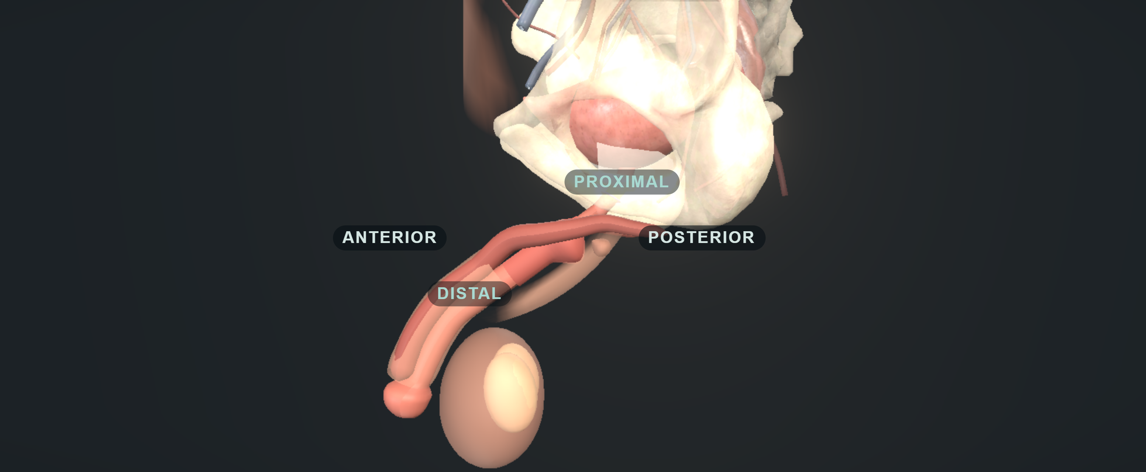
ACT III · THE URETHRA
15 / 38 · 22:00 – 23:15
Three different sites of narrowing
Anatomical distinctions
Anterior stricture: urethra and spongiosum
Bladder-neck contracture: prostate partly present
VUAS: anastomosis after radical prostatectomy
Symptoms, flow, residual and anatomy must support a stable outlet.
EAUSTR26 · BAUS25 · AUA24
Notes:
[Act III · The urethra · Teaching slide 15 of 38 · 22:00-23:15 · 1:15]
THIS SLIDE: Three anatomically different narrowings that the word "stricture" hides.
SAY
The shorthand stricture hides different operations and different risks. An anterior urethral stricture involves the urethra and spongiosum. Bladder-neck contracture commonly follows surgery with part of the prostate still present. After radical prostatectomy, the relevant narrowing is usually the vesicourethral anastomosis. Use the anatomy in the discussion and in the referral.
Review every dilation, urethrotomy and reconstruction, including the operative reports. Establish how quickly the narrowing recurred and whether patency currently depends on repeated calibration. Add imaging when the anatomy, length or reconstructive plan requires it.
We call an outlet stable after a credible interval without recurrence, with symptoms, flow, residual and endoscopic findings that support a durable outlet. A scope that happened to pass once does not show that.
Finally, think ahead. A patient who is likely to need further incision, tumour surveillance or treatment for radiation bleeding needs an access plan before a cuff makes those procedures more complicated.
STUDIES ON THIS SLIDE
• EAUSTR26 — EAU urethral strictures guideline 2026. What it is: European guideline. What it says: Distinguishes anterior strictures from posterior stenosis and gives reconstruction-specific pathways, including deferring continence surgery for three to six months after redo vesicourethral anastomosis. That interval belongs to that setting, not to every dilation or urethroplasty.
• BAUS25 — BAUS consensus 2025 (Bhatt et al., BJU Int). What it is: UK expert consensus after literature review and modified Delphi. What it says: Sets the UK assessment and perioperative pathway: VUDS for surgical candidates, severity-dependent recovery periods, treatment of narrowing before continence surgery, and a five-minute topical field scrub that it labels as Delphi extrapolation. Consensus supports a consistent pathway; it does not prove each interval or step is uniquely optimal.
• AUA24 — AUA/GURS/SUFU incontinence after prostate treatment, amended 2024. What it is: US guideline. What it says: Permits surgery from six months for bothersome non-improving SUI and recommends offering it at one year; cystourethroscopy before SUI surgery is expert opinion; urodynamics is conditional (Grade C) when it helps diagnosis or counselling. It also supports pump suitability, lifetime counselling and interval cystoscopy at least four to six weeks after treating BNC or VUAS.
TRANSITION → Stability is a finding, not a date on the calendar. Here is what the three guidelines actually say about the interval.
Image: UroOps 3D, https://uroops3d.com/lab/aus . Captured 10 October 2026. © UroOps3D / UroRef / Nity G. Teaching schematic with clinical review pending. It illustrates spatial relationships, not validated anatomy, tissue perfusion or operative instructions.

Slide 20
ACT III · THE URETHRA
16 / 38 · 23:15 – 24:45
Reassessment and urethral stability
Guideline | Interval | The relevant pathway
AUA | At least 4–6 weeks | Interval cystoscopy after symptomatic BNC/VUAS treatment
EAU | 3–6 months | Advice after redo vesicourethral anastomosis
BAUS | At least six months without recurrence | After treatment of post-prostatectomy narrowing
These intervals describe different pathways. Recurrence pattern, tissue quality and future access remain decisive.
BAUS25 · AUA24 · EAUSTR26 · ICS16
Notes:
[Act III · The urethra · Teaching slide 16 of 38 · 23:15-24:45 · 1:30]
THIS SLIDE: Three intervals from three guidelines, each describing a different pathway.
SAY
BAUS recommends waiting at least six months after treating a post-prostatectomy narrowing, with no recurrence, before continence surgery. That is a genuine consensus recommendation, although it is not a randomised demonstration that six months is the unique safe interval.
The AUA discussion describes interval cystoscopy at least four to six weeks after treatment of symptomatic bladder-neck contracture or anastomotic stenosis. That is a point for reassessment, with no guarantee that every reconstructed or irradiated urethra is ready for a cuff. EAU's three-to-six-month advice after redo vesicourethral anastomosis belongs to that particular reconstructive setting.
Staged treatment lets us observe recurrence and avoid instrumenting a newly implanted cuff. Synchronous treatment has been reported in selected expert series, but should not become the default for aggressive, recurrent disease.
Our decision would use the recurrence pattern, tissue quality, planned future access and the guideline context. A patient who has repeatedly restenosed after a short interval has not become low risk because the calendar reaches a convenient date.
STUDIES ON THIS SLIDE
• BAUS25 — BAUS consensus 2025 (Bhatt et al., BJU Int). What it is: UK expert consensus after literature review and modified Delphi. What it says: Sets the UK assessment and perioperative pathway: VUDS for surgical candidates, severity-dependent recovery periods, treatment of narrowing before continence surgery, and a five-minute topical field scrub that it labels as Delphi extrapolation. Consensus supports a consistent pathway; it does not prove each interval or step is uniquely optimal.
• AUA24 — AUA/GURS/SUFU incontinence after prostate treatment, amended 2024. What it is: US guideline. What it says: Permits surgery from six months for bothersome non-improving SUI and recommends offering it at one year; cystourethroscopy before SUI surgery is expert opinion; urodynamics is conditional (Grade C) when it helps diagnosis or counselling. It also supports pump suitability, lifetime counselling and interval cystoscopy at least four to six weeks after treating BNC or VUAS.
• EAUSTR26 — EAU urethral strictures guideline 2026. What it is: European guideline. What it says: Distinguishes anterior strictures from posterior stenosis and gives reconstruction-specific pathways, including deferring continence surgery for three to six months after redo vesicourethral anastomosis. That interval belongs to that setting, not to every dilation or urethroplasty.
• ICS16 — ICS AUS consensus 2015, published 2016 (Biardeau et al.). What it is: International consensus, centred on AMS 800. What it says: Covers assessment, operative principles, complications and aftercare: adequate dexterity and cognition, bladder and outlet evaluation, and device-aware instrumentation. Its technical and catheter advice is AMS-era and context-specific, not a universal ContiClassic rule.
TRANSITION → Our third patient brings all of that together, with radiation added.

Slide 21
ACT III · THE URETHRA
17 / 38 · 24:45 – 26:15
Case 3: radiation and recurrent VUAS
FICTIONAL CASE 03
Implant, stage reconstruction or reconsider the endpoint?
Radical prostatectomy and salvage radiotherapy
Severe SUI between endoscopic treatments
YOUR CALL
Recurrent vesicourethral anastomotic stenosis
IMPLANT
STAGE
RECONSIDER
Patency still depends on further intervention
Radiation increases risk. A 2025 timing study does not establish a fixed waiting rule; stable patency and reconstruction come first.
RT22 · BAUS25 · EAUSTR26 · AUA24 · RTTIME25
Notes:
[Act III · The urethra · Teaching slide 17 of 38 · 24:45-26:15 · 1:30]
THIS SLIDE: Case 3: an irradiated, repeatedly re-stenosing anastomosis and a man who wants to be dry now.
SAY
This fictional patient has had radical prostatectomy, salvage radiotherapy and repeated treatment of an anastomotic stenosis. He leaks severely when the outlet is open, but the narrowing returns. He understandably wants continence now.
Would you put an AUS into that pathway? [Pause for six seconds.] Our first answer is to defer the implant and obtain a specialist reconstructive plan. Current patency is not durable, and more endoscopic treatment is likely. We also need to understand the bladder, including compliance and the burden of radiation cystitis.
Radiation is associated with worse continence and greater erosion or explantation risk in pooled observational AUS studies, roughly a doubling of the odds of erosion. Those estimates combine different follow-up periods and case mixes, so they cannot give his personal probability of failure. A 2025 cohort found the same association with cuff removal and hinted at a timing effect, but that trend was not significant and sets no waiting rule.
Definitive reconstruction followed by demonstrated stability and later AUS may be reasonable. In a devastated outlet with unsafe or intolerable bladder function, a different drainage or diversion strategy may ultimately offer the better life. There is more than one defensible endpoint. Repeatedly reopening a narrow lumen is not necessarily progress if it stops us agreeing a durable plan.
STUDIES ON THIS SLIDE
• RT22 — Zhang and Xu 2022: radiation meta-analysis. What it is: Meta-analysis of 18 observational studies. What it says: Prior radiation was associated with lower odds of complete continence and more erosion or explantation (pooled erosion OR about 2.0, 95% CI 1.15–3.45). An odds ratio is not a personal probability, and radiation is a counselling and tissue-planning factor, not an automatic exclusion.
• BAUS25 — BAUS consensus 2025 (Bhatt et al., BJU Int). What it is: UK expert consensus after literature review and modified Delphi. What it says: Sets the UK assessment and perioperative pathway: VUDS for surgical candidates, severity-dependent recovery periods, treatment of narrowing before continence surgery, and a five-minute topical field scrub that it labels as Delphi extrapolation. Consensus supports a consistent pathway; it does not prove each interval or step is uniquely optimal.
• EAUSTR26 — EAU urethral strictures guideline 2026. What it is: European guideline. What it says: Distinguishes anterior strictures from posterior stenosis and gives reconstruction-specific pathways, including deferring continence surgery for three to six months after redo vesicourethral anastomosis. That interval belongs to that setting, not to every dilation or urethroplasty.
• AUA24 — AUA/GURS/SUFU incontinence after prostate treatment, amended 2024. What it is: US guideline. What it says: Permits surgery from six months for bothersome non-improving SUI and recommends offering it at one year; cystourethroscopy before SUI surgery is expert opinion; urodynamics is conditional (Grade C) when it helps diagnosis or counselling. It also supports pump suitability, lifetime counselling and interval cystoscopy at least four to six weeks after treating BNC or VUAS.
• RTTIME25 — Radiation and cuff-removal timing cohort 2025 (Lee et al., World J Urol). What it is: Retrospective cohort, 283 men. What it says: Prior radiation was associated with cuff removal (HR 3.30, 95% CI 1.05–10.40). An exploratory trend towards later implantation after radiation was not significant and validates no waiting rule.
TRANSITION → Suppose he does get his reconstruction. What does a repaired urethra mean for the operation we would do later?

Slide 22
ACT III · THE URETHRA
18 / 38 · 26:15 – 27:45
AUS after urethral reconstruction
The reconstruction history
The next operation
Repair site and operative report
Preserve remaining tissue and attachments
Transecting or non-transecting repair
Select viable cuff-bearing tissue
Prior erosion, graft or posterior reconstruction
Reassess unsafe planes or stage the procedure
2026 meta-analysis: prior urethroplasty is associated with more explantation; transecting repairs carry higher erosion risk. Observational.
URETH26 · BAUS25 · AUA24 · ICS16 · URETHMETA26
Notes:
[Act III · The urethra · Teaching slide 18 of 38 · 26:15-27:45 · 1:30]
THIS SLIDE: How a previous urethroplasty changes the tissue available and the dissection we plan.
SAY
Previous urethroplasty covers several different operations. Was the urethra transected? Was there a graft, a posterior reconstruction, a prior cuff erosion or a fistula? Where is the viable spongiosum now? Those details should change where and how we dissect.
The operation must preserve what remains. Avoid extending mobilisation through a repaired segment unless it is needed. A technically convenient cuff site may have poor tissue. If a safe plane cannot be established, pause and reconsider the approach or stage the operation.
Davis's multicentre cohort reports very different later AUS outcomes after transecting and non-transecting urethroplasty, and the 2026 meta-analysis of 533 men points the same way: prior urethroplasty roughly doubles explantation, and transecting repairs carry more erosion and explantation. It adds evidence beyond the older guidance, but it remains observational. Stricture severity, anatomy, selection and unequal follow-up confound the comparison. It supports a more detailed reconstructive history and careful counselling; it cannot support a claim that every transection was avoidable.
The practical point is to plan the reconstruction and any future continence surgery together. After previous erosion and explantation, healing, patency and realistic reimplantation expectations need to be demonstrated again.
STUDIES ON THIS SLIDE
• URETH26 — Davis et al. 2026: AUS after urethroplasty. What it is: Retrospective multicentre series, 178 cases, 15 institutions. What it says: Complications requiring explantation occurred in 56.2% after transecting versus 23.5% after non-transecting urethroplasty. Selection, stricture severity and follow-up confound the comparison; it supports a detailed reconstructive history, not a claim that every transection was avoidable.
• BAUS25 — BAUS consensus 2025 (Bhatt et al., BJU Int). What it is: UK expert consensus after literature review and modified Delphi. What it says: Sets the UK assessment and perioperative pathway: VUDS for surgical candidates, severity-dependent recovery periods, treatment of narrowing before continence surgery, and a five-minute topical field scrub that it labels as Delphi extrapolation. Consensus supports a consistent pathway; it does not prove each interval or step is uniquely optimal.
• AUA24 — AUA/GURS/SUFU incontinence after prostate treatment, amended 2024. What it is: US guideline. What it says: Permits surgery from six months for bothersome non-improving SUI and recommends offering it at one year; cystourethroscopy before SUI surgery is expert opinion; urodynamics is conditional (Grade C) when it helps diagnosis or counselling. It also supports pump suitability, lifetime counselling and interval cystoscopy at least four to six weeks after treating BNC or VUAS.
• ICS16 — ICS AUS consensus 2015, published 2016 (Biardeau et al.). What it is: International consensus, centred on AMS 800. What it says: Covers assessment, operative principles, complications and aftercare: adequate dexterity and cognition, bladder and outlet evaluation, and device-aware instrumentation. Its technical and catheter advice is AMS-era and context-specific, not a universal ContiClassic rule.
• URETHMETA26 — Prior urethroplasty meta-analysis 2026 (Deameh et al., Urology). What it is: Meta-analysis of four observational studies, 533 men. What it says: Prior urethroplasty was associated with higher explantation (RR 2.05, 95% CI 1.08–3.89); the pooled erosion difference was not significant. Transecting versus non-transecting repair was associated with more erosion (RR 2.34) and explantation (RR 2.38). Observational and partly overlapping with Davis; not causal.
TRANSITION → When the dorsal plane is hostile, one option is to go through the corpora. It is an option with a price.

Slide 23
ACT III · THE URETHRA
19 / 38 · 27:45 – 29:00
Transcorporal placement: role and costs
Selected role
Costs and limitations
A hazardous dorsal dissection plane
Corporal injury and bleeding
A manoeuvre addressing a defined dissection problem
Sexual consequences and future prosthesis surgery
Comparative erosion protection remains uncertain
Confounding by indication in comparative series
Latest systematic review suggests less erosion but more revision. Non-randomised data do not prove causal protection.
TC20 · TC23 · BAUS25 · AP23 · TCSYS25
Notes:
[Act III · The urethra · Teaching slide 19 of 38 · 27:45-29:00 · 1:15]
THIS SLIDE: Transcorporal placement: a manoeuvre for a defined problem, with real costs and uncertain protection.
SAY
Transcorporal placement can avoid a hazardous dorsal dissection and include tunical tissue beneath part of the cuff. That is a plausible reconstructive purpose, but it does not prove protection from erosion.
The comparative retrospective evidence points in different directions. Redmond's fragile-urethra series favoured it numerically. Kurtzman's high-risk series found more infection or erosion-related explantation in the transcorporal group. The latest systematic review pools twenty studies and suggests less erosion but more revision. Surgeons tend to select it for the worst urethras, so confounding by indication is substantial in both directions.
Discuss corporal bleeding, erectile consequences and the implications for an existing or future penile prosthesis. Sizing must account for the tissue actually enclosed, using the relevant device protocol and no improvised correction factor.
Tandem cuffs, wraps, relocation and capsular procedures also consume tissue or add complexity. Choose a manoeuvre because it addresses a demonstrated problem, and state its limitation. If the proposal is simply to squeeze a failing urethra harder, the diagnosis and the endpoint need another look.
STUDIES ON THIS SLIDE
• TC20 — Redmond et al. 2020: transcorporal placement in fragile urethras. What it is: Retrospective series, 76 patients, 24 transcorporal. What it says: Revision 20.8% versus 36.5% and erosion 8.3% versus 17.3%, numerically favouring transcorporal placement, but the erosion difference was not statistically significant and allocation was not randomised.
• TC23 — Kurtzman et al. 2023: high-risk transcorporal AUS. What it is: Retrospective single-surgeon high-risk cohort, 68 men, 77 cuffs. What it says: Transcorporal placement was associated with more infection or erosion-related explants (HR 2.74). Surgeons may have chosen it for the worst tissue, so it cannot prove the technique caused harm. With Redmond it blocks any confident claim of erosion protection.
• BAUS25 — BAUS consensus 2025 (Bhatt et al., BJU Int). What it is: UK expert consensus after literature review and modified Delphi. What it says: Sets the UK assessment and perioperative pathway: VUDS for surgical candidates, severity-dependent recovery periods, treatment of narrowing before continence surgery, and a five-minute topical field scrub that it labels as Delphi extrapolation. Consensus supports a consistent pathway; it does not prove each interval or step is uniquely optimal.
• AP23 — Asia-Pacific AMS 800 consensus 2023 (Chung et al.). What it is: Regional expert consensus. What it says: Practical consensus on selection, investigation, troubleshooting and aftercare, including common AMS 800 pressure selection (61–70 cmH2O) and preparation. Its fill volumes and preparation sequence belong to AMS 800, not automatically to ContiClassic.
• TCSYS25 — Transcorporal placement systematic review, online 2025 (Domínguez Gutiérrez et al.). What it is: Systematic review, 20 studies, eight comparative. What it says: Transcorporal placement was associated with more revisions (OR 2.99), less erosion (OR 0.35) and less infection (OR 0.33), with no significant explantation difference. Non-randomised, heterogeneous risk selection, and the pooled estimates conflict with some cohorts.
TRANSITION → That is the urethra. Now a different kind of decision: the things we do before the skin is opened, and whether the evidence supports them.

Slide 24
ACT
29:00 – 36:00 · 7 MINUTES
IV
20
The fifteen-minute wash question
21
Skin culture reduction and clinical infection
22
Urine and antibiotic disagreements
23
Contamination control during implantation
Preparation without ritual
24
The pre-implant theatre checklist
Identify the activity, the product and the evidence before debating a duration.
Decide before theatre
The bladder
The urethra
Preparation without ritual
The operation
After the implant
Notes:
[Act IV · Preparation without ritual · 29:00 – 36:00 · 7 minutes · teaching slides 20–24]
Transition slide; it takes no time from the clock. Read the act title, say the one-line question, and move on.
SAY
"Identify the activity, the product and the evidence before debating a duration."

Slide 25
ACT IV · PREPARATION WITHOUT RITUAL
20 / 38 · 29:00 – 30:15
The fifteen-minute wash question
No direct AUS outcome evidence establishes a fixed 15-minute preparation
1
Patient washing
2
Skin preparation
Preoperative hygiene
Correct product, site, contact and drying
3
Hand antisepsis
4
Irrigation and device preparation
The team’s hands and forearms
Separate interventions and compatibility rules
BAUS’s five-minute topical field scrub is consensus with extrapolation. Product timings address different activities.
BAUS25 · NICE · WHO09 · PREP24 · IRRIG26
Notes:
[Act IV · Preparation without ritual · Teaching slide 20 of 38 · 29:00-30:15 · 1:15]
THIS SLIDE: The fifteen-minute wash: first identify which activity we mean.
SAY
Is a fifteen-minute wash or scrub necessary before AUS implantation? We found no direct evidence that establishes a universal requirement.
NICE advises soap washing the day before or the day of surgery. That is different from operative skin preparation, surgical hand antisepsis, wound irrigation, external device dipping and internal device filling. Identify the activity before debating its duration.
BAUS recommends a five-minute topical field scrub by Delphi consensus, and acknowledges that this is extrapolated from penile prosthesis and other implant surgery. It does not establish fifteen minutes as an AUS standard. For hands, use the selected product's surgical antisepsis instructions. For the patient's skin, use the appropriate product and its application, contact and complete drying requirements.
Waiting fifteen minutes cannot compensate for missed skin, an unsuitable product, pooled alcohol or a contaminated field. The lack of evidence for this ritual does not make antisepsis dispensable. We need correct, reproducible preparation.
STUDIES ON THIS SLIDE
• BAUS25 — BAUS consensus 2025 (Bhatt et al., BJU Int). What it is: UK expert consensus after literature review and modified Delphi. What it says: Sets the UK assessment and perioperative pathway: VUDS for surgical candidates, severity-dependent recovery periods, treatment of narrowing before continence surgery, and a five-minute topical field scrub that it labels as Delphi extrapolation. Consensus supports a consistent pathway; it does not prove each interval or step is uniquely optimal.
• NICE — NICE NG125: surgical site infection. What it is: UK national guidance. What it says: Soap washing before surgery, appropriate antiseptic skin preparation with drying, clipping rather than shaving if hair removal is needed, and no wound irrigation solely to reduce SSI. It tests no fifteen-minute AUS preparation.
• WHO09 — WHO hand hygiene guidance 2009. What it is: International standard. What it says: Covers surgical hand antisepsis. Its relevance is the distinction between preparing the team's hands and preparing the patient's skin. It sets no patient-field scrub duration.
• PREP24 — Bourgi et al. 2024: AMS 800 skin-preparation protocols. What it is: Retrospective sequential-era comparison, 156 procedures. What it says: Intensified povidone preparation showed no association with device removal (OR 0.97, 95% CI 0.28–3.37). Wide interval, era confounding and inconsistent reporting; it never compared fifteen minutes against a shorter preparation.
• IRRIG26 — Gentamicin withdrawal cohort 2026 (Skrzypczyk et al., Antibiotics). What it is: Single-centre before-after study, 173 uncoated AMS 800 procedures. What it says: 90-day SSI 1 of 59 with gentamicin versus 2 of 114 without (difference +0.1 points, 95% CI −7.4 to +4.7). Three events in total, immersion and irrigation changed together, and broad systemic prophylaxis continued. Not equivalence, and not transferable to coated AMS 800 or ContiClassic.
TRANSITION → What the studies can actually support is narrower than the folklore, and here is the best of them.

Slide 26
ACT IV · PREPARATION WITHOUT RITUAL
21 / 38 · 30:15 – 32:00
Skin culture reduction and clinical infection
A microbiological endpoint
Positive post-preparation skin cultures
Direct AUS infection evidence remains limited
Correct product, anatomy and complete drying still matter
Yeung 2013: 100 initial GU prosthetic procedures, 50 per arm. Immediate skin cultures, not AUS infection or a duration trial.
YEUNG13 · PREP24 · NICE · CHLORA26 · BAUS25
Notes:
[Act IV · Preparation without ritual · Teaching slide 21 of 38 · 30:15-32:00 · 1:45]
THIS SLIDE: One good randomised trial with a surrogate endpoint: skin cultures, not implant infections.
SAY
In a randomised study of one hundred patients having initial genitourinary prosthetic surgery, chlorhexidine-alcohol produced fewer positive post-preparation skin cultures than povidone-iodine. The reported proportions were eight versus thirty-two per cent. That is a microbiological endpoint in a mixed prosthesis population. The study did not show fewer ContiClassic infections.
A later retrospective AMS 800 study compared different povidone preparation protocols. It did not show an advantage for the intensified protocol, but era effects, reporting inconsistencies and limited follow-up reporting weaken the inference. It did not compare fifteen minutes against a shorter preparation.
General SSI guidance supports an appropriate alcohol-based preparation where suitable, with alternatives for contraindications or anatomical requirements. The exact product matters around genital skin and mucosa. Check allergy, permitted application sites and the product information before applying a study's formulation to every field.
Do not remove hair routinely. If it is required for exposure or adhesion, clipping on the day is the general NICE recommendation, and avoid skin trauma. Before draping and diathermy, confirm drying and the absence of pooling in skin folds or under the patient. Those are practical safety requirements, whatever the stopwatch says.
STUDIES ON THIS SLIDE
• YEUNG13 — Yeung et al. 2013: GU prosthetic skin preparation RCT. What it is: Single-centre randomised trial, 100 initial GU prosthetic procedures, 50 per arm. What it says: Post-preparation skin cultures were positive in 8% with chlorhexidine-alcohol versus 32% with povidone-iodine (P = 0.0091). A microbiological surrogate in a mixed-device population; it did not show fewer AUS infections and tested no duration.
• PREP24 — Bourgi et al. 2024: AMS 800 skin-preparation protocols. What it is: Retrospective sequential-era comparison, 156 procedures. What it says: Intensified povidone preparation showed no association with device removal (OR 0.97, 95% CI 0.28–3.37). Wide interval, era confounding and inconsistent reporting; it never compared fifteen minutes against a shorter preparation.
• NICE — NICE NG125: surgical site infection. What it is: UK national guidance. What it says: Soap washing before surgery, appropriate antiseptic skin preparation with drying, clipping rather than shaving if hair removal is needed, and no wound irrigation solely to reduce SSI. It tests no fifteen-minute AUS preparation.
• CHLORA26 — ChloraPrep Swabstick UK product information, 2026. What it is: Product information (SmPC). What it says: Permitted sites, allergy, intact-skin-only use, a 30-second application with complete air drying and flammability warnings for that presentation. It shows why the actual formulation matters; it is not a universal genital preparation prescription.
• BAUS25 — BAUS consensus 2025 (Bhatt et al., BJU Int). What it is: UK expert consensus after literature review and modified Delphi. What it says: Sets the UK assessment and perioperative pathway: VUDS for surgical candidates, severity-dependent recovery periods, treatment of narrowing before continence surgery, and a five-minute topical field scrub that it labels as Delphi extrapolation. Consensus supports a consistent pathway; it does not prove each interval or step is uniquely optimal.
TRANSITION → Skin is one disagreement. Urine and antibiotics are another, and here the sources genuinely conflict.

Slide 27
ACT IV · PREPARATION WITHOUT RITUAL
22 / 38 · 32:00 – 33:30
Urine and antibiotic disagreements
Question | Evidence or instruction
Symptomatic infection | Treat and reassess before implantation
Asymptomatic bacteriuria | BAUS urine pathway and IDSA’s AUS-specific position differ
Prophylaxis | Complete before incision and plan appropriate redosing
Postoperative antibiotics | Older observational data show no clear benefit; retrieved ContiClassic IFU differs.
AUA 2026 IP09-18 addresses postoperative antibiotics; full results unverified. Reconcile regional IFU and local microbiology policy.
IDSA19 · BAUS25 · AUAABX20 · ABX18 · CCIFU · AUAABX26
Notes:
[Act IV · Preparation without ritual · Teaching slide 22 of 38 · 32:00-33:30 · 1:30]
THIS SLIDE: Four questions where guidance, evidence and the device label disagree, stated openly.
SAY
Treat symptomatic urinary infection and reassess before elective implantation. Asymptomatic bacteriuria is different.
BAUS asks for a preoperative urine sample and treatment of infection. IDSA specifically suggests against screening for or treating asymptomatic bacteriuria solely for AUS implantation, although that recommendation rests on very low-quality evidence. Procedures involving urinary mucosal trauma are a separate situation.
Agree the urine pathway with local microbiology, and do not equate every positive culture with symptomatic infection. Choose prophylaxis using the implant policy, previous isolates, allergies and renal function. Complete administration at the appropriate time before incision, and redose when the agent and procedure require it.
Observational AUS evidence has not shown a convincing benefit from routine postoperative oral antibiotics; Adamsky's claims cohort found explantation rates of 3.9 and 4.0 per cent with and without them. However, the retrieved ContiClassic IFU describes forty-eight hours of intravenous antibiotics and five days of oral antibiotics after discharge as general care. That conflicts with shorter-prophylaxis stewardship approaches. We would respond by verifying current regional labelling and agreeing a documented protocol with the implant service and microbiology. Do not silently ignore either source, and do not describe an extended regimen as universally proven to prevent infection.
STUDIES ON THIS SLIDE
• IDSA19 — IDSA asymptomatic bacteriuria guideline 2019 (Nicolle et al.). What it is: US infectious-disease guideline. What it says: Suggests against screening for or treating asymptomatic bacteriuria solely for AUS or penile prosthesis implantation, with standard prophylaxis retained. The recommendation is weak, on very-low-quality evidence, and differs from the BAUS urine pathway.
• BAUS25 — BAUS consensus 2025 (Bhatt et al., BJU Int). What it is: UK expert consensus after literature review and modified Delphi. What it says: Sets the UK assessment and perioperative pathway: VUDS for surgical candidates, severity-dependent recovery periods, treatment of narrowing before continence surgery, and a five-minute topical field scrub that it labels as Delphi extrapolation. Consensus supports a consistent pathway; it does not prove each interval or step is uniquely optimal.
• AUAABX20 — AUA antimicrobial prophylaxis statement 2020 (Lightner et al.). What it is: Consensus statement informed by literature review. What it says: Correct timing, redosing and the shortest necessary duration; single-dose prophylaxis for most urological procedures and no unnecessary continuation. It does not settle every high-risk implant or override product precautions.
• ABX18 — Adamsky et al. 2018: postoperative oral antibiotics. What it is: Claims-based observational study, 3,594 AUS recipients. What it says: Explantation within three months was 3.9% with and 4.0% without postoperative oral antibiotics, with no protective association after adjustment. It challenges routine prolonged oral prophylaxis; it cannot prove identical safety in every subgroup.
• CCIFU — Rigicon ContiClassic instructions for use, REV.03, 2023. What it is: Manufacturer labelling. What it says: Requires associated urge, overflow or instability to be treated and controlled or resolved, contraindicates irresolvable instability, warns about poor compliance and thin spongiosum, requires cuff deflation and deactivation before instrumentation, specifies four to six weeks deactivated, and describes a longer postoperative antibiotic regimen than stewardship sources. These are product instructions, not proof of efficacy. Country and lot applicability and the separate OR protocol remain unverified.
• AUAABX26 — AUA 2026 abstract IP09-18: postoperative antibiotics. What it is: Conference abstract, title and programme verified only. What it says: Its title states no infection benefit from postoperative antibiotics. Full methods and results were unavailable; nothing numerical is inferred.
TRANSITION → Once the patient is prepared, the remaining risk is what we do with our hands and the implant.

Slide 28
ACT IV · PREPARATION WITHOUT RITUAL
23 / 38 · 33:30 – 35:00
Contamination control during implantation
1
Protect the implant until the field is ready
2
Limit skin contact and unnecessary handling
3
Use fresh sterile gloves and a clean handling pause
4
Separate irrigation, device dipping and internal filling
2026 uncoated AMS 800 cohort: 90-day SSI 1/59 with gentamicin versus 2/114 without. Wide uncertainty; no equivalence proof.
TOUCH23 · NICE · AP23 · CCIFU · IRRIG26
Notes:
[Act IV · Preparation without ritual · Teaching slide 23 of 38 · 33:30-35:00 · 1:30]
THIS SLIDE: Four practical contamination controls, offered as rationale rather than proof.
SAY
There are sensible ways to reduce contamination. Prepare the equipment before opening the implant, establish a protected sterile handling area, minimise skin contact, and avoid unnecessary traffic and repeated hand-offs.
Our preference is fresh sterile gloves before handling the device and after any contamination concern. We offer that as a practical control, without claiming that each glove change has been proven to reduce AUS infection. Minimal-touch AUS series are encouraging, but they compare different eras and unequal follow-up. We cannot attribute their results to one drape or one manoeuvre.
Separate wound irrigation from device dipping and internal filling. General NICE guidance does not support wound irrigation solely to prevent SSI. AUS consensus literature also acknowledges uncertainty about antibiotic irrigants. The 2026 gentamicin-withdrawal cohort saw one infection in 59 procedures with gentamicin and two in 114 without; three events cannot prove equivalence, and immersion and irrigation changed together. A hydrophilic coating's ability to absorb a solution does not establish that any chosen antibiotic mixture improves clinical outcomes.
For ContiClassic, follow the verified device instructions and obtain the operative protocol for detailed preparation. Do not substitute a remembered AMS 800 recipe or improvise an unverified antiseptic bath for an implant.
STUDIES ON THIS SLIDE
• TOUCH23 — Ziegelmann et al. 2023: minimal-touch AUS technique. What it is: Historical comparison of a contamination-control bundle. What it says: Crude infections appeared lower after the bundle, but twelve-month cumulative incidence differences were not statistically significant. A sensible bundle to study; it cannot credit one glove change, drape or pause.
• NICE — NICE NG125: surgical site infection. What it is: UK national guidance. What it says: Soap washing before surgery, appropriate antiseptic skin preparation with drying, clipping rather than shaving if hair removal is needed, and no wound irrigation solely to reduce SSI. It tests no fifteen-minute AUS preparation.
• AP23 — Asia-Pacific AMS 800 consensus 2023 (Chung et al.). What it is: Regional expert consensus. What it says: Practical consensus on selection, investigation, troubleshooting and aftercare, including common AMS 800 pressure selection (61–70 cmH2O) and preparation. Its fill volumes and preparation sequence belong to AMS 800, not automatically to ContiClassic.
• CCIFU — Rigicon ContiClassic instructions for use, REV.03, 2023. What it is: Manufacturer labelling. What it says: Requires associated urge, overflow or instability to be treated and controlled or resolved, contraindicates irresolvable instability, warns about poor compliance and thin spongiosum, requires cuff deflation and deactivation before instrumentation, specifies four to six weeks deactivated, and describes a longer postoperative antibiotic regimen than stewardship sources. These are product instructions, not proof of efficacy. Country and lot applicability and the separate OR protocol remain unverified.
• IRRIG26 — Gentamicin withdrawal cohort 2026 (Skrzypczyk et al., Antibiotics). What it is: Single-centre before-after study, 173 uncoated AMS 800 procedures. What it says: 90-day SSI 1 of 59 with gentamicin versus 2 of 114 without (difference +0.1 points, 95% CI −7.4 to +4.7). Three events in total, immersion and irrigation changed together, and broad systemic prophylaxis continued. Not equivalence, and not transferable to coated AMS 800 or ContiClassic.
TRANSITION → All of this collapses into one checklist that the whole team runs before the implant is opened.

Slide 29
ACT IV · PREPARATION WITHOUT RITUAL
24 / 38 · 35:00 – 36:00
The pre-implant theatre checklist
Check | Basis
Indication, infection review, prophylaxis and asepsis | Guidance-supported
Antiseptic, drying, antibiotic choice and redosing | Product and local policy
Model, sizes, pressure, preparation and drainage | Current device instructions and local plan
Clean handling pause and contamination response | Expert implementation
Fixed 15 minutes, best irrigant, prolonged prophylaxis | Unresolved evidence
NICE · BAUS25 · CCIFU · AUAABX20 · IRRIG26
Notes:
[Act IV · Preparation without ritual · Teaching slide 24 of 38 · 35:00-36:00 · 1:00]
THIS SLIDE: The checklist we would actually use, with each row labelled by the kind of authority behind it.
SAY
Before opening the implant, confirm the patient, intended operation, tissue concerns and stop conditions. Review urinary and skin infection concerns, prophylaxis delivery and the redosing plan. Confirm that the preparation is anatomically suitable and dry.
Then confirm the exact device and compatible components, available cuff sizes, planned pressure range, current instructions and the person responsible for preparation. Agree the catheter and postoperative rescue plan.
Finally, establish what happens if the urethra is injured or sterility is compromised. A checklist is most useful when it makes that response predictable. Notice the last row: a fixed fifteen minutes, the best irrigant and prolonged prophylaxis sit there as unresolved evidence, not as requirements.
Audit completion of these steps. The duration of a wash is not a measure of the quality of the whole operation.
STUDIES ON THIS SLIDE
• NICE — NICE NG125: surgical site infection. What it is: UK national guidance. What it says: Soap washing before surgery, appropriate antiseptic skin preparation with drying, clipping rather than shaving if hair removal is needed, and no wound irrigation solely to reduce SSI. It tests no fifteen-minute AUS preparation.
• BAUS25 — BAUS consensus 2025 (Bhatt et al., BJU Int). What it is: UK expert consensus after literature review and modified Delphi. What it says: Sets the UK assessment and perioperative pathway: VUDS for surgical candidates, severity-dependent recovery periods, treatment of narrowing before continence surgery, and a five-minute topical field scrub that it labels as Delphi extrapolation. Consensus supports a consistent pathway; it does not prove each interval or step is uniquely optimal.
• CCIFU — Rigicon ContiClassic instructions for use, REV.03, 2023. What it is: Manufacturer labelling. What it says: Requires associated urge, overflow or instability to be treated and controlled or resolved, contraindicates irresolvable instability, warns about poor compliance and thin spongiosum, requires cuff deflation and deactivation before instrumentation, specifies four to six weeks deactivated, and describes a longer postoperative antibiotic regimen than stewardship sources. These are product instructions, not proof of efficacy. Country and lot applicability and the separate OR protocol remain unverified.
• AUAABX20 — AUA antimicrobial prophylaxis statement 2020 (Lightner et al.). What it is: Consensus statement informed by literature review. What it says: Correct timing, redosing and the shortest necessary duration; single-dose prophylaxis for most urological procedures and no unnecessary continuation. It does not settle every high-risk implant or override product precautions.
• IRRIG26 — Gentamicin withdrawal cohort 2026 (Skrzypczyk et al., Antibiotics). What it is: Single-centre before-after study, 173 uncoated AMS 800 procedures. What it says: 90-day SSI 1 of 59 with gentamicin versus 2 of 114 without (difference +0.1 points, 95% CI −7.4 to +4.7). Three events in total, immersion and irrigation changed together, and broad systemic prophylaxis continued. Not equivalence, and not transferable to coated AMS 800 or ContiClassic.
TRANSITION → Now into theatre. The next eight slides follow the operation in order, and the model will show us each space.

Slide 30
ACT
36:00 – 50:00 · 14 MINUTES
V
25
Positioning and exposure
26
Bulbar dissection and tissue preservation
27
Cuff measurement and fit
28
Urethral injury or contamination
The operation
29
Balloon pocket and pressure selection
30
Pump position and patient access
Preserve tissue, measure what the cuff will enclose, follow the actual device protocol, and verify before closing.
31
System checks and handover
32
UroOps 3D: anatomy and component routes
Decide before theatre
The bladder
The urethra
Preparation without ritual
The operation
After the implant
Notes:
[Act V · The operation · 36:00 – 50:00 · 14 minutes · teaching slides 25–32]
Transition slide; it takes no time from the clock. Read the act title, say the one-line question, and move on.
SAY
"Preserve tissue, measure what the cuff will enclose, follow the actual device protocol, and verify before closing."

Slide 31
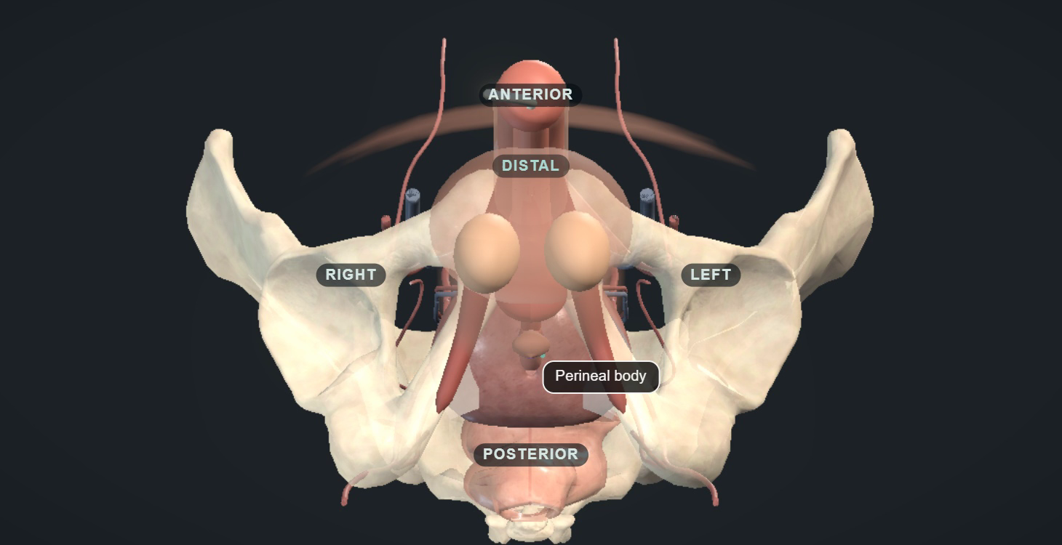
ACT V · THE OPERATION
25 / 38 · 36:00 – 37:15
Positioning and exposure
The access plan
Respect hip mobility and protect pressure points
Plan perineal, abdominal and pump access together
Review scars, mesh, previous devices and repairs
Improve limited exposure before further dissection
AUA24 · ICS16 · AP23
Notes:
[Act V · The operation · Teaching slide 25 of 38 · 36:00-37:15 · 1:15]
THIS SLIDE: Positioning that serves the anatomy we have, and an access plan for all three components.
SAY
Positioning should expose the bulbar urethra while protecting pressure points and respecting hip mobility. Check the patient before anaesthesia when restricted movement is likely to matter. Do not accept excessive flexion simply because it improves the first view.
For a standard male bulbar implant, a single-cuff perineal approach has guideline support. Other approaches may be appropriate for selected anatomy and experienced operators, but convenience alone should not determine access to a compromised urethra.
Plan where the balloon and pump will go at the same time. Previous pelvic surgery, inguinal mesh, abdominal scars and an existing penile prosthesis alter that plan. Have the relevant operative records available.
If exposure is poor, improve the incision, retraction or positioning deliberately. Excessive traction to compensate for a small working space transfers force to the urethra. The purpose of exposure is to make the next decision visible, and a shorter incision is not worth losing that.
STUDIES ON THIS SLIDE
• AUA24 — AUA/GURS/SUFU incontinence after prostate treatment, amended 2024. What it is: US guideline. What it says: Permits surgery from six months for bothersome non-improving SUI and recommends offering it at one year; cystourethroscopy before SUI surgery is expert opinion; urodynamics is conditional (Grade C) when it helps diagnosis or counselling. It also supports pump suitability, lifetime counselling and interval cystoscopy at least four to six weeks after treating BNC or VUAS.
• ICS16 — ICS AUS consensus 2015, published 2016 (Biardeau et al.). What it is: International consensus, centred on AMS 800. What it says: Covers assessment, operative principles, complications and aftercare: adequate dexterity and cognition, bladder and outlet evaluation, and device-aware instrumentation. Its technical and catheter advice is AMS-era and context-specific, not a universal ContiClassic rule.
• AP23 — Asia-Pacific AMS 800 consensus 2023 (Chung et al.). What it is: Regional expert consensus. What it says: Practical consensus on selection, investigation, troubleshooting and aftercare, including common AMS 800 pressure selection (61–70 cmH2O) and preparation. Its fill volumes and preparation sequence belong to AMS 800, not automatically to ContiClassic.
TRANSITION → With the urethra exposed, the next decisions are about which tissue the cuff will sit on, and how much of it we disturb.
Animation and image: UroOps 3D, https://uroops3d.com/lab/aus . Captured 10 October 2026. © UroOps3D / UroRef / Nity G. Teaching schematic with clinical review pending. It illustrates spatial relationships, not validated anatomy, tissue perfusion or operative instructions. The clip starts and loops by itself in slide-show mode.

Slide 32
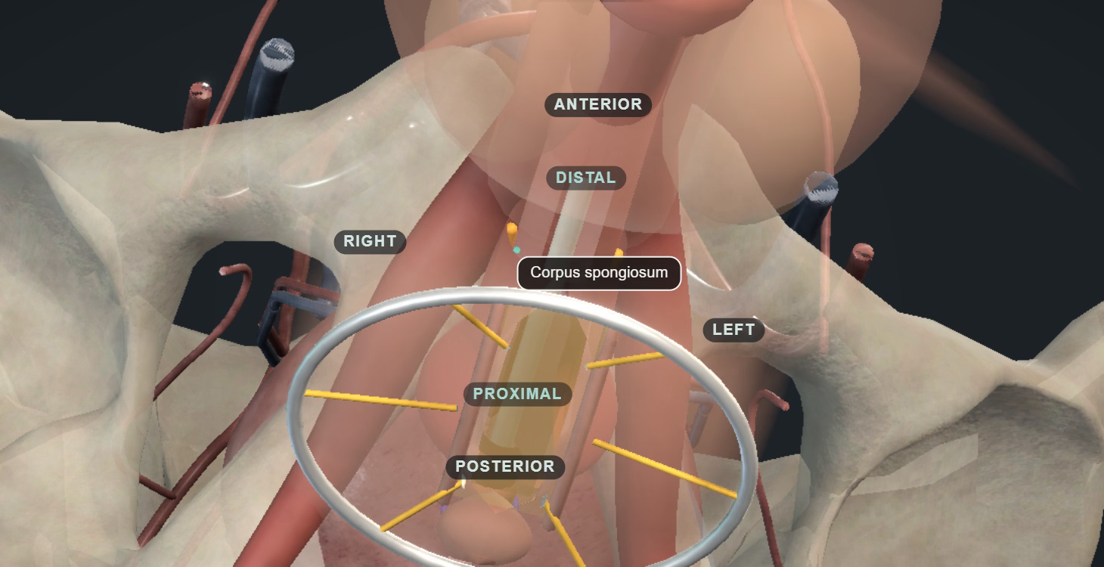
ACT V · THE OPERATION
26 / 38 · 37:15 – 38:45
Bulbar dissection and tissue preservation
The cuff-bearing segment
Viable tissue with adequate spongiosal support
Dorsal dissection under direct control
Mobilisation limited to the required length
Uncertain plane or integrity prompts reassessment
ICS16 · AP23 · CCIFU · URETH26
Notes:
[Act V · The operation · Teaching slide 26 of 38 · 37:15-38:45 · 1:30]
THIS SLIDE: The cuff-bearing segment: enough controlled exposure, and no more mobilisation than the cuff needs.
SAY
The goal is a cuff around a viable urethral segment, not a completely skeletonised urethra. In a straightforward case, the proximal bulbar region often offers useful spongiosal tissue. Prior repair, erosion or scarring may change which segment is safest.
The dorsal relationship to the corporal bodies is where a small error can become a full-thickness injury. Use controlled dissection with a clear view of the plane. Do not pass an instrument blindly behind the urethra and assume that resistance is a harmless adhesion.
Preserve spongiosum and vascular attachments, limit circumferential mobilisation to what the cuff requires, and control bleeding without indiscriminate thermal injury. In scarred tissue, repeated forceful spreading can do more damage than a deliberate change of approach.
If the plane disappears, stop. Improve the view, reassess the site or seek reconstructive help. Transcorporal placement may be an option in selected hands, but it should be a considered plan with consent and appropriate expertise. Tissue preservation has a clear biological rationale. The contribution of each manoeuvre to erosion prevention has not been separated in high-quality comparative trials.
STUDIES ON THIS SLIDE
• ICS16 — ICS AUS consensus 2015, published 2016 (Biardeau et al.). What it is: International consensus, centred on AMS 800. What it says: Covers assessment, operative principles, complications and aftercare: adequate dexterity and cognition, bladder and outlet evaluation, and device-aware instrumentation. Its technical and catheter advice is AMS-era and context-specific, not a universal ContiClassic rule.
• AP23 — Asia-Pacific AMS 800 consensus 2023 (Chung et al.). What it is: Regional expert consensus. What it says: Practical consensus on selection, investigation, troubleshooting and aftercare, including common AMS 800 pressure selection (61–70 cmH2O) and preparation. Its fill volumes and preparation sequence belong to AMS 800, not automatically to ContiClassic.
• CCIFU — Rigicon ContiClassic instructions for use, REV.03, 2023. What it is: Manufacturer labelling. What it says: Requires associated urge, overflow or instability to be treated and controlled or resolved, contraindicates irresolvable instability, warns about poor compliance and thin spongiosum, requires cuff deflation and deactivation before instrumentation, specifies four to six weeks deactivated, and describes a longer postoperative antibiotic regimen than stewardship sources. These are product instructions, not proof of efficacy. Country and lot applicability and the separate OR protocol remain unverified.
• URETH26 — Davis et al. 2026: AUS after urethroplasty. What it is: Retrospective multicentre series, 178 cases, 15 institutions. What it says: Complications requiring explantation occurred in 56.2% after transecting versus 23.5% after non-transecting urethroplasty. Selection, stricture severity and follow-up confound the comparison; it supports a detailed reconstructive history, not a claim that every transection was avoidable.
TRANSITION → Once the segment is chosen, we measure it. And measurement is where the most avoidable errors live.
Animation and image: UroOps 3D, https://uroops3d.com/lab/aus . Captured 10 October 2026. © UroOps3D / UroRef / Nity G. Teaching schematic with clinical review pending. It illustrates spatial relationships, not validated anatomy, tissue perfusion or operative instructions. The clip starts and loops by itself in slide-show mode.

Slide 33
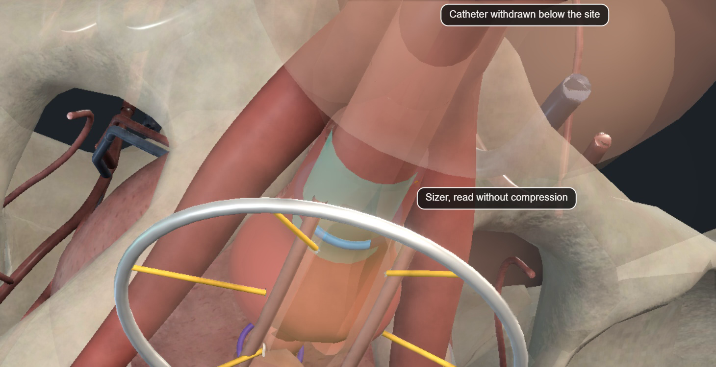
ACT V · THE OPERATION
27 / 38 · 38:45 – 40:30
Cuff measurement and fit
Sizing errors
Release traction and artificial compression
Confirm which tissue the cuff will enclose
Use the exact system’s supplied sizing method
Recheck poor fit rather than increasing pressure
ICS16 · CCIFU · CCSAFETY · AP23
Notes:
[Act V · The operation · Teaching slide 27 of 38 · 38:45-40:30 · 1:45]
THIS SLIDE: Measuring the tissue the cuff will actually enclose, with the device's own method.
SAY
Measurement fails when the tissue being measured is not the tissue the cuff will finally enclose. Retraction can stretch the urethra, and a tight measuring tape can compress it. Included fat, scar or muscle can enlarge the apparent circumference, and haematoma and tissue distortion add further uncertainty.
Relax the traction, confirm the plane and use the manufacturer's sizing method. Recheck an implausible reading; do not select the familiar size from memory. In a reconstruction or transcorporal operation the enclosed tissue is different, so do not apply an unsupported numerical adjustment simply because it is traditional.
Too small a cuff can cause excessive compression, retention and tissue injury. Too large a cuff can leave poor coaptation and persistent leakage. Neither problem is reliably solved by choosing a stronger pressure-regulating balloon. Assess the final relationship and device function, with an appropriate integrity check when indicated. If the finding and the measurement disagree, investigate the discrepancy.
The early ContiClassic safety series included revisions attributed to sizing errors, four of its eight. That reinforces the importance of this step without telling us which sizing strategy is superior. More available sizes may help a surgeon choose a fit. Their availability alone is not evidence of better long-term continence or less erosion.
STUDIES ON THIS SLIDE
• ICS16 — ICS AUS consensus 2015, published 2016 (Biardeau et al.). What it is: International consensus, centred on AMS 800. What it says: Covers assessment, operative principles, complications and aftercare: adequate dexterity and cognition, bladder and outlet evaluation, and device-aware instrumentation. Its technical and catheter advice is AMS-era and context-specific, not a universal ContiClassic rule.
• CCIFU — Rigicon ContiClassic instructions for use, REV.03, 2023. What it is: Manufacturer labelling. What it says: Requires associated urge, overflow or instability to be treated and controlled or resolved, contraindicates irresolvable instability, warns about poor compliance and thin spongiosum, requires cuff deflation and deactivation before instrumentation, specifies four to six weeks deactivated, and describes a longer postoperative antibiotic regimen than stewardship sources. These are product instructions, not proof of efficacy. Country and lot applicability and the separate OR protocol remain unverified.
• CCSAFETY — Wilson et al.: first ContiClassic safety outcomes, IJIR 2024. What it is: Uncontrolled early device series, 116 implants, mixed indications. What it says: Eight revisions (6.9%), no reported infections and 93.2% twelve-month Kaplan–Meier device survival; four revisions were attributed to sizing errors. Device survival is not continence, there is no comparator, and only abstract-level results were accessible.
• AP23 — Asia-Pacific AMS 800 consensus 2023 (Chung et al.). What it is: Regional expert consensus. What it says: Practical consensus on selection, investigation, troubleshooting and aftercare, including common AMS 800 pressure selection (61–70 cmH2O) and preparation. Its fill volumes and preparation sequence belong to AMS 800, not automatically to ContiClassic.
TRANSITION → Sometimes the dissection or the measurement reveals something that changes what today's operation is for.
Animation and image: UroOps 3D, https://uroops3d.com/lab/aus . Captured 10 October 2026. © UroOps3D / UroRef / Nity G. Teaching schematic with clinical review pending. It illustrates spatial relationships, not validated anatomy, tissue perfusion or operative instructions. The clip starts and loops by itself in slide-show mode.

Slide 34
ACT V · THE OPERATION
28 / 38 · 40:30 – 42:00
Urethral injury or contamination
The endpoint can change
to repair and safe drainage
1
Confirm uncertain integrity with controlled testing or endoscopy
2
Recognised urethral injury prompts stopping implantation
3
Replace contaminated disposables and restore the clean setup
An improvised antiseptic soak cannot rescue a contaminated single-use implant.
BAUS25 · AP23 · ICS16 · CCIFU
Notes:
[Act V · The operation · Teaching slide 28 of 38 · 40:30-42:00 · 1:30]
THIS SLIDE: The stop conditions: a recognised injury or a lost sterile field changes the endpoint.
SAY
Suspect injury when the plane is wrong, the wall appears breached, fluid escapes or there has been difficult instrumentation. Inspection, an appropriate controlled leak test and cystoscopy can help, but a negative test does not make aggressive dissection harmless. No single test has proven superiority for preventing erosion.
Recognised urethral injury should change the objective of the operation. Stop implantation, define the injury, repair when appropriate and establish suitable drainage. Explain the change to the patient afterwards, and plan reassessment of healing and patency before considering another implant. Consensus intervals are guides. The injury and the reconstruction determine the actual pathway.
For contamination, stop handling the device and identify what has been contaminated: a glove, instrument, component or the operative field. Replace contaminated disposable components and restore a clean setup as appropriate. Gross contamination or an uncertain tissue field may justify abandoning implantation and staging it.
These are single-use implants. A dropped or contaminated component should not return to service after an improvised antiseptic soak. Finishing with no implant can be the correct outcome when the conditions for safe implantation have gone.
STUDIES ON THIS SLIDE
• BAUS25 — BAUS consensus 2025 (Bhatt et al., BJU Int). What it is: UK expert consensus after literature review and modified Delphi. What it says: Sets the UK assessment and perioperative pathway: VUDS for surgical candidates, severity-dependent recovery periods, treatment of narrowing before continence surgery, and a five-minute topical field scrub that it labels as Delphi extrapolation. Consensus supports a consistent pathway; it does not prove each interval or step is uniquely optimal.
• AP23 — Asia-Pacific AMS 800 consensus 2023 (Chung et al.). What it is: Regional expert consensus. What it says: Practical consensus on selection, investigation, troubleshooting and aftercare, including common AMS 800 pressure selection (61–70 cmH2O) and preparation. Its fill volumes and preparation sequence belong to AMS 800, not automatically to ContiClassic.
• ICS16 — ICS AUS consensus 2015, published 2016 (Biardeau et al.). What it is: International consensus, centred on AMS 800. What it says: Covers assessment, operative principles, complications and aftercare: adequate dexterity and cognition, bladder and outlet evaluation, and device-aware instrumentation. Its technical and catheter advice is AMS-era and context-specific, not a universal ContiClassic rule.
• CCIFU — Rigicon ContiClassic instructions for use, REV.03, 2023. What it is: Manufacturer labelling. What it says: Requires associated urge, overflow or instability to be treated and controlled or resolved, contraindicates irresolvable instability, warns about poor compliance and thin spongiosum, requires cuff deflation and deactivation before instrumentation, specifies four to six weeks deactivated, and describes a longer postoperative antibiotic regimen than stewardship sources. These are product instructions, not proof of efficacy. Country and lot applicability and the separate OR protocol remain unverified.
TRANSITION → If the cuff is safely placed, two separate decisions remain for the balloon: where it goes, and which pressure component we choose.

Slide 35
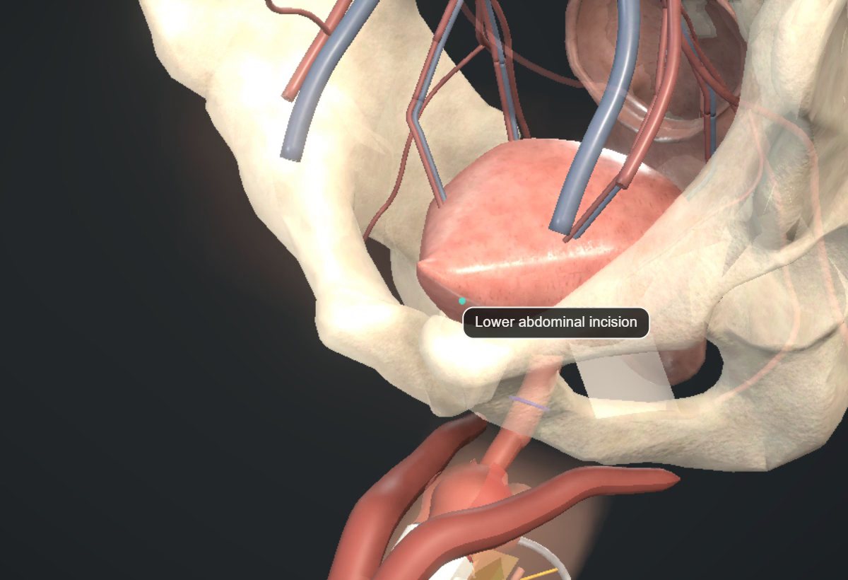
ACT V · THE OPERATION
29 / 38 · 42:00 – 43:30
Balloon pocket and pressure selection
ContiClassic label
60–69 cmH₂O
AMS 800 consensus
Commonly 61–70 cmH₂O
These ranges are device-specific
A safe pocket and the correct pressure component are separate decisions. Fill volumes and selection rules require the current OR protocol.
CCIFU · AP23 · ICS16
Notes:
[Act V · The operation · Teaching slide 29 of 38 · 42:00-43:30 · 1:30]
THIS SLIDE: Balloon pocket and pressure component: two decisions, two device-specific labels.
SAY
A routine retropubic pocket can become hazardous after pelvic surgery, radiation, mesh repair or previous implants. Review that anatomy before entering the space. Do not overcome unexpected resistance with a stronger finger or instrument: bladder, bowel and vessels may be close to the intended route.
An alternative ectopic or submuscular position may be appropriate in experienced hands, with attention to the device's permitted placement, secure coverage, access and tubing route. These approaches also have limitations, including malposition, palpability and herniation. A different pocket is only safer if it is created correctly.
Pressure selection is a separate issue. ContiClassic labelling lists ranges including sixty to sixty-nine centimetres of water. AMS 800 consensus commonly discusses sixty-one to seventy. Those labels must not be treated as interchangeable operative instructions.
The public ContiClassic IFU confirms sterile saline filling but directs detailed implantation to a separate Operating Room Protocol. Without that protocol we cannot verify a filling volume or a universal pressure-selection algorithm. Confirm both before surgery. And increasing pressure should never be a substitute for diagnosing a poor cuff fit or a failing urethra.
STUDIES ON THIS SLIDE
• CCIFU — Rigicon ContiClassic instructions for use, REV.03, 2023. What it is: Manufacturer labelling. What it says: Requires associated urge, overflow or instability to be treated and controlled or resolved, contraindicates irresolvable instability, warns about poor compliance and thin spongiosum, requires cuff deflation and deactivation before instrumentation, specifies four to six weeks deactivated, and describes a longer postoperative antibiotic regimen than stewardship sources. These are product instructions, not proof of efficacy. Country and lot applicability and the separate OR protocol remain unverified.
• AP23 — Asia-Pacific AMS 800 consensus 2023 (Chung et al.). What it is: Regional expert consensus. What it says: Practical consensus on selection, investigation, troubleshooting and aftercare, including common AMS 800 pressure selection (61–70 cmH2O) and preparation. Its fill volumes and preparation sequence belong to AMS 800, not automatically to ContiClassic.
• ICS16 — ICS AUS consensus 2015, published 2016 (Biardeau et al.). What it is: International consensus, centred on AMS 800. What it says: Covers assessment, operative principles, complications and aftercare: adequate dexterity and cognition, bladder and outlet evaluation, and device-aware instrumentation. Its technical and catheter advice is AMS-era and context-specific, not a universal ContiClassic rule.
TRANSITION → The third component is the one the patient will touch every day.
Image source: Rigicon ContiClassic IFU, CC-IFU REV.03, 12 October 2023, printed page 1 (PDF page 4). https://www.rigicon.com/files/e-labeling/ContiClassic-IFU.pdf . Manufacturer illustration, shown for component identification, without a comparative superiority claim.
Animation and image: UroOps 3D, https://uroops3d.com/lab/aus . Captured 10 October 2026. © UroOps3D / UroRef / Nity G. Teaching schematic with clinical review pending. It illustrates spatial relationships, not validated anatomy, tissue perfusion or operative instructions. The clip starts and loops by itself in slide-show mode.

Slide 36
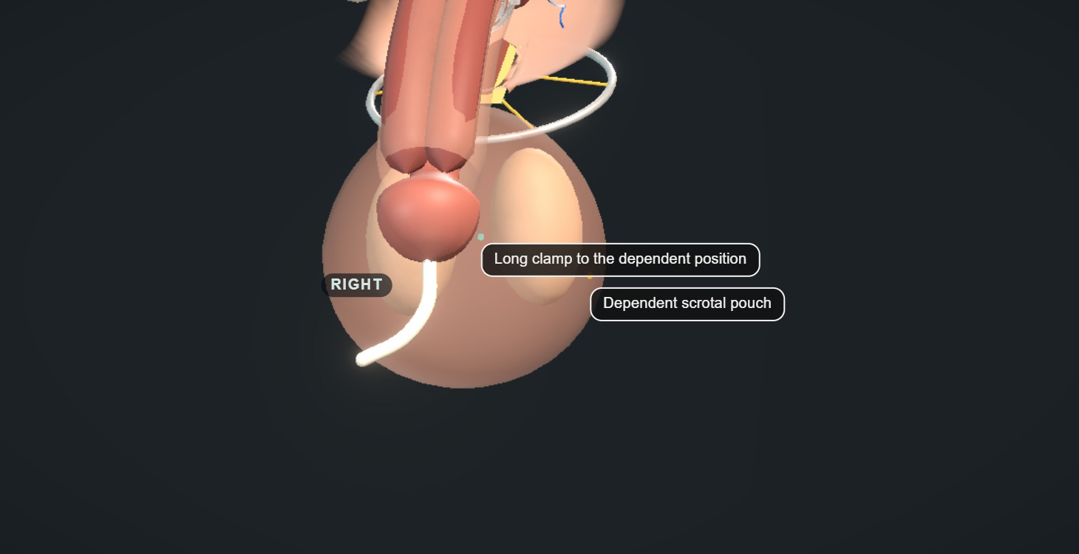
ACT V · THE OPERATION
30 / 38 · 43:30 – 44:45
Pump position and patient access
A functional position
Use the accessible side agreed in clinic
Avoid crowding, skin tension and testicular compression
Check orientation and tubing traction before closure
Recheck access with the patient at activation
AP23 · ICS16 · CCIFU
Notes:
[Act V · The operation · Teaching slide 30 of 38 · 43:30-44:45 · 1:15]
THIS SLIDE: A pump position that works for this patient, standing, seated and swollen.
SAY
The pump position is part of the functional result. The patient has already shown us where he can reach, which hand he uses and whether another scrotal device causes confusion. Use that information.
A dependent, accessible position is generally useful, but the exact pocket must suit the patient and device. Too much dissection can encourage migration. Too little space or excessive tension can cause pain, poor access or pressure on adjacent tissue. Keep the pump distinct from the testis and avoid thin, threatened skin.
Before closure, consider how the pump will sit when the patient stands, and whether the tubing will pull it upwards. Check that its orientation permits both normal cycling and access to the deactivation control.
A demonstration pump that is easy to feel on a table does not tell us that a swollen postoperative scrotum will be easy to use. Check accessibility again at activation, with the patient performing the task.
STUDIES ON THIS SLIDE
• AP23 — Asia-Pacific AMS 800 consensus 2023 (Chung et al.). What it is: Regional expert consensus. What it says: Practical consensus on selection, investigation, troubleshooting and aftercare, including common AMS 800 pressure selection (61–70 cmH2O) and preparation. Its fill volumes and preparation sequence belong to AMS 800, not automatically to ContiClassic.
• ICS16 — ICS AUS consensus 2015, published 2016 (Biardeau et al.). What it is: International consensus, centred on AMS 800. What it says: Covers assessment, operative principles, complications and aftercare: adequate dexterity and cognition, bladder and outlet evaluation, and device-aware instrumentation. Its technical and catheter advice is AMS-era and context-specific, not a universal ContiClassic rule.
• CCIFU — Rigicon ContiClassic instructions for use, REV.03, 2023. What it is: Manufacturer labelling. What it says: Requires associated urge, overflow or instability to be treated and controlled or resolved, contraindicates irresolvable instability, warns about poor compliance and thin spongiosum, requires cuff deflation and deactivation before instrumentation, specifies four to six weeks deactivated, and describes a longer postoperative antibiotic regimen than stewardship sources. These are product instructions, not proof of efficacy. Country and lot applicability and the separate OR protocol remain unverified.
TRANSITION → Then we finish the system, and we hand over the risk with it.
Animation and image: UroOps 3D, https://uroops3d.com/lab/aus . Captured 10 October 2026. © UroOps3D / UroRef / Nity G. Teaching schematic with clinical review pending. It illustrates spatial relationships, not validated anatomy, tissue perfusion or operative instructions. The clip starts and loops by itself in slide-show mode.

Slide 37
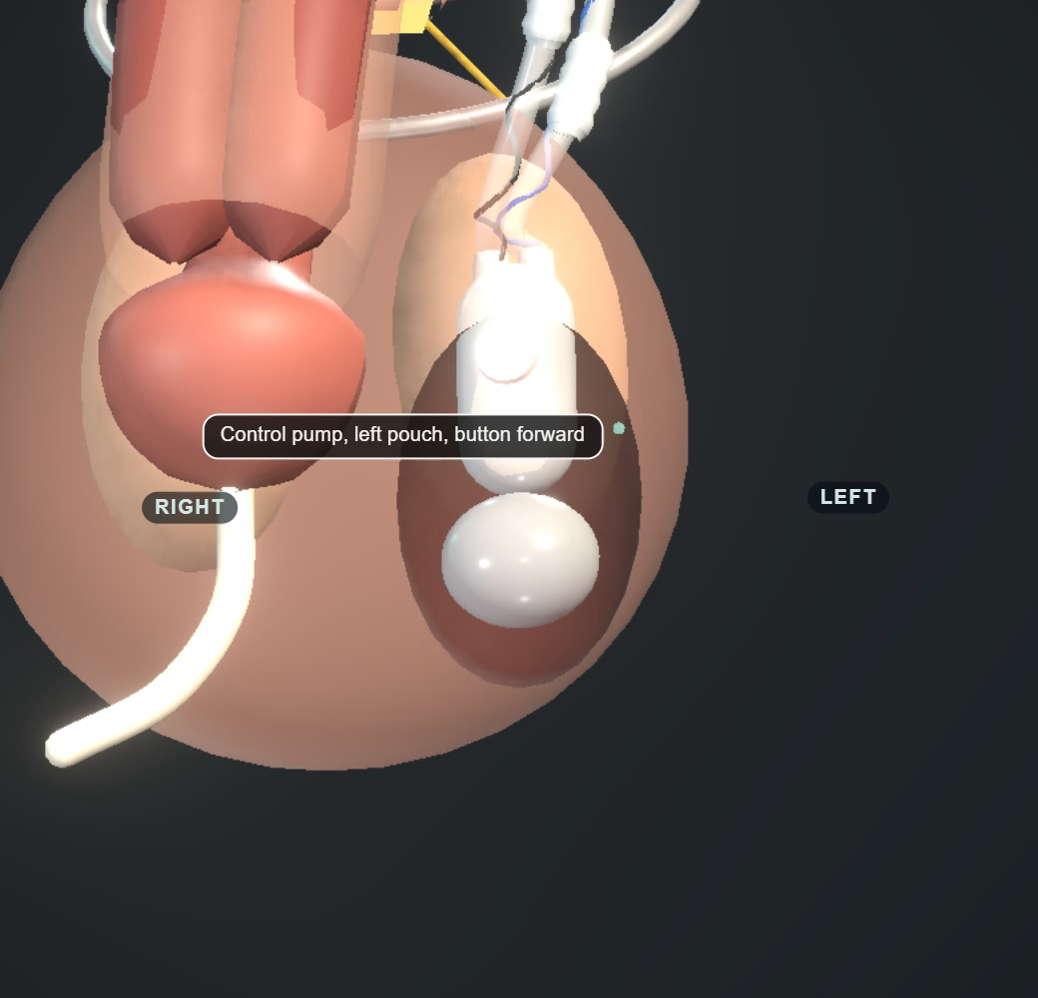
ACT V · THE OPERATION
31 / 38 · 44:45 – 46:00
System checks and handover
1
Trace tubing for tension, bends and entrapment
2
Confirm compatible connections and device function
3
Confirm an open cuff and correct deactivation
4
Record device details, drainage and the urgent contact route
Deactivation and urgent-contact instructions matter: a 2026 survey identifies training gaps. Filling follows the actual product protocol.
CCIFU · ICS16 · AP23 · CATH13 · INSTR26
Notes:
[Act V · The operation · Teaching slide 31 of 38 · 44:45-46:00 · 1:15]
THIS SLIDE: Four verifications before closure, and a handover that protects the patient from the next catheter.
SAY
Follow each tube between components. Avoid tension, excessive loops, kinks and entrapment during closure. Keep needles and instruments away from the components.
Prepare and connect the system using its own operative protocol. Use compatible components, remove air as instructed and verify the connections. Cycle the device to check function, then confirm that the cuff is open and the device correctly deactivated. Pressing a button without establishing the cuff state is not enough.
Choose an appropriate small, atraumatically placed catheter for the individual cuff and urethra, and plan early removal after an uncomplicated implant. Device instructions, an injury or a reconstruction may change that plan, and no universal catheter size should be improvised.
The handover should record the model, cuff site and size, balloon specification and position, deactivated state, catheter plan and contact details. The next clinician must know there is an AUS before attempting drainage. The 2026 survey of urologists is the reason we labour this: the gap in deactivation confidence is real.
STUDIES ON THIS SLIDE
• CCIFU — Rigicon ContiClassic instructions for use, REV.03, 2023. What it is: Manufacturer labelling. What it says: Requires associated urge, overflow or instability to be treated and controlled or resolved, contraindicates irresolvable instability, warns about poor compliance and thin spongiosum, requires cuff deflation and deactivation before instrumentation, specifies four to six weeks deactivated, and describes a longer postoperative antibiotic regimen than stewardship sources. These are product instructions, not proof of efficacy. Country and lot applicability and the separate OR protocol remain unverified.
• ICS16 — ICS AUS consensus 2015, published 2016 (Biardeau et al.). What it is: International consensus, centred on AMS 800. What it says: Covers assessment, operative principles, complications and aftercare: adequate dexterity and cognition, bladder and outlet evaluation, and device-aware instrumentation. Its technical and catheter advice is AMS-era and context-specific, not a universal ContiClassic rule.
• AP23 — Asia-Pacific AMS 800 consensus 2023 (Chung et al.). What it is: Regional expert consensus. What it says: Practical consensus on selection, investigation, troubleshooting and aftercare, including common AMS 800 pressure selection (61–70 cmH2O) and preparation. Its fill volumes and preparation sequence belong to AMS 800, not automatically to ContiClassic.
• CATH13 — Seideman et al. 2013: prolonged catheterisation and erosion. What it is: Observational implantation and revision cohort, 200 men. What it says: Urethral catheterisation for more than 48 hours was associated with erosion (17 of 44 exposed men), alongside radiation and revision. It supports avoiding unnecessary prolonged urethral access; 48 hours is not a guaranteed safe boundary.
• INSTR26 — AUS instrumentation knowledge survey 2026 (Girgin, Neurourol Urodyn). What it is: Self-selected survey of 286 Turkish urologists. What it says: Found training and confidence gaps in AUS deactivation and instrumentation. It supports device cards and an urgent-contact route; its proposed catheter sizes and durations cannot become universal rules.
TRANSITION → Let us now see all three spaces together on the model, and follow the tubing between them. Four minutes.
Animation and image: UroOps 3D, https://uroops3d.com/lab/aus . Captured 10 October 2026. © UroOps3D / UroRef / Nity G. Teaching schematic with clinical review pending. It illustrates spatial relationships, not validated anatomy, tissue perfusion or operative instructions. The clip starts and loops by itself in slide-show mode.

Slide 38

ACT V · THE OPERATION
32 / 38 · 46:00 – 50:00
UroOps 3D: anatomy and component routes
FOUR-MINUTE DEMONSTRATION
1
Cuff and dorsal plane
2
Pump access
3
Balloon pocket
4
Tubing route
uroops3d.com/lab/aus
Live page. Teaching schematic, clinical review pending.
ICS16 · AP23 · CCIFU
Notes:
[Act V · The operation · Teaching slide 32 of 38 · 46:00-50:00 · 4:00]
THIS SLIDE: Four minutes on the UroOps 3D model: cuff and dorsal plane, pump access, balloon pocket, tubing route.
SAY
Open uroops3d.com/lab/aus and use the scene controls. Say aloud that this is a teaching schematic with clinical review pending; it shows spatial relationships, not validated anatomy, perfusion or operative instructions.
00:00–00:20: Transition to anatomical relationships. 00:20–01:05: Cuff site view. Discuss viable bulbar tissue and supporting spongiosum. 01:05–01:45: Surgeon's view. Discuss the dorsal plane and why scarred tissue changes dissection. 01:45–02:20: The three spaces view. Discuss accessible pump position. 02:20–03:10: Space of Retzius view. Discuss how previous surgery changes balloon access; describe alternative pockets verbally if absent. 03:10–03:45: Final configuration view. Trace tubing without claiming the schematic proves tension or perfusion. 03:45–04:00: Return to postoperative care.
If loading fails, keep this slide displayed and use the spoken fallback below. Do not spend the allocated session troubleshooting beyond the opening twenty seconds.
FALLBACK 00:00–00:20: "The model is not loading, so let us walk through the same anatomy verbally. Picture the bulbar urethra in the perineum, the pump in the scrotum and the balloon beneath the abdominal wall. We will connect each position to one operative decision."
FALLBACK 00:20–01:05: "Begin with the cuff. It surrounds the urethra and its supporting spongiosal tissue. Our task is to identify a viable segment and preserve that support while creating only the space the cuff needs. A thin, scarred or previously eroded segment does not become healthy because it accepts a measuring tape. The operative report from previous reconstruction is therefore part of the anatomical assessment. Before measuring, release traction and check that the tape encloses the tissue the cuff will actually surround."
FALLBACK 01:05–01:45: "Dorsally, the urethra lies closely related to the corporal bodies. In a normal plane, controlled dissection separates the structures. In a scarred plane, blind force may cross the urethral wall. The decision is to improve exposure, choose another strategy or stage the operation. Transcorporal placement may avoid a particular dangerous plane, but its comparative protection against erosion remains uncertain. It also changes the tissue within the cuff and the implications for future corporal surgery."
FALLBACK 01:45–02:20: "Next, put the pump in the patient's hand, mentally. Can he find it, distinguish it from the testis and reach its controls? The position must work when sitting as well as standing. An oversized pocket permits migration, while tension and crowding cause discomfort. This is why pump access is agreed before anaesthesia. At activation, let him demonstrate the full operation rather than merely identify where the pump sits."
FALLBACK 02:20–03:10: "Now consider the balloon. After pelvic surgery, the retropubic space may not behave like the textbook space. Adhesions, mesh, bowel, bladder and vessels change the route. An alternative submuscular pocket may be useful, but it must be deliberately and safely created. The choice of pocket and the choice of pressure are separate decisions. Neither a new pocket nor a higher pressure compensates for a poorly selected cuff site. Unexpected resistance during access should prompt reassessment, not force. Confirm the actual product's placement and preparation instructions before committing to the pocket."
FALLBACK 03:10–04:00: "Trace the tubing between all three components. Avoid tension, sharp turns and entrapment under closure. Recheck connections, cycle the system and confirm an open cuff with correct deactivation. The same route helps us investigate a later failure: patient operation, cuff and urethra, tubing, then balloon and fluid system. Future instrumentation has to pass through the cuffed segment, so deactivation and appropriate instrument selection remain essential even when the hydraulics work normally. That is the anatomical logic we wanted the model to demonstrate. Let us return to postoperative care."
STUDIES ON THIS SLIDE
• ICS16 — ICS AUS consensus 2015, published 2016 (Biardeau et al.). What it is: International consensus, centred on AMS 800. What it says: Covers assessment, operative principles, complications and aftercare: adequate dexterity and cognition, bladder and outlet evaluation, and device-aware instrumentation. Its technical and catheter advice is AMS-era and context-specific, not a universal ContiClassic rule.
• AP23 — Asia-Pacific AMS 800 consensus 2023 (Chung et al.). What it is: Regional expert consensus. What it says: Practical consensus on selection, investigation, troubleshooting and aftercare, including common AMS 800 pressure selection (61–70 cmH2O) and preparation. Its fill volumes and preparation sequence belong to AMS 800, not automatically to ContiClassic.
• CCIFU — Rigicon ContiClassic instructions for use, REV.03, 2023. What it is: Manufacturer labelling. What it says: Requires associated urge, overflow or instability to be treated and controlled or resolved, contraindicates irresolvable instability, warns about poor compliance and thin spongiosum, requires cuff deflation and deactivation before instrumentation, specifies four to six weeks deactivated, and describes a longer postoperative antibiotic regimen than stewardship sources. These are product instructions, not proof of efficacy. Country and lot applicability and the separate OR protocol remain unverified.
TRANSITION → Back from the model: the operation is finished, and the first weeks decide whether it was worth doing.
Animation and image: UroOps 3D, https://uroops3d.com/lab/aus . Captured 10 October 2026. © UroOps3D / UroRef / Nity G. Teaching schematic with clinical review pending. It illustrates spatial relationships, not validated anatomy, tissue perfusion or operative instructions. The clip starts and loops by itself in slide-show mode.

Slide 39
ACT
50:00 – 60:00 · 10 MINUTES
VI
33
Aftercare, activation and urgent review
34
Case 4: leakage after three good years
35
Established benefit and unresolved questions
36
Five decisions before implantation
After the implant
37
Five decisions protecting the result
38
Discussion
Hand over the risk, diagnose late leakage before revising, and say where the evidence stops.
Decide before theatre
The bladder
The urethra
Preparation without ritual
The operation
After the implant
Notes:
[Act VI · After the implant · 50:00 – 60:00 · 10 minutes · teaching slides 33–38]
Transition slide; it takes no time from the clock. Read the act title, say the one-line question, and move on.
SAY
"Hand over the risk, diagnose late leakage before revising, and say where the evidence stops."

Slide 40
ACT VI · AFTER THE IMPLANT
33 / 38 · 50:00 – 51:00
Aftercare, activation and urgent review
Planned care
Earlier assessment
Selected day-case care with verified emptying
Retention or difficult voiding
ContiClassic: 4–6 weeks deactivated until pain and oedema settle
Worsening pain, erythema, discharge or fever
Activation includes patient demonstration and device information
Suspected infection or erosion needs specialist review
BAUS 2026 day-case audit and comparative studies support selected pathways. Confirm emptying, support and rapid access to review.
BAUS25 · CCIFU · AUA24 · CATH13 · BAUSDAY26 · DAYMETA26 · DAYCASE26
Notes:
[Act VI · After the implant · Teaching slide 33 of 38 · 50:00-51:00 · 1:00]
THIS SLIDE: The planned aftercare, and the symptoms that bring the patient back early.
SAY
After uncomplicated implantation, remove the catheter early and check voiding. Persistent retention needs assessment of deactivation, oedema, cuff fit and obstruction, with safe drainage and no repeated blind catheter attempts. Selected day-case pathways are feasible: the BAUS 2026 audit discharged 88 per cent the same day, and the 2026 meta-analysis found no significant excess of retention or emergency visits, with wide intervals. That supports a selected pathway with verified emptying, not a universal instruction.
Worsening pain, erythema, discharge, fever or voiding difficulty needs specialist review. Suspected erosion requires device-aware investigation, and established infection or erosion generally needs explantation, not antibiotics alone.
ContiClassic specifies four to six weeks deactivated, until pain and oedema settle. At activation, verify patient operation and emptying. Arrange subsequent functional review and access for problems.
Give him the device card and clear instructions to alert clinicians before catheterisation or endoscopy. Safe future care depends on that information reaching the person holding the instrument.
STUDIES ON THIS SLIDE
• BAUS25 — BAUS consensus 2025 (Bhatt et al., BJU Int). What it is: UK expert consensus after literature review and modified Delphi. What it says: Sets the UK assessment and perioperative pathway: VUDS for surgical candidates, severity-dependent recovery periods, treatment of narrowing before continence surgery, and a five-minute topical field scrub that it labels as Delphi extrapolation. Consensus supports a consistent pathway; it does not prove each interval or step is uniquely optimal.
• CCIFU — Rigicon ContiClassic instructions for use, REV.03, 2023. What it is: Manufacturer labelling. What it says: Requires associated urge, overflow or instability to be treated and controlled or resolved, contraindicates irresolvable instability, warns about poor compliance and thin spongiosum, requires cuff deflation and deactivation before instrumentation, specifies four to six weeks deactivated, and describes a longer postoperative antibiotic regimen than stewardship sources. These are product instructions, not proof of efficacy. Country and lot applicability and the separate OR protocol remain unverified.
• AUA24 — AUA/GURS/SUFU incontinence after prostate treatment, amended 2024. What it is: US guideline. What it says: Permits surgery from six months for bothersome non-improving SUI and recommends offering it at one year; cystourethroscopy before SUI surgery is expert opinion; urodynamics is conditional (Grade C) when it helps diagnosis or counselling. It also supports pump suitability, lifetime counselling and interval cystoscopy at least four to six weeks after treating BNC or VUAS.
• CATH13 — Seideman et al. 2013: prolonged catheterisation and erosion. What it is: Observational implantation and revision cohort, 200 men. What it says: Urethral catheterisation for more than 48 hours was associated with erosion (17 of 44 exposed men), alongside radiation and revision. It supports avoiding unnecessary prolonged urethral access; 48 hours is not a guaranteed safe boundary.
• BAUSDAY26 — BAUS 2026 abstract P4-8: day-case AUS audit. What it is: Conference audit, 98 men. What it says: 88% same-day discharge in an established service. Short follow-up and a selected population; it does not establish long-term equivalence or antibiotic policy.
• DAYMETA26 — Day-case AUS meta-analysis 2026 (Grigoryan et al.). What it is: Systematic review, six studies, 2,424 men; four pooled. What it says: No significant difference in retention (RR 1.44, 95% CI 0.81–2.56) or 90-day emergency visits (RR 0.91). Moderate-to-serious bias and wide intervals; same-day discharge is a selected pathway, not an instruction.
• DAYCASE26 — Day-case versus inpatient AUS 2026 (Youssef et al.). What it is: Retrospective single-centre comparison, 177 men. What it says: 30-day composite complications 11.3% ambulatory versus 8.2% inpatient, p = 0.78. Inpatient selection depended on ASA and social factors; a non-significant result is not proof of equal safety.
TRANSITION → Our last patient did everything right and was dry for three years. Then he was not.

Slide 41
ACT VI · AFTER THE IMPLANT
34 / 38 · 51:00 – 52:30
Case 4: leakage after three good years
FICTIONAL CASE 04
What would you investigate before choosing revision?
An initially useful AUS result
Recurrent leakage after three years
YOUR CALL
Leakage mechanism and pump use still need assessment
USE
URETHRA
MECHANICS
BLADDER
Erosion, mechanics and bladder dysfunction remain possible
2026 PRB fatigue study adds a mechanical explanation. Diagnose the cause; do not automatically downsize or replace the balloon.
ATROPHY20 · BAUS25 · AUA24 · CCIFU · AUASAFER26 · PRBFAT26 · EROSION26 · SECOND26
Notes:
[Act VI · After the implant · Teaching slide 34 of 38 · 51:00-52:30 · 1:30]
THIS SLIDE: Case 4: late leakage is a diagnosis to make, not a cuff size to shrink.
SAY
Our fourth fictional patient had three useful years with his AUS and now leaks again. Would you book a smaller cuff? [Pause for five seconds.]
Start by separating persistent leakage since activation from true recurrence after a successful interval. Ask whether this is activity-related leakage, urgency, overflow or difficulty cycling. Observe his technique and check the device state.
Review urine and residual, examine the components, and use appropriately deactivated cystoscopy to look for erosion and assess the urethra. Investigate fluid loss, mechanical problems and bladder dysfunction as indicated.
Urethral atrophy is an explanation to establish, not a diagnosis made by the passage of time. Bergeson's revision series attributed only eight per cent of failures to atrophy and a third to the pressure-regulating balloon, and the 2026 laboratory study of retrieved balloons shows why: they stiffen and thin with age. That is a mechanism, not an instruction to replace every balloon at three years. Capsular restriction and poor initial sizing can also complicate the label.
The answer may be retraining, bladder treatment, component revision, a revised cuff strategy or explantation. In an older system, discuss whole-system replacement. The French national cohort reminds us that second implants have 68 per cent reintervention-free survival at five years, and that only a fifth of men whose first device was removed ever received another. Repeated failure or a compromised urethra warrants specialist review before another tissue-consuming procedure.
STUDIES ON THIS SLIDE
• ATROPHY20 — Bergeson et al. 2020: causes of AUS revision. What it is: Selected contemporary revision cohort, 137 revisions, erosions excluded. What it says: Atrophy was assigned in 8% and pressure-regulating balloon failure in 34%. It tells us to check mechanics before labelling late leakage as atrophy; it does not show atrophy never occurs.
• BAUS25 — BAUS consensus 2025 (Bhatt et al., BJU Int). What it is: UK expert consensus after literature review and modified Delphi. What it says: Sets the UK assessment and perioperative pathway: VUDS for surgical candidates, severity-dependent recovery periods, treatment of narrowing before continence surgery, and a five-minute topical field scrub that it labels as Delphi extrapolation. Consensus supports a consistent pathway; it does not prove each interval or step is uniquely optimal.
• AUA24 — AUA/GURS/SUFU incontinence after prostate treatment, amended 2024. What it is: US guideline. What it says: Permits surgery from six months for bothersome non-improving SUI and recommends offering it at one year; cystourethroscopy before SUI surgery is expert opinion; urodynamics is conditional (Grade C) when it helps diagnosis or counselling. It also supports pump suitability, lifetime counselling and interval cystoscopy at least four to six weeks after treating BNC or VUAS.
• CCIFU — Rigicon ContiClassic instructions for use, REV.03, 2023. What it is: Manufacturer labelling. What it says: Requires associated urge, overflow or instability to be treated and controlled or resolved, contraindicates irresolvable instability, warns about poor compliance and thin spongiosum, requires cuff deflation and deactivation before instrumentation, specifies four to six weeks deactivated, and describes a longer postoperative antibiotic regimen than stewardship sources. These are product instructions, not proof of efficacy. Country and lot applicability and the separate OR protocol remain unverified.
• AUASAFER26 — AUA 2026 abstract IP09-17: SAFER erosion management. What it is: Conference abstract, title and programme verified only. What it says: Compared in situ urethroplasty with conservative management at explantation for cuff erosion. Results were unavailable; no practice change is inferred.
• PRBFAT26 — Pressure-regulating balloon fatigue 2026 (Salvino et al., Urology). What it is: Laboratory study of 32 retrieved balloons. What it says: Age correlated with stiffness and reduced wall thickness; microcracks appeared in the oldest specimens. Mechanistic evidence from selected retrieved parts; it does not tell us to replace a balloon because three years have passed.
• EROSION26 — Immediate urethral repair at explantation 2026 (Park et al., World J Urol). What it is: Selected single-centre series, 16 men, median follow-up 14 months. What it says: One stricture after repair (6.3%) but seven wound dehiscences needing closure (43.8%). No drainage-only comparator; it does not establish universal immediate repair.
• SECOND26 — Second AUS survival, national French cohort 2026 (Tokarski et al.). What it is: National administrative cohort, 1,619 second implants. What it says: Reintervention-free survival 68% at five years and 61% at ten years; only 21% of men whose first device was removed received another. It strengthens consent about the path after erosion or explantation.
TRANSITION → So where does all this leave us? Here is what we think is established, and what honestly is not.

Slide 42
ACT VI · AFTER THE IMPLANT
35 / 38 · 52:30 – 53:15
Established benefit and unresolved questions
Supported or plausible
Still uncertain
Selected patients gain substantial continence benefit
The best salvage strategy for a fragile urethra
Tissue preservation and contamination control have strong rationale
Optimal irrigants and preparation duration
Future access belongs in the operative plan
Comparable long-term ContiClassic outcomes
2026 reviews and early electronic-AUS data add options, while comparative and long-term evidence remains limited.
MASTER22 · TC20 · TC23 · PREP24 · CCSAFETY · DEVICE26 · UROACTIVE26
Notes:
[Act VI · After the implant · Teaching slide 35 of 38 · 52:30-53:15 · 0:45]
THIS SLIDE: What is supported, what is plausible, and what remains open.
SAY
AUS can deliver substantial benefit, with revision and erosion part of its lifetime burden. Tissue preservation, contamination control and planned instrumentation have strong rationale, although individual technical details often lack comparative evidence.
We cannot name one best salvage operation for every fragile urethra, one optimal irrigant or a proven universal preparation duration. New device features, including the first electronic sphincters, need outcome evidence with comparable populations and definitions before engineering advantages become clinical claims.
Make that uncertainty visible in consent and operative planning.
STUDIES ON THIS SLIDE
• MASTER22 — MASTER trial 2022 (Constable et al., NIHR HTA). What it is: UK multicentre randomised non-inferiority trial, 380 men, sling versus AUS. What it says: At twelve months the sling met non-inferiority on the patient-reported continence endpoint (difference −3.4 points, 95% CI −11.7 to +4.8, 15-point margin). Both groups improved and several secondary outcomes favoured AUS. Prior implants and unresolved narrowing were excluded, so it says nothing about complex revision practice.
• TC20 — Redmond et al. 2020: transcorporal placement in fragile urethras. What it is: Retrospective series, 76 patients, 24 transcorporal. What it says: Revision 20.8% versus 36.5% and erosion 8.3% versus 17.3%, numerically favouring transcorporal placement, but the erosion difference was not statistically significant and allocation was not randomised.
• TC23 — Kurtzman et al. 2023: high-risk transcorporal AUS. What it is: Retrospective single-surgeon high-risk cohort, 68 men, 77 cuffs. What it says: Transcorporal placement was associated with more infection or erosion-related explants (HR 2.74). Surgeons may have chosen it for the worst tissue, so it cannot prove the technique caused harm. With Redmond it blocks any confident claim of erosion protection.
• PREP24 — Bourgi et al. 2024: AMS 800 skin-preparation protocols. What it is: Retrospective sequential-era comparison, 156 procedures. What it says: Intensified povidone preparation showed no association with device removal (OR 0.97, 95% CI 0.28–3.37). Wide interval, era confounding and inconsistent reporting; it never compared fifteen minutes against a shorter preparation.
• CCSAFETY — Wilson et al.: first ContiClassic safety outcomes, IJIR 2024. What it is: Uncontrolled early device series, 116 implants, mixed indications. What it says: Eight revisions (6.9%), no reported infections and 93.2% twelve-month Kaplan–Meier device survival; four revisions were attributed to sizing errors. Device survival is not continence, there is no comparator, and only abstract-level results were accessible.
• DEVICE26 — Emerging AUS devices review 2026 (Schnell et al., Neurourol Urodyn). What it is: Narrative review. What it says: Describes new hydraulic and electronic designs while stressing the lack of robust direct comparisons and long-term outcomes. Engineering advantages are not proven clinical superiority.
• UROACTIVE26 — UroActive electronic AUS first-in-human 2026 (Mozer et al., J Urol). What it is: Single-arm feasibility study, six men. What it says: All activated successfully with no explant or revision in the first year; nine device deficiencies involved the remote control. Zero revisions in six men is not zero risk.
TRANSITION → Let us condense the hour into ten decisions. Five belong before theatre.

Slide 43
ACT VI · AFTER THE IMPLANT
36 / 38 · 53:15 – 54:00
Five decisions before implantation
1
Demonstrated SUI and a meaningful patient goal
2
Pump use, access and future capability
3
Investigations resolving anatomy, storage and emptying
4
Separate DO, DU and poor compliance
5
A stable urethra and future access plan
BAUS25 · EAU26 · AUA24 · DU23 · ICS16
Notes:
[Act VI · After the implant · Teaching slide 36 of 38 · 53:15-54:00 · 0:45]
THIS SLIDE: The five pre-theatre decisions in one list.
SAY
The first five take-home messages belong before theatre. Establish the leakage mechanism and the improvement that matters. Watch the patient use a pump and assess access over time. Choose investigations to answer explicit questions, acknowledging the differences between guidelines.
Keep detrusor overactivity, underactivity and poor compliance separate, because they lead to different decisions. Finally, establish a stable outlet and think through future instrumentation.
A successful implant starts with a patient, bladder and urethra that can support the intended result. Apply them to the cases: optimise case one, investigate case two, and stage a reconstructive plan for case three.
STUDIES ON THIS SLIDE
• BAUS25 — BAUS consensus 2025 (Bhatt et al., BJU Int). What it is: UK expert consensus after literature review and modified Delphi. What it says: Sets the UK assessment and perioperative pathway: VUDS for surgical candidates, severity-dependent recovery periods, treatment of narrowing before continence surgery, and a five-minute topical field scrub that it labels as Delphi extrapolation. Consensus supports a consistent pathway; it does not prove each interval or step is uniquely optimal.
• EAU26 — EAU non-neurogenic male LUTS guideline 2026. What it is: European guideline. What it says: Recommends structured symptom assessment, diary, pad-weight and residual measures; weakly recommends invasive urodynamics before invasive treatment while acknowledging limited outcome evidence. A weak recommendation signals uncertainty, not a valueless test.
• AUA24 — AUA/GURS/SUFU incontinence after prostate treatment, amended 2024. What it is: US guideline. What it says: Permits surgery from six months for bothersome non-improving SUI and recommends offering it at one year; cystourethroscopy before SUI surgery is expert opinion; urodynamics is conditional (Grade C) when it helps diagnosis or counselling. It also supports pump suitability, lifetime counselling and interval cystoscopy at least four to six weeks after treating BNC or VUAS.
• DU23 — Han et al. 2023: AUS with detrusor underactivity. What it is: Retrospective cohort, 78 patients, 55 with BCI below 100. What it says: Postoperative residuals did not differ significantly by DU status, although flow stayed lower. It excluded complications needing revision within three months, which weakens the safety inference. BCI below 100 is the study definition, not an eligibility cutoff.
• ICS16 — ICS AUS consensus 2015, published 2016 (Biardeau et al.). What it is: International consensus, centred on AMS 800. What it says: Covers assessment, operative principles, complications and aftercare: adequate dexterity and cognition, bladder and outlet evaluation, and device-aware instrumentation. Its technical and catheter advice is AMS-era and context-specific, not a universal ContiClassic rule.
TRANSITION → And five decisions protect the result once the implant is open.

Slide 44
ACT VI · AFTER THE IMPLANT
37 / 38 · 54:00 – 55:00
Five decisions protecting the result
6
Correct antisepsis and appropriate prophylaxis
7
Preserved tissue and undistorted measurement
8
Actual device protocol and explicit stop conditions
9
Verified deactivation, drainage and patient teaching
10
A diagnosis before choosing revision
CCIFU · NICE · AP23 · ATROPHY20 · BAUS25
Notes:
[Act VI · After the implant · Teaching slide 37 of 38 · 54:00-55:00 · 1:00]
THIS SLIDE: The five decisions that protect the result, from preparation to revision.
SAY
Preparation must be correct for the product, anatomy and implant pathway. A fifteen-minute ritual is not a substitute. In theatre, preserve the tissue you need, measure what the cuff will actually enclose, and correct uncertainty before closing.
Use the instructions for the device being implanted. Similar components do not make pressure ranges, preparation or operating sequences interchangeable. Recognised injury or unsafe contamination is a reason to change the plan.
Confirm the cuff state, drainage and the patient's ability to use the device. Make future instrumentation precautions explicit.
When leakage returns, diagnose it before selecting a smaller cuff or higher pressure. The goal is useful continence over time, with safe storage, emptying and an agreed plan for further treatment.
STUDIES ON THIS SLIDE
• CCIFU — Rigicon ContiClassic instructions for use, REV.03, 2023. What it is: Manufacturer labelling. What it says: Requires associated urge, overflow or instability to be treated and controlled or resolved, contraindicates irresolvable instability, warns about poor compliance and thin spongiosum, requires cuff deflation and deactivation before instrumentation, specifies four to six weeks deactivated, and describes a longer postoperative antibiotic regimen than stewardship sources. These are product instructions, not proof of efficacy. Country and lot applicability and the separate OR protocol remain unverified.
• NICE — NICE NG125: surgical site infection. What it is: UK national guidance. What it says: Soap washing before surgery, appropriate antiseptic skin preparation with drying, clipping rather than shaving if hair removal is needed, and no wound irrigation solely to reduce SSI. It tests no fifteen-minute AUS preparation.
• AP23 — Asia-Pacific AMS 800 consensus 2023 (Chung et al.). What it is: Regional expert consensus. What it says: Practical consensus on selection, investigation, troubleshooting and aftercare, including common AMS 800 pressure selection (61–70 cmH2O) and preparation. Its fill volumes and preparation sequence belong to AMS 800, not automatically to ContiClassic.
• ATROPHY20 — Bergeson et al. 2020: causes of AUS revision. What it is: Selected contemporary revision cohort, 137 revisions, erosions excluded. What it says: Atrophy was assigned in 8% and pressure-regulating balloon failure in 34%. It tells us to check mechanics before labelling late leakage as atrophy; it does not show atrophy never occurs.
• BAUS25 — BAUS consensus 2025 (Bhatt et al., BJU Int). What it is: UK expert consensus after literature review and modified Delphi. What it says: Sets the UK assessment and perioperative pathway: VUDS for surgical candidates, severity-dependent recovery periods, treatment of narrowing before continence surgery, and a five-minute topical field scrub that it labels as Delphi extrapolation. Consensus supports a consistent pathway; it does not prove each interval or step is uniquely optimal.
TRANSITION → That is our ten. The last five minutes are yours.

Slide 45
ACT VI · AFTER THE IMPLANT
38 / 38 · 55:00 – 60:00
Discussion
FIVE MINUTES
1
Which bladder finding makes you defer an implant?
2
What establishes urethral stability in your practice?
3
Which preparation or salvage practice needs a trial?
Which finding would change your plan?
Notes:
[Act VI · After the implant · Teaching slide 38 of 38 · 55:00-60:00 · 5:00]
THIS SLIDE: Five minutes of moderated discussion on decisions, not preferences.
SAY
55:00–55:20: "We would like to use these final five minutes on decisions rather than preferences alone. Choose one of the cases, tell us what you would do, and identify the finding that would make you change your plan."
55:20–57:20: Invite a response on bladder dysfunction or urethral stability. Take one contrasting view and a brief reply. Ask, if needed: "Is that a guideline requirement, a device instruction, or your interpretation of the evidence?"
57:20–59:40: Invite a second question on operative practice, preparation or failure. Use the prepared answers in the presenter guide if relevant. Keep individual contributions brief enough to allow disagreement and clarification.
59:40–60:00: "Thank you. The useful differences are now clear: what the evidence supports, what the device requires and where our judgement remains decisive. Those distinctions should be visible in our consent, our operation notes and the outcomes we report."
A show of hands is audience opinion; do not convert it into consensus evidence. For a question beyond the retrieved evidence, state the uncertainty precisely.

Slide 46
BACKUP · OUTSIDE THE TIMED TALK
Outcome evidence: device and endpoint
Study and population | Endpoint and result | Limits
AUSCO 2026: AMS 800 115 primary implants, 25 irradiated | 12 months after activation 91/97 ≥50% pad-weight reduction 61/101 zero pads | Prospective single-arm, funded by manufacturer. Missing data, one year, expert centres
Linder 2015: AMS 800 1,082 primary implants, 27% irradiated | Freedom from any secondary surgery KM 74% at five years 57% at ten years | Historical specialist cohort. Continence and revision-free survival differ
Wilson 2024: ContiClassic 116 recipients, mixed indications | Eight revisions 12-month KM device survival 93.2% | Early safety series. No standardised continence comparator; mixed indications
Notes:
Backup, outside the timed talk. Outcome definitions, populations and limitations follow the repository outcome-context table.
AUSCO26: 91/97 achieved at least 50% pad-weight reduction (93.8%); 61/101 reported zero pads (60.4%). Prospective single-arm, manufacturer-funded, 17 sites; nine revisions in the reported period. https://pmc.ncbi.nlm.nih.gov/articles/PMC12794701/
LINDER15: 1,082 primary implants; Kaplan–Meier freedom from any secondary surgery 74% at five years and 57% at ten years. Historical specialist cohort. https://pubmed.ncbi.nlm.nih.gov/26135815/
CCSAFETY: 116 implants, eight revisions (four attributed to sizing), 93.2% twelve-month Kaplan–Meier device survival. Device survival is not continence; no comparator. https://pubmed.ncbi.nlm.nih.gov/37543658/
Newer context: REGRET26 (reoperation the only independent predictor of regret, +18 points; benefit deteriorated over time; survivor cohort, no non-surgical comparator) https://doi.org/10.1016/j.euros.2025.12.006. SECOND26 (1,619 second implants; reintervention-free survival 68% at five and 61% at ten years; only 21% of men whose first device was removed received another) https://doi.org/10.1590/s1677-5538.ibju.2025.0374. REPORT26 (227 implants with systematic complication capture: 47% early, mostly minor; 7.9% major; 73% five-year explantation-free survival; includes double and transcorporal cuffs) https://doi.org/10.1007/s00345-026-06246-y.

Slide 47
BACKUP · OUTSIDE THE TIMED TALK
Comparative and preparation evidence
Study | Finding | Limits
MASTER 2022 / 2026 Same 380 randomised men | 24-month non-inferiority retained Further surgery: sling 11%, AUS 2% | Selected trial population. Secondary outcomes favour AUS; not general equivalence
Yeung 2013 100 initial GU prosthetic procedures | Post-preparation skin culture positivity 8% versus 32% | Surrogate outcome. Mixed devices. No AUS infection or duration conclusion
Gentamicin withdrawal 2026 173 uncoated AMS 800 procedures | 90-day SSI: 1/59 versus 2/114 No significant difference detected | Sparse events, era confounding, broad systemic prophylaxis; not equivalence
Notes:
Backup, outside the timed talk.
MASTER26: extended follow-up of the same 380 randomised men. At 24 months sling met the prespecified non-inferiority criterion on the strict self-reported continence endpoint: risk difference −0.6 percentage points (95% CI −9.2 to +8.0). Further surgery 20 men (11%) after sling and four (2%) after AUS. Secondary outcomes generally favoured AUS. Non-inferiority on one endpoint is not identical effectiveness, zero-pad equivalence or an endorsement for irradiated or reconstructed revision cases. https://doi.org/10.1016/j.euf.2026.07.012
YEUNG13: 4/50 versus 16/50 positive post-preparation skin cultures (8% versus 32%) in mixed GU prosthetic procedures; a surrogate endpoint, not AUS infection or a duration trial. https://pubmed.ncbi.nlm.nih.gov/23164373/
IRRIG26: 173 uncoated AMS 800 procedures in 164 men, 59 with and 114 without gentamicin. 90-day SSI 1/59 (1.7%) versus 2/114 (1.8%); risk difference +0.1 points (95% CI −7.4 to +4.7). Three events; immersion and irrigation changed together; broad IV and ten-day oral prophylaxis continued. Not equivalence; not transferable to coated AMS 800 or ContiClassic. https://doi.org/10.3390/antibiotics15090894
PREP24 remains in the bibliography as an earlier sequential preparation study: https://tau.amegroups.org/article/view/130351/html

Slide 48
BACKUP · OUTSIDE THE TIMED TALK
Evidence gaps
1
Routine versus selective UDS and meaningful outcomes
2
Functional eligibility in DU or chronic retention
3
Staging intervals after different reconstructions
4
Comparative protection from salvage strategies
5
Preparation, irrigation and prolonged prophylaxis
6
Independent long-term ContiClassic outcomes
7
Mechanisms and revision strategy in late leakage
Notes:
Backup, outside the timed talk. Evidence gaps preserved from section 7 of the manuscript. No new clinical thresholds or device superiority claims are introduced. Each gap needs a defined population, intervention and meaningful outcome before it becomes a trial question.

Slide 49
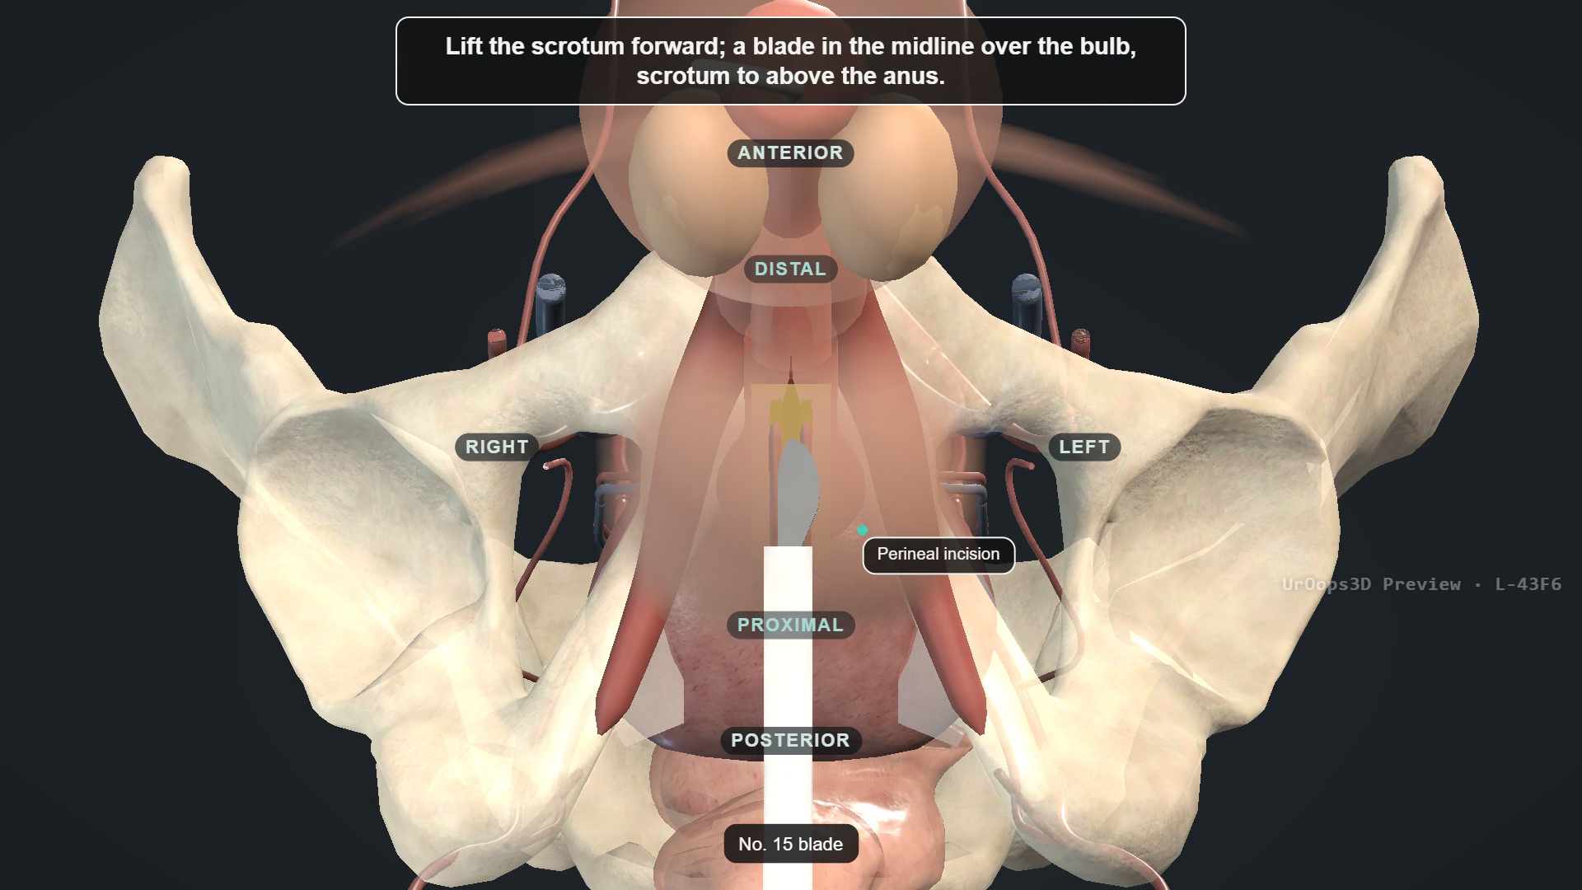
BACKUP · OUTSIDE THE TIMED TALK
UroOps 3D lesson: recorded run-through
Use only if the live page fails
Click to play. 102 seconds, no sound. Same four-minute narration as teaching slide 32.
Notes:
Backup, outside the timed talk. A recorded run-through of the UroOps 3D AUS lesson (102 seconds, no sound), for use only if the live page on teaching slide 32 cannot be opened. Click the video to play. Video: UroOps 3D, https://uroops3d.com/lab/aus . Captured 10 October 2026. © UroOps3D / UroRef / Nity G. Teaching schematic with clinical review pending. It illustrates spatial relationships, not validated anatomy, tissue perfusion or operative instructions.

Slide 50
REFERENCES · OUTSIDE THE TIMED TALK
Sources 1 of 3
BAUS25
BAUS consensus, BJU Int 2025
WHO09
WHO hand hygiene guidance, 2009
EAU26
EAU male LUTS guidelines, 2026
CHLORA26
ChloraPrep UK product information, 2026
AUA24
AUA/GURS/SUFU IPT amendment, 2024
IDSA19
IDSA asymptomatic bacteriuria, 2019
EAUSTR26
EAU urethral strictures guidelines, 2026
AUAABX20
AUA antimicrobial prophylaxis, 2020
ICS16
ICS AUS consensus, NUU 2016
CCSAFETY
Wilson: ContiClassic safety, IJIR 2024
AP23
Asia-Pacific AMS 800 consensus, 2023
MASTER22
MASTER randomised trial, HTA 2022
CCIFU
Rigicon ContiClassic IFU, REV.03, 2023
UDS09
Lai: pre-AUS urodynamics, Urology 2009
ICSUDS17
ICS good urodynamic practices, 2017
OAB11
Lai: OAB and post-prostatectomy AUS, 2011
AUAOAB24
AUA/SUFU idiopathic OAB guideline, 2024
DO24
Bhatt: preoperative DO systematic review, 2024
NICE
NICE NG125: surgical site infection
DOFAIL23
Krughoff: earlier AUS failure, 2023
Notes:
Reference slide, outside the timed talk. Every entry is a live hyperlink. Source dictionary checked 5 October 2026; study design, findings, limits and access level for each code are in presenter-guide/AUS-ST5-presenter-guide.md and in the "Studies on this slide" block of each teaching slide's notes. Older sources remain when they answer a different question from newer evidence.
BAUS25 https://doi.org/10.1111/bju.16726
EAU26 https://uroweb.org/guidelines/management-of-non-neurogenic-male-luts/chapter/disease-management
AUA24 https://www.auanet.org/documents/Guidelines/PDF/2024%20Guidelines/IPT%20Unabridged%20Final%206-18-24.pdf
EAUSTR26 https://uroweb.org/guidelines/urethral-strictures/chapter/disease-management-in-males
ICS16 https://www.ics.org/folder/standardisation/current-ics-standardisations/d/artificial-urinary-sphincter-report-of-the-2015-consensus-conference/download
AP23 https://doi.org/10.1111/iju.15083
CCIFU https://www.rigicon.com/files/e-labeling/ContiClassic-IFU.pdf
ICSUDS17 https://doi.org/10.1002/nau.23124
AUAOAB24 https://doi.org/10.1097/JU.0000000000003985
NICE https://www.nice.org.uk/guidance/ng125/chapter/recommendations
WHO09 https://www.who.int/publications/i/item/9789241597906
CHLORA26 https://www.medicines.org.uk/emc/product/101238/smpc
IDSA19 https://www.idsociety.org/practice-guideline/asymptomatic-bacteriuria/
AUAABX20 https://doi.org/10.1097/JU.0000000000000509
CCSAFETY https://pubmed.ncbi.nlm.nih.gov/37543658/
MASTER22 https://doi.org/10.3310/TBFZ0277
UDS09 https://pubmed.ncbi.nlm.nih.gov/19371935/
OAB11 https://pubmed.ncbi.nlm.nih.gov/21497853/
DO24 https://doi.org/10.1002/bco2.442
DOFAIL23 https://pubmed.ncbi.nlm.nih.gov/36921845/

Slide 51
REFERENCES · OUTSIDE THE TIMED TALK
Sources 2 of 3
DU23
Han: AUS with detrusor underactivity, 2023
YEUNG13
Yeung: GU skin preparation RCT, 2013
CIC23
Krughoff: CIC after bulbar AUS, 2023
ABX18
Adamsky: postoperative antibiotics, 2018
CATH13
Seideman: prolonged catheterisation, 2013
TOUCH23
Ziegelmann: minimal-touch AUS, 2023
UDS14
Weissbart: absent leak during UDS, 2014
LINDER15
Linder: long-term AMS 800 outcomes, 2015
RT22
Zhang: radiation meta-analysis, 2022
AUSCO26
Kaufman: AMS 800 AUSCO study, 2026
URETH26
Davis: AUS after urethroplasty, 2026
AUASTATUS26
AUA current guideline register, July 2026
TC20
Redmond: transcorporal fragile urethra, 2020
BAUSDAY26
BAUS 2026 P4-8: day-case AUS audit
TC23
Kurtzman: high-risk transcorporal AUS, 2023
BAUSSCI26
BAUS 2026 P12-7: bulbar AUS in SCI
ATROPHY20
Bergeson: urethral atrophy and revision, 2020
AUAUDS26
AUA 2026 IP09-22: pre-AUS UDS and cystoscopy
PREP24
Bourgi: AUS preparation protocols, 2024
AUAABX26
AUA 2026 IP09-18: postoperative antibiotics
Notes:
Reference slide, outside the timed talk. Every entry is a live hyperlink. Source dictionary checked 5 October 2026; study design, findings, limits and access level for each code are in presenter-guide/AUS-ST5-presenter-guide.md and in the "Studies on this slide" block of each teaching slide's notes. Older sources remain when they answer a different question from newer evidence.
DU23 https://pubmed.ncbi.nlm.nih.gov/36906798/
CIC23 https://pubmed.ncbi.nlm.nih.gov/36332702/
CATH13 https://pubmed.ncbi.nlm.nih.gov/24074987/
UDS14 https://pubmed.ncbi.nlm.nih.gov/25483765/
RT22 https://doi.org/10.3389/fsurg.2022.825239
URETH26 https://pubmed.ncbi.nlm.nih.gov/41022035/
TC20 https://doi.org/10.5489/cuaj.6431
TC23 https://pubmed.ncbi.nlm.nih.gov/36749394/
ATROPHY20 https://doi.org/10.21037/tau.2019.07.18
PREP24 https://tau.amegroups.org/article/view/130351/html
YEUNG13 https://pubmed.ncbi.nlm.nih.gov/23164373/
ABX18 https://doi.org/10.1016/j.urology.2017.07.064
TOUCH23 https://doi.org/10.5152/tud.2023.22136
LINDER15 https://pubmed.ncbi.nlm.nih.gov/26135815/
AUSCO26 https://pmc.ncbi.nlm.nih.gov/articles/PMC12794701/
AUASTATUS26 https://helpdesk.auanet.org/hc/en-us/articles/40948838469143-Guidelines
BAUSDAY26 https://journals.sagepub.com/doi/full/10.1177/20514158261451299
BAUSSCI26 https://journals.sagepub.com/doi/full/10.1177/20514158261451299
AUAUDS26 https://doi.org/10.1097/01.JU.0001191316.72449.22.22
AUAABX26 https://doi.org/10.1097/01.JU.0001191316.72449.22.18

Slide 52
REFERENCES · OUTSIDE THE TIMED TALK
Sources 3 of 3
AUASAFER26
AUA 2026 IP09-17: SAFER erosion management
INSTR26
AUS instrumentation knowledge survey, 2026
MASTER26
MASTER: 24-month RCT results, 2026
EROSION26
Immediate urethral repair at explantation, 2026
URETHMETA26
Prior urethroplasty: meta-analysis, 2026
DEVICE26
Emerging AUS devices review, 2026
IRRIG26
Gentamicin withdrawal: AMS 800 cohort, 2026
SECOND26
Second AUS survival: national French cohort, 2026
DAYMETA26
Day-case AUS meta-analysis: 2026 issue
TCSYS25
Transcorporal systematic review, online 2025
DAYCASE26
Day-case versus inpatient AUS: 177 men, 2026
RTTIME25
Radiation and cuff-removal timing cohort, 2025
FRAIL26
Frailty and SUI surgery: Medicare cohort, 2026
UROACTIVE26
Electronic AUS: first-in-human study, 2026
PAD26
Pad count versus 24-hour weight: 2026
REPORT26
Standardised complication reporting: 2026
PRBFAT26
PRB material fatigue: 2026 issue
REGRET26
Long-term decisional regret after AUS, 2026 issue
Notes:
Reference slide, outside the timed talk. Every entry is a live hyperlink. Source dictionary checked 5 October 2026; study design, findings, limits and access level for each code are in presenter-guide/AUS-ST5-presenter-guide.md and in the "Studies on this slide" block of each teaching slide's notes. Older sources remain when they answer a different question from newer evidence.
AUASAFER26 https://doi.org/10.1097/01.JU.0001191316.72449.22.17
MASTER26 https://doi.org/10.1016/j.euf.2026.07.012
URETHMETA26 https://doi.org/10.1016/j.urology.2026.05.024
IRRIG26 https://doi.org/10.3390/antibiotics15090894
DAYMETA26 https://doi.org/10.1007/s11255-025-04711-y
DAYCASE26 https://doi.org/10.1016/j.fjurol.2026.103135
FRAIL26 https://doi.org/10.1097/ju.0000000000005102
PAD26 https://doi.org/10.1111/bju.70224
PRBFAT26 https://doi.org/10.1016/j.urology.2025.12.031
REGRET26 https://doi.org/10.1016/j.euros.2025.12.006
INSTR26 https://doi.org/10.1002/nau.70417
EROSION26 https://doi.org/10.1007/s00345-026-06629-1
DEVICE26 https://doi.org/10.1002/nau.70400
SECOND26 https://doi.org/10.1590/s1677-5538.ibju.2025.0374
TCSYS25 https://doi.org/10.1016/j.urology.2025.11.222
RTTIME25 https://doi.org/10.1007/s00345-025-05625-1
UROACTIVE26 https://doi.org/10.1097/ju.0000000000004945
REPORT26 https://doi.org/10.1007/s00345-026-06246-y

