Slide 1
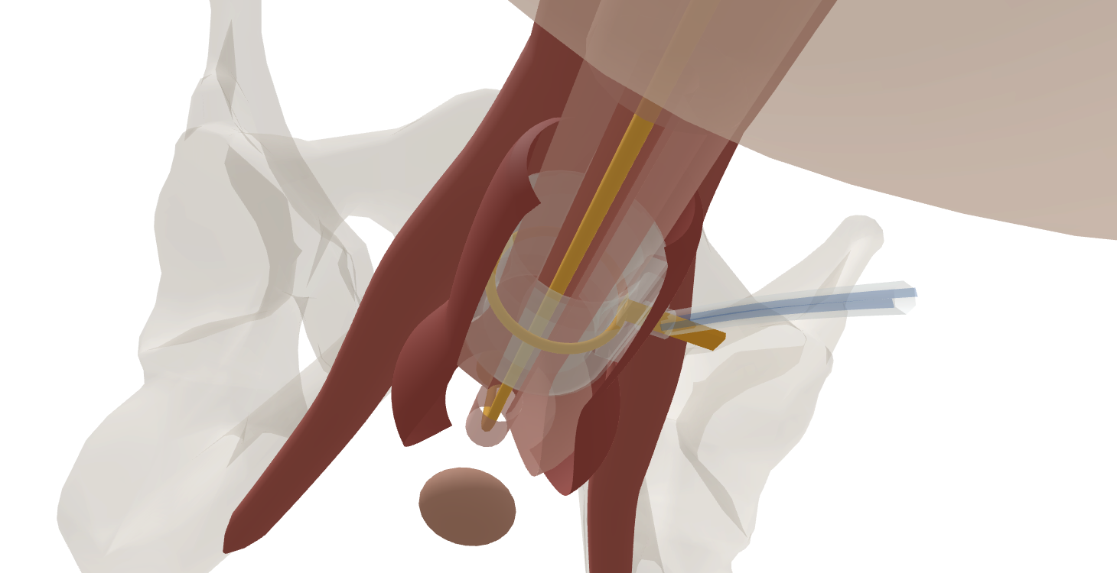
Cuff measurement and fit
Sizing errors
Release traction and artificial compression
Confirm which tissue the cuff will enclose
Use the exact system’s supplied sizing method
Recheck poor fit rather than increasing pressure
UroOps 3D teaching schematic. Clinical review pending.
Teaching illustration. Not patient-specific. Not a medical device.
ICS16 · CCIFU · CCSAFETY · AP23
27
Notes:
Teaching slide 27. Measurement: a tighter cuff is not a better measurement
Time 1:45. Clock 38:45-40:30.
Speaker notes
Measurement fails when the tissue being measured is not the tissue that the cuff will ultimately enclose. Retraction can stretch the urethra. A tight measuring tape can compress it. Included fat, scar or muscle can enlarge the apparent circumference. Haematoma and tissue distortion create further uncertainty.
Relax the traction, confirm the plane and use the manufacturer's sizing method. Recheck an implausible reading rather than selecting the familiar size from memory. In a reconstruction or transcorporal operation, the enclosed tissue is different; do not apply an unsupported numerical adjustment simply because it is traditional.
Too small a cuff can create excessive compression, retention and tissue injury. Too large a cuff can leave poor coaptation and persistent leakage. Neither problem is reliably solved by choosing a stronger pressure-regulating balloon.
Assess the final relationship and device function, with an appropriate integrity check when indicated. If the finding and measurement disagree, investigate the discrepancy. The early ContiClassic safety series included revisions attributed to sizing errors, which reinforces the practical importance of this step without telling us which sizing strategy is superior.
More available sizes may help a surgeon choose a fit. Their availability alone is not evidence of better long-term continence or less erosion.
References: ICS16 https://www.ics.org/folder/standardisation/current-ics-standardisations/d/artificial-urinary-sphincter-report-of-the-2015-consensus-conference/download; CCIFU https://www.rigicon.com/files/e-labeling/ContiClassic-IFU.pdf; CCSAFETY https://pubmed.ncbi.nlm.nih.gov/37543658/; AP23 https://doi.org/10.1111/iju.15083.
Evidence status: Sizing principles are consensus/IFU-supported. No universal undersizing rule or comparative clinical benefit from finer cuff increments is asserted.
Image source: https://uroops3d.com/lab/aus . Captured 30 September–1 October 2026 (UTC). © UroOps3D / UroRef / Nity G. The site describes this as a schematic ContiClassic model with clinical review pending. Images illustrate spatial relationships, not validated anatomy, tissue perfusion or operative instructions.
3D: the sizer sits round the proximal bulbar urethra without compressing it; the ghosted cuff beside it shows where the tubing will leave laterally.

