Slide 1
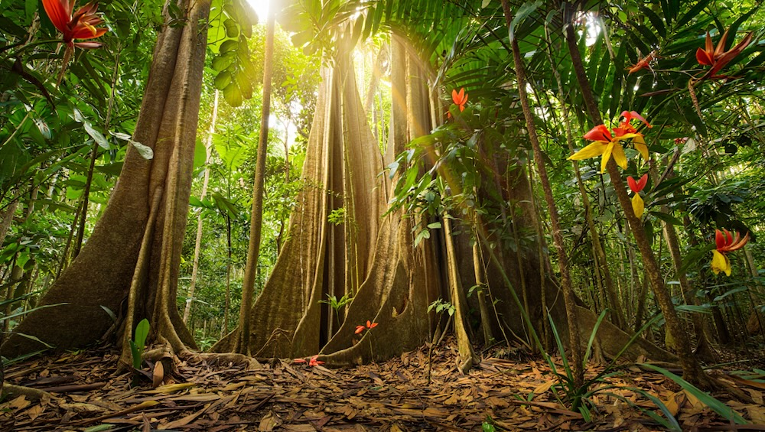
Strong warm sunlight
Large red/yellow flowers
Large butress root trees
Leaf-covered ground

Slide 2
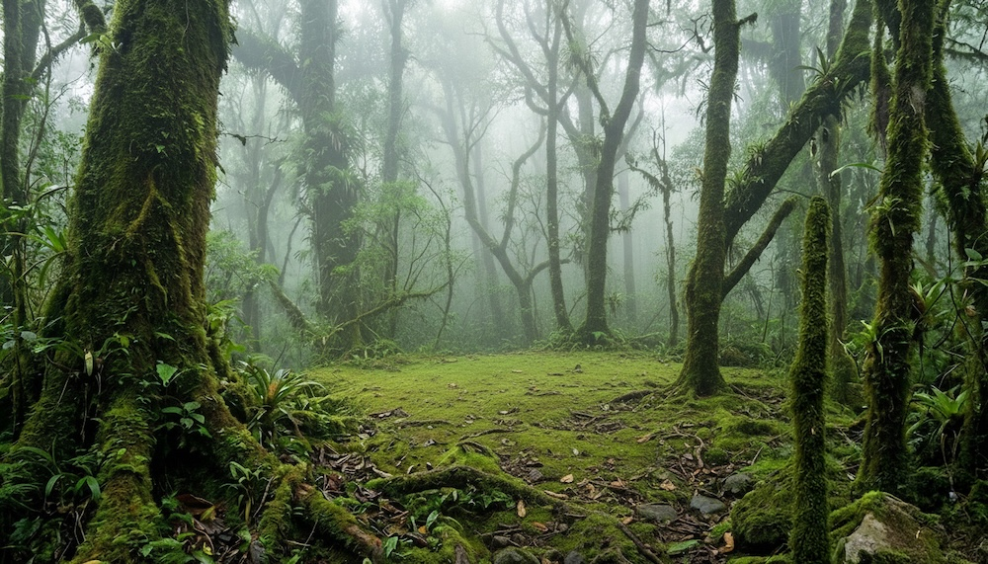
Visible mist
Cool, dim, diffuse lighting
Thick moss covering trees and ground

Slide 3
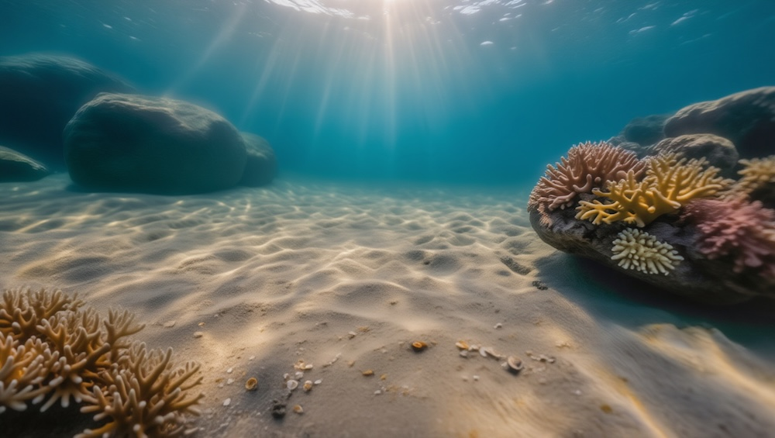
Strong visible sun rays through clear water
Pale rippled sand covering the seafloor
Colorful coral on larger rocks

Slide 4
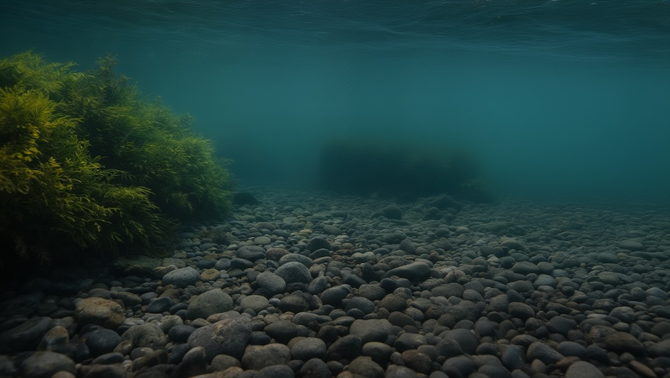
Slightly hazy water with diffuse light (no sun beams)
Green/yellow aquatic seaweed
Smooth rounded pebbles covering the ground

