Slide 1
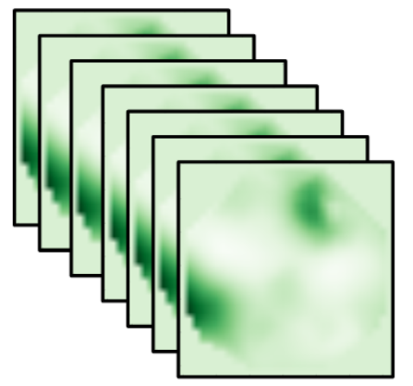
a
case transformation
boundary
target case
study kernel
source case
converter trace
verified answer
b
certificate obligations
O1 structure
O2 privacy
O3 physics
O4 result
checked before trust
c
proof-carrying run
yes
release
valid?
auditable trusted base
target case
certificate
PCC verifier
reject
no
Fig. 1. Proof-carrying canonicalization links obfuscated power-grid cases to verifiable study results.
Notes:
[Sources] Structure from manuscript Fig. 1; components copied from supplied ML Visual library slides 7, 8, 44, and 126.

Slide 2
Copied components from the supplied ML Visual library
All parts remain editable PowerPoint objects.
slide 7 tensor cube
slide 7 feature cube
slide 8 3D block
slide 44 grid block
slide 7 plane
slide 126 stack
slide 8 evidence stack
slide 7 compact cube
slide 44 large grid
slide 8 output block
Notes:
[Sources] Components copied from supplied ML Visual library slides 7, 8, 44, and 126.

