Slide 1
William Stallings Computer Organization and Architecture 10th Edition
Chapter 15
Reduced Instruction Set Computers
Notes:
RISC缩写

Slide 2
Key points
Studies of the execution behavior of high-level language programs provide guidance in designing RISC:
Assignment predominate->simple movement of data should be optimized
Many IF and LOOP instructions->sequence control mechanism needs to be optimized for pipelining
Operand reference patterns->keeping a moderate number of operands in registers
Key characteristics of RISC
a limited instruction set with a fixed format (RI)
A large number of registers, optimization of register usage (Fast)
Optimized pipeline (Efficient)
RISC is efficient for pipeline (Why? delay branch technique is fit for RISC)
Notes:
对高级语言程序的研究知道产生了RISC
-赋值语句；
-if语句、loop循环：流水线的条件转移处理方式；
-保留一定数量的操作数在寄存器中；
指令集有限，格式固定——精简RI；
大量寄存器——高效；
最重要的应用——流水线；

Slide 3
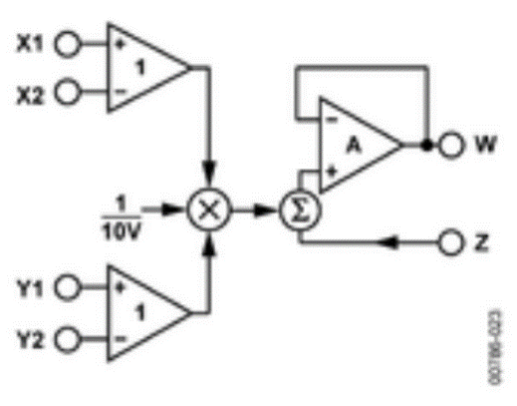
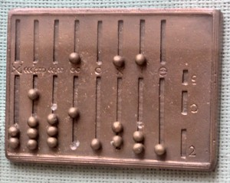


Major Advances in Computers
The family concept
IBM System/360 1964
DEC PDP-8
Separates architecture from implementation
X*Y=?
The Roman Abacus, 500 B.C.
The ENIAC, 1946
Notes:
系列的概念：来自system/360
机器结构和具体实现解耦；
不同价格和性能的一组PC，对用户来说结构相同。
乘法器的实现：成本、复杂度等。

Slide 4
Major Advances in Computers
Microprogrammed control unit
Idea by Wilkes 1951
Produced by IBM S/360 1964
Cache memory
IBM S/360 Model 85 in 1968
Pipelining
Introduces parallelism into fetch execute cycle
Multiple processors

Slide 5
The Next Step - RISC
Reduced Instruction Set Computer
Key features
Large number of general purpose registers
or use of compiler technology to optimize register use
Limited and simple instruction set
Emphasis on optimising the instruction pipeline

Slide 6
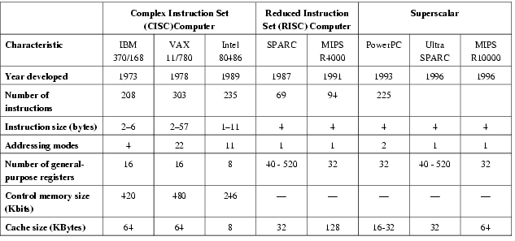
Comparison of processors

Slide 7
15.1 Instruction execution characteristics
Operations performed
Operands used
Execution sequencing

Slide 8
Driving force for CISC
Software costs far exceed hardware costs
Increasingly complex high level languages
Semantic gap： the difference between the operations provided in HLLs and those provided in computer architecture
Semantic gap
Execution inefficiency
Excessive machine program size
Compiler complexity
1.Large instruction sets
2.More addressing modes
3.Various HLL statements implemented in hardware. e.g. CASE (switch) on VAX
Notes:
Gap的症状包括：执行效率低下、机器程序过大和编译器复杂。
设计人员解决办法有：1.Large instruction sets；2.More addressing modes 3.Hardware implementations of HLL statements

Slide 9
Intention of CISC
Such complex instruction sets are intended to:
Ease compiler writing
Improve execution efficiency
Complex operations in microcode
Support more complex HLLs
Never forget why CISC started.
Notes:
CISC的本意,
不忘初心，方得始终

Slide 10

A different approach
Make the architecture that support the HLL simpler, rather than more complex
Need A New
Architecture
simple
complex
HLL

Slide 11
Execution Characteristics
Operations performed
Operands used
Execution sequencing
Studies have been done based on programs written in HLLs
Dynamic studies are measured during the execution of the program

Slide 12
Operations
Assignments
Movement of data
Conditional statements (IF, LOOP)
Sequence control
Procedure call-return is very time consuming
Some HLL instruction lead to many machine code operations
(next diagram)
Notes:
主要关注的操作类型；

Slide 13
Weighted Relative Dynamic Frequency of HLL Operations [PATT82a]
Dynamic Occurrence
Machine-Instruction Weighted
Memory-Reference Weighted
Pascal
C
Pascal
C
Pascal
C
ASSIGN
45%
38%
13%
13%
14%
15%
LOOP
5%
3%
42%
32%
33%
26%
CALL
15%
12%
31%
33%
44%
45%
IF
29%
43%
11%
21%
7%
13%
GOTO
—
3%
—
—
—
—
OTHER
6%
1%
3%
1%
2%
1%
Notes:
设计RISC的依据；

Slide 14
Operands
Mainly local scalar variables
Optimization should concentrate on accessing local variables
Pascal
C
Average
Integer Constant
16%
23%
20%
Scalar Variable
58%
53%
55%
Array/Structure
26%
24%
25%

Slide 15
Procedure Calls
Very time consuming
Depends on number of parameters passed
Depends on level of nesting
Most programs do not do a lot of calls followed by lots of returns
Most variables are local
(c.f. locality of reference)
98% of dynamically called procedures were passed fewer than six arguments and that 92% of them used fewer than six local scalar variables
Narrow window of procedure nesting depth

Slide 16
Implications
Best support is given by optimising most used and most time consuming features
Use a large number of registers or use a compiler to optimize register usage
Optimize operand referencing
Careful design of pipelines
The high proportion of conditional branch and procedure call instructions->pipeline inefficient
Simplified (reduced) instruction set
Instructions should have predictable costs and a high performance implementation.

Slide 17
15.2 The use of a large register file
Register windows
Global variables
Large register file versus cache

Slide 18
Large Register File
Software solution
Require compiler to allocate registers
Allocate based on most used variables in a given time
Requires sophisticated program analysis
Hardware solution
Have more registers
Thus more variables will be in registers
Notes:
两大方法，集中讲硬件方法

Slide 19

Registers for Local Variables
Use of large set of registers reduces memory access
Design task is to organize the registers
Store local scalar variables in registers
Every procedure (function) call changes locality. -->local variables must be saved from reg. to memory.
Parameters must be passed
Results must be returned
Variables from calling programs must be restored
Notes:
使用large reg的目的；
遇到的locality的问题；

Slide 20


Register Windows
Only few parameters
Limited range of depth of call
Use multiple small sets of registers
Calls switch to a different set of registers
Returns switch back to a previously used set of registers
Register
Windows
Notes:
观察call-return过程，研究解决方案；

Slide 21
Register Windows cont.
Three areas within a register set
Parameter registers
Local registers
Temporary registers
Temporary registers from one set overlap parameter registers from the next
This allows parameter passing without moving data
Notes:
指导了“寄存器窗口”的概念产生；
Overlap物理同一；

Slide 22
Overlapping Register Windows
overlap
overlap
Temporary registers : For parameters to deeper called functions, the return value from deeper function calls
Notes:
void main(){
int a1,a2,a3;
a3=A(a1,a2);
}
int A(int a1,int a2){
int b1,b2,b3,b4;
b1=a1+a2;
b2=a1-a2;
b3=B(b1,b2);
b4=b3+1;
return b4;}
int B(int b1,int b2){ return b1+b2;}
A函数调用B函数时，b1，b2和b3放在A的temporary Reg、也就是B的Parameter Reg中。

Slide 23
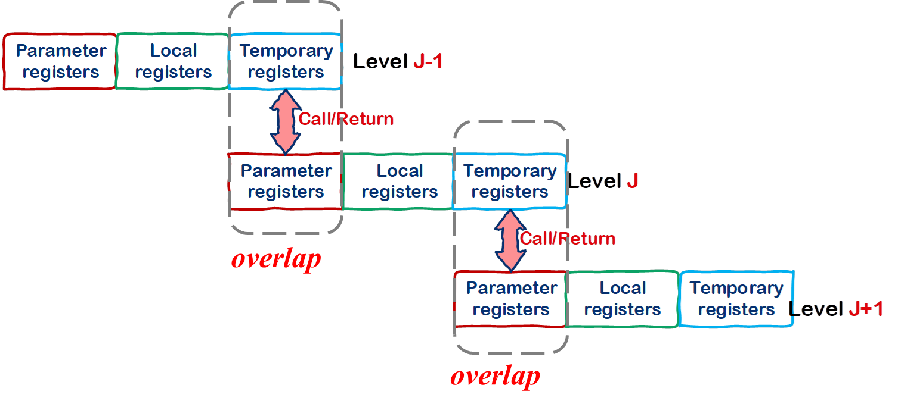
Overlapping Register Windows
void main(){
int a1, a2, a3;
a3 = A(a1, a2);
}
int A(int a1, int a2){
int b1,b2,b3,b4;
b1 = a1 + a2;
b2 = a1 - a2;
b3 = B(b1, b2);
b4=b3+1;
return b4;}
int B(int b1, int b2){ return b1+b2;}
A函数调用B函数时，b1，b2和b3放在A的temporary Reg、也就是B的Parameter Reg中。
Notes:
void main(){
int a1,a2,a3;
a3=A(a1,a2);
}
int A(int a1,int a2){
int b1,b2,b3,b4;
b1=a1+a2;
b2=a1-a2;
b3=B(b1,b2);
b4=b3+1;
return b4;}
int B(int b1,int b2){ return b1+b2;}
A函数调用B函数时，b1，b2和b3放在A的temporary Reg、也就是B的Parameter Reg中。

Slide 24
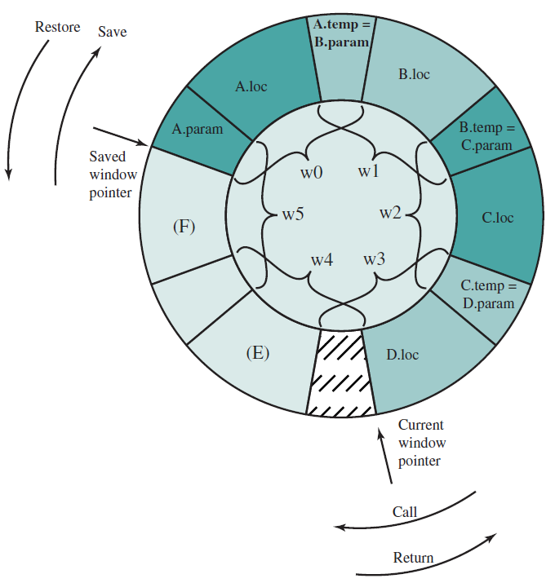
Circular Buffer diagram
Call process:
CWP++;
If CWP = SWP (mod W)
Save window;
SWP++;
Call;
Else
Call;
Return Process:
CWP--;
If CWP = SWP (mod W)
Restore window;
SWP--;
Return;
Else
Return;
SWP
CWP
Notes:
99%的call-return过程限制在8窗口深度（有限深度的窗口）；
图示为6窗口的环形0~5

Slide 25
Operation of Circular Buffer
When a call is made, a current window pointer is moved to show the currently active register window
If all windows are in use, an interrupt is generated and the oldest window (the one furthest back in the call nesting) is saved to memory
A saved window pointer indicates where the next saved windows should restore to
An N-window register file can hold only N-1 procedure activations

Slide 26
Operation of Circular Buffer
memory
When CWP is incremented and becomes equal to SWP,
An interrupt occurs,
Window A is saved to memory
The SWP is incremented
The call to F proceeds.
memory
When B returns to A, CWP is decremented and becomes equal to SWP. This causes an interrupt that results in the restoration of A’s window.

Slide 27
Register Window based Call and Return
Call : A -> B -> C -> D -> E -> F -> G -> H
CWP: 0 1 2 3 4 5 0 1
SWP: -1 -1 -1 -1 -1 0 1 2
Return : A <- B <- C <- D <- E <- F <- G <- H
CWP: 0 1 2 3 4 5 0 1
SWP: -1 0 1 2 2 2 2 2

Slide 28
Global Variables
Allocated by the compiler to memory
Inefficient for frequently accessed variables
Have a set of registers for global variables
Notes:
多个过程使用；
两种解决方法：

Slide 29
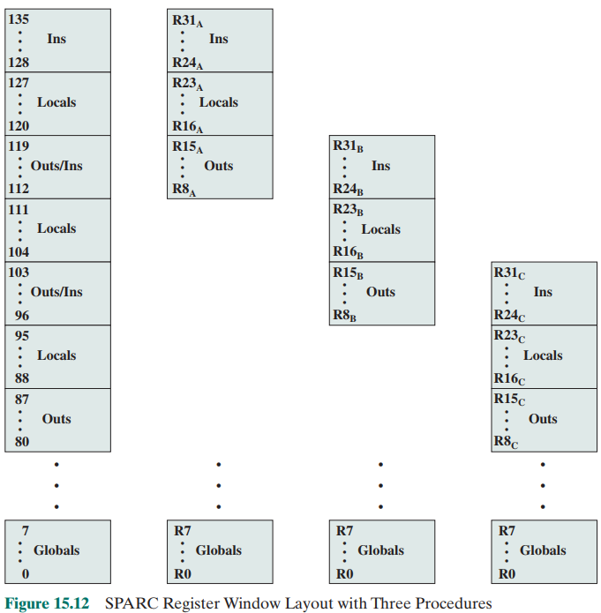
Register Windows cont.
Each window consists of 24 registers.
Physical registers 0~7 are global registers shared by all procedures.
Each procedure sees logical registers 0 through 31.

Slide 30
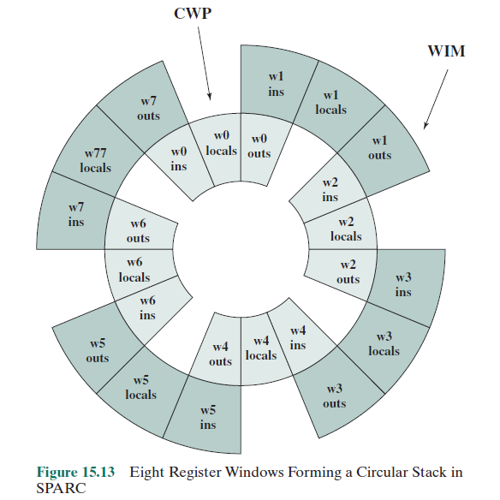
A Circular Stack in SPARC

Slide 31
Registers vs Cache
Large Register File
Cache
All local scalars
Recently-used local scalars
Individual variables
Blocks of memory
Compiler-assigned global variables
Recently-used global variables
Save/Restore based on procedure nesting depth
Save/Restore based on cache replacement algorithm
Register addressing
Memory addressing
Notes:
虽然都是高速缓冲器，但是调用机制不同，决定了二者无法替代对方；

Slide 32
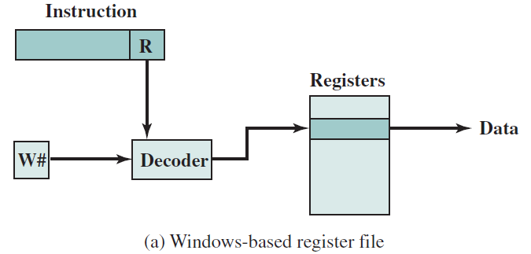
Referencing a Scalar - Window Based Register File

Slide 33
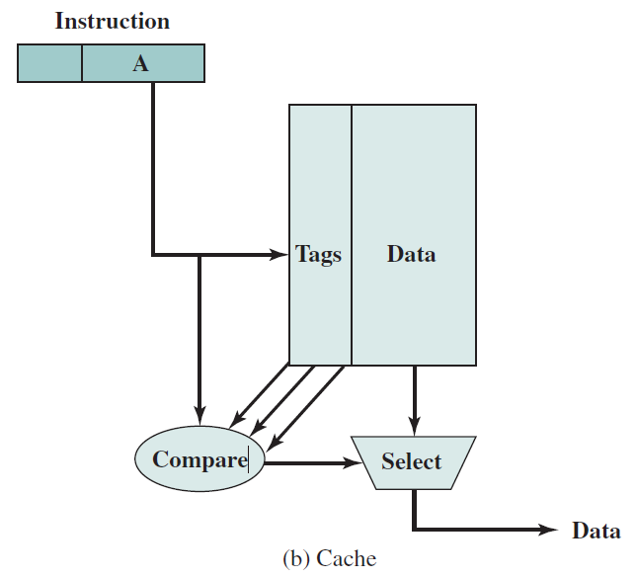
Referencing a Scalar - Cache

Slide 34
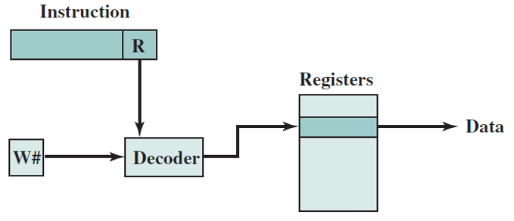
15.3 Compiler Based Register Optimization
RISC ：Assignment predominate->simple movement of data should be optimized
Hardware solution
Memory access ; Reg. access
Have more registers：A large register file

Slide 35
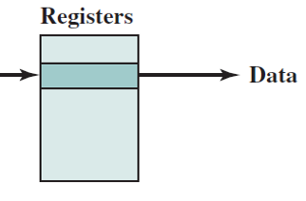
Compiler Based Register Optimization
Software solution
Require compiler to allocate registers
int function1(int i)
{
int a;
int b;
int c;
……
return c;
}
Variables
unlimited Symbolic/virtual Register
Map
a fixed number of real registers
1
2
…
32
Notes:
Allocate based on most used variables in a given time
Requires sophisticated program analysis

Slide 36

Compiler Based Register Optimization
Assume small number of registers (16-32)
Optimizing use is up to compiler
HLL programs have no explicit references to registers
Compiler task
Map :Assign symbolic or virtual register to real register
Rules:
Symbolic registers that do not overlap (?) can share real registers
If you run out of real registers, some variables use memory
How to map?
Graph Coloring

Slide 37


The Four Color Problem
The Four Color Problem dates back to 1852 : Francis Guthrie→ Frederick →De Morgan → Hamilton(1865)
The first printed reference is due to Cayley in 1878.
In 1890, every planar map can be colored with Five Colors.
It influenced the development of certain branches of graph theory. In 1976 an affirmative answer to the four-colour problem, with the use of a computer, was announced.
Notes:
1852年，弗朗西斯试着给英国地图着色，问它读大学的弟弟, 问他的老师De Morgan，老师问他的好友汉密尔顿（数学家），1865年去世了也没有解决这个问题。
后来，到了1878年，当时英国著名的数学家凯莱向伦敦数学学会提出了这个问题。

Slide 38
Graph Coloring – Mapping Method
Given a graph of nodes and edges
Assign a color to each node
Adjacent nodes have different colors
Use minimum number of colors
Nodes:Symbolic Reg
Two registers that are live in the same program fragment are joined by an edge
Color the graph with n colors. (n is the number of real Reg.s)
Nodes that can not be colored are placed in memory.
Notes:
图例说明 图着色法
Nodes are symbolic registers
Two registers that are live in the same program fragment are joined by an edge

Slide 39
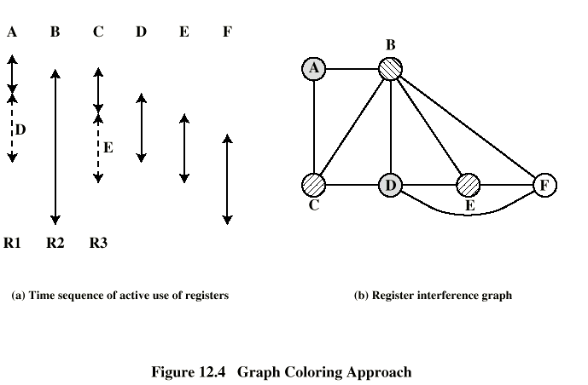
Graph Coloring Approach
Live
Time
1)Color a node with the smallest degree.
Degree(A,B,C,D,E,F)=[2,5,3,4,3,3]
2) Color a non-adjacent node
Symbolic Reg
？
placed in memory
Real Reg
Notes:
Draw diagram yourself

Slide 40
Graph Coloring Approach
placed in memory
placed in memory
？
？
1) Color a node with the smallest degree. Degree(A,B,C,D,E,F)=[2,5,3,4,3,3]
2) Color a non-adjacent node until we cannot find them.
3) Go to step1) and color the remaining nodes with a new color.
Notes:
Draw diagram yourself

Slide 41
15.4 Reduced Instruction Set Architecture
Why CISC(a desire to simplify compilers & a desire to improve performance)
RIS Architecture Characteristics
RISC vs CISC
Notes:
总结回顾RISC的结构特点

Slide 42
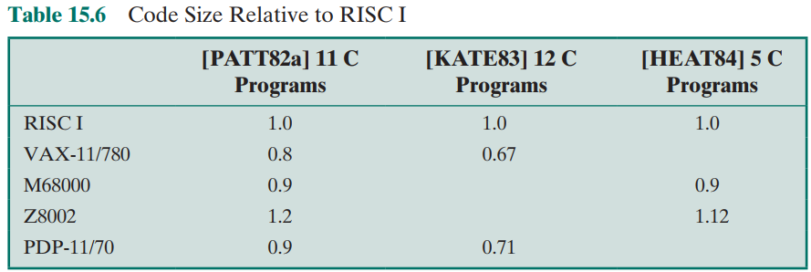
Why CISC
Compiler simplification?
Complex machine instructions harder to exploit
Complier Optimization more difficult
Smaller programs?
Program takes up less memory but memory is now cheap
May not occupy less bits (Table 15.6)
Notes:
三个支持CISC的基本理由：
简化编译器；
更小的程序；
更快的程序；

Slide 43
Why CISC
Faster programs?
Bias towards use of simpler instructions
More complex control unit
Microprogram control store larger
Increase the execution time of simple instructions
CISC
Intel
AMD
RISC
ARM
Power PC
MIPS
It is far from clear that CISC is the appropriate solution
Point out some of the potential pitfalls in the CISC approach
Provide some understanding of the motivation of the RISC adherents
Notes:
三个支持CISC的基本理由：
简化编译器；
更小的程序；
更快的程序；

Slide 44
RIS Architecture Characteristics
One machine instruction per machine cycle
Machine Cycle: fetch 2 Operands from Reg. + ALU + Write Operand in Reg.
no need for Microprogram/microprogram control store
Thus faster than CISC
Register to register operations
most operations from Reg to Reg
only LOAD, STORE for memory access
Thus, Simpler (?) and faster (?) than CISC
Few, simple addressing modes
most Reg addressing mode
Simplify the instruction set and the control unit
Few, simple instruction formats
fixed instruction length, word unit (advantage?)
fixed field configuration (advantage?)
Notes:
Machine cycle:由寄存器取两个操作数，完成一个alu操作，再将结果写入寄存器的时间；

Slide 45

RISC vs CISC
Not clear cut – CISC / RISC
who is stronger than the other ???
Many designs borrow from both philosophies
e.g. PowerPC (not “pure” RISC) and Pentium II (not “pure” CISC) (table 15.7)
Notes:
各有优点，各有好处；
互相取长补短；

Slide 46
15.5 RISC Pipelining
Most instructions are register to register
and has two stages:
I: Instruction fetch
E: Execute
ALU operation with register input and output
For load and store, three stages:
I: Instruction fetch
E: Execute
Calculate memory address
D: Memory
Register to memory or memory to register operation

Slide 47
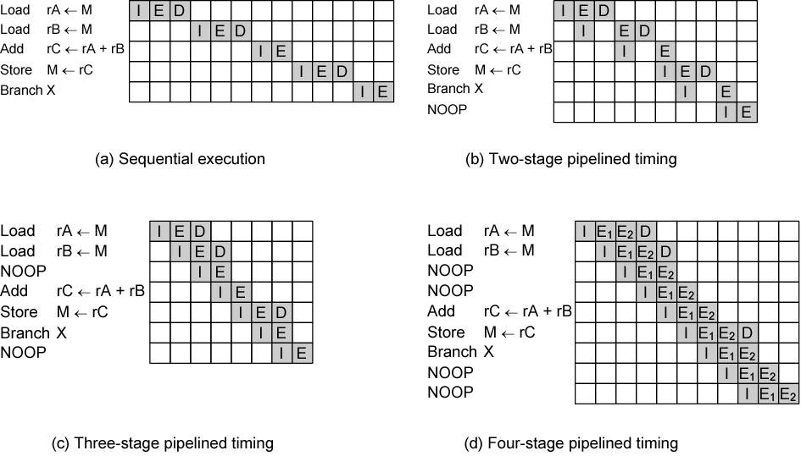
Effects of Pipelining
data dependency
branch
(No pipeline)
Only 1 memory access per stage
data dependency
data
dependency
branch
branch
Permit 2 memory accesses per stage
E₁:Reg Read; E₂: ALU & Reg Write
Notes:
在2段流水图中（同一时间只能访问一个存储器），I可以与E组合，带式I与D不能在同一时间出现，延迟I与E到下一时钟周期；
注意noop的作用：解除数据相关性、解除转移相关性；
插入noop，就不需要清除流水线的专用电路了；
图d中 Add rC<- rA+rB与Store M<-rC 之间还要插入一个noop？

Slide 48
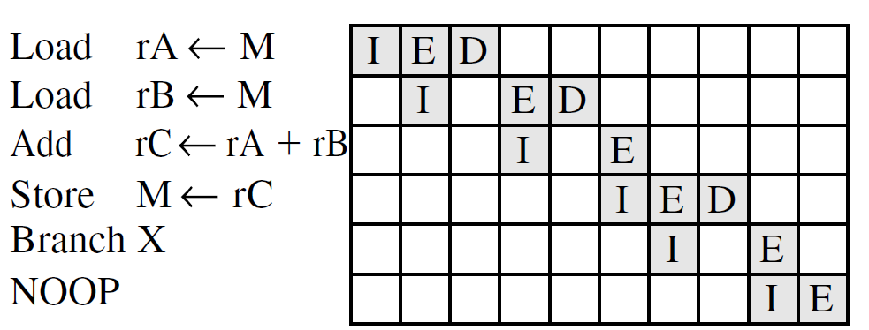
Optimization of Pipelining
Delayed branch
Makes use of a branch that does not take effect until after execution of following instruction (after NOOP)
This following instruction is in the delay slot

Slide 49
Normal and Delayed Branch
Address
Normal Branch
Delayed Branch with NOOP
Optimized Delayed Branch
100
LOAD X, rA
LOAD X, rA
LOAD X, rA
101
ADD 1, rA
ADD 1, rA
JUMP 105
102
JUMP 105
JUMP 106
ADD 1, rA
103
ADD rA, rB
NOOP
ADD rA, rB
104
SUB rC, rB
ADD rA, rB
SUB rC, rB
105
STORE rA, Z
SUB rC, rB
STORE rA, Z
106
STORE rA, Z

Slide 50
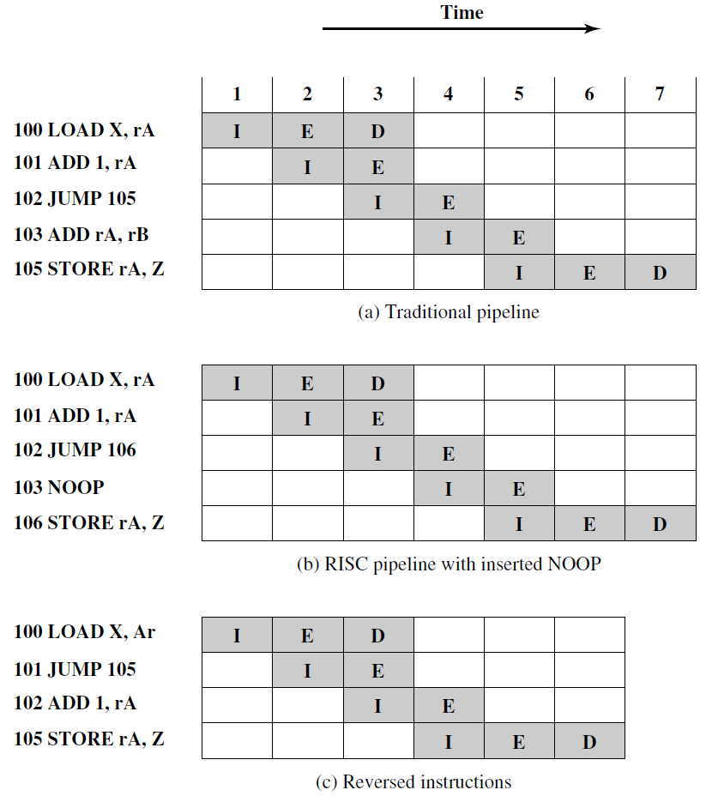

Use of Delayed Branch
the pipeline must be cleared
Notes:
既保持了原语义，又使总的时钟周期减少了一个；
需要提醒的是：reversed branch这种形式可以用于un-conditional\call-return；对于conditional来讲，插入NOOP更安全，不会对判定条件产生影响；

Slide 51
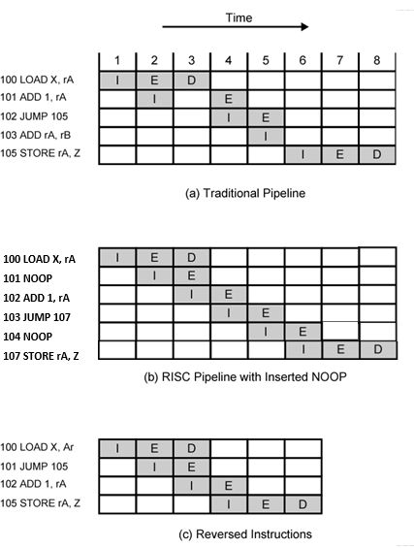
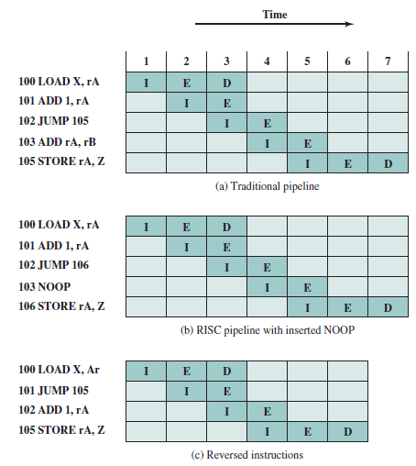
Use of Delayed Branch
Considering Data dependency
Without considering Data dependency
Notes:
无条件branch，call/return 都可以用这种交换；
条件转移，要看情况，多数可以。

Slide 52
RISC versus CISC Controversy
Quantitative
compare program sizes and execution speeds
Qualitative
examine issues of high level language support and use of VLSI real estate
Problems
No pair of RISC and CISC that are directly comparable
No definitive set of test programs
Difficult to separate hardware effects from complier effects
Most comparisons done on “toy” rather than production machines
Most commercial devices are a mixture
Notes:
试图从两个方面进行比较：定性和定量；
产生的问题：

Slide 53
CH15 Key points
Studies of the execution behavior of high-level language programs provide guidance in designing RISC:
Assignment predominate->simple movement of data should be optimized
Many IF and LOOP instructions->sequence control mechanism needs to be optimized for pipelining
Operand reference patterns->keeping a moderate number of operands in registers
Key characteristics of RISC
a limited instruction set with a fixed format (RI)
A large number of registers, optimization of register usage (Fast)
Optimized pipeline (Efficient)
RISC is efficient for pipeline (Why? delay branch technique is fit for RISC)
Notes:
对高级语言程序的研究知道产生了RISC
-赋值语句；
-if语句、loop循环：流水线的条件转移处理方式；
-保留一定数量的操作数在寄存器中；
指令集有限，格式固定——精简RI；
大量寄存器——高效；
最重要的应用——流水线；

Slide 54
Homework
Reading chapter 15
Translate Key terms
Review Questions
1, 4, 5
Problems:
2, 4, 6, 10

