Slide 2
























$$t_{4}$$
$$X_{1}<t_{1}$$
$$R_{5}$$
$$R_{6}$$
$$R_{2}$$
$$t_{3}$$
$$X_{2}<t_{5}$$
$$X_{2}<t_{2}$$
$$X_{2}$$
$$R_{4}$$
$$t_{5}$$
$$t_{2}$$
$$X_{2}<t_{3}$$
$$R_{1}$$
$$R_{3}$$
$$R_{1}$$
$$R_{2}$$
$$R_{3}$$
$$t_{1}$$
$$X_{1}$$
$$X_{1}<t_{4}$$
$$R_{4}$$
$$R_{5}$$
$$R_{6}$$

Slide 3









$$R_{2}$$
$$R_{1}$$
$$R_{3}$$
$$X_{2}$$
$$X_{2}$$
$$R_{2}$$
$$R_{1}$$
$$X_{1}$$
$$X_{1}$$

Slide 4
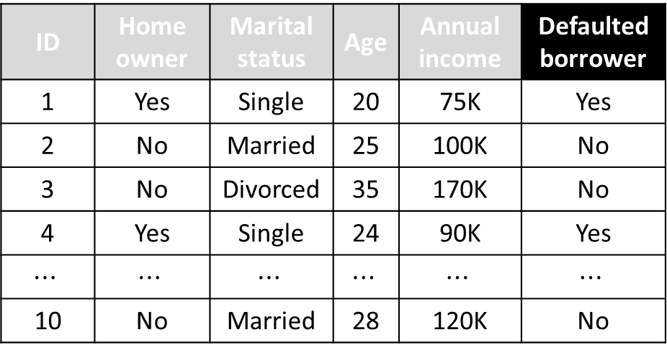
binary target
binary
categorical
integer
continuous
ID | Home owner | Marital status | Age | Annual income | Defaulted borrower
1 | Yes | Single | 20 | 75K | Yes
2 | No | Married | 25 | 100K | No
3 | No | Divorced | 35 | 170K | No
4 | Yes | Single | 24 | 90K | Yes
$$⋯$$ | $$⋯$$ | $$⋯$$ | $$⋯$$ | $$⋯$$ | $$⋯$$
10 | No | Married | 28 | 120K | No

Slide 5



Training examples
$$\left(x_{1}{,y}_{1}\right),\left(x_{2},y_{2}\right),…,\left(x_{N},y_{N}\right)$$
Optimized
Model
Learning System
Unseen testing data
$$x$$
Prediction System
$$y$$

Slide 6
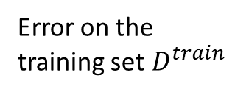
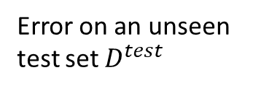
Error
Error on an unseen test set $D^{test}$
Error on the training set$D^{train}$
Simple model
Complex model

Slide 7
Perfect classifier
B
0.0
0.2
TPR
A
1.0
0.4
0.6
0.8
0.0
0.2
0.4
0.6
0.8
1.0
FPR

