Slide 1
CS 548 Project 2 Classification & Regression
ROHITPAL SINGH
SUCHITHRA BALAKRISHNAN
MU NIU

Slide 2

Dataset description
Credit card default situation in Taiwan
April to September, 2005
30,000 instances
24 attributes (including target attributes)
9 nominal attributes
14 numerical attributes
No missing value

Slide 3
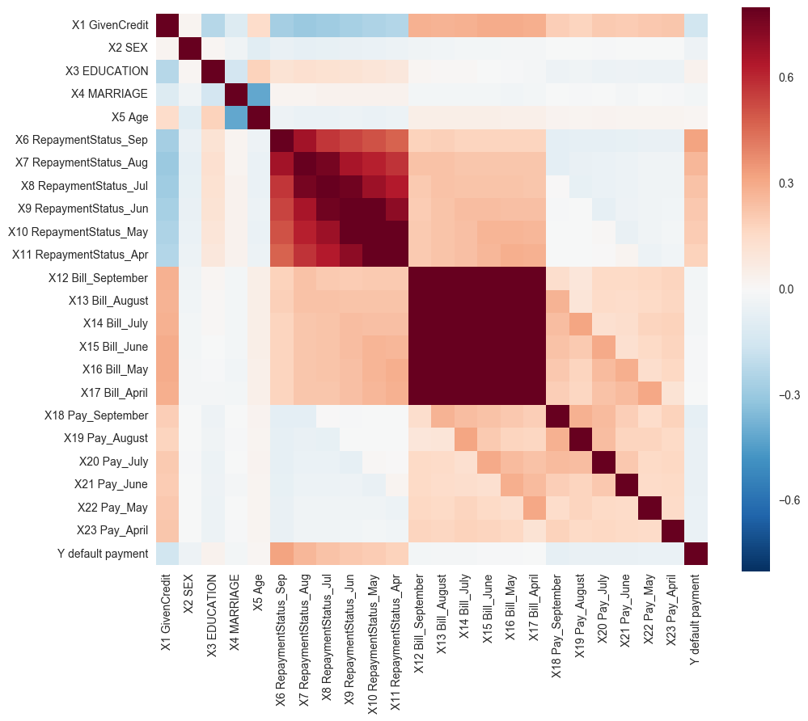
Data exploration
X3 education have 7 values instead of 4 as descripted
Lower correlation. with target attributes among continuous attributes.
Unclear statement and explanation on dataset

Slide 4
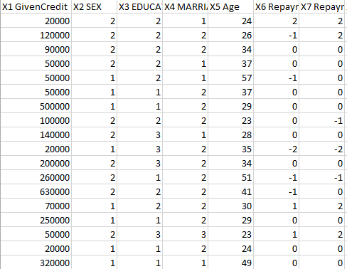
Data initial preprocessing
Remove ID column
Combine the first two lows into one
Replace value 5,6,0 in attribute X3 as 4

Slide 5
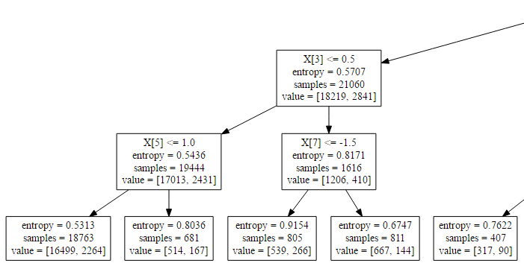
J4.8 Description
Input:
Output:
entropy based
Calculating information gain
information gain = entropy(target)
- entropy(target, attribute)
Stopping point
No information gain
Pruning tree
information gain <= 0.25

Slide 6

M5P Description
Input:
Output:
SDR based
Calculating SDR
Stopping point
negative SDR
# of instances less that 4
Pruning tree

Slide 7
Python packages & functions

Slide 8
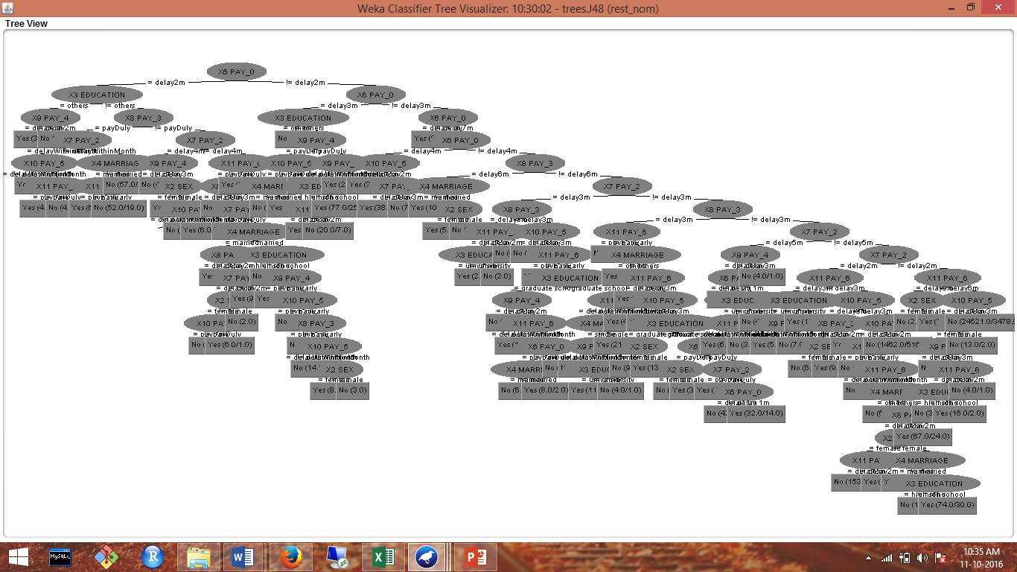
Classification Experiment (Weka)
ZeroR
OneR
Decision tree (High accuracy with just nominal data)

Slide 9
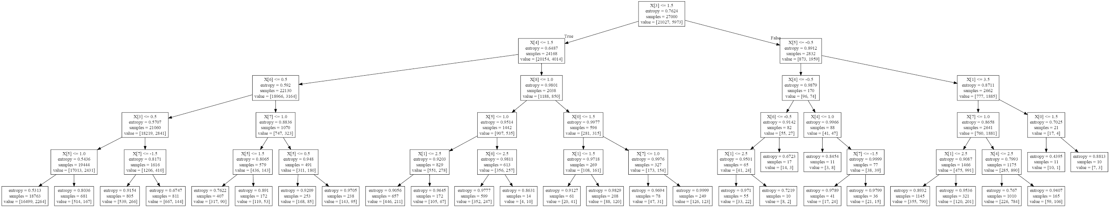
Classification Experiment (Python)
ZeroR
OneR
Decision tree (Best with just nominal data)

Slide 10
Classification Experiment (Python)
Tech. | ZeroR
Guiding questions | 2
Pre-process | NA
Parameters | Y
Post-process &Pruning | NA
Accuracy, Precision, Recall, ROC Area | 77.88%
Time to build model | 0.0 s
Size of model | 2
Interesting patterns in the model | We don’t need to think about attribute other than the target attribute.
Analysis & observations about experiment | the accuracy is the same as percentage of target attribute with value 0. It takes the shortest time.
How education influence the default action? Which education level have most defaulters by percentage?
Which method will give the least processing time?
Is credit limit determine or at least, highly related with default activity?

Slide 11
Classification Experiment (Python)
How education influence the default action? Which education level have most defaulters by percentage?
Which method will give the least processing time?
Is credit limit determine or at least, highly related with default activity?
Tech. | OneR | OneR | OneR
Guiding questions | 1,2 | 1,2 | 3
Pre-process | NA | NA | NA
Parameters | X6, Y | X3, Y | X1, Y
Post-process &Pruning | NA | NA | NA
Accuracy, Precision, Recall, ROC Area | 81.99% | 77.88% | 77.88%
Time to build model | 0.09 s | 0.02 s | 0.02 s
Size of model | 22 | 162 | 8
Interesting patterns in the model | X6 is the best attribute in both nominal and continuous attributes | The result is no better than ZeroR method. | The result is no better than ZeroR method.
Analysis & observations about experiment | Adding one highly correlated attribute improve accuracy significantly. | Education is not deterministic attributes for prediction | Credit limit is not a good representative on target attribute.

Slide 12
Classification Experiment (Python)
How education influence the default action? Which education level have most defaulters by percentage?
Which method will give the least processing time?
Is credit limit determine or at least, highly related with default activity?
Tech. | Decision tree | Decision tree | Decision tree
Guiding questions | 1,2,3 | 1,2,3 | 1,2
Pre-process | NA | Discretize | Dice
Parameters | All | All | nominal
Post-process &Pruning | NA | NA | NA
Accuracy, Precision, Recall, ROC Area | 81.19% | 81.65% | 82.09%
Time to build model | 13.4 s | 2.45 s | 1.13 s
Size of model | 588 | 625 | 62
Interesting patterns in the model | It takes a long time to form a huge tree. | Node number decreased after discretize, but accuracy increases | It actually more accurate if we use nominal attributes only
Analysis & observations about experiment | The tree is too big to analyze, we need to find a way to shorten it | The tree size and accuracy haven’t changed enough after discretization. | The first splitting point is X3<=1.5,

Slide 13

Classification summary
ZeroR can considered as an accuracy benchmark
X3 (education) is not highly related with Y, but splitting it with graduate and other level of education gives highest information gain.
Credit limit can’t be used to predict target attribute

Slide 14
Regression Experiment (Weka)

Slide 15
Regression Experiment (Python)

Slide 16
Regression summary

Slide 17
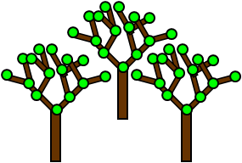
Advanced topic – Random forest
RANDOM FOREST = DECISION TREE ALGORITHM + BAGGING TECHNIQUE
Handles Missing values
Finds Outliers
High accuracy
Efficient on large data set

Slide 18
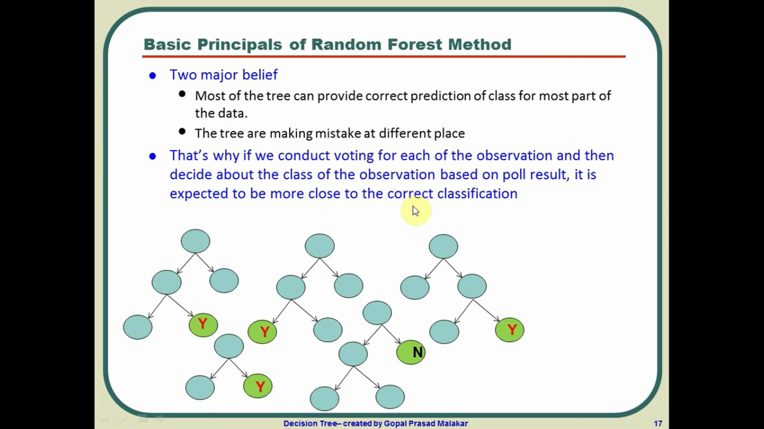
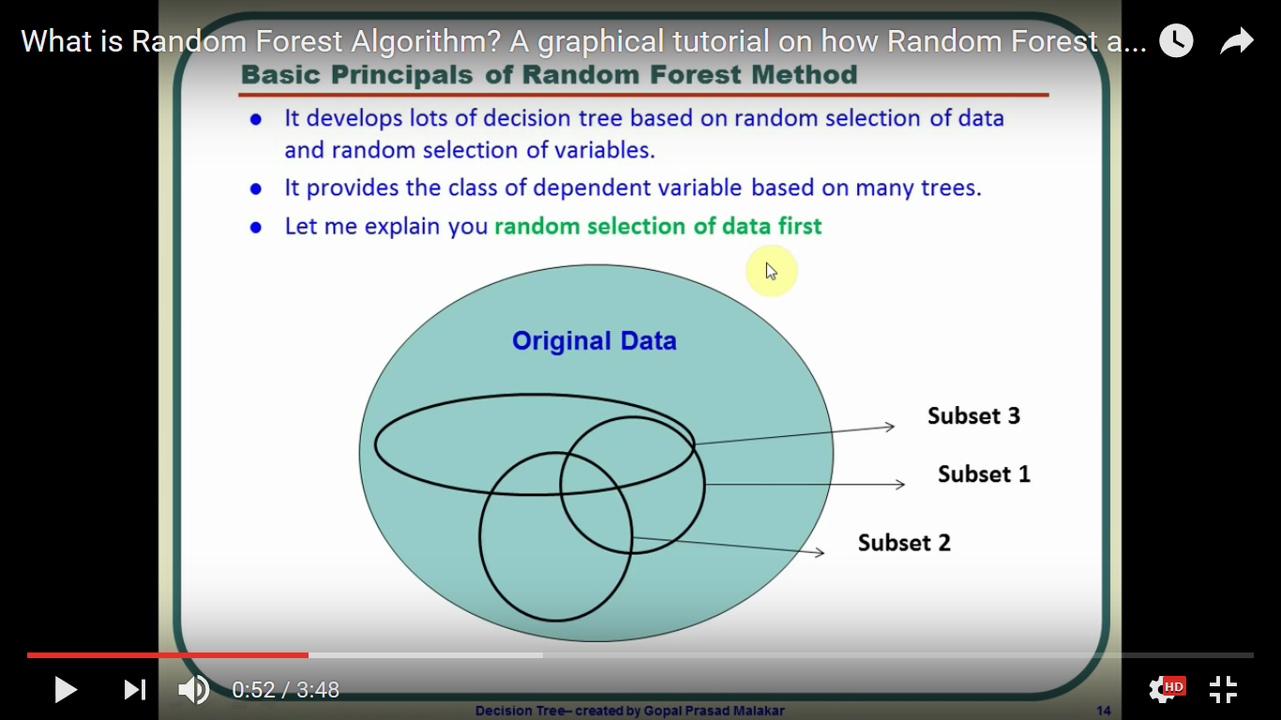
Bagging technique
Bootstrap sampling
Decision trees creation

Slide 19
Out-of-bag (OOB) error evaluation

Slide 20
