Slide 1
CS 548 Project 3 ASSOCIATION RULE MINING
ROHITPAL SINGH
SUCHITHRA BALAKRISHNAN
MU NIU

Slide 2

Dataset description
Mainly causes for heart disease
Sex
Age
Resting blood pressure
297 instances, 14 attributes
Target attribute: #58(num):
Diagnosis of heart disease
6 missing values(removed row)

Slide 3
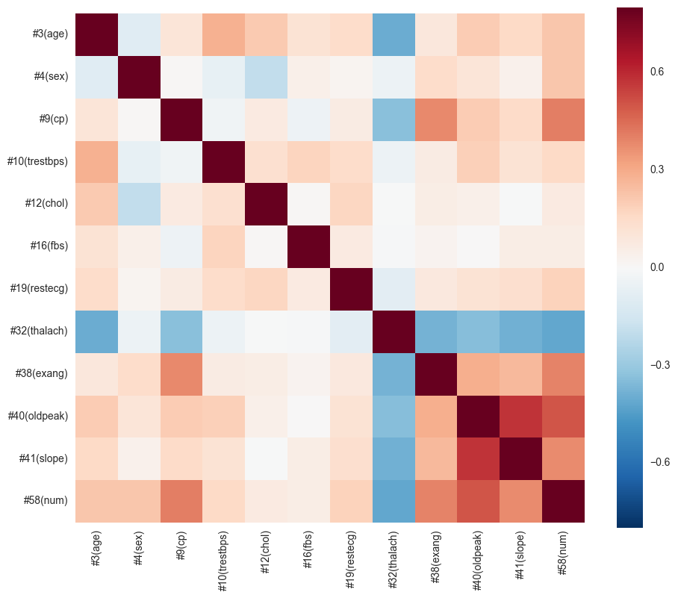
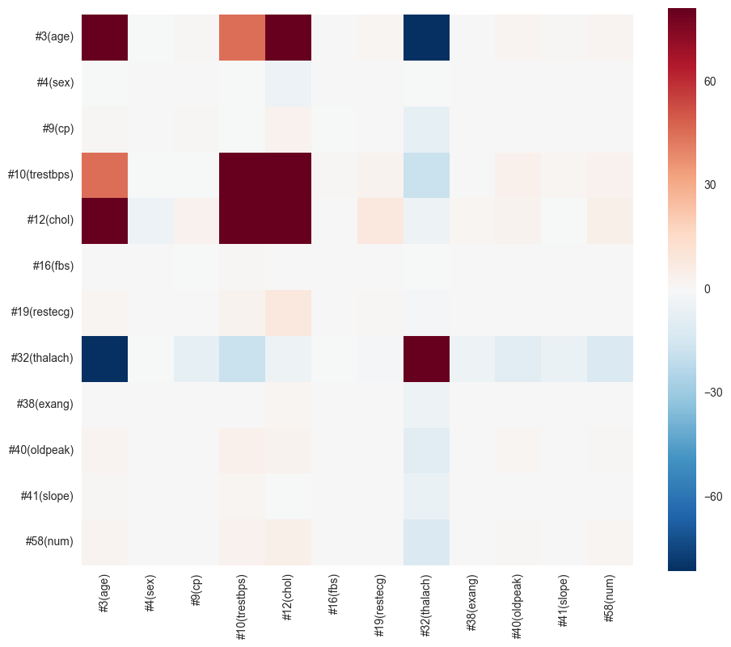
Data exploration
Last four attributes and the third attribute are linear correlated with target attribute
#10(trestbps): resting blood pressure and #12(chol):serum cholestoral in mg/d move together
#16(fbs) shows low correlation with other attributes, but it’s crucial in forming association rules

Slide 4
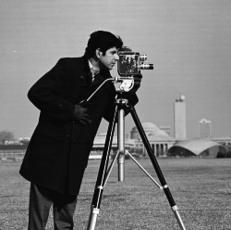
Data initial preprocessing
Change nominal attributes’ value to text
Remove missing values (row)
Discretise continuous attributes
Unsupervised discretization
Equal width
10 bins
https://www.mathworks.com/help/images/use-imregcorr-as-a-preprocessing-step-in-a-registration.html?requestedDomain=www.mathworks.com

Slide 5
Association Rules Code Description

Slide 6
Classification Association Rule Code Description

Slide 7

Experiments
Guiding questions:
Do men tend to have higher chest pain? Does it mean they have higher risk to have heart disease?
What is the mainly associated symptoms of lower blood sugar?
Which medical condition of person is less likely to have heart disease?
https://blogs.thegospelcoalition.org/kevindeyoung/2016/04/29/what-i-have-learned-about-pastoral-care-by-going-to-the-doctor/

Slide 8
Experiments -- 1
1. Do men tend to have higher chest pain? Does it mean they have higher risk to have heart disease?
 | Weka | Python
Tech. | CAR | AR |  | CAR
Pre-processing | Subset selection | Subset selection |  | Subset selection
Mincof/Minsup | 0.1/0.3 | 0.01/0.8 | 0.01/0.35 | 0.01/0.35
Association rule | #4(sex)=male ==> #58(num)=<50% | #58(num)=TRUE → #4(sex)=male |  | 4(sex)=female, 9(cp)=AtypicalAngina → 58(num)=FALSE
 | #4(sex)=female ==> #58(num)=<50% | #4(sex)=female → #9(cp)=Non-anginaPain
Explanation | From these rules we can say that female have higher confidence of not getting the heart disease than men | Men tends to suffer from higher risk to get heart disease. Female tend to have less chest pain compared to male.

Slide 9
Experiments -- 2
2. What is the mainly associated symptoms of lower blood sugar?
 | Weka | Python
Tech. | AR | AR
Pre-processing | Discretize | Discretize
Mincof/Minsup | 0.2/0.9 | 0.25/0.9
Association rule | #40(oldpeak)='(-inf-0.62]‘ #44(ca)=noVesselColored #51(thal)=Normal #58(num)=<50% ==> #16(fbs)=FALSE | #44(ca)=NoVesselColored, #51(thal)=Normal →#16(fbs)=FALSE
Explanation | If a person has no fasting blood sugar, then they tend to not have heart disease and has no major blood vessels colored | If a person have lower fasting blood sugar (<= 120 mg/dl), then we can say with more than 90% confidence that this person has no major vessels colored by fluoroscopy and does not have thalassemia.

Slide 10
Experiments -- 3
3. Which medical condition of person is less likely to have heart disease?
 | Weka | Python
Tech. | CAR | CAR
Pre-processing | Discretize | Discretize
Mincof/Minsup | 0.15/0.9 | 0.15/0.9
Association rule | #19(restecg)=normal #38(exang)=no #40(oldpeak)='(-inf-0.62]' #51(thal)=Normal 49 ==> #58(num)=<50% | #9(cp)=asymptomatic, #51(thal)=ReversableDefect → #58(num)=TRUE | #38(exang)=no, #44(ca)=noVesselColored, #51(thal)=Normal → #58(num)=FALSE
Explanation | a person with no heart disease has health conditions like the rest ecg and thalassemia as normal and no exercise angina pain | If a person does not have heart disease, there is a high confidence to say this person has no major vessels colored by fluoroscopy and does not have thalassemia. But if the person have heart disease, asymptomatic and reversible defected thalassemia could be considered as red flag.

Slide 11
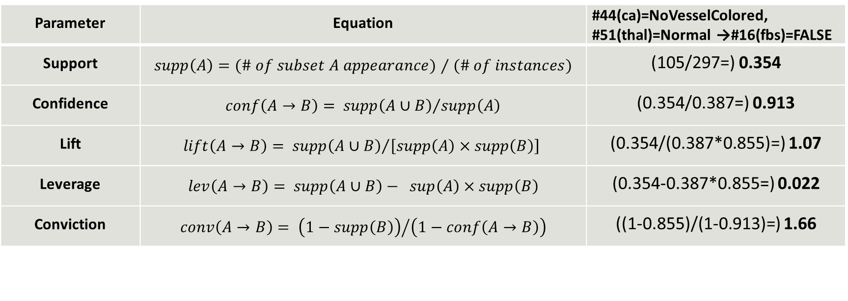

Quantitative Analysis
Parameter | Equation | #44(ca)=NoVesselColored, #51(thal)=Normal →#16(fbs)=FALSE
Support | $supp\left(A\right)=(\# of subset A appearance)⁄(\# of instances)$ | (105/297=) 0.354
Confidence | $conf\left(A→B\right)= {supp\left(A∪B\right)}/{supp\left(A\right)}$ | (0.354/0.387=) 0.913
Lift | $$lift\left(A→B\right)= {supp\left(A∪B\right)}/{\left[supp\left(A\right)×supp\left(B\right)\right]}$$ | (0.354/(0.387*0.855)=) 1.07
Leverage | $lev\left(A→B\right)= supp\left(A∪B\right)−$ $sup\left(A\right)×supp\left(B\right)$ | (0.354-0.387*0.855=) 0.022
Conviction | $$conv\left(A→B\right)= {\left(1−supp\left(B\right)\right)}/{\left(1−conf\left(A→B\right)\right)}$$ | ((1-0.855)/(1-0.913)=) 1.66

Slide 12
Qualitative Analysis

Slide 13
Advanced topic – FP Growth Algorithm

Slide 14
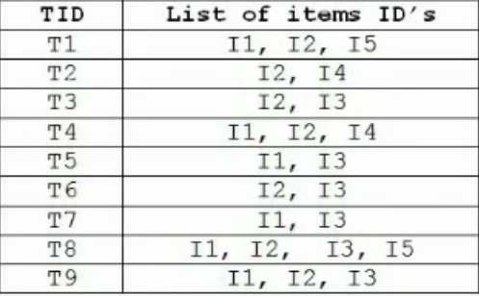
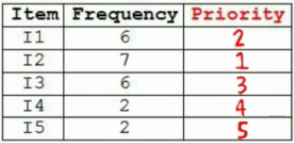
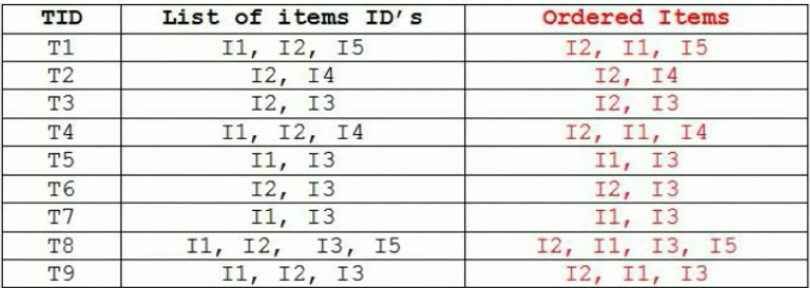

Slide 15
