Slide 1
CS 548 Project 4 CLUSTERING
ROHITPAL SINGH
SUCHITHRA BALAKRISHNAN
MU NIU

Slide 2

Dataset description
❑ Mainly causes for heart disease
➢ Sex
➢ Age
➢ Resting blood pressure
❑ 297 instances, 14 attributes
❑ Target attribute: #58(num):
Diagnosis of heart
disease
❑ 6 missing values(removed row)

Slide 3
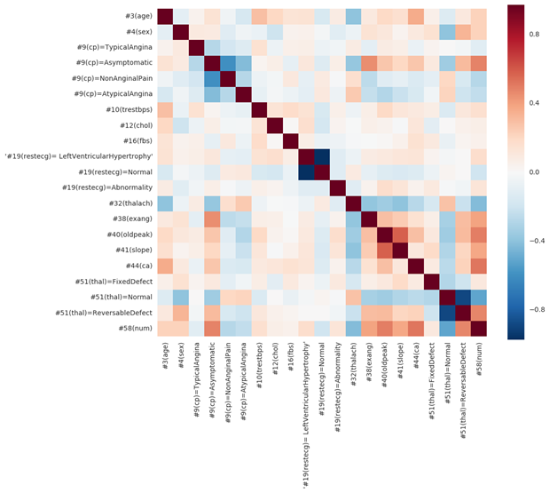
Data initial preprocessing
❑Nominal to binominal
(CP, restecg, thal)
❑ Normalize all attributes
❑High correlation among numerical attributs.

Slide 4
K-Means Clustering Code Description
Inputs : Preprocessed dataset , SimpleKMean as cluster algorithm with default parameters and Target attribute for cluster evaluation.
Process : 1. Remove all missing values by mean and mode from the training set.
2. Call moveCentroid () - calculate initial centroid by taking mean for numeric attribute and first index of value of nominal attribute which appears the most as original centroids.
3. In first iteration each individual instance acts as separate cluster.
4. Increases the iteration and for each instances in the dataset it calculate the distance using Euclidean distance method from each previous centroid.
5. And assign all the instances in the dataset according to shortest Euclidean distance to respective clusters.
6. Again it calculate the centroid for each clusters and repeat the process till (either max number of iteration or centroid of clusters changes)
7. In the end it evaluate the performance of clustering against target attribute and displays the output.
Output : Number of iteration= 6, SSE=515.77 (within cluster), final cluster centroids , time taken to build clusters and incorrectly clustered instances .

Slide 5
Hierarchical Clustering Code Description
Input : Preprocessed dataset , hierarchicalCluster as cluster algorithm with default parameters and Target attribute for cluster evaluation.
Process : 1. Hierarchical Clustering Initially uses all instances as a separate cluster .
2. If ‘Linktype’ is not “neighbour joining” then Hierarchical Clustering call the function doLinkClustering().
3. In doLinkClustering() , it creates a matrix having Euclidean distance between each pair of instances and checks the condition if (nClusters < nNumClusters) where nNumClusters is by default 2 as dataset has two class values( 0 and 1).
4. If above condition is true it starts merging two clusters which are close to each other using Merge().
5. Updates the distance matrix.
6. Continue till nClusters becomes equal to nNumClusters.
7. Evaluate the performance of clustering against target attribute .
Output : List of Clusters , Time taken to build the model, Evaluation using Class values and Incorrectly Clustered instances

Slide 6
Python packages & functions
Package | Function | Input | Output
sklearn | cluster | Data, # of clusters, other parameters | cluster label, centroid
sklearn | metrics | Cluster label, predicted cluster label | score
scipy | Distance, hierarchy | Data, algorithm, eps, min sample | Dendrogram tree
seaborn | heatmap | Similarity matrix | Visualization

Slide 7

Experiment
Guiding questions:
What combination groups exist for people who have heart disease based on age and gender?
What groups occur with chest pain, fasting blood sugar level and maximum heart rate?
If a person suffers from severe heart problem, what other conditions exist in such clusters?

Slide 8
Experiment (K-Means)
1. What combination groups exist for people who have heart disease based on age and gender?
 | Weka |  |  | Python
Pre-processing | Subset selection (sex, age num(0-4)) |  |  | Subset selection (sex, age num(0-4))
# of clusters | 6 | 8 | 2 | 2 | 4 | 5 | 6
Distance funtion | Manhattan | Euclidean |  | Euclidean
SSE | 36.87 | 4.32 | 15.49 | 155.6 | 60.7 | 39.6 | 30
% instance per cluster | 15%,16%,20%,13%,20%, 16% | 72%,28% |  | 30%,12%,24%,12%,18%,4%

Slide 9
Experiment (Hierarchical)
2. What groups occur with chest pain, fasting blood sugar level and maximum heart rate?
 | Weka | Python
Pre-processing | Subset selection (cp(binominal),fbs,thalach)
# of clusters | 7 | 5
Link type | Complete | Ward
Time taken | 0.14 s | 0.007 s
% instance per cluster | 2%,42%,23%,21%,6%,6%,2% | 28%,16%,42%,8%,5%

Slide 10
Experiment (DBSCAN)
3. If a person suffers from severe heart problem, what other conditions exist in such clusters?
 | Python
Pre-processing | NA
# of clusters | 7 | 14 | 10 | 2 | 2 | 8
Epsilon | 0.6 | 0.8 | 1.25 | 0.6 | 0.8 | 1.25
minPts | 5 |  |  | 10
% instance per cluster | 3%,3%,5%,3%,3%,2%,2% | 2%,3%,3%,2%,5%,2%,3%,2%,2%,3%,2%,2%,2%,2% | 11%,11%,4%,7%,6%,11%,10%,8%,2%,2% | 3%,5% | 3%,5% | 11%,4%,8%,5%,11%,8%,10%,6%

Slide 11
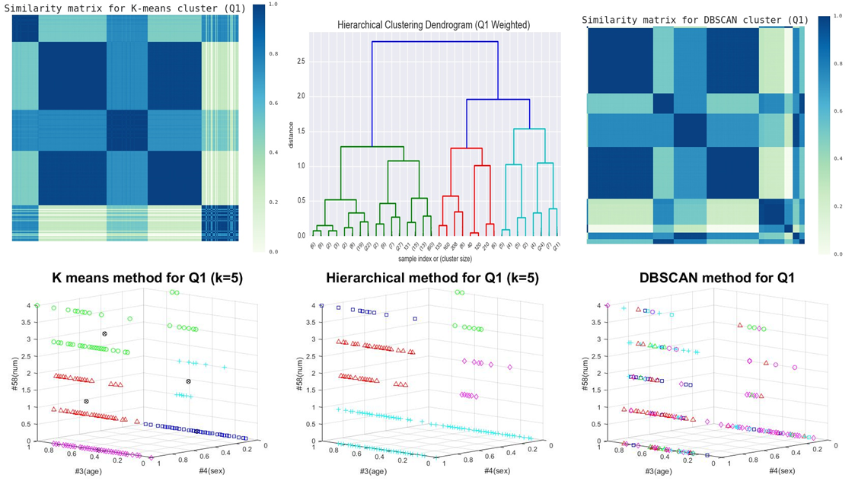
Visualization (Q1)
NMI = 0.84
V-measure = 0.837
Silhouette Coefficient:
0.622368261186 0.803439928985 0.588073863753 0.761474555383 0.465524942487

Slide 12
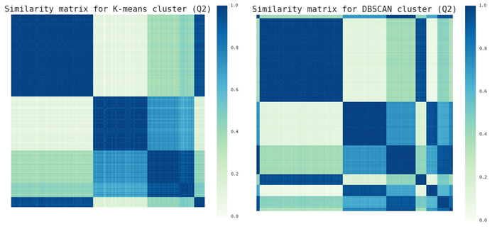
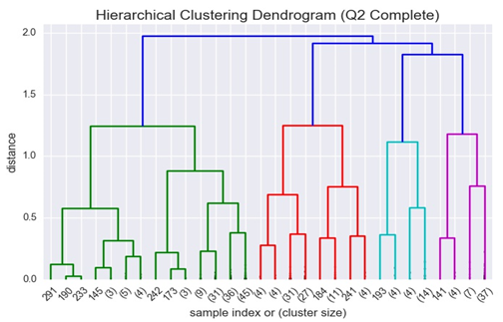
Visualization (Q2)
NMI = 0.13
V-measure = 0.13
Silhouette Coefficient:
0.803724158909 0.693487747208 0.779045286186 0.660304466969 0.815084406678

Slide 13
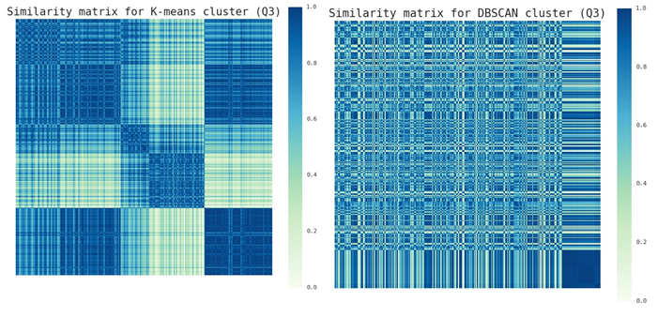
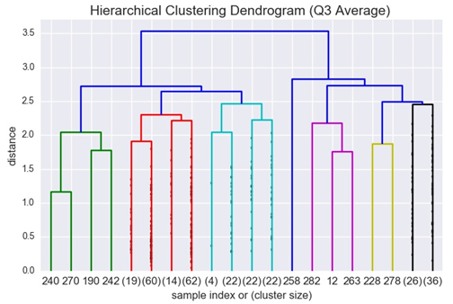
Visualization (Q3)
NMI = 0.5
V-measure = 0.494
Silhouette Coefficient:
0.0597695339366 0.188558950917 0.176710114097 0.179843077553 0.282335440823

Slide 14
Advanced topic – BIRCH algorithm Balanced Iterative Reducing and Clustering using Hierarchies
Unsupervised data mining algorithm
Performs hierarchical clustering
Developed for large datasets
Handles noise
Small memory requirement
Minimizes I/O costs

Slide 15
CF and CF- Tree
Clustering Feature CF
CF- Tree
CF= (N, LS, SS)
N- number of data points
LS- Linear sum
SS- square sum of data points
CF- Tree
Height Balanced Tree based on two parameters,
B- Branching Factor
T- Threshold

Slide 16
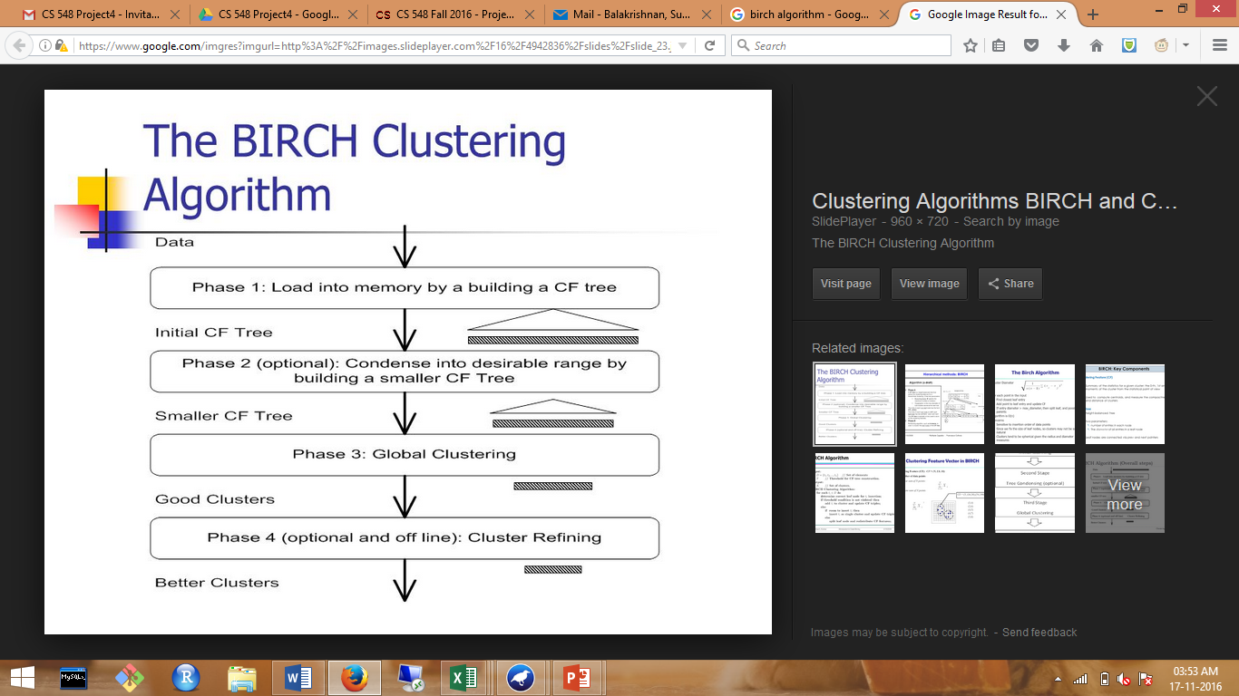
Phases
In phase 1,
construction of the CF Tree begins by inserting points based on the initial threshold.
If it runs out of memory before it finishes scanning the data, then it increases the threshold value and rebuilds a new smaller tree.
In phase 2,
the leaf entries of the CF Tree are scanned to build smaller CF Tree.
Outliers are removed and larger clusters are created from several crowded sub-clusters.
In phase 3,
any existing clustering algorithm is used to cluster the leaf nodes. Agglomerative hierarchical clustering method is applied to the sub-clusters represented by the CF vectors.
User can provide the desired number of clusters.
In phase 4,
additional scans are performed and centroids are calculated. Based on the centroids, the points are redistributed.
Outliers can also be eliminated.

Slide 17
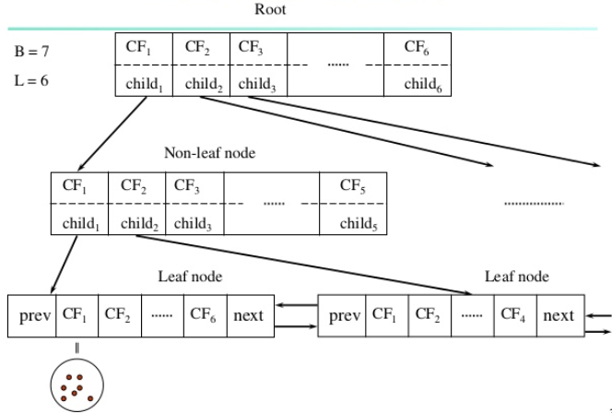
CF- Tree

Slide 18
Thankyou..

