Slide 1
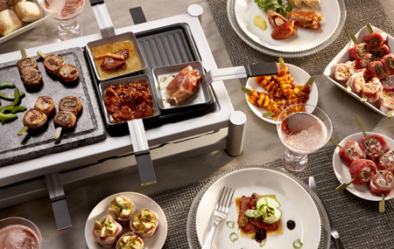
What’s cooking?
CS 548 Project 5
Mu Niu

Slide 2
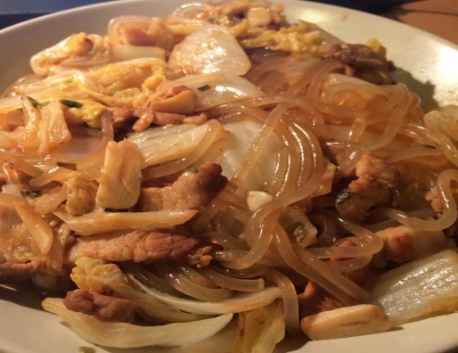
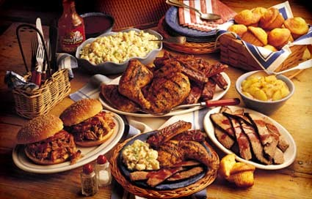
Data description
Kaggle project
JSON file with country name, recipe ID and food materials
39774 instances
90% instances as train set, 10% instances as test set.
20 countries in total

Slide 3

Initial preprocessing
Original dataset is clean
No missing value
Remove brackets
Remove column “id”
Change format from JSON to pandas data frame

Slide 4
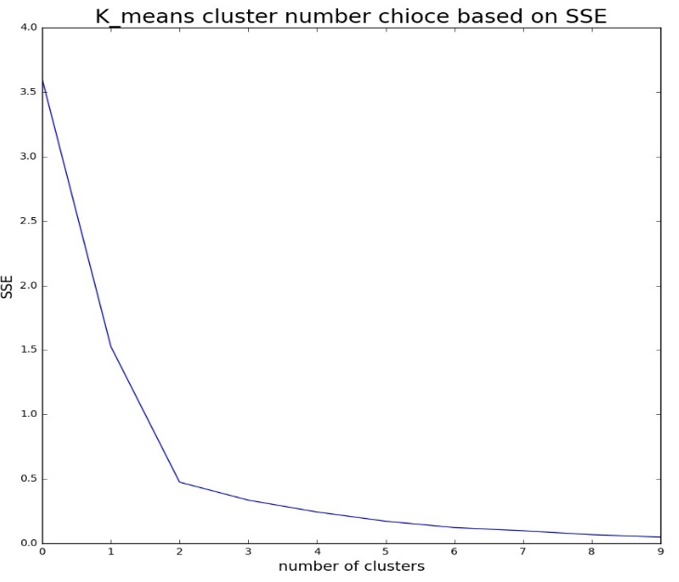
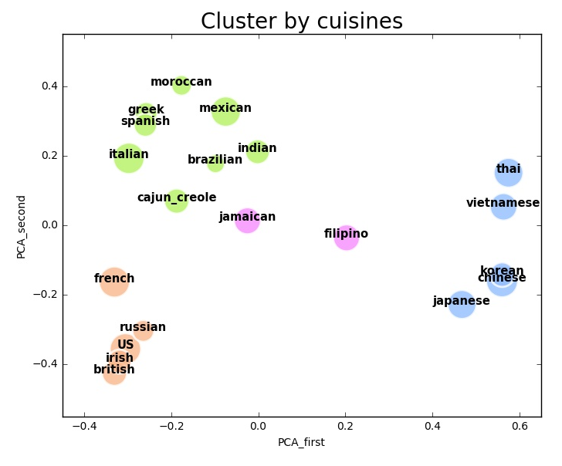
1. Is any countries share food materials in cooking?
Country with similar recipe tend to stay in the same clusters
PCA and then K means
Jamaica and Philippines are in the same cluster but not too similar
“elbow”: 4

Slide 5
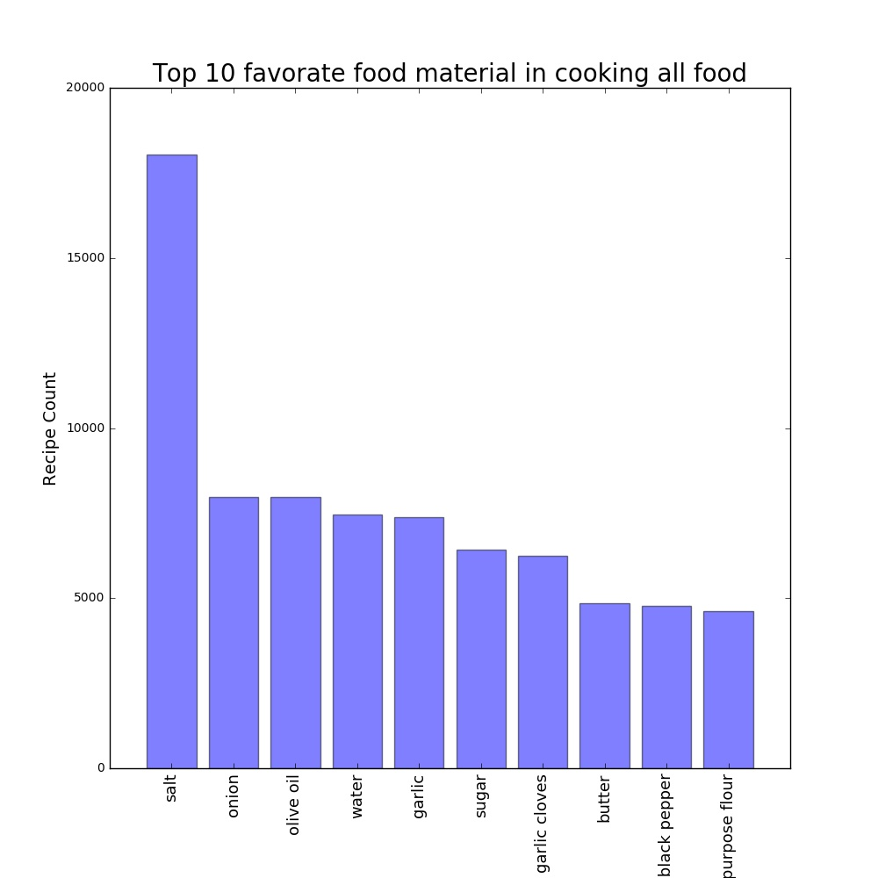
2. What’s the most common cooking material?
Salt is important in all country
US have similar result with “all”
China and U.S. do not have similar food

Slide 6
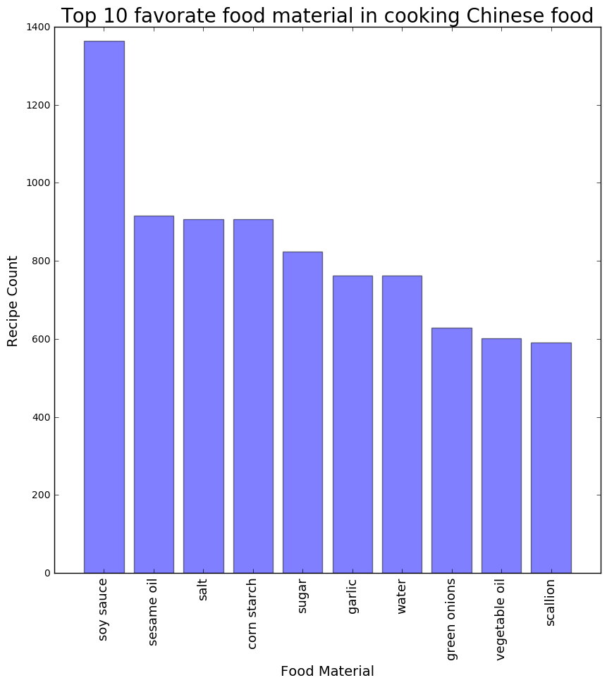
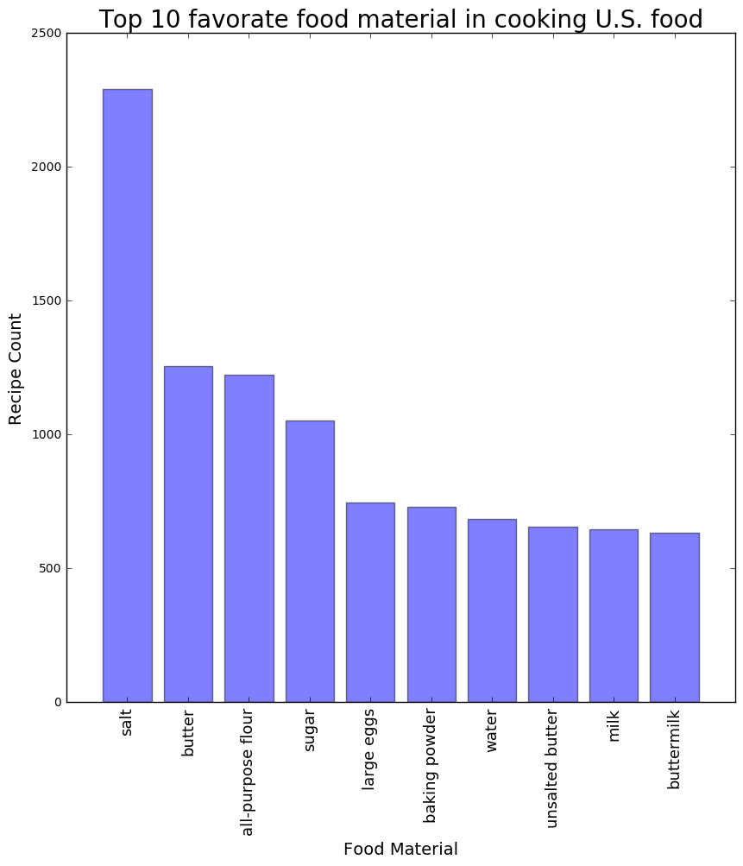
2. What’s the most common cooking material?

Slide 7
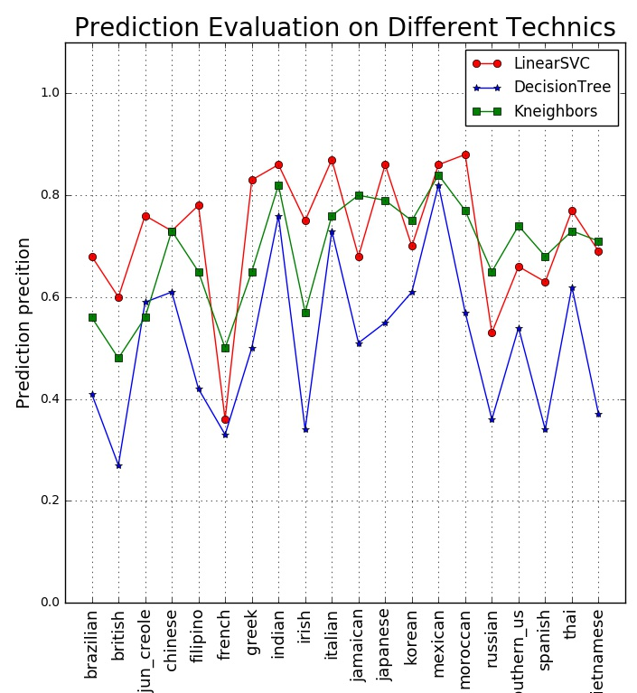
3. Which country’s food will be made based on materials customers have?
Vectored by TF-IDF method
Classification:
Linear SVC
Decision Tree
K nearest neighbor

Slide 8

Learned in project
Text mining is just a start at data mining process
Text structure can be complicated and mining direction can be blurry
Teammates are important.

Slide 9
Questions?

Slide 10
Thank you

