Slide 1
Use complex techniques to develop a digital media outcome
Achievement | Achievement with Merit | Achievement with Excellence
Use complex techniques to develop a digital media outcome. | Use complex techniques to develop an informed digital media outcome. | Use complex techniques to develop a refined digital media outcome.

Slide 2
Use complex programming techniques to develop a computer program
Achievement | Achievement with Merit | Achievement with Excellence
Use complex programming techniques to develop a computer program. | Use complex programming techniques to develop an informed computer program. | Use complex programming techniques to develop a refined computer program.

Slide 3
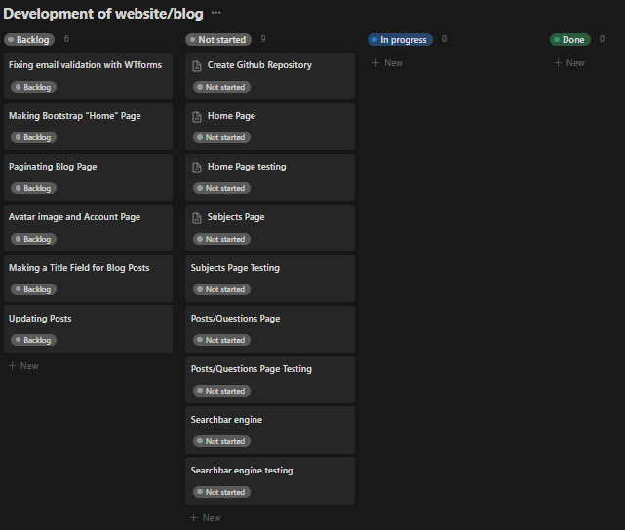
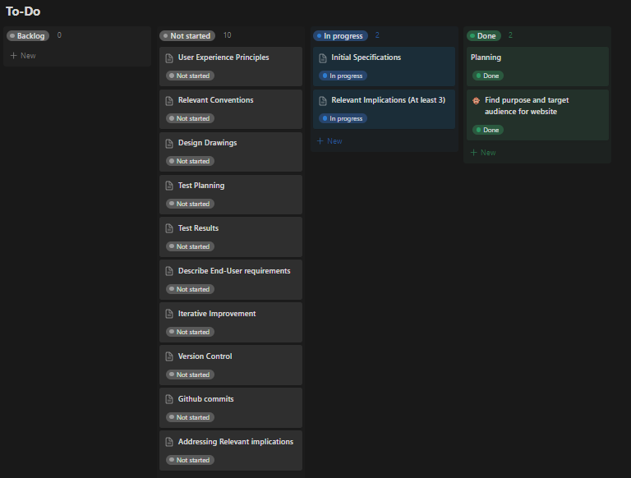
Project Management - Planning

Slide 4
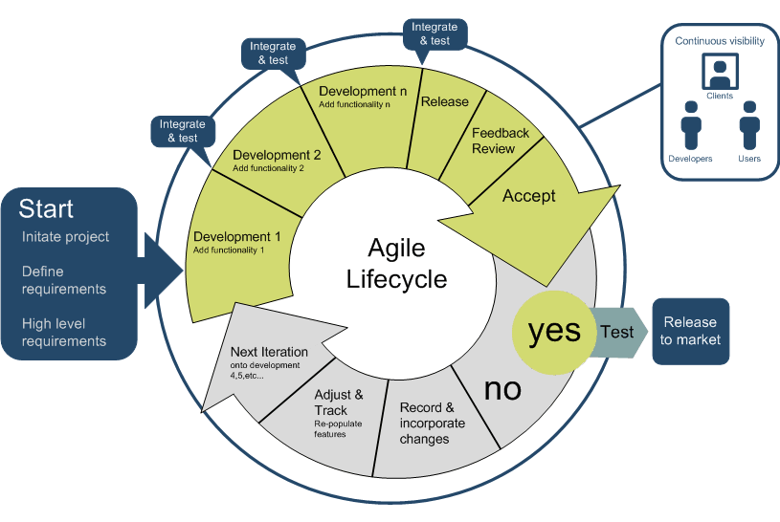
Project Management - Planning
Explain how you plan to manage the project

Slide 5
Describe the purpose and target audience of your website
Purpose of my website is for people to be able to post their reviews and thoughts on Jollibee. This type of website will be most beneficial to current and possible future consumers. Additionally, it is also beneficial for the fast food restaurant Jollibee. It will serve as free marketing and can attract new consumers that will be influenced by the users reviews.
(also to potentially bring Jollibee to NZ)

Slide 6
Initial Specifications
Review website/consumer review platform
Consumers can post their review and thoughts on Jollibee
Other users will post their comments ​
Database will store posts and comments
Signup/login page
Be able to edit or delete their own posts/reviews
Be responsive (display content effectively on wide and narrow screens).

Slide 7
Explain the relevant implications (at least 3) Duplicate this slide.
Examples of relevant implications include:
● social
● cultural
● legal
● ethical
● intellectual property
● privacy
● accessibility
● usability
● functionality
● aesthetics
● sustainability and future proofing
● end-user considerations
● health and safety.
This could include an explanation on why your outcome needs to:
be socially/culturally acceptable
honour legal, ethical and intellectual property obligations
be accessible, usable and functional
be sustainable and future proof
effectively use web design conventions.

Slide 8
Relevant Implications - Ethical
Implication 1
Describe the implication?
Ethics focuses on what is right and wrong. Depending on the target audience, it can be inappropriate to allow the use of swear words or letting them be uncensored. It is best to ensure that the content on the website is also appropriate and avoids anything offensive.
How does this apply to your project?
How do you plan to address this implication?

Slide 9
Relevant Implications - Functionality
Implication 2
Describe the implication?
Functionality means ensuring that the entire website and its features work. It should be able to work for the expected values/cases, as well as the boundary cases and unexpected cases. For example, when a user goes to signup on the blog/website, it should be able to create an account if the email address is new, but when they input an existing email address that is already used, then it will inform the user to input a different one.
How does this apply to your project?
How do you plan to address this implication?

Slide 10
Relevant Implications – Legal
Implication 3
Describe the implication?
Legal implications focuses on ensuring that any information or images that be used is allowed.
How does this apply to your project?
My site will be a review/testimonial website about the best fast food restaurant
How do you plan to address this implication?

Slide 11
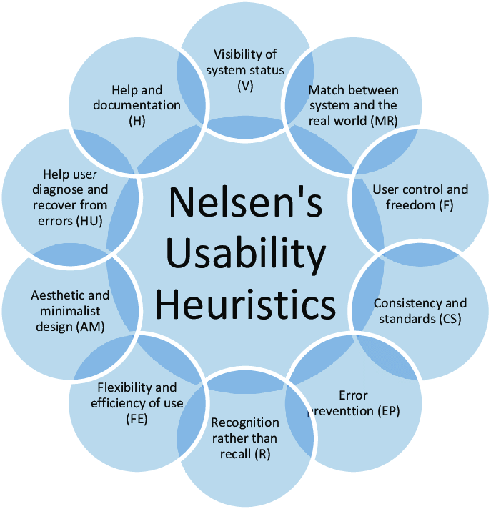
User Experience Principles
Describe the most relevant HCI rules

Slide 12
HCI
Summarise the most relevant usability rules and how they apply to your project (duplicate slide)

Slide 13
Relevant Conventions
These could include:
Coding conventions – HTML, CSS (validated)
Coding conventions – Python (PEP8)
File Naming and file management
Web design conventions
Commenting
Usability Heuristics
Visual Hierarchy

Slide 14
Relevant Conventions
Discuss how you plan to apply relevant conventions to improve the quality of your outcome.

Slide 15
Design Drawings
Home

Slide 16
Design Drawings (Database Plan)

Slide 17
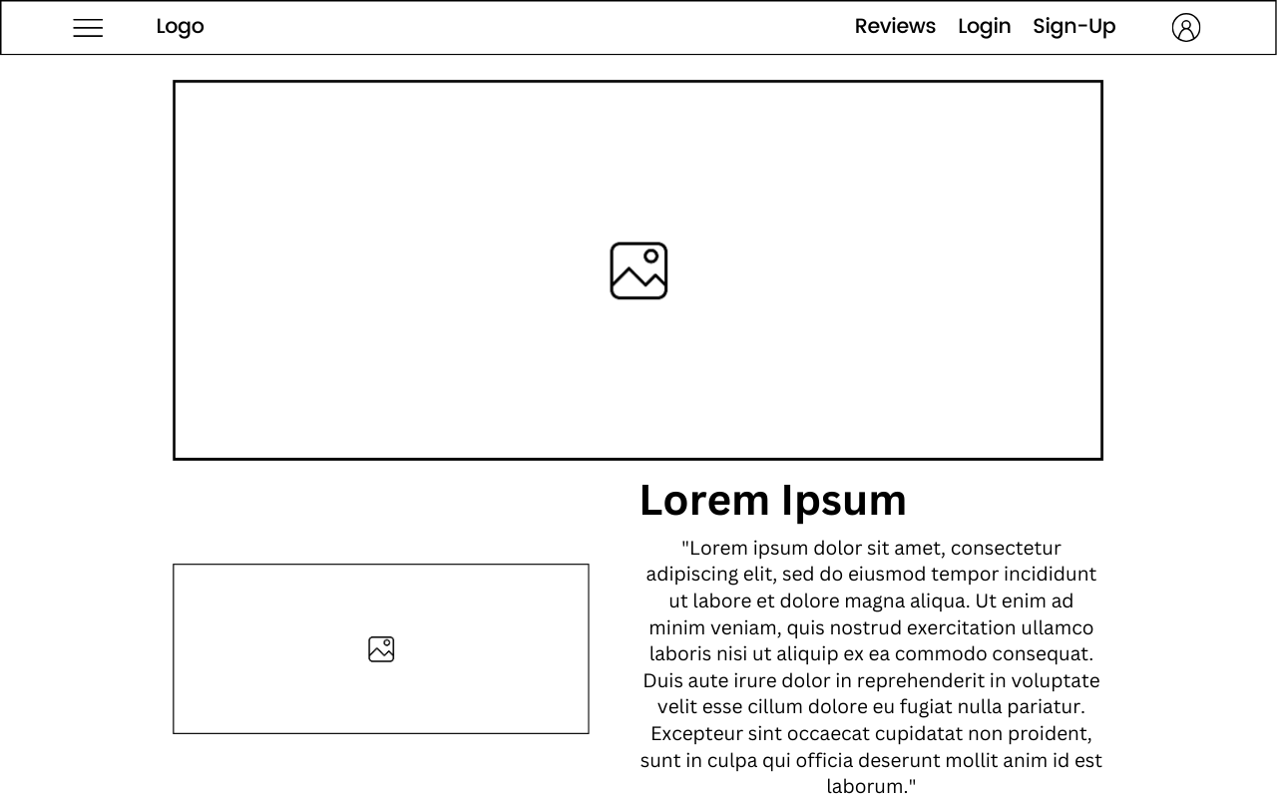
Design Drawings (Home Page)

Slide 18
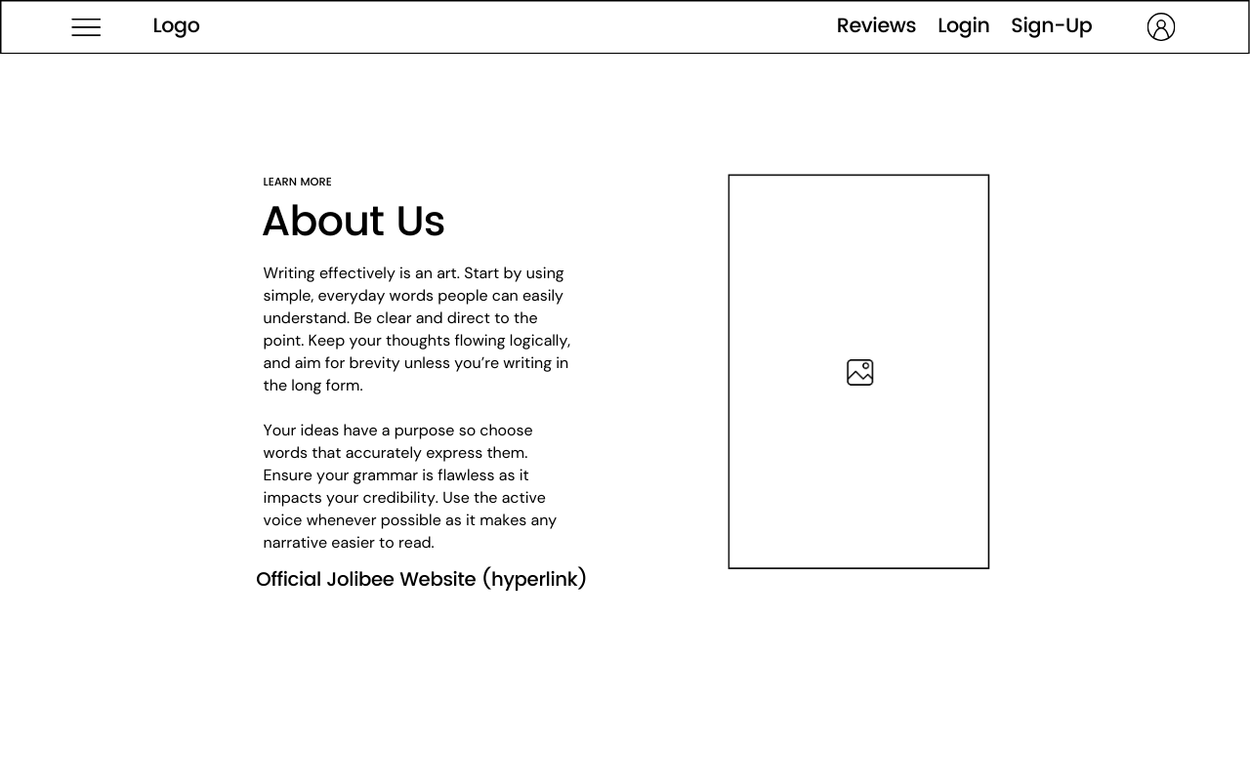
Design Drawings (About Us Page)

Slide 19
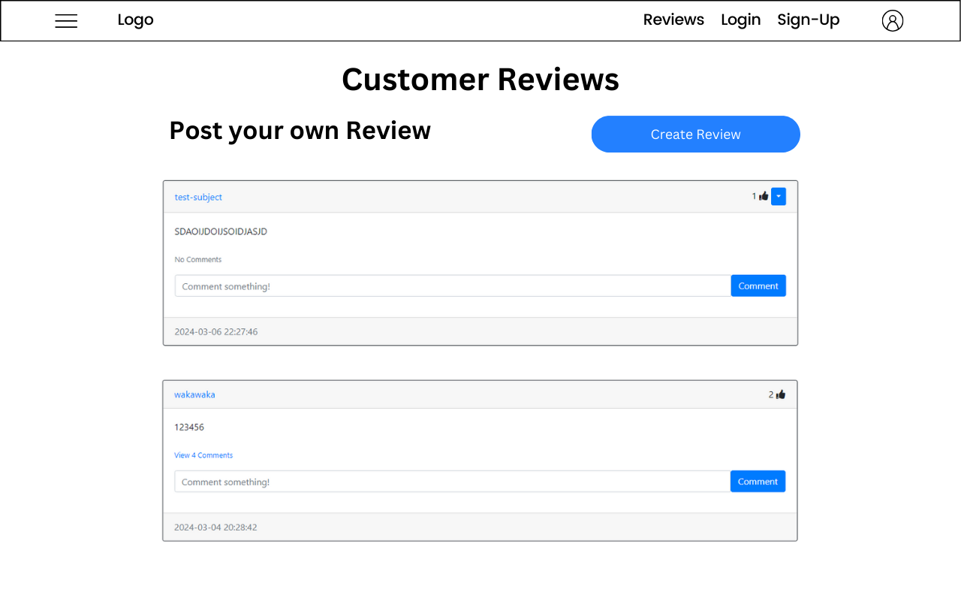
Design Drawings (Reviews Page)

Slide 20
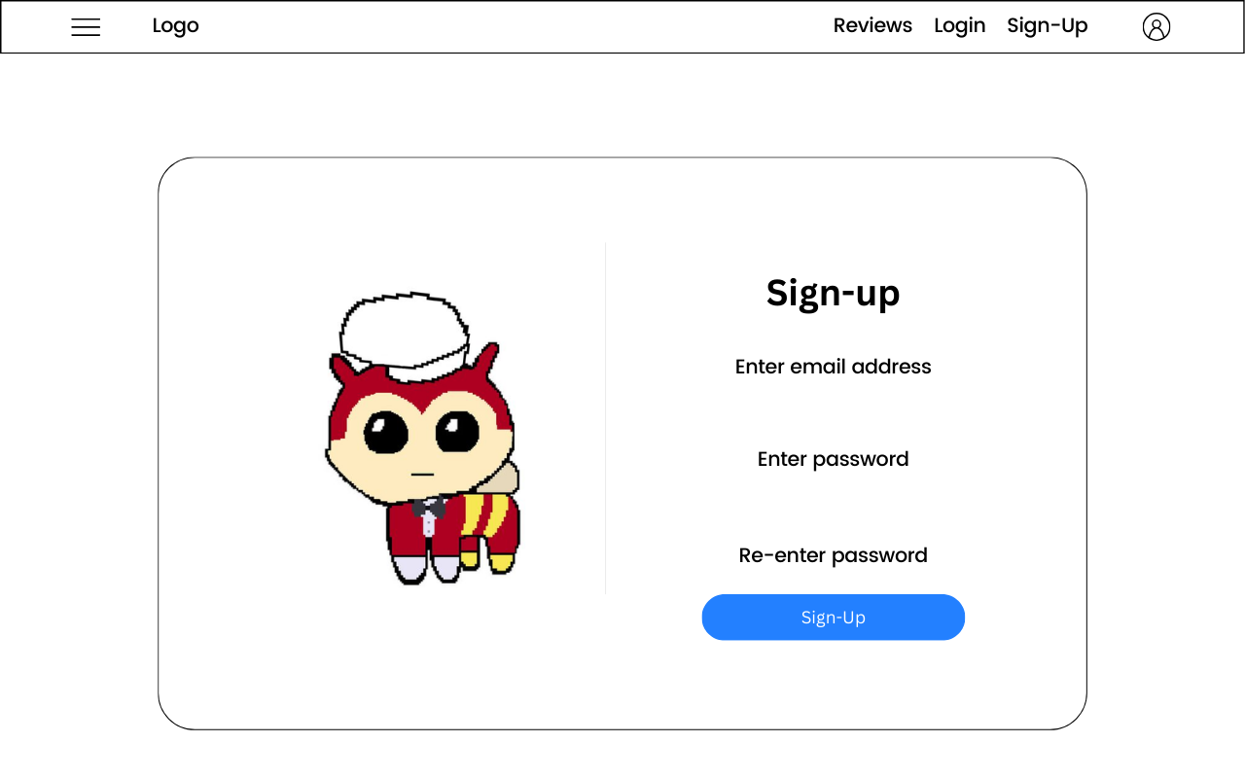
Design Drawings (Sign-up Page)

Slide 21
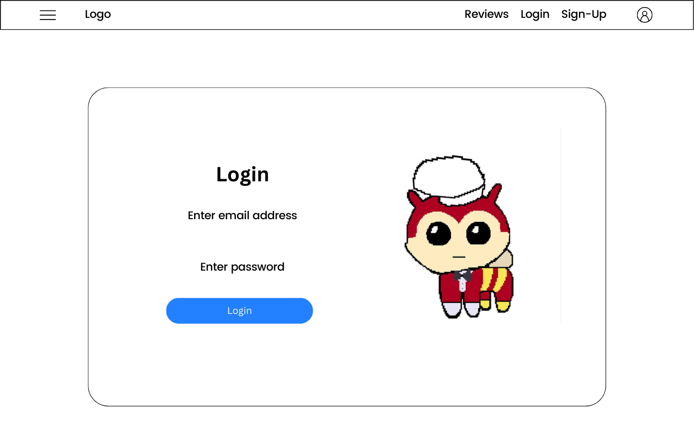
Design Drawings (Login Page)

Slide 22
Test Plan
How are you going test your program
to ensure it functions correctly
Using the Blog App that I had previously done in class, I have already ensured that the main functions of my program (signup/login, creating/deleting posts), as well as some additional features function already. When I am adding any new components or features into my program/website, I will be sure to test it by taking screenshots before and after implementing the code.
That the python code is PEP8 compliant
In VSCode there is a PEP8 formatting extension which I will utilise. Doing this, the extension will automatically format my python code making sure that is compliant
for validation and error correction
Is well structured
Is flexible and robust
Comprehensively tested and debugged

Slide 23
Test results
Summarise the results of your testing and how you addressed any issues or problems that arise during testing. Make sure you get others to test your site and get feedback.

Slide 24
Describe the end user requirements
Describe how the chosen tools and techniques to develop the website were appropriate for the purpose and end users.

Slide 25
Iterative Improvement
Show how you have used iterative improvement throughout the design, development and testing process to produce a high-quality outcome. (through providing screenshots/a screencast)

Slide 26
Version 1 Iterative Improvement

Slide 27
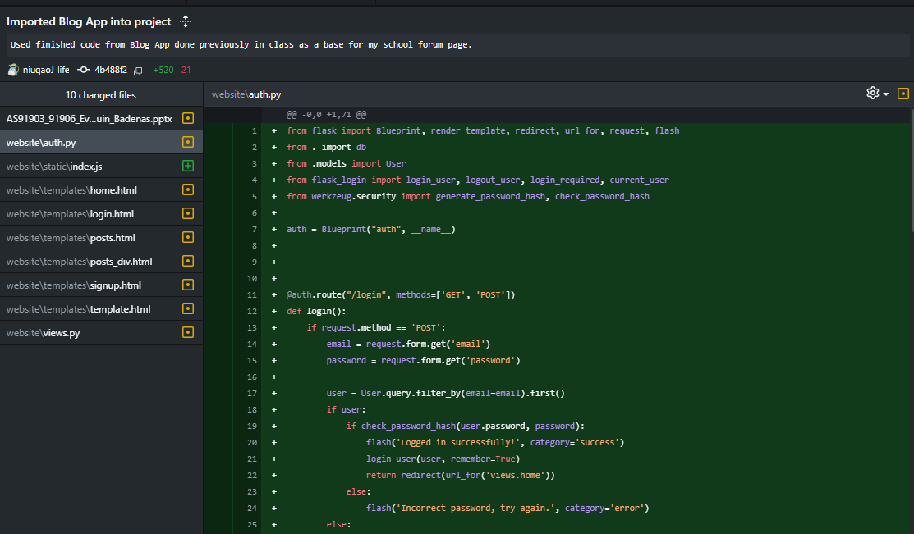
Imported Blog App

Slide 28


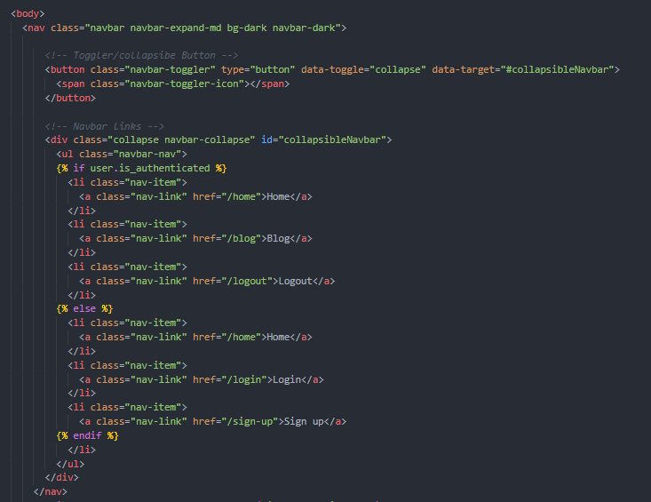
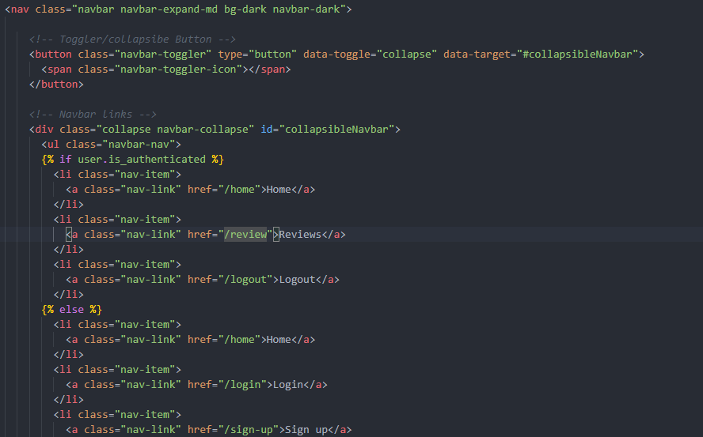
Iterative Improvement (Navbar V1)
Using the Blog App previously done. | Firstly, simply changed the name of the hyperlink to fit the context of my website.

Slide 29


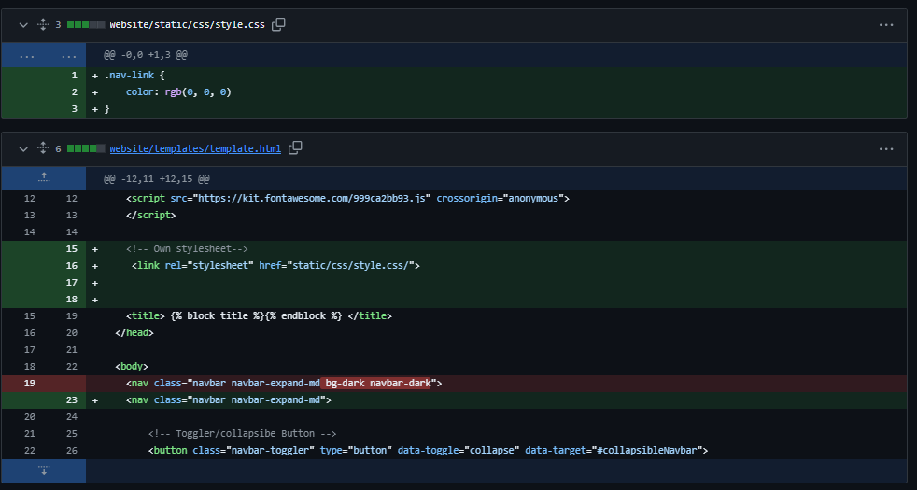
Iterative Improvement (Navbar V1)
Next, the colour of the navbar felt too dark and not fitting. | Doing this, I decided to change to the navbar to be white with black text with the hyperlinks.

Slide 30

Iterative Improvement (Navbar V1)
Then the font felt that it was not aesthetically pleasing and matches well with the Jollibee brand | Then I found in the official Jollibee website that the font they use and embedded it into my website.

Slide 31
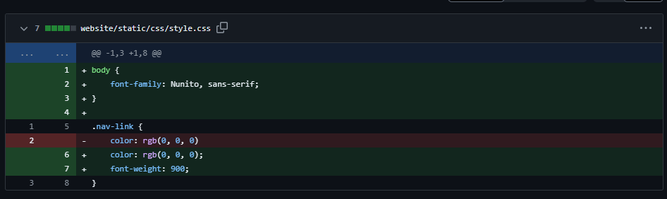
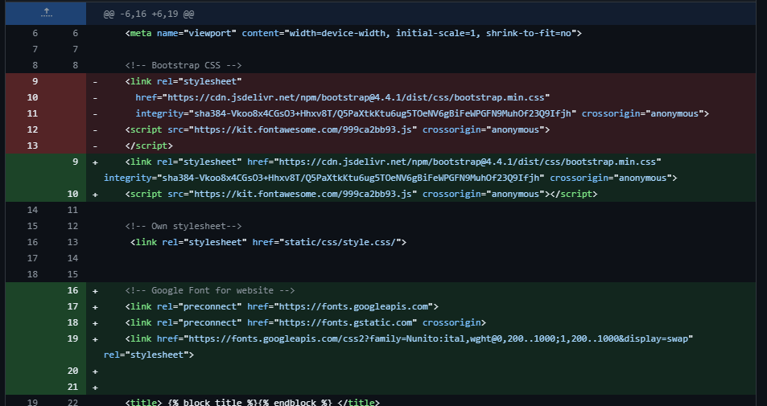
Iterative Improvement (Navbar V1)

Slide 32
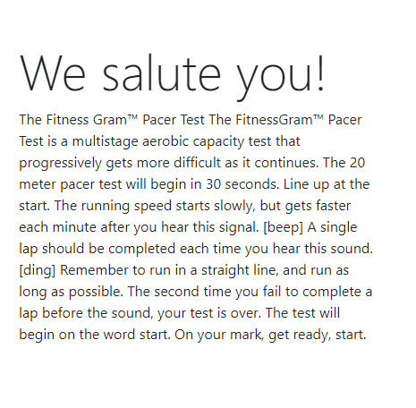
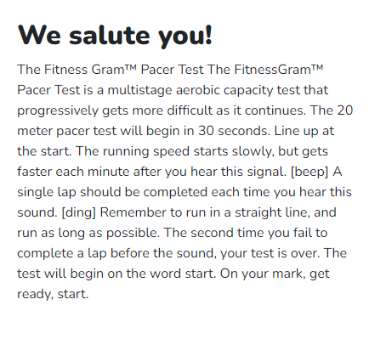
Iterative Improvement (Navbar V1)
I felt that the headings on my website were not bold enough. Looking at my code I saw that the bootstrap was written as ‘display-4’ which gave it that look. | Instead, I decided to remove that and just simply make the headings bolder even if the size of the headings are smaller. I believe it makes the headings pop out more.

Slide 33
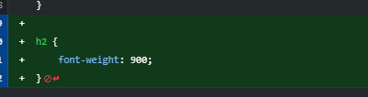
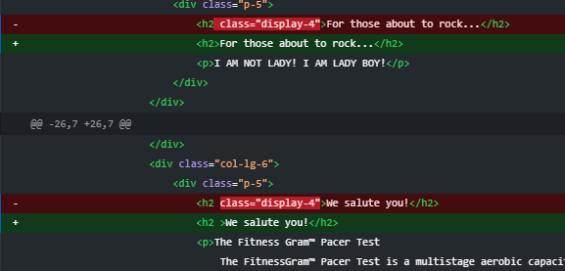
Iterative Improvement (Navbar V1)
I felt that the headings on my website were not bold enough. Looking at my code I saw that the bootstrap was written as ‘display-4’ which gave it that look. | Instead, I decided to remove that and just simply make the headings bolder even if the size of the headings are smaller. I believe it makes the headings pop out more.

Slide 34
Version 2 Iterative Improvement

Slide 35
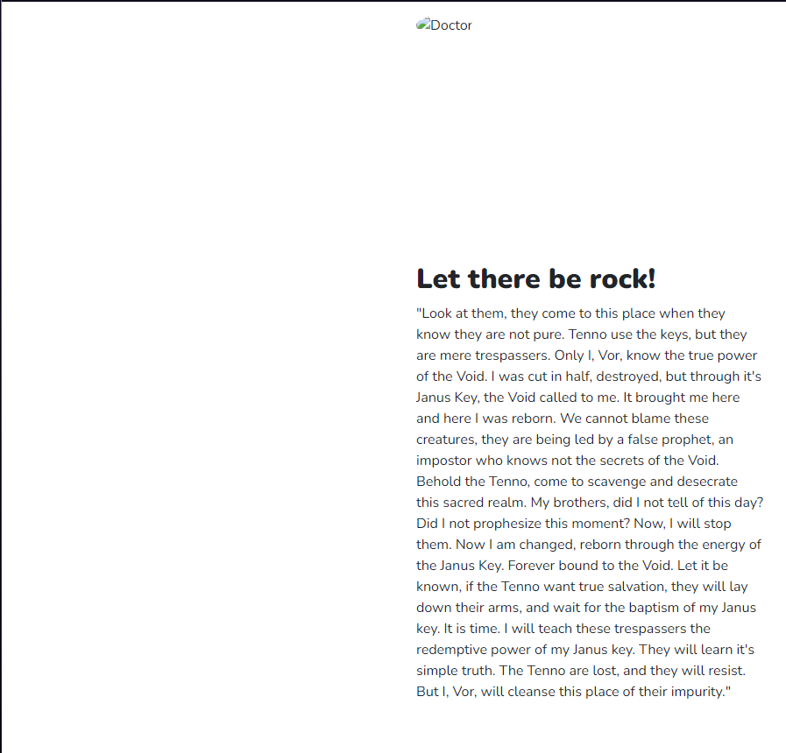
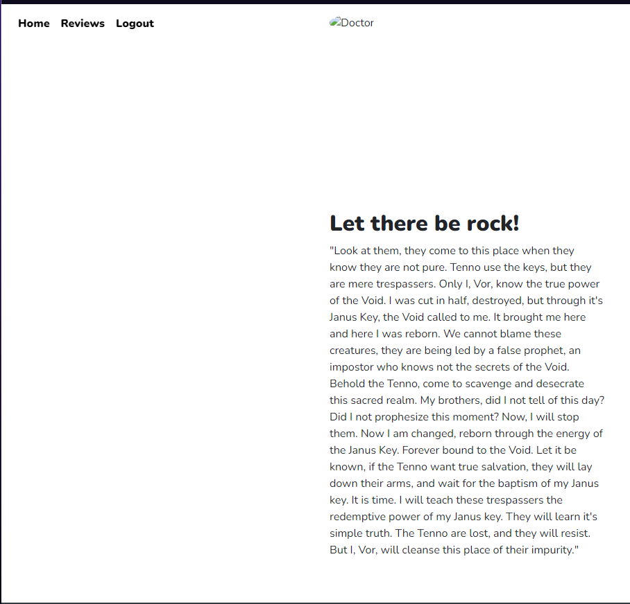
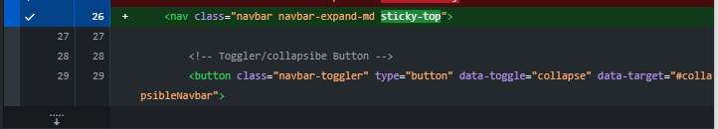
Iterative Improvement (Navbar V2)
Then I wanted to make the navbar stick to the top of the page even when scrolling down. | To do this, I used bootstrap classing which made it simple to make the navbar sticky

Slide 36

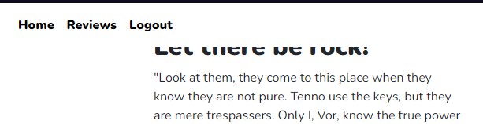
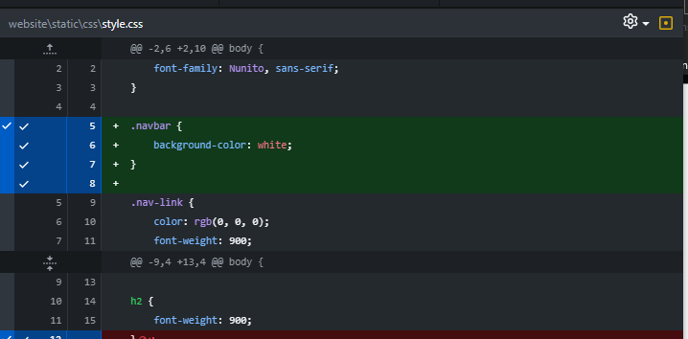
Iterative Improvement (Navbar V2)
After making my navbar stick to the top, scrolling down made me realise that the navbar was transparent rather than being white. | I corrected this by setting the background colour in my stylesheet.

Slide 37
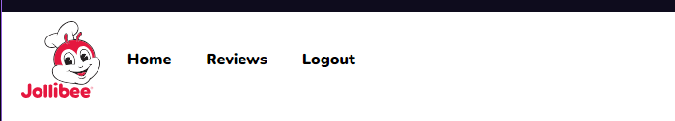
Iterative Improvement (Navbar V2)
The navbar was also missing the image of the logo in the navbar.

Slide 38
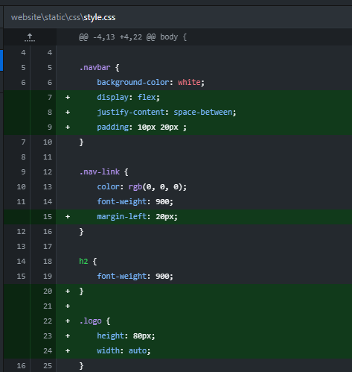
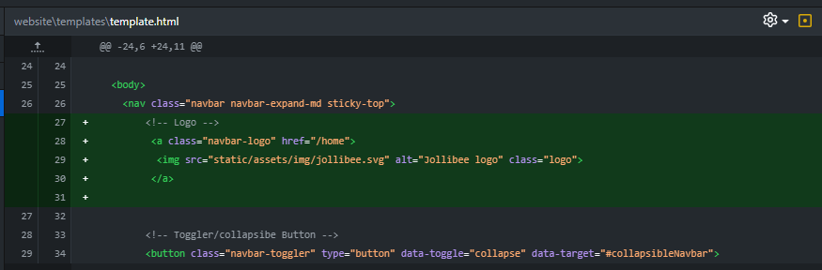
Iterative Improvement (Navbar V2)
The navbar was also missing the image of the logo in the navbar.

Slide 39
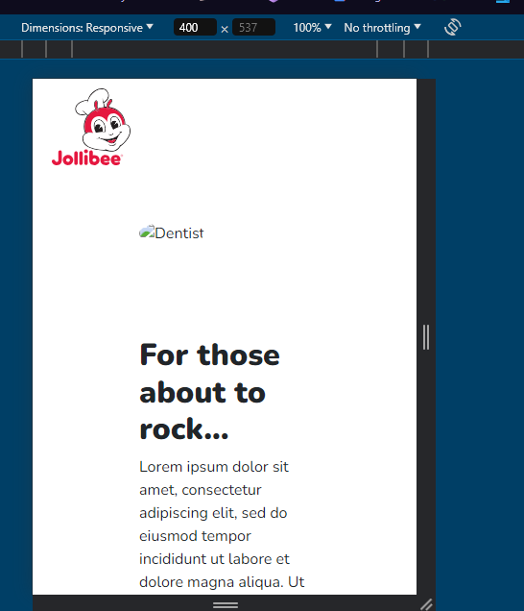
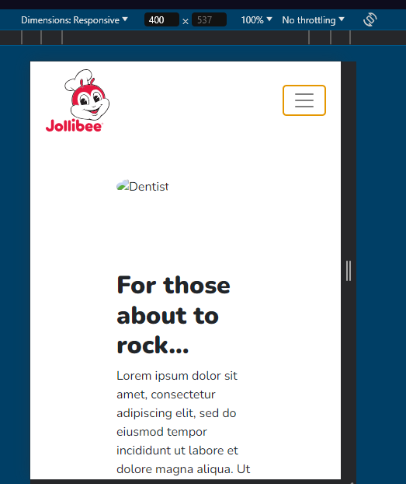
Iterative Improvement (Navbar V2)
Looking at the html structure of the classes, and then making adjustments in CSS, now the the menu icon will appear.
When checking if the navbar is responsive. It does not to be collapsoble

Slide 40
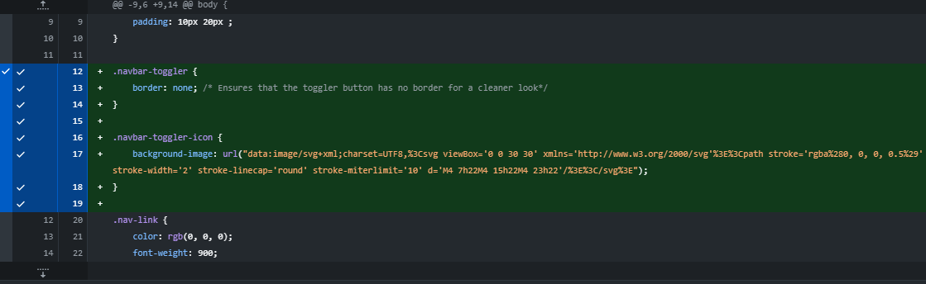
Iterative Improvement (Navbar V2)
Looking at the html structure of the classes, and then making adjustments in CSS, now the the menu icon will appear.

Slide 41
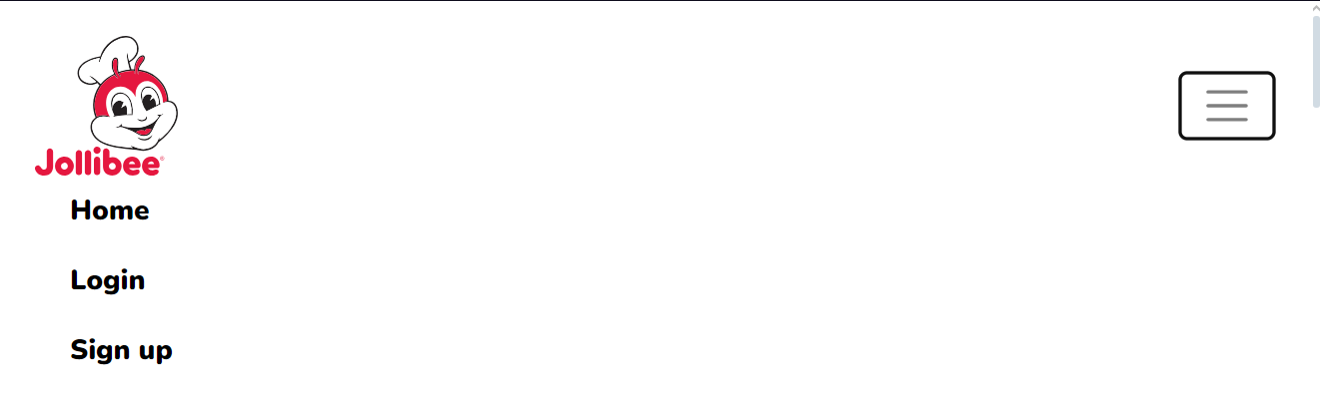
Iterative Improvement (Navbar V2)
However pressing the toggler icon, the navbar links being underneath look off. The home navlink seems too close to the logo.

Slide 42
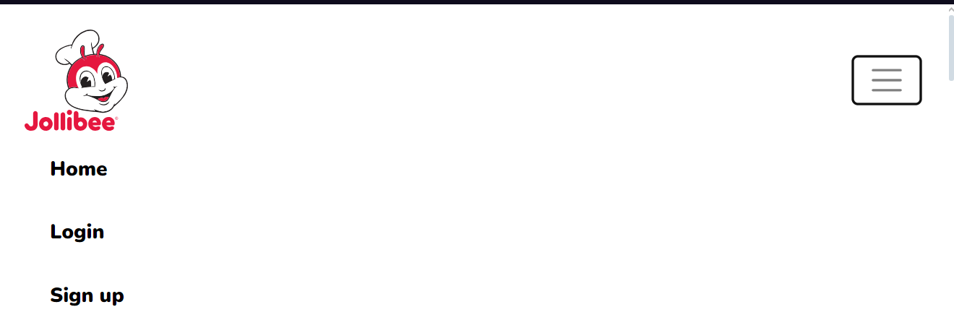
Iterative Improvement (Navbar V2)
However pressing the toggler icon, the navbar links being underneath look off.

Slide 43
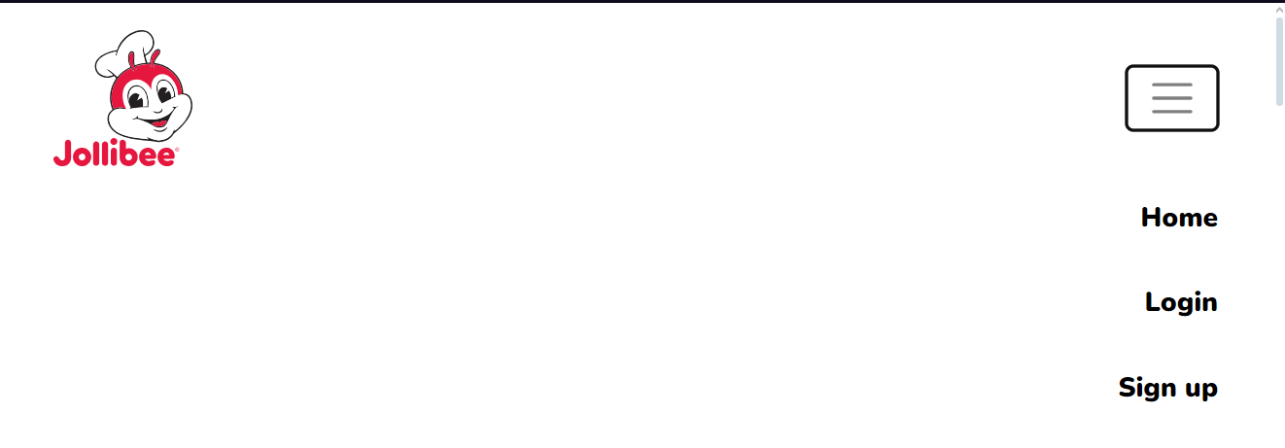
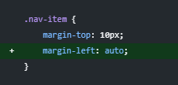
Iterative Improvement (Navbar V2)
But having the toggler icon be on the right and then the nav links appear on the left also felt off

Slide 44
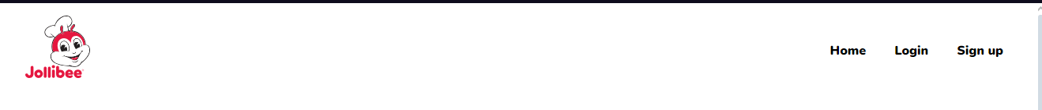
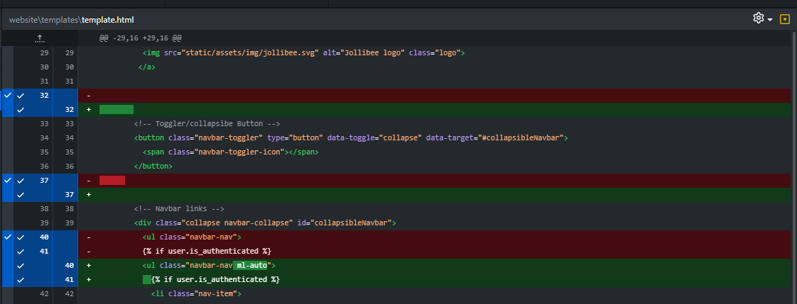
Iterative Improvement (Navbar V2)
As a result, it made sense to always be on the right while the logo stayed on the right.

Slide 45
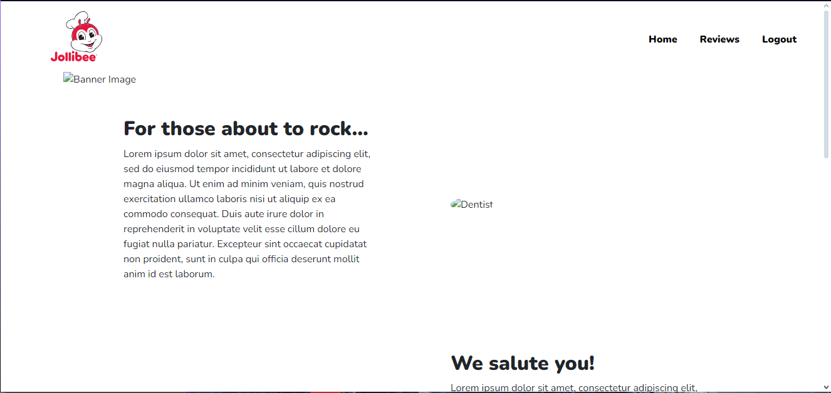
Iterative Improvement (Home Page V2)
For the home page it was fitting to add a banner image

Slide 46
Version Control
Show how you have used version control throughout the design, development, and testing process.

Slide 47
GitHub Commits
Show how you have used GitHub throughout the design, development, and testing process.

Slide 48
Addressing Relevant Implications
Discuss how have you addressed relevant implications?

