Slide 1
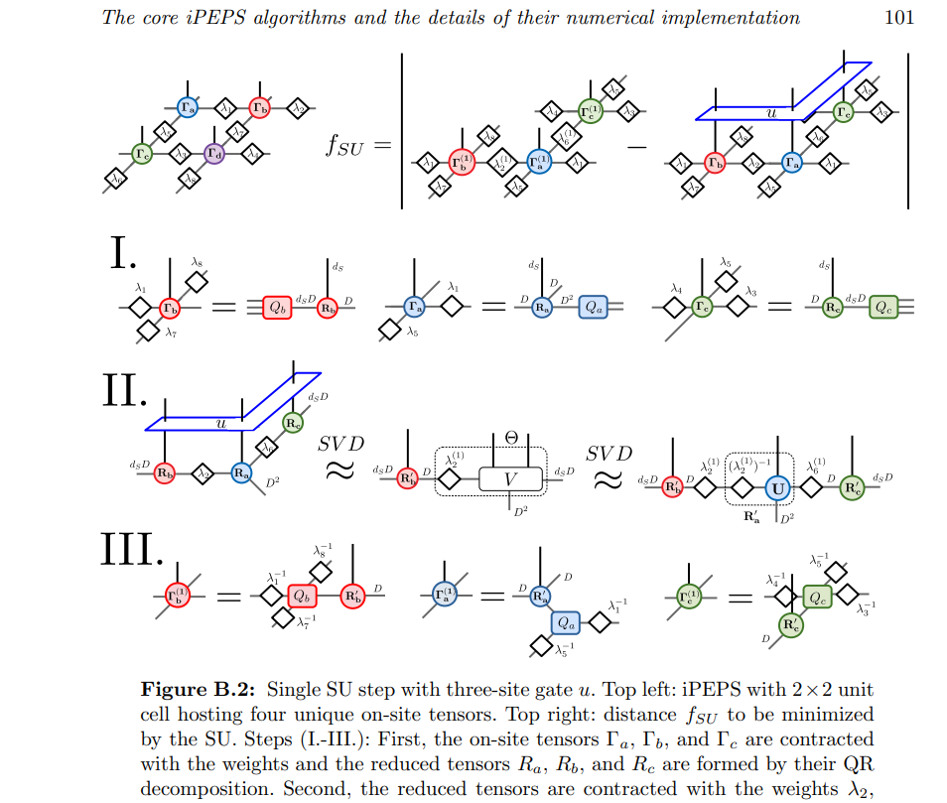
Square lattice

Slide 2
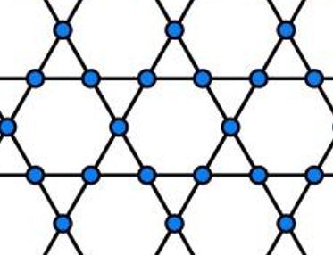
J1-J_{\chi}
Tu
Ba
Bb
Td
Td
Bc
Tu
Tu
Bb
Ba
Bb
Td
Td

Slide 3
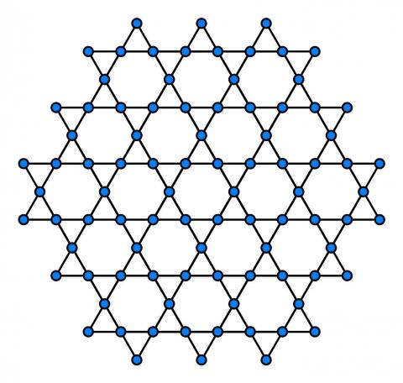

J2-J3
D
D
I
F
A_a
A_b
H
E
G
H
E
C
B
A
C
B
A
A_c
I
F
D
I
F
F_b
D_a
G
H
E
G
C
B
A

Slide 4
Bond tensor
First index connected to down triangle
Second index connected to up triangle
Third index is physical
Steps for J2-J3 model
Update all down triangles
Update all up triangles
lambda tensor
First index connected to triangle
Second index connected to bond

Slide 5
J2 term1

Slide 6
J2 term2

Slide 7
J2 term3

Slide 8
J2 term4

Slide 9
J2 term5

Slide 10
J2 term6

Slide 11
J3 term1
Lambda_c_dn3
Ba2
Bb3
Lambda_b_up9
Tu2
Lambda_a_up8
Lambda_a_dn7
Lambda_b_dn10
Lambda_a_dn4
Lambda_b_dn2
Td1
Td3
Lambda_c_dn6
Lambda_c_dn11
Bc1
Bc4
Lambda_c_up1
Lambda_c_up5

Slide 12
J3 term2

Slide 13
J3 term3

Slide 14
bipartition and fuse legs: J3 term1

