Slide 1
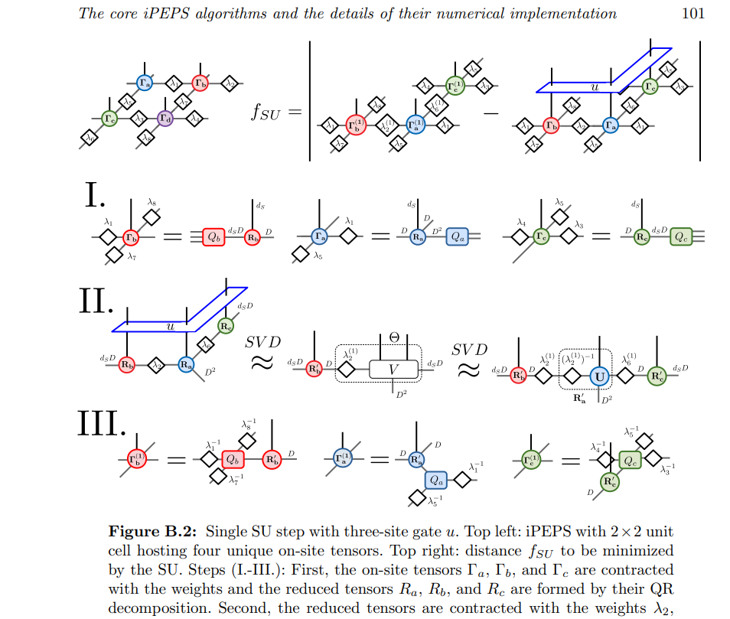
Square lattice

Slide 2
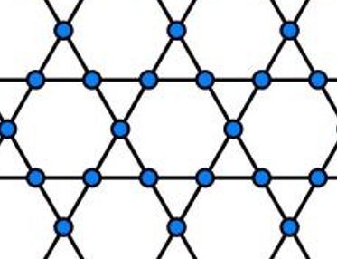
J1-J_{\chi}
Tu
Ba
Bb
Td
Td
Bc
Tu
Tu
Bb
Ba
Bb
Td
Td

Slide 3
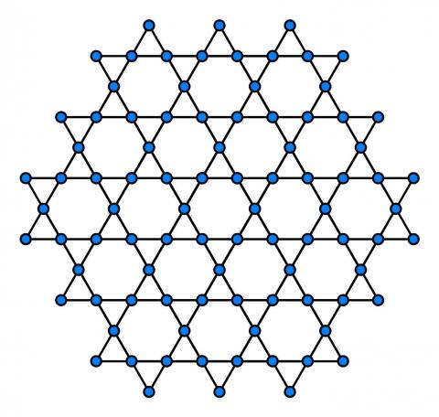

J2-J3
D
D
I
F
A_a
A_b
H
E
G
H
E
C
B
A
C
B
A
A_c
I
F
D
I
F
F_b
D_a
G
H
E
G
Label of B tensor is defined by the neighbor down triangle
C
B
A
Label of lambda tensor is defined by the neighbor triangle and a/b/c direction

Slide 4
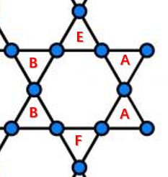
Triangle lable around a hexagon, from left-top, clockwise:
B,E,A,A,F,B

Slide 5
Bond tensor
First index connected to down triangle
Second index connected to up triangle
Third index is physical
Steps for J2-J3 model
Update all down triangles
Update all up triangles
lambda tensor
First index connected to triangle
Second index connected to bond

Slide 6
J2 term1
Lambda_c_up3
Bb2
Ba3
Lambda_b_up8
Lambda_a_up9
Tu2
Lambda_a_dn2
Lambda_b_dn7
Lambda_a_dn10
Td1
Lambda_c_dn6
Bc1
Lambda_c_up1

Slide 7
J2 term2

Slide 8
J2 term3

Slide 9
J2 term4

Slide 10
J2 term5

Slide 11
J2 term6

Slide 12
J3 term1
Lambda_c_up3
Bb2
Ba3
Lambda_a_up9
Tu2
Lambda_b_up8
Lambda_b_dn7
Lambda_a_dn10
Lambda_b_dn4
Lambda_a_dn2
Td1
Td3
Lambda_c_dn6
Lambda_c_dn11
Bc1
Bc4
Lambda_c_up1
Lambda_c_up5

Slide 13
J3 term2
alpha
beta

Slide 14
J3 term3

Slide 15
bipartition and fuse legs: J3 term1
3
2
4
1
5

