Slide 1
IBM University Engagement Project Submission
“Exploring the Power of Agentic AI with IBM Granite and LangFlow”

Slide 2

Project Tile – [TRAVEL PLANNER AGENT]
Domain of Project – [ TRAVEL AND TOURISM ]
Student Name | Recent Passport Photo | Email ID | Mobile number [WhatsApp]
NIVASINI YARRU |  | yarrunivasini@gmail.com | 8688392221

Slide 3
Problem Statement :
The Challenge: Traveling involves scattered data across unreliable sources. Travelers struggle with manual itinerary planning, budget tracking, and real-time navigation configurations. Without automated, consolidated, and personalized real-time guidance, making informed choices dynamically is difficult.
The Objective: Build an AI-powered Travel Planner Agent that delivers personalized travel insights, optimized routes, and itinerary guidance. The system should:
Personalized Itineraries: Recommend detailed daily schedules based on user travel preferences, budget limits, and stay duration.
Travel Data RAG Retrieval: Fetch and compile dynamic travel parameters and regional information from a local knowledge base
Interactive Digital Assistant: Embed a clean cloud-hosted user widget interface directly onto a web-accessible homepage.

Slide 4
Technology Used
IBM Watsonx Orchestrate: For orchestration layout configs, environment hosting, and chat widget management.
IBM Granite Model (Granite-3-2-8b / Granite-4.0): Powers natural language reasoning, destination summarization, and query execution.
GitHub Pages: For global hosting and front-end deployment of the interface.
Retrieval-Augmented Generation (RAG): Connects the agent to the custom compiled travel data asset file

Slide 5
Proposed Solution -
The proposed solution is an AI-Powered Travel Planner Agent utilizing IBM Watsonx Orchestrate and Granite Models to provide automated, real-time trip routing and schedule management.
At its core, the solution leverages an embedded frontend web framework connected to a backend retrieval mechanism. It queries the global_travel_plans.pdf dataset using a target layout architecture to serve user inputs accurately.
Core Execution Flows:
Front-End Layer: Hosted entirely on GitHub Pages using an isolated, responsive script structure that safely loads the interface assets container.
Agentic Orchestration Layer: The configuration initializes target IDs (orchestrationID, agentId) to link the frontend to the live IBM gateway servers securely.
Response Generation: The underlying model evaluates real-time prompts, analyzes context rules, and provides interactive layout cards or responses.

Slide 6
Components Breakdown:
Chat Input: Web interface where users submit trip requirements, length of stay, and specific budget queries.
IBM watsonx AI Agent: Processes user intent parameters using Granite models to synthesize relevant itinerary responses.
IBM Granite Model: ibm-granite-3-2-8b (or your exact loaded version) $\rightarrow$ optimized for high-speed parameter processing and low-latency interaction.
Chat Output: Displays the generated, structured itinerary text and budget outlines directly inside the custom floating layout box.
File Component: Processes and extracts text vectors from the local repository asset file.

Slide 7
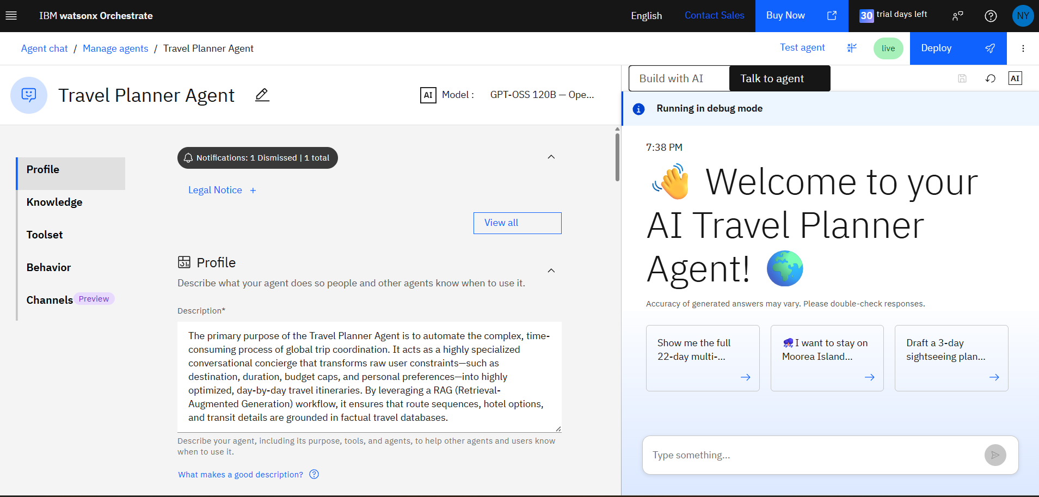
IBM WATSON ORCHESTRATE

Slide 8
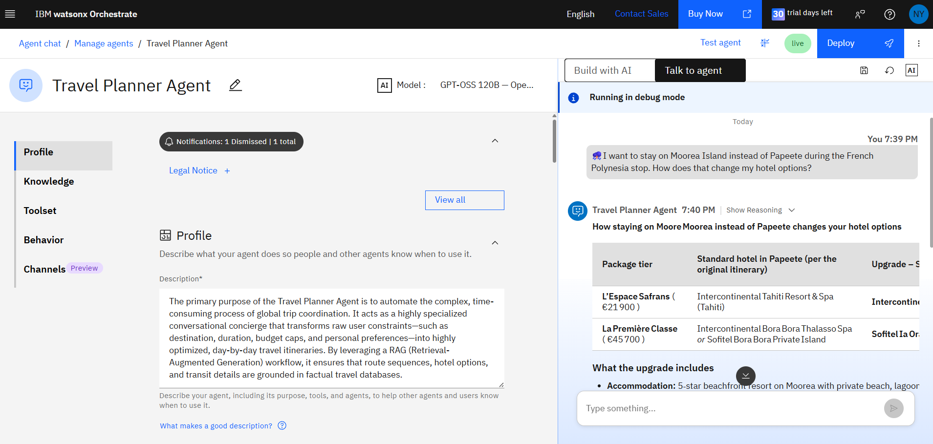
AI AGENT ARCHITECTURE

Slide 9

Role of Agentic AI in the solution
Agentic AI transforms this from a basic static text script into a dynamic, goal-driven travel consultant.
Contextual Awareness: Instead of simply pulling matched keywords from search strings, it analyzes the user's explicit structural constraints (such as days, preferences, and destination limitations).
Autonomous Optimization: The agent uses background reasoning mechanisms to format raw data points into sequential, daily travel tables automatically.
Dynamic Adaptation: It maintains contextual state data throughout the chat pipeline, allowing users to modify details (e.g., "Change day 2 to an outdoor activity") on the fly

Slide 10
Novelty and Uniqueness
Zero-Server Frontend Footprint: Deployed as an entirely serverless web execution app on GitHub Pages, ensuring zero hosting costs and high global availability.
RAG-Backed Accuracy: Direct linking with custom target files reduces standard language model hallucination risks for hotel/destination data.
Compact Resource Footprint: Leverages the lightweight, highly optimized 8B Granite configuration model, ensuring fast token generation rates
Plug-and-Play Widget Structure: Built modularly, meaning the underlying scripts can be inserted into any existing corporate website with a single block of HTML code.

Slide 11
Git Hub Link
· Please create public github repository (Enable Add README button while creating repository) with format –https://github.com/niva-2008/Travel-Planner-Agent.git
Please test and Paste the working Github URL – https://niva-2008.github.io/Travel-Planner-Agent/
index.html (The primary web container layout and loader configuration scripts)
global_travel_plans.pdf (The core domain data knowledge base used for planning)
ProjectPresentation.pptx (This official presentation file)
README.md (Comprehensive setup steps and alternative environment screenshots verifying active system state).
·
·
·

Slide 12
Future Scope
Live Translation & Currency APIs: Integration with live webhooks to fetch real-time financial exchange rates and translate itineraries into regional languages automatically.
Booking Engine Integrations: Connecting the agent to public flight and hospitality industry APIs (like Amadeus or Skyscanner) to allow users to book their planned trips directly from the chat interface.
·
·
·

Slide 13


