Slide 1
Rxcellent
An app to get your prescription, without the struggle

Slide 2
Content
Team Members
Overview
Requirements
Management Plan
Configuration Management Plan
Quality Assurance Plan

Slide 3
Roles
Ryan: Team Leader, (Backup QA Leader)
Ignacio: Requirements and Configuration Leader
Christol: Design Leader (Backup Configuration Leader)
Nivan: Implementation Leader
Tsing: Security Leader
Zahit: QA Leader (Backup Team Leader)

Slide 4
Overview
Rxcellent is an e-commerce pharmacy website that sells prescription medications.
Purpose :-
The motivation is to sell medicine to cut out the middleman directly to sick adults and teens with prescriptions without them having to go to a brick and mortar pharmacy.
Users:
Anyone with a prescription within valid date of medication.

Slide 5
Requirements
As a user i should be able to order medicine so that i dont have to walk to store to get medicine.
As a person with a need for prescription medicine, I want to be able to order prescriptions online so that I always have them in reserve.
As a hospital worker, I want users to be registered before buying prescription medicine so that we’re not selling medicine to people that don’t deserve it.
As a hospital worker, I want to have an administration panel so that I can accept or reject the users, depending on the prescription condition.

Slide 6
Management Plan
High priority is to deploy the software successfully with little to no bugs, and maintain high quality.
In this project, we will use Git and Github as the version control tools.
We are going to use VS Code as IDE; Husky for pre-commit lint check; Vercel as the first choice for deployment and Heroku as a backup.
Each iteration will begin by reviewing the previous iteration and using that to plan out the next
Each week goals will be reviewed and tasks assigned to appropriate parties
At the end of each iteration a review will assess the completed work to discuss / deal with any encountered problems or risks.

Slide 7
Configuration Management Plan
Tools
VSCode
ESLint + Husky as Static App Security Tool
DeepScan.io for critical bugs
Vercel for deployment

Slide 8
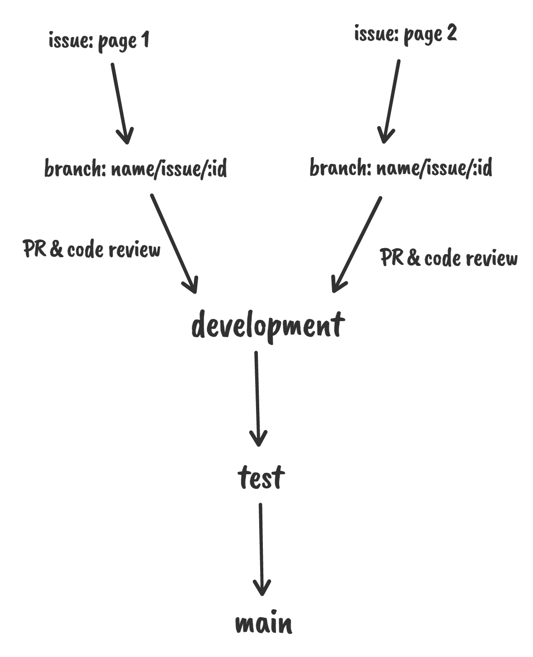
Configuration Management Plan
Code commit and branching strategy
Create issue for a dev task on GitHub
Create a branch with issue
Use commitzen for commit messages:
feat, fix, doc, style, test, chore
Use pull requests to merge branches
Deploy to Vercel or Heroku

Slide 9
Quality Assurance Plan
Metric Name | Description
# of test cases | Total of unit and integration tests. At least one test case for each method
test cases pass rate | We aim a %100 passing rate
# of resolved bugs | We aim to identify the bugs with ESLint + Husky and resolve all the bugs identified
# of user stories completed | We aim to complete all user stories related with essential features
Test coverage rate | We aim to achieve at least %75 coverage (using Jest)
# of critical bugs | We aim to perform static coding analysis with DeepScan.io and to produce 0 critical bugs

Slide 10
Quality Assurance Plan
Coding Standard
Prettier + ESLint (configurable)
Code review
In feature branches with automated rules
In development branch, Design leader/Implementation Leader or QA Leader will review the code at pull requests

Slide 11
Quality Assurance Plan
Testing
Manual and unit testing by developers in feature branches
React-testing-library (Automatized with Jest)
Manual testing in development branch and Integration testing in test branch by QA Leader
Critical bug testing in test branch via DeepScan.io
Defect Management
GitHub for defect management
Bugs, flaws, failed test, configuration issues
Anyone can report a defect
Defects mostly will be reported by Design, Implementation or QA Leader and will be assigned to related person

