Slide 1
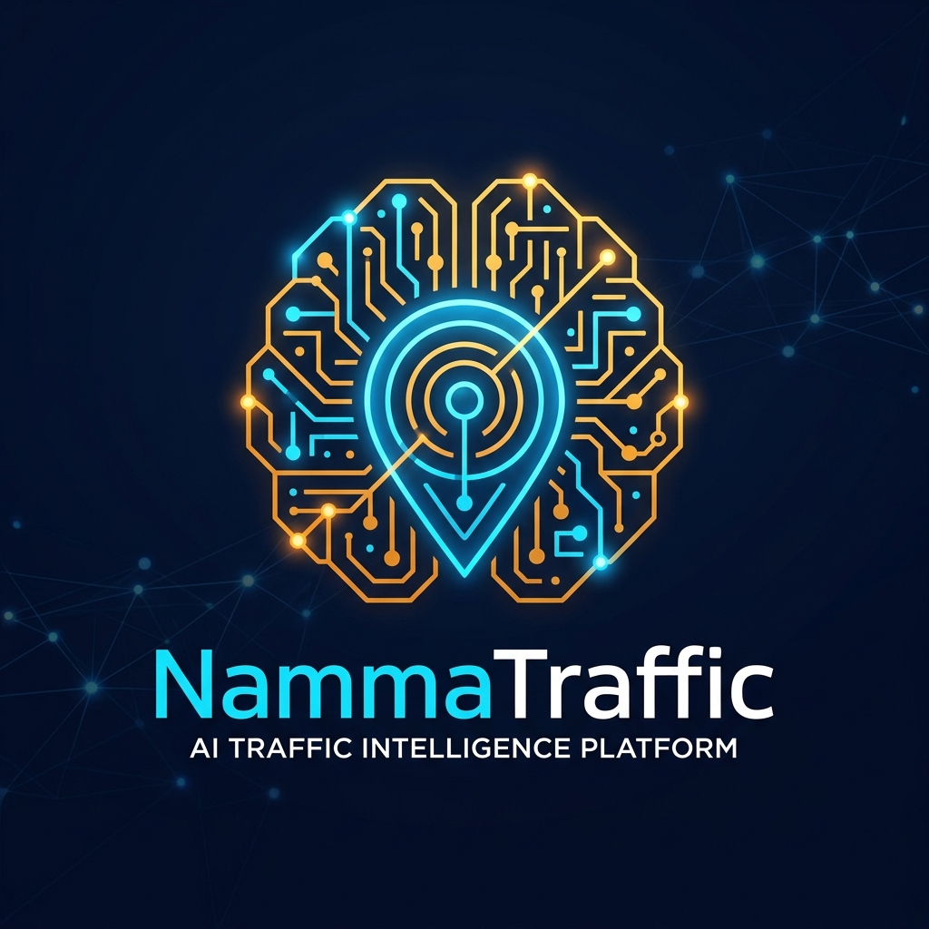
NAMMATRAFFIC
Bengaluru Traffic Incident Intelligence & Command Platform
8,173 Incidents Analyzed | 22 Corridors Covered | 5 Predictive Intelligence Models

Slide 2
THE IMPACT OF REACTIVE OPERATIONS
Reactive Dispatch
Delayed Response
Congestion Spread
Citizen Impact
8,173 incidents recorded in 150 days in Bengaluru.

Slide 3
THE CORE PROBLEMS
Unquantified Impact
Event impact is not quantified in advance, causing operational surprises.
Experience-Driven
Resource deployment relies heavily on individual experience, not data.
No Post-Event Learning
Every incident is forgotten. No institutional memory or continuous learning.
Fragmented Decisions
Lack of a unified, intelligent decision-support platform for authorities.

Slide 4
THE SOLUTION: AI COMMAND PLATFORM
Incident Data
ML Engine
GIS Intelligence
AI Copilot
Command Center
RECOMMEND
Suggest exact manpower, cranes, and diversions.
PREDICT
Forecast incident resolution time and severity.
VISUALIZE
Live GIS mapping of next-hour hotspots.
LEARN
AI Copilot querying historical incident intelligence.

Slide 5
PLATFORM CAPABILITIES
Module 1
Incident Intelligence Engine
Module 2
Congestion Forecasting
Module 3
Resource Recommender
Module 4
Diversion Engine
Module 5
Similar Incident Search
Module 6
GIS Hotspot / Risk Map
Module 7
AI Traffic Copilot
Module 8
Post-Event Learning Engine

Slide 6
DATA & INTELLIGENCE MODELLING
Trained on 8,173 Real Bengaluru Incidents
Severity Prediction
F1 Score: 0.88
Classifies High, Medium, Low impact instantly.
Road Closure
AUC: 0.91
Probability of complete corridor blockage.
Resolution Time
MAE: ~2.2 Hours
CatBoost Regressor optimizing timeline.

Slide 7
PREDICTIVE OUTPUTS IN ACTION
Output: AI Command
► Severity: HIGH (89% Confidence)
► Road Closure Prob: 76%
► Est. Resolution: 3h 15m
► Required: 4 Officers, 1 Crane
Input: Live Event
Event: Vehicle Breakdown
Location: Bellary Road
Time: 18:00 (Peak Hour)
Weather: Clear

Slide 8
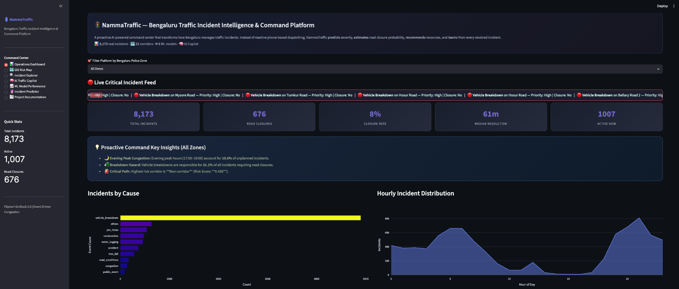
LIVE PROTOTYPE: COMMAND CENTER

Slide 9
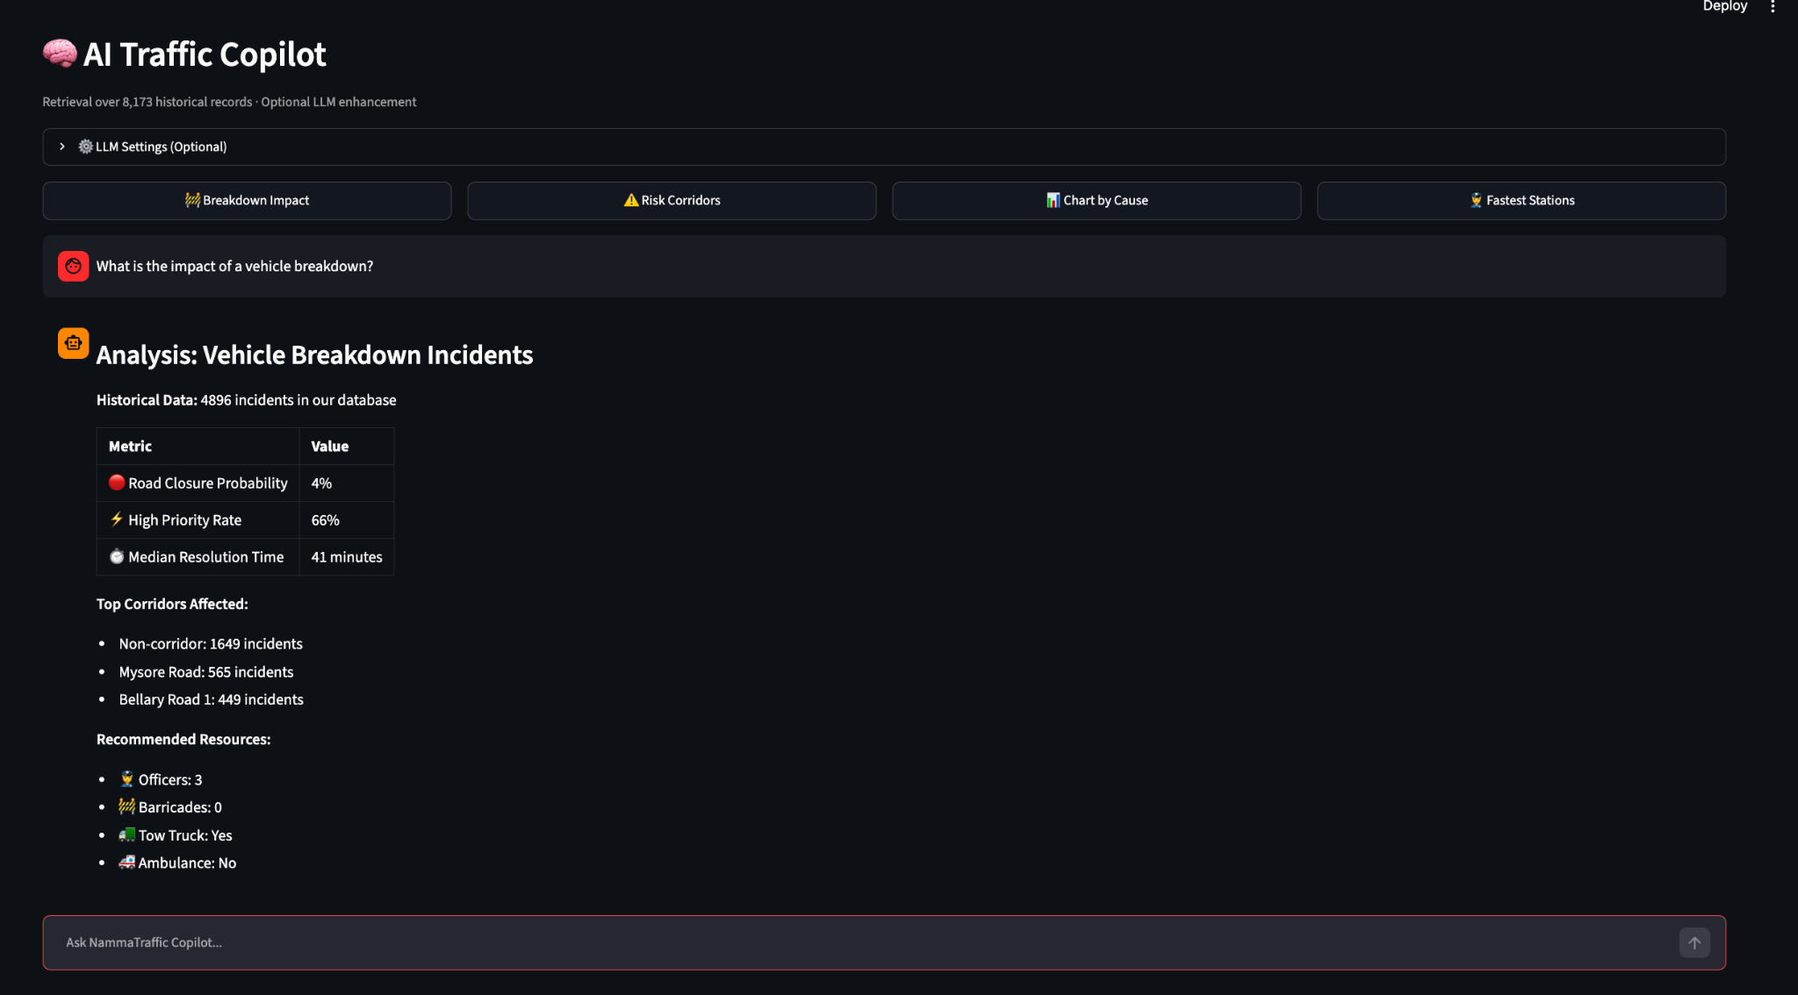
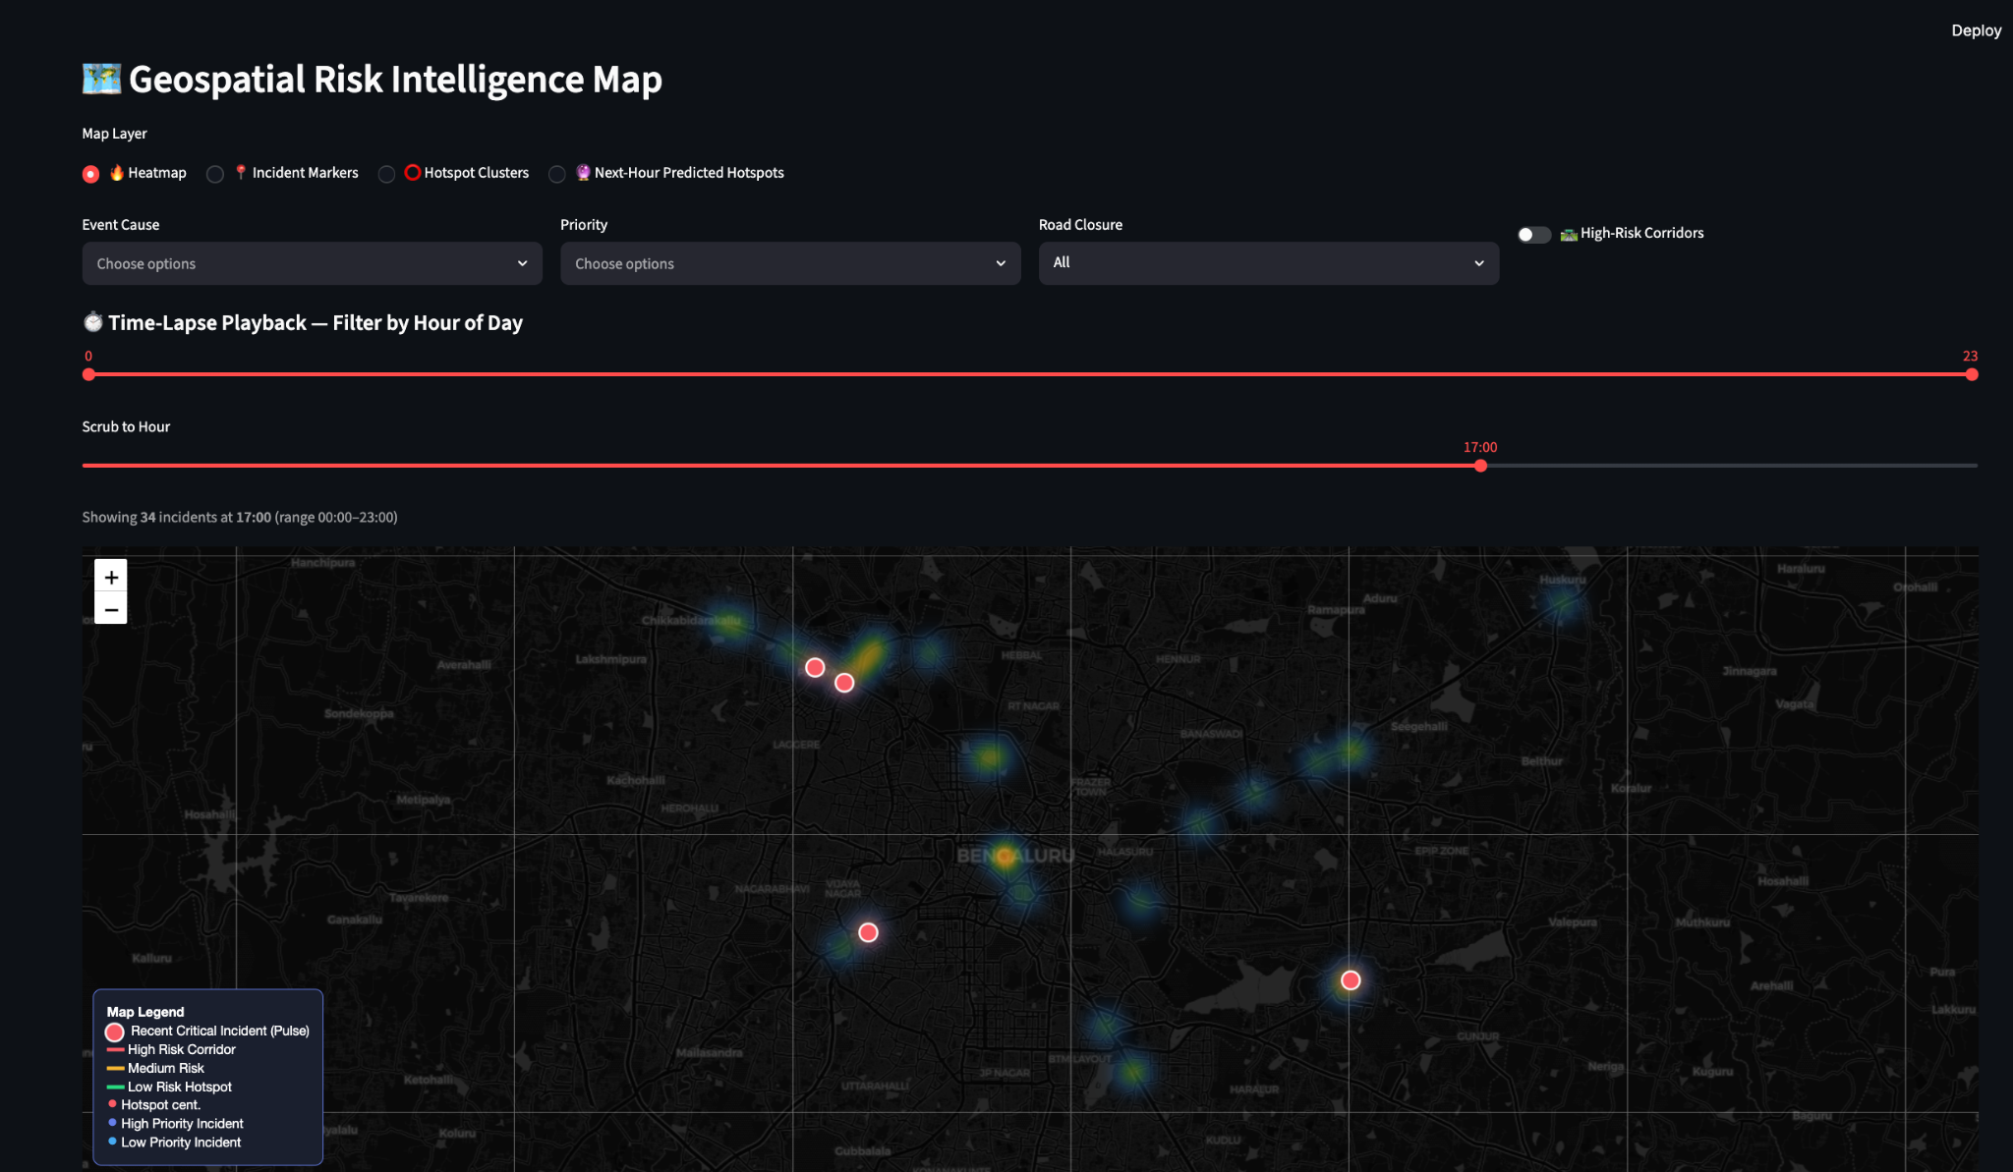
AI TRAFFIC COPILOT
Natural Language Traffic Intelligence
RAG over 8,173 historical incidents.
“What is the impact of a vehicle breakdown near Bellary Road at 6 PM?”
“Which corridors are at highest risk today?”

Slide 10
REAL-WORLD IMPACT
BEFORE (Current System) | AFTER (NammaTraffic)
Reactive Operations | Predictive Intelligence
Manual Experience-based Planning | AI Data-Driven Recommendations
Static Historical Reports | Live Real-Time GIS Intelligence
No Learning Loop | Continuous Institutional Learning

Slide 11
Transforming Bengaluru Traffic Operations from
Reactive Response to Predictive Intelligence.

