Slide 1
Cryptographic Bill of Materials & Post-Quantum Readiness Console
CRYPTONEX
SIH 2026 | Problem Statement 26164
Offline-first. Nothing ever leaves the machine.
CRYPTONEX | SIH 2026 | PS 26164
Notes:
[0:00 - 0:03] (no narration - let the title land)
- SIH 2026 | Problem Statement 26164
- Offline-first. Nothing ever leaves the machine.

Slide 2
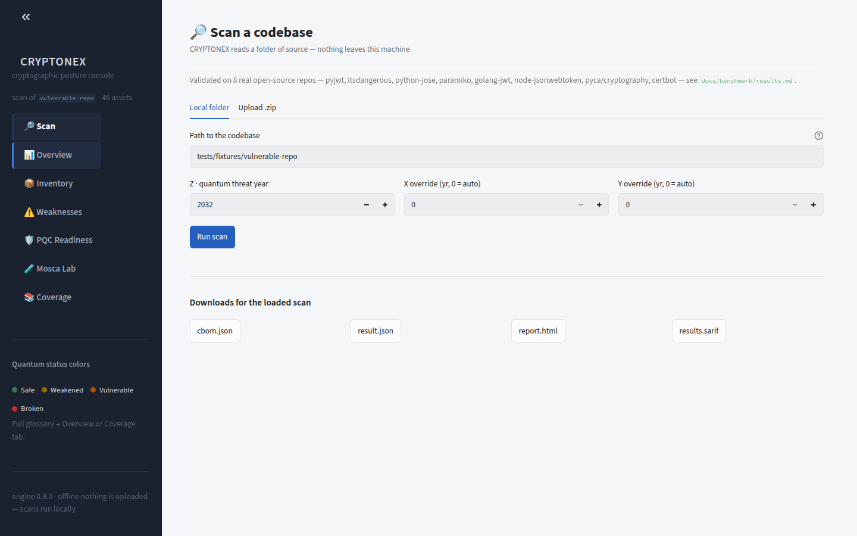
SCAN PAGE, IDLE
You Cannot Migrate What You Cannot See
0:03 - 0:08
NARRATION
You cannot migrate what you cannot see. CRYPTONEX scans a codebase locally - nothing is ever uploaded.
WHAT TO NOTICE
▪ Point it at any codebase - no agent, no cloud, no telemetry
▪ The scan runs entirely on the local machine
▪ Air-gap safe: suitable for regulated and classified estates
CRYPTONEX | SIH 2026 | PS 26164
2
Notes:
[0:03 - 0:08] You cannot migrate what you cannot see. CRYPTONEX scans a codebase locally - nothing is ever uploaded.
- Point it at any codebase - no agent, no cloud, no telemetry
- The scan runs entirely on the local machine
- Air-gap safe: suitable for regulated and classified estates

Slide 3
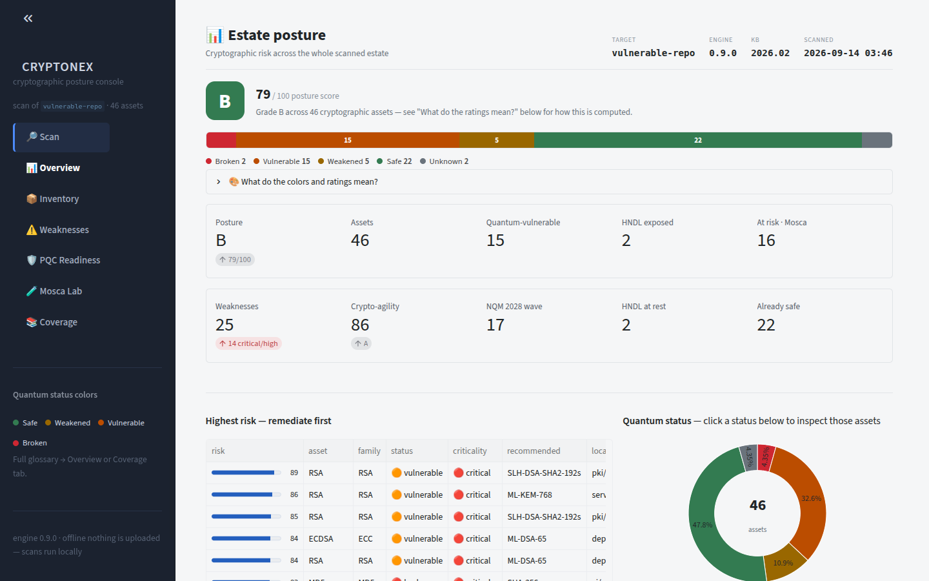
ESTATE POSTURE
46 Cryptographic Assets, Graded
0:08 - 0:14
NARRATION
Forty-six cryptographic assets found. Estate posture: grade B out of a hundred.
WHAT TO NOTICE
▪ 46 crypto assets discovered across the estate
▪ Single headline posture grade: B / 100
▪ One number a CISO can take to the board
CRYPTONEX | SIH 2026 | PS 26164
3
Notes:
[0:08 - 0:14] Forty-six cryptographic assets found. Estate posture: grade B out of a hundred.
- 46 crypto assets discovered across the estate
- Single headline posture grade: B / 100
- One number a CISO can take to the board

Slide 4
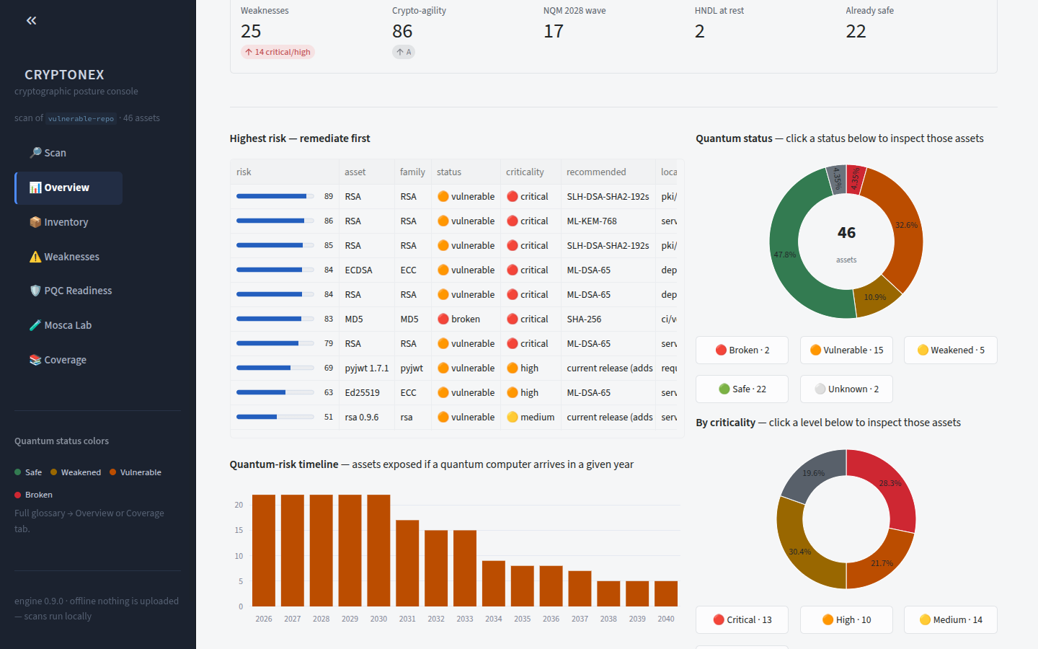
OVERVIEW DONUTS
Quantum Status and Criticality at a Glance
0:14 - 0:21
NARRATION
Quantum status and criticality, at a glance - color-coded, and every color explained. Click any slice to drill straight in.
WHAT TO NOTICE
▪ Two donuts: quantum status and business criticality
▪ Every color is defined in-product - no legend guesswork
▪ Charts are navigation: click a slice to drill in
CRYPTONEX | SIH 2026 | PS 26164
4
Notes:
[0:14 - 0:21] Quantum status and criticality, at a glance - color-coded, and every color explained. Click any slice to drill straight in.
- Two donuts: quantum status and business criticality
- Every color is defined in-product - no legend guesswork
- Charts are navigation: click a slice to drill in

Slide 5
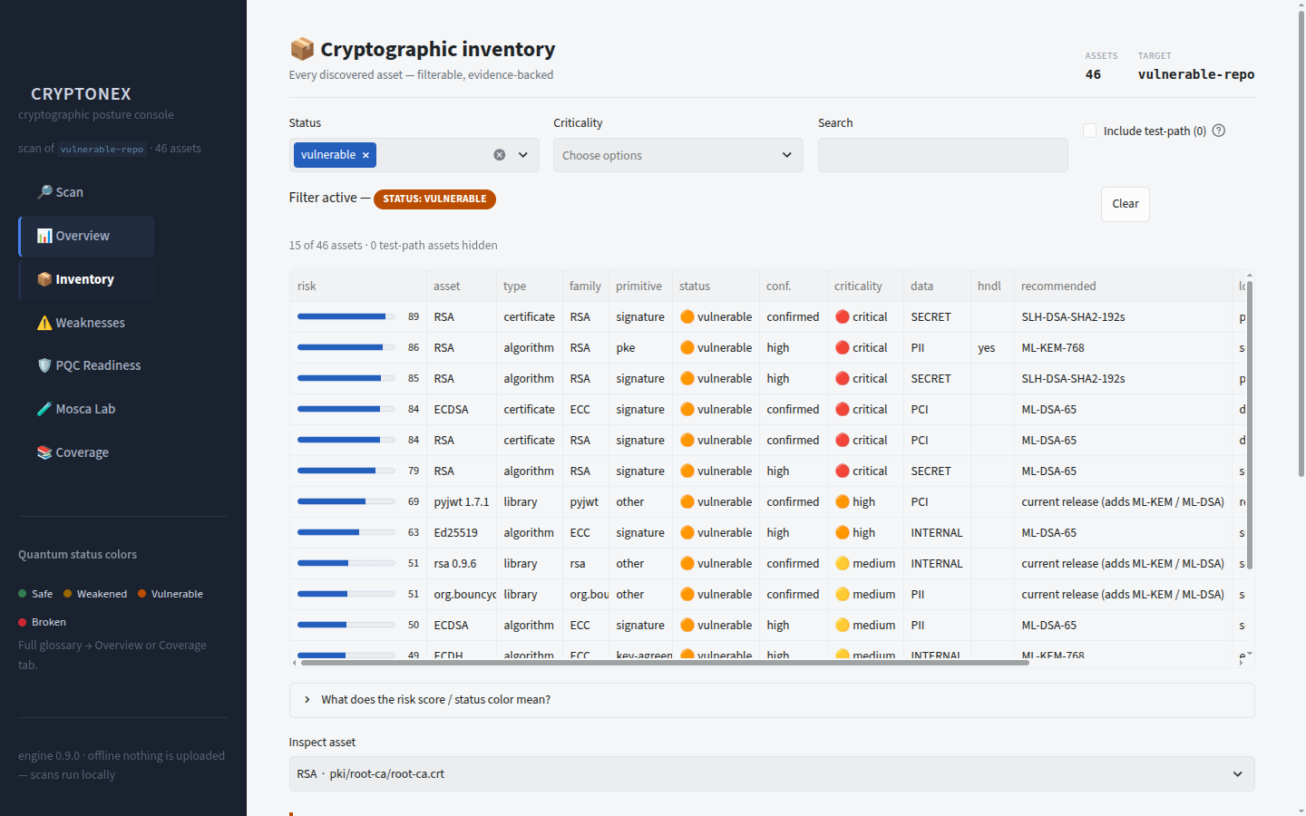
VULNERABLE -> INVENTORY, FILTERED
One Click to the 15 Assets That Matter
0:21 - 0:27
NARRATION
One click on 'Vulnerable' - and we're in the inventory, already filtered to the fifteen assets that need attention.
WHAT TO NOTICE
▪ Clicking 'Vulnerable' lands in the inventory pre-filtered
▪ 15 of 46 assets flagged as quantum-vulnerable
▪ Zero manual filtering between insight and action
CRYPTONEX | SIH 2026 | PS 26164
5
Notes:
[0:21 - 0:27] One click on 'Vulnerable' - and we're in the inventory, already filtered to the fifteen assets that need attention.
- Clicking 'Vulnerable' lands in the inventory pre-filtered
- 15 of 46 assets flagged as quantum-vulnerable
- Zero manual filtering between insight and action

Slide 6
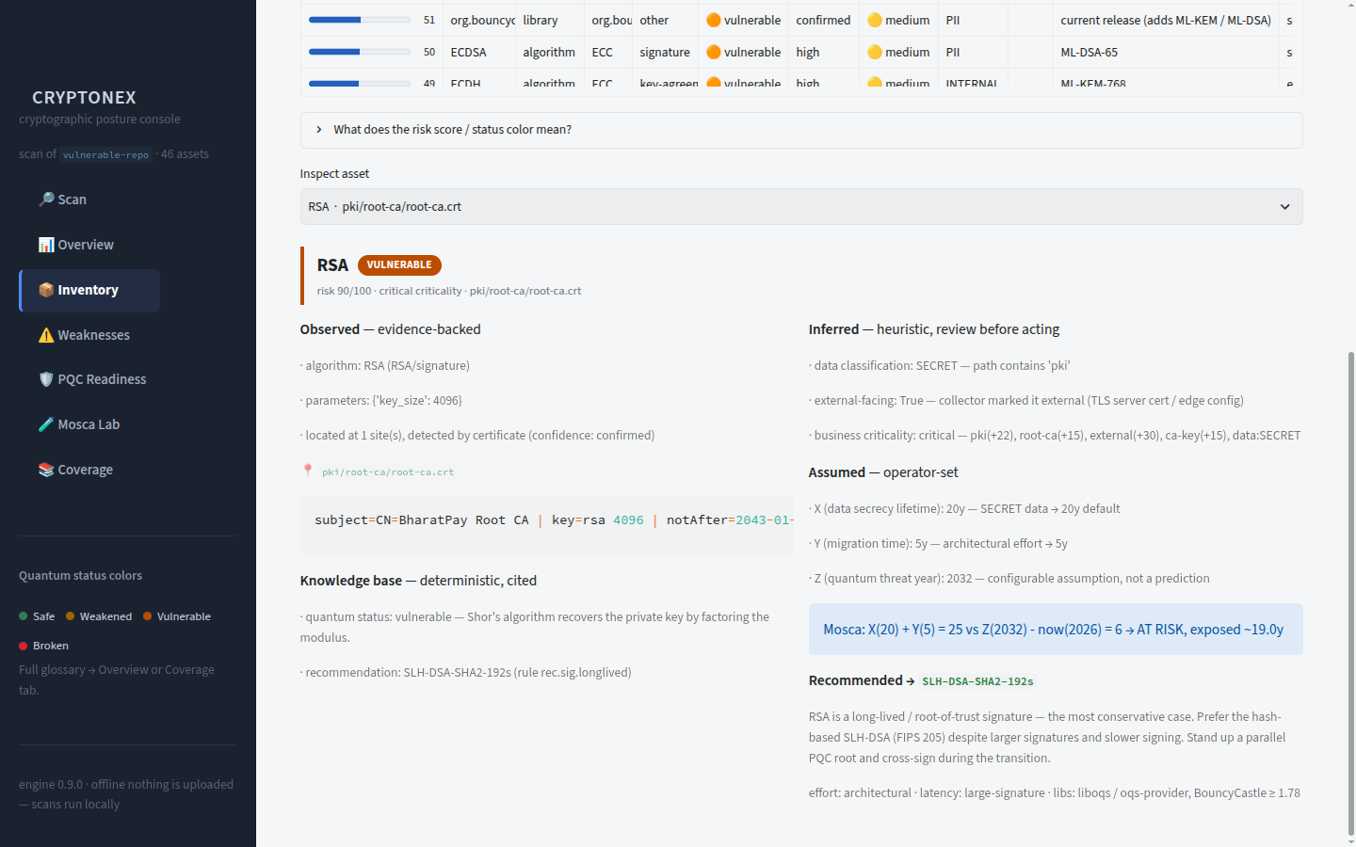
INVENTORY DETAIL
Inside One Asset: The RSA Root of Trust
0:27 - 0:35
NARRATION
Let's inspect one: the RSA root of trust. Observed evidence, inferred criticality, the Mosca exposure window, and the exact post-quantum recommendation.
WHAT TO NOTICE
▪ Observed evidence - where and how the asset was found
▪ Inferred criticality, with the reasoning shown
▪ Mosca exposure window and the exact PQC replacement
CRYPTONEX | SIH 2026 | PS 26164
6
Notes:
[0:27 - 0:35] Let's inspect one: the RSA root of trust. Observed evidence, inferred criticality, the Mosca exposure window, and the exact post-quantum recommendation.
- Observed evidence - where and how the asset was found
- Inferred criticality, with the reasoning shown
- Mosca exposure window and the exact PQC replacement

Slide 7
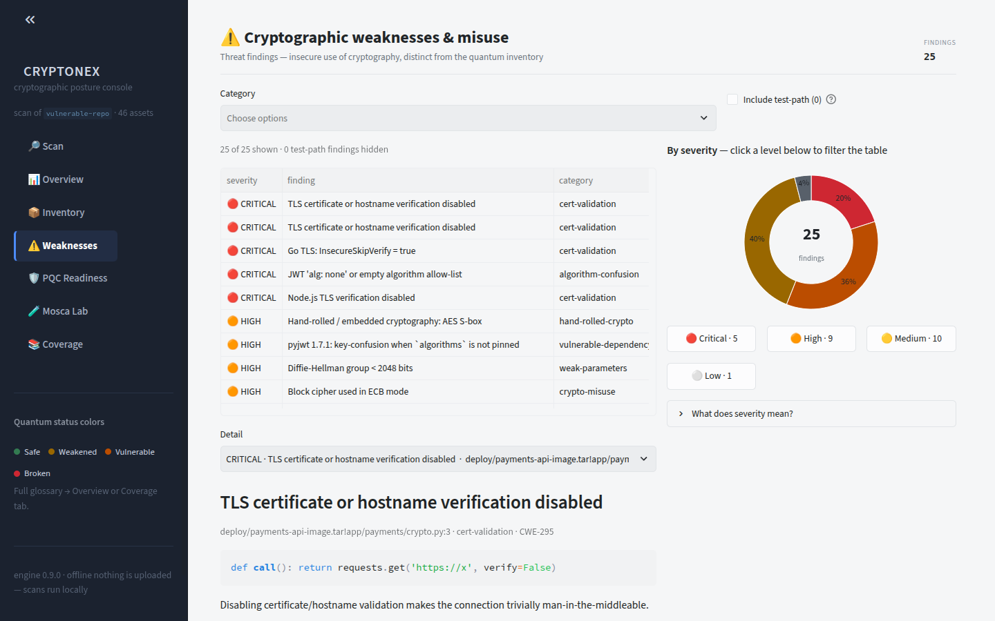
WEAKNESSES, SEVERITY DONUT
25 Real-World Misuse Findings
0:35 - 0:40
NARRATION
Twenty-five real-world misuse findings - hardcoded keys, weak modes, disabled TLS checks. Click a severity to filter.
WHAT TO NOTICE
▪ Hardcoded keys, weak cipher modes, disabled TLS verification
▪ Beyond inventory: how the crypto is actually misused
▪ Severity donut doubles as the filter control
CRYPTONEX | SIH 2026 | PS 26164
7
Notes:
[0:35 - 0:40] Twenty-five real-world misuse findings - hardcoded keys, weak modes, disabled TLS checks. Click a severity to filter.
- Hardcoded keys, weak cipher modes, disabled TLS verification
- Beyond inventory: how the crypto is actually misused
- Severity donut doubles as the filter control

Slide 8
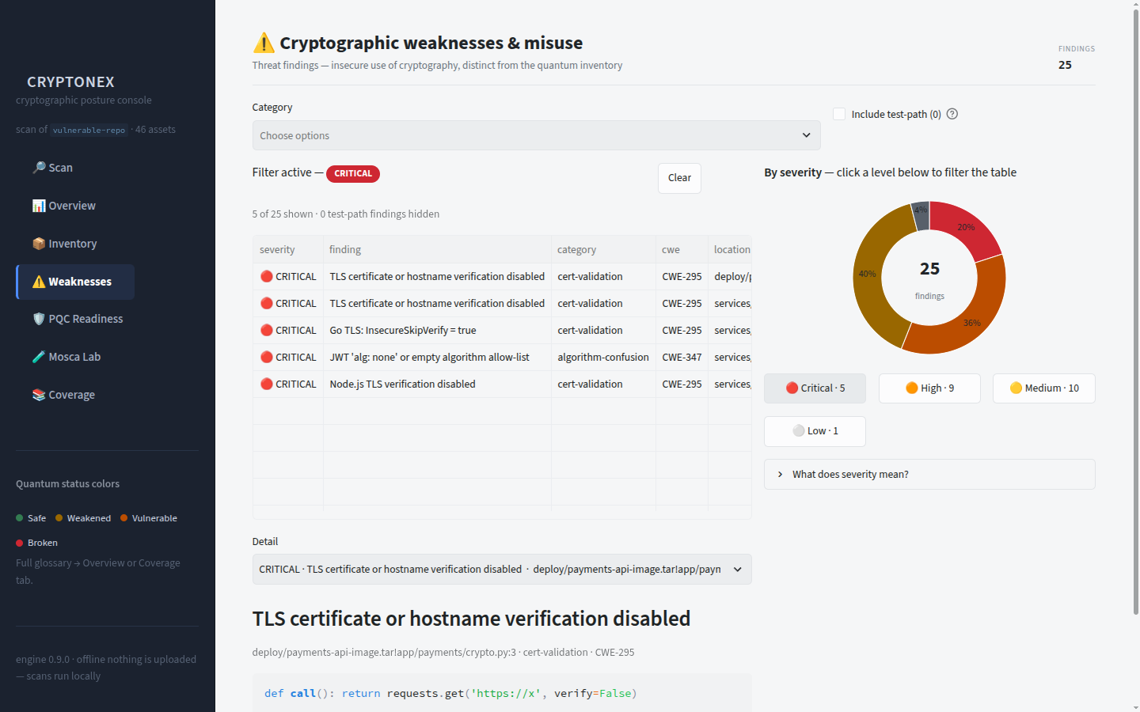
WEAKNESSES FILTERED TO CRITICAL
5 Critical Findings, Isolated Instantly
0:40 - 0:46
NARRATION
Five critical findings, isolated instantly - each with the exact line, the fix, and the CWE.
WHAT TO NOTICE
▪ Exact file and line number for every finding
▪ A concrete remediation, not a generic warning
▪ CWE mapping for audit and ticket traceability
CRYPTONEX | SIH 2026 | PS 26164
8
Notes:
[0:40 - 0:46] Five critical findings, isolated instantly - each with the exact line, the fix, and the CWE.
- Exact file and line number for every finding
- A concrete remediation, not a generic warning
- CWE mapping for audit and ticket traceability

Slide 9
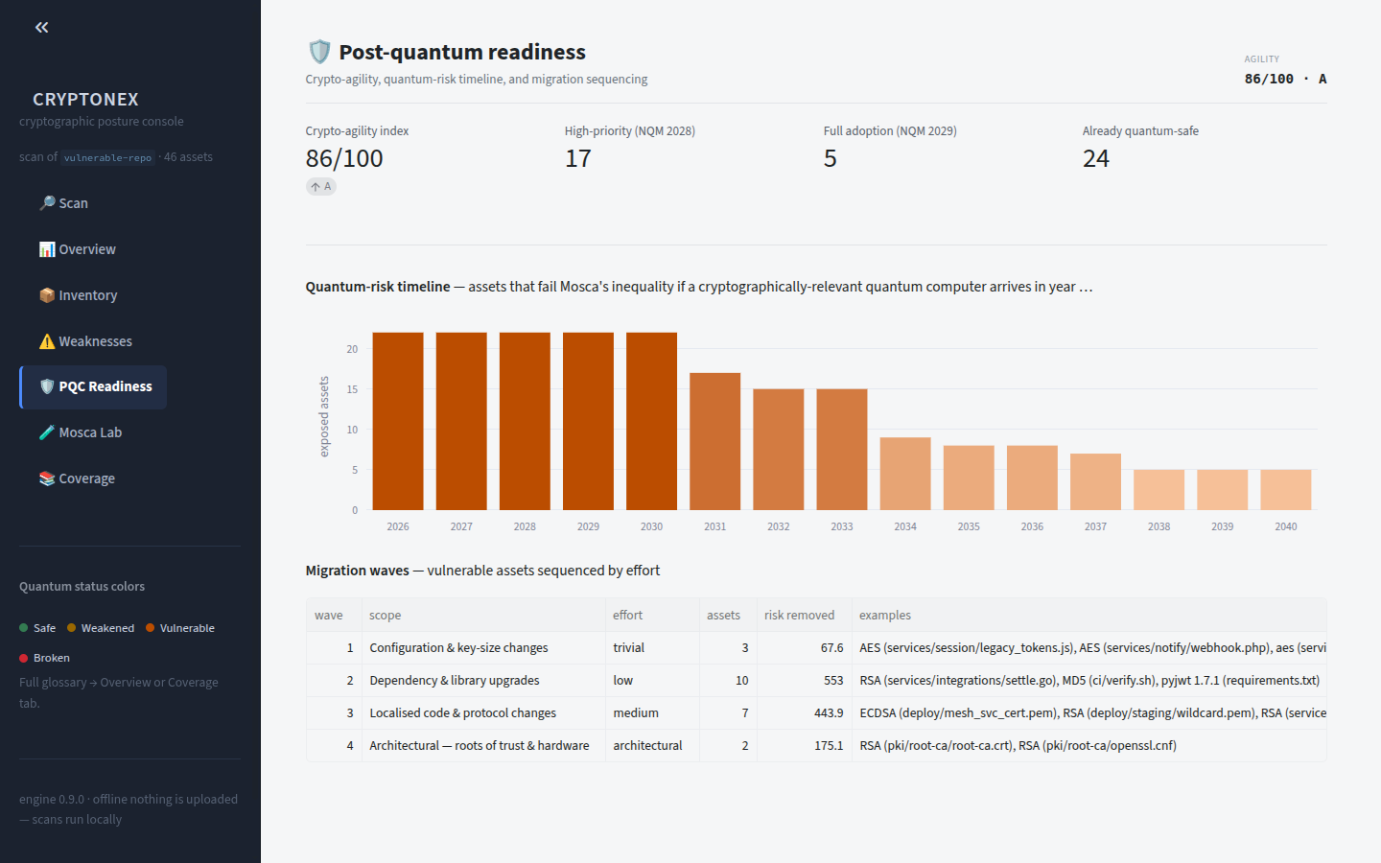
PQC READINESS: TIMELINE + MIGRATION WAVES
Post-Quantum Readiness, Sequenced
0:46 - 0:53
NARRATION
Post-quantum readiness: a crypto-agility score, a quantum-risk timeline, and migration waves sequenced by effort.
WHAT TO NOTICE
▪ Crypto-agility score: how replaceable the estate really is
▪ Quantum-risk timeline projected across the coming years
▪ Migration waves ordered by effort - a plan, not a list
CRYPTONEX | SIH 2026 | PS 26164
9
Notes:
[0:46 - 0:53] Post-quantum readiness: a crypto-agility score, a quantum-risk timeline, and migration waves sequenced by effort.
- Crypto-agility score: how replaceable the estate really is
- Quantum-risk timeline projected across the coming years
- Migration waves ordered by effort - a plan, not a list

Slide 10
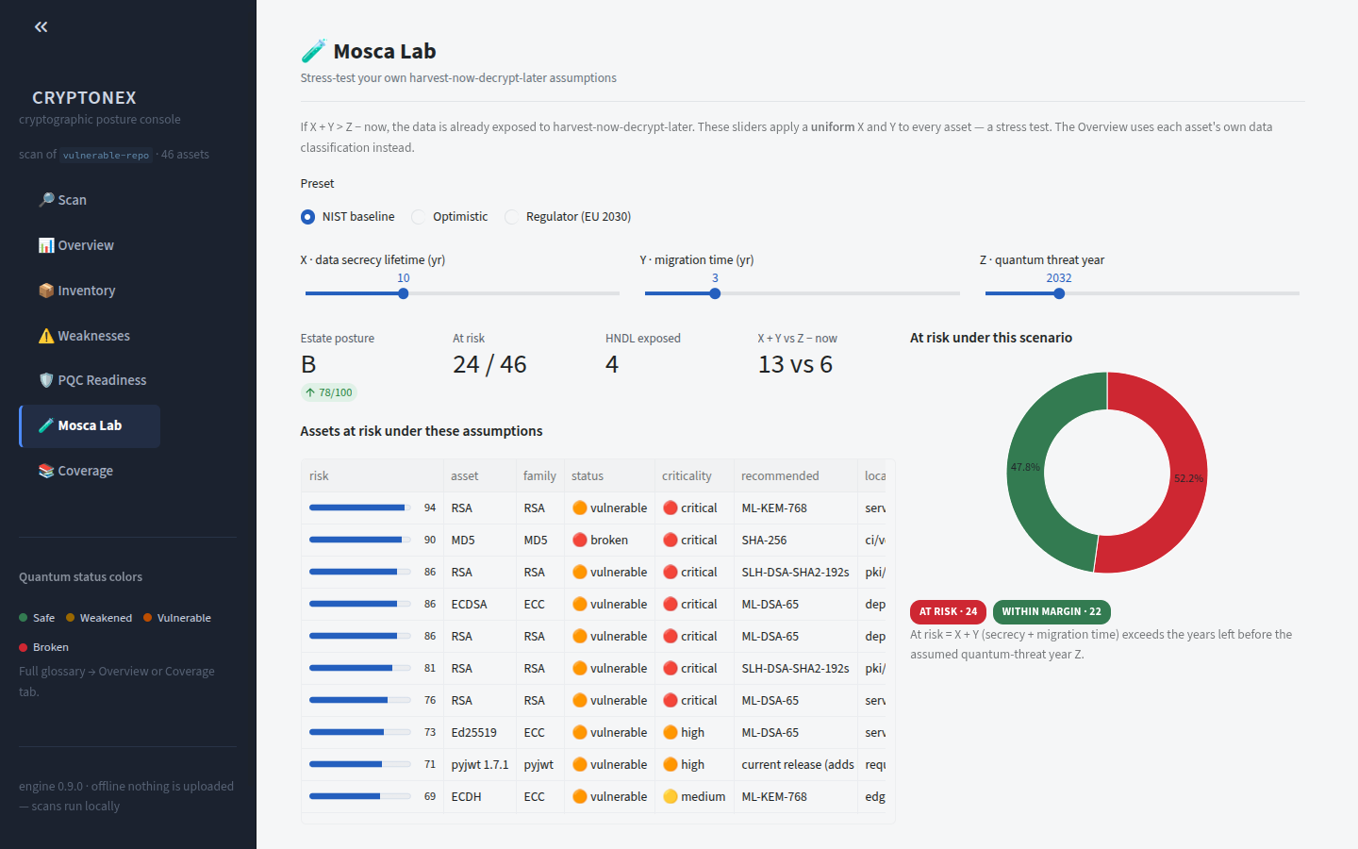
MOSCA LAB, NIST BASELINE
The Mosca Lab: Model Your Own Assumptions
0:53 - 0:58
NARRATION
The Mosca Lab lets you model your own assumptions - how long data must stay secret, how long migration takes.
WHAT TO NOTICE
▪ Mosca's inequality made interactive
▪ Set data shelf life and migration duration yourself
▪ Starts from the NIST baseline assumptions
CRYPTONEX | SIH 2026 | PS 26164
10
Notes:
[0:53 - 0:58] The Mosca Lab lets you model your own assumptions - how long data must stay secret, how long migration takes.
- Mosca's inequality made interactive
- Set data shelf life and migration duration yourself
- Starts from the NIST baseline assumptions

Slide 11

REGULATOR PRESET, LIVE RECOMPUTE
EU-2030 Preset: 24 of 46 Assets Fall at Risk
0:58 - 1:05
NARRATION
Switch to the EU-2030 regulator preset - assumptions tighten, and twenty-four of forty-six assets fall at risk. Everything recomputes live.
WHAT TO NOTICE
▪ Regulator presets encode real compliance deadlines
▪ Tighter assumptions push at-risk assets from 15 to 24
▪ Every score, chart and wave recomputes live
CRYPTONEX | SIH 2026 | PS 26164
11
Notes:
[0:58 - 1:05] Switch to the EU-2030 regulator preset - assumptions tighten, and twenty-four of forty-six assets fall at risk. Everything recomputes live.
- Regulator presets encode real compliance deadlines
- Tighter assumptions push at-risk assets from 15 to 24
- Every score, chart and wave recomputes live

Slide 12
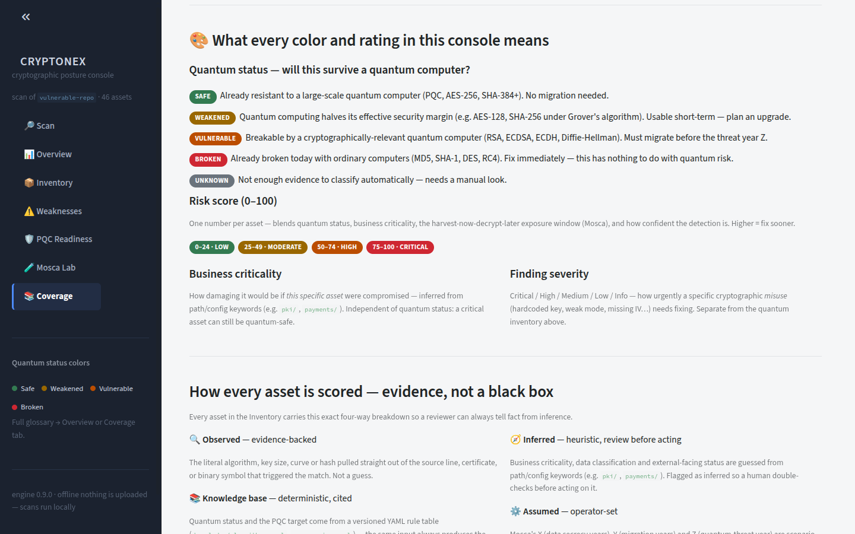
COVERAGE: THE COLOR AND RATING GLOSSARY
Nothing Here Is a Black Box
1:05 - 1:12
NARRATION
And nothing here is a black box - every color, every score, every rating is explained, right in the console.
WHAT TO NOTICE
▪ Built-in glossary for every color, score and rating
▪ Explanations live in the console, not a separate manual
▪ Auditable by design - defensible in front of a regulator
CRYPTONEX | SIH 2026 | PS 26164
12
Notes:
[1:05 - 1:12] And nothing here is a black box - every color, every score, every rating is explained, right in the console.
- Built-in glossary for every color, score and rating
- Explanations live in the console, not a separate manual
- Auditable by design - defensible in front of a regulator

Slide 13
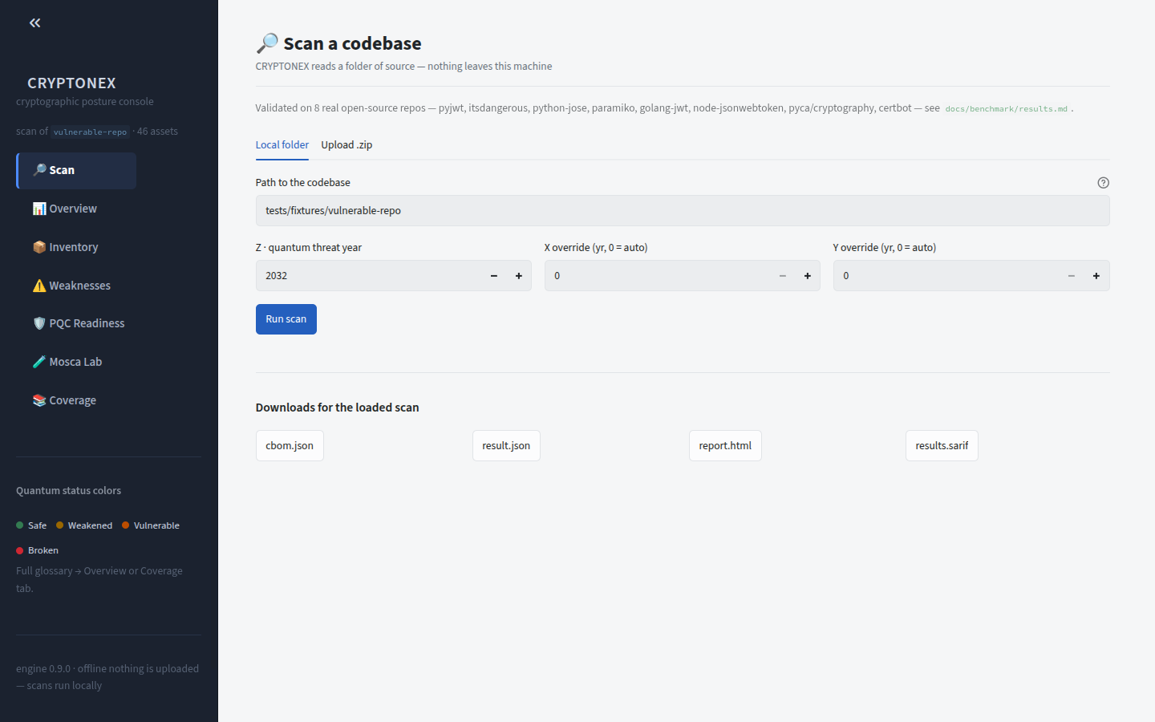
SCAN PAGE: DELIVERABLES
Export CBOM, SARIF and Report - Fully Offline
1:12 - 1:18
NARRATION
Export the CBOM, SARIF, and report - fully offline, ready for a GRC platform, a SIEM, or your CI pipeline.
WHAT TO NOTICE
▪ CBOM for GRC platforms and asset inventories
▪ SARIF for SIEM ingestion and CI/CD gating
▪ Human-readable report for auditors and leadership
CRYPTONEX | SIH 2026 | PS 26164
13
Notes:
[1:12 - 1:18] Export the CBOM, SARIF, and report - fully offline, ready for a GRC platform, a SIEM, or your CI pipeline.
- CBOM for GRC platforms and asset inventories
- SARIF for SIEM ingestion and CI/CD gating
- Human-readable report for auditors and leadership

Slide 14
CRYPTONEX
See It. Score It. Migrate It.
Discover every cryptographic asset - locally
Score quantum exposure with Mosca's inequality
Ship a sequenced, auditable migration plan
CRYPTONEX | SIH 2026 | PS 26164
Notes:
[1:18 - 1:22] (no narration - let the tagline land)
- Discover every cryptographic asset - locally
- Score quantum exposure with Mosca's inequality
- Ship a sequenced, auditable migration plan

