Slide 1
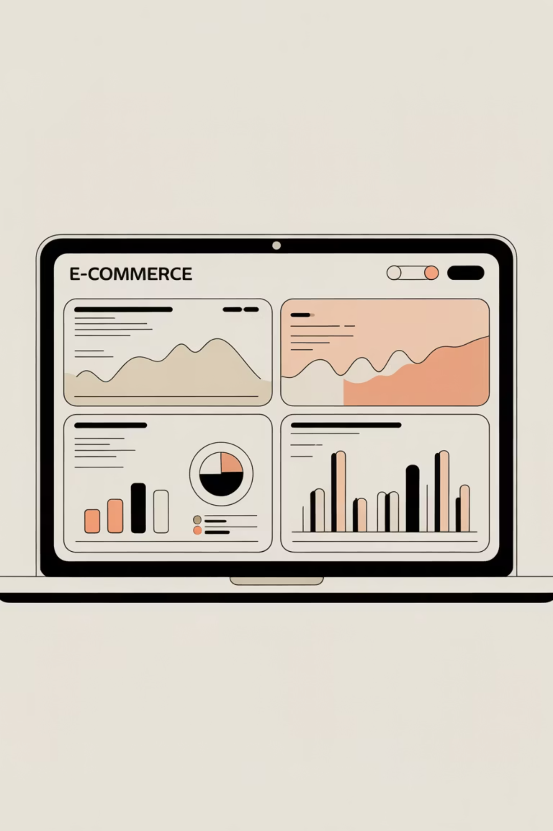
E-commerce Business Analysis using SQL & Python
End-to-End Data Preparation, Analytics & Business Insights
Nivas Kumar

Slide 2
Presentation Overview
01
02
03
Project Objective
Questions & Analysis
Scope
Dataset Overview
Defining the analytical mission and business goals
Understanding the data sources and structure
Key business questions driving our investigation
04
04
04
Tools & Workflow
Data Ingestion Strategy
SQL & Python Analysis
Technical stack and analytical
approach
Loading data efficiently at scale
Executing multi-tiered analytics
07
Key Insights & Outcomes
Actionable findings and business impact

Slide 3

Project Objective
This project demonstrates end-to-end analytical capabilities by transforming raw e-commerce data into strategic business intelligence.
Extract Insights
Multi-Tool Approach
Drive Decisions
Analyze real-world e-commerce datasets to uncover actionable patterns in sales, customers, and products
Leverage SQL for scalable analytics and Python for data preparation and rich visualizations
Support data-driven business strategy with clear metrics on performance, behavior, and growth

Slide 4
Questions Addressed
Our analysis answers critical business questions that shape strategic decisions and operational priorities.
Revenue Trends
Top Contributors
Product Performance
Pricing Impact
How is revenue trending over time? Identifying growth patterns and seasonal fluctuations
Which customers and sellers generate the most value? Pinpointing high-impact segments
How does pricing affect customer demand? Analyzing price sensitivity and elasticity
What products drive volume versus revenue? Understanding the catalog's true performers
Business Growth
What is the overall trajectory? Measuring expansion, retention, and long-term health

Slide 5

Tools & Workflow
Python
Conver the dataset format, load the data into workbench, perform basic checks, and creates rich visualizations
Excel Sources
Python Cleaning
MySQL
MySQL Storage
Scalable analytics through complex joins, aggregations, and window functions
SQL & Visualization
GitHub
This workflow mirrors real-world production analytics environments where different tools handle specialized responsibilities.
Share the all work along with python notebook, SQL script, and datasets

Slide 6
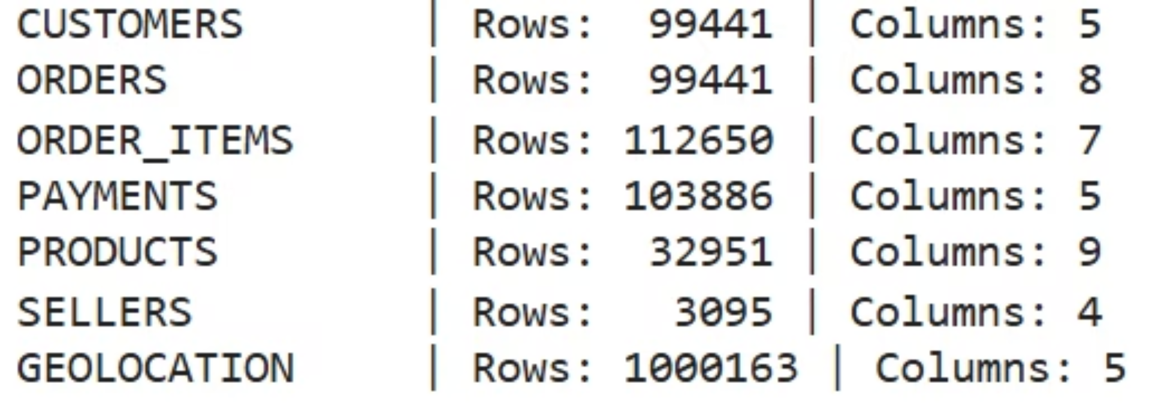
Dataset Overview
The provided dataset files spanning multiple dimensions and categories of the business, from customer demographics to payment behavior.
Customers
Orders
Order Items
Payments
Customer ID, Unique ID, Zip Code, City, and State information is present
Have the details of order status with time stamps. Order ID is there with respect to customer ID
This has the product Id with the price and quantity, ordered with respect to the order ID
With respect to the order ID , it has the amount, method of payment and installments details
Products
Sellers
Geolocation
This has details of products with the name, size, photos and description code
Information of seller location with the city, state and zip code
With respect to the Zip code it has the coordinates, city name and the state code.

Slide 7
Learning Phase
1
Data Ingestion Strategy
Python-based ingestion demonstrated for educational purposes and proof of concept
2
Production Choice
MySQL LOAD DATA INFILE selected for final implementation
Loading data efficiently is critical for production-scale analytics and sets the foundation for all downstream analysis.
Performance Benefits
3
Industry-standard approach delivering faster load times and superior scalability
4
Documentation
Decision rationale and implementation details clearly documented in project notebook

Slide 8



SQL Analysis Scope
The analysis progresses through three tiers of increasing complexity, building from foundational metrics to sophisticated business intelligence.
Basic Analysis
Order counts, customer demographics, payment method distribution, and fundamental business metrics
Intermediate Analysis
Revenue calculations, seller performance rankings, time-based trends, and comparative metrics
Advanced Analysis
Growth rate modeling, customer retention cohorts, lifetime value calculation, and top contributor identification

Slide 9
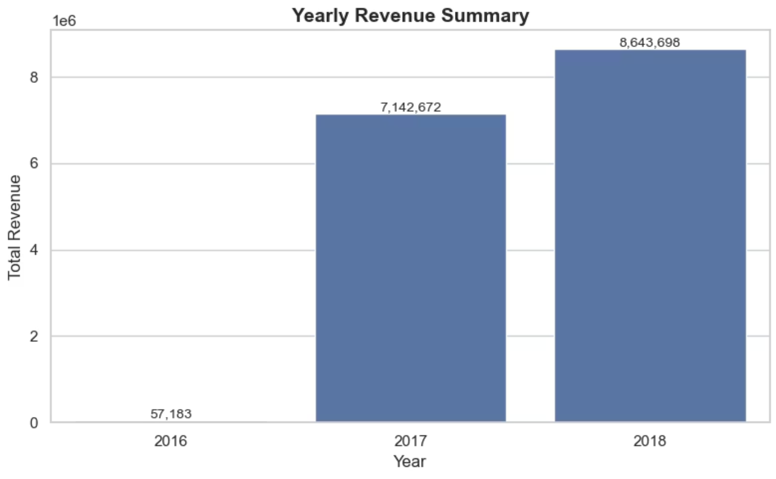
REVENUE ANALYSIS
Revenue Performance
Strong Growth
Year-wise revenue analysis shows that 2018 was the strongest performing year, generating a total revenue of 8,643,698.
The revenue trend closely aligns with order growth, reinforcing volume-driven revenue expansion.

Slide 10

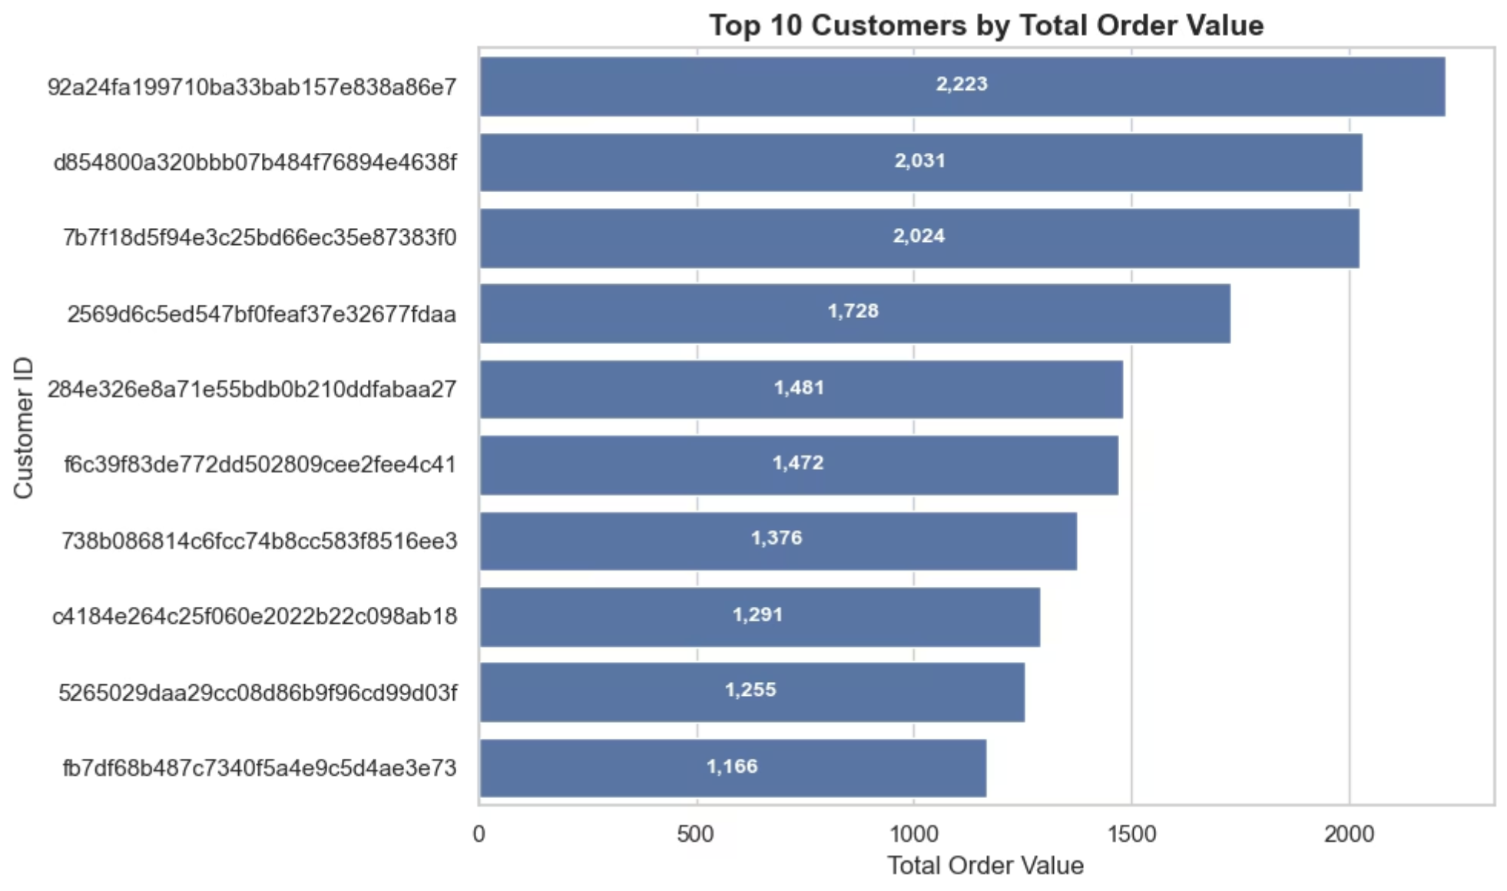
CUSTOMER INSIGHTS
Customer Value Analysis
High Value order Customer
Our analysis reveals that 10 top customers who places the higher value order indicating the customer who spent high amount.
Actionable Opportunities:
Targeting more similar customers
Add the valuable and most selling products
Help managing the product pricing

Slide 11

CUSTOMER INSIGHTS
Customer Retention Analysis
The dataset assigns a unique customer ID to every order, resulting in no identifiable repeat customers.
As a result, the calculated customer retention rate is 0%.
This highlights a data limitation, making retention analysis inconclusive rather than negative.

Slide 12
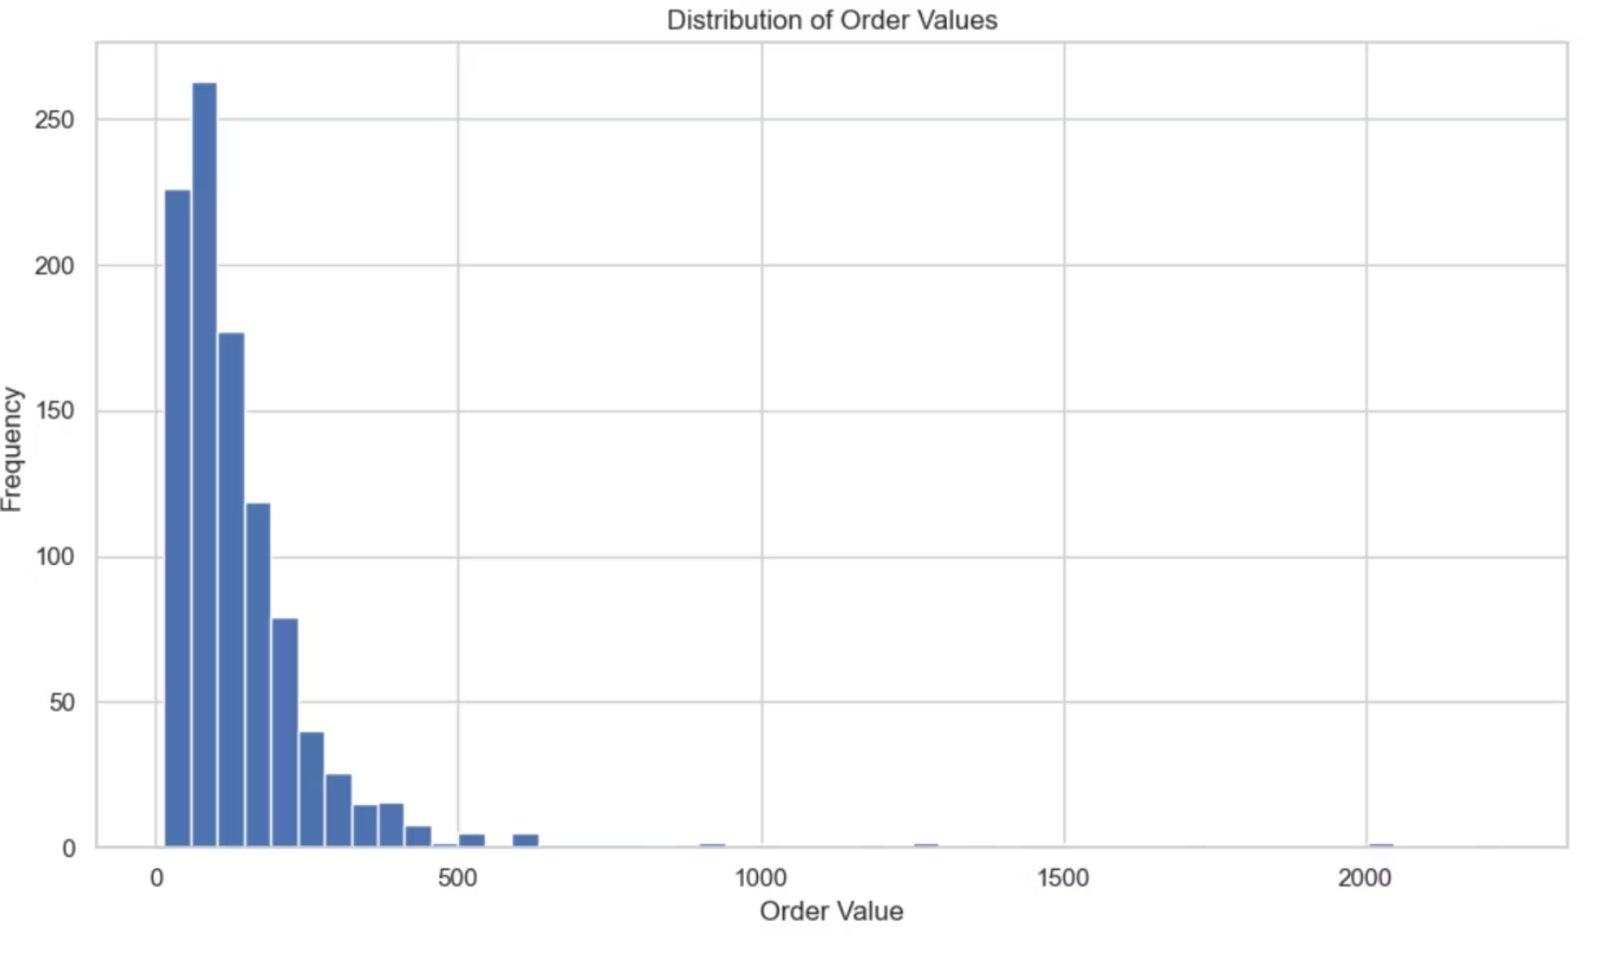
Order Value Distribution
Order Volume Trends
Across 2016, 2017, and 2018, the platform received a total of 99,441 orders.
Year-wise breakdown:
2016: 329 orders
2017: 45,101 orders
2018: 54,011 orders
Although 2018 recorded the highest number of orders, the increase from 2017 is incremental rather than exponential, indicating steady and sustainable growth rather than a sudden spike.
Volume Driver
Revenue Outliers
Most orders are modest in value but high in frequency
Few high-value transactions contribute significantly to total revenue

Slide 13

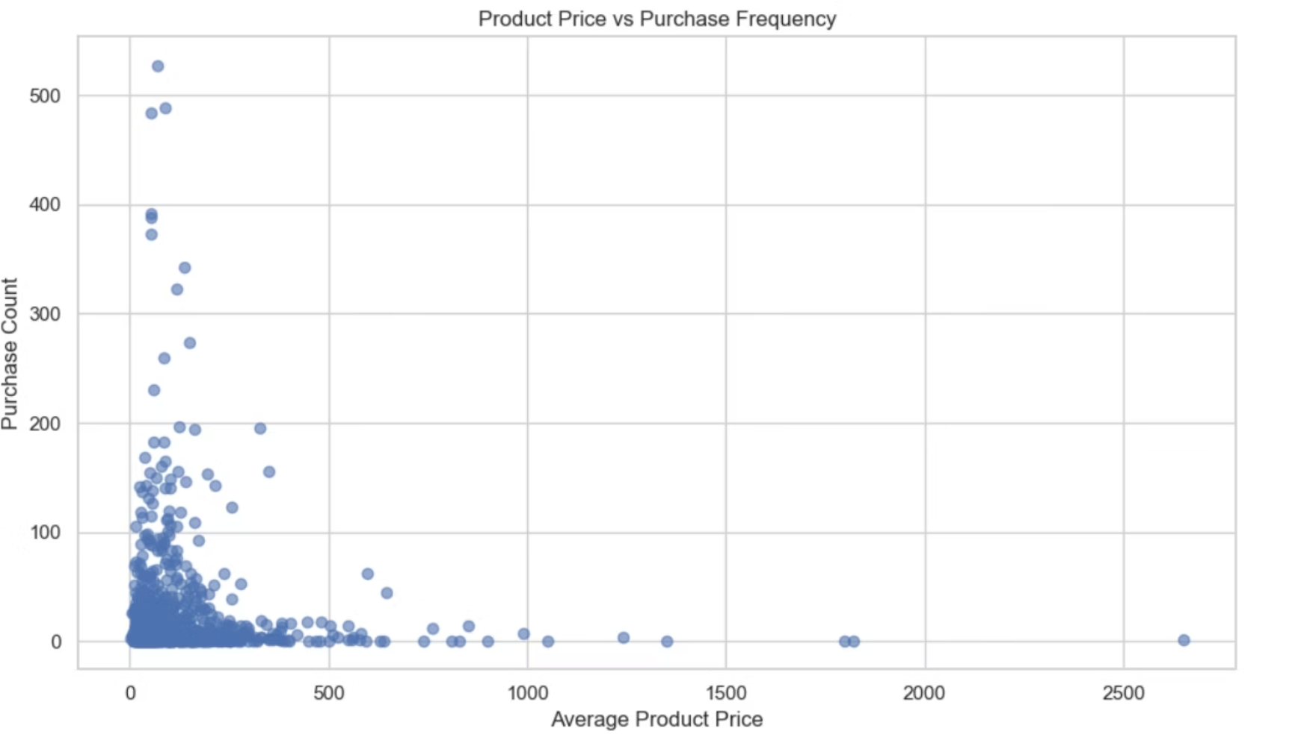
PRICING STRATEGY
Pricing vs Demand Relationship
Classic Demand Curve
Our analysis confirms an inverse relationship between price and demand, consistent with fundamental economic principles.
Volume Products
Premium Segment
Low-priced items drive transaction volume and customer
acquisition
High-priced products serve niche markets with lower velocity but higher margins

Slide 14
High-Value Product Insight
Housewares emerged as the most expensive product category.
Despite higher pricing, it recorded a substantial total quantity sold of 6,795 units, highlighting strong demand even at premium price points.

Slide 15

Seller Performance
The marketplace consists of 3,095 active sellers.
The top-performing seller (4869f7a5dfa277a7dca6462dcf3b52b2) completed:
1,124 orders
Generated 226,987 in revenue, making it the highest-volume seller.
The second-highest seller (53243585a1d6dc2643021fd1853d8905) delivered:
348 orders
Generated 217,940 in revenue, indicating a high average order value and sale of premium-priced items.

Slide 16




Key Cross-Analysis Insights
Revenue Growth
Customer Spending
Pricing Strongly Affects Demand
SQL + Python Complement
Consistent year-over-year revenue growth indicates strong platform adoption, increasing order volume, and sustained business expansion
Top 10 customers shows the order placed at higher value. But the retention rate of the customer is zero. The data has only one customer per unique id.
Lower-priced products drive volume while premium items serve profitable niches, informing optimal pricing and inventory strategies.
Combining SQL's analytical power with Python's visualization capabilities creates a robust, scalable analytics framework for comprehensive insights.

Slide 17





DELIVERABLES
Project Outcomes
End-to-End Analytics Pipeline
Scalable SQL Analysis
Built a comprehensive data workflow from ingestion through visualization, demonstrating practical application of modern analytics best practices.
Developed efficient, reusable SQL queries that handle complex business logic and can scale with growing data volumes.
Well-Documented,
Reproducible Project
Executive-Ready Visual
Insights
Delivered executive-ready visual insights that translate technical analysis into clear, actionable business intelligence.
Maintained comprehensive documentation and version control, ensuring the analysis is fully reproducible, auditable, and extensible.

Slide 18
THANK YOU

