Slide 1
AI-Powered Customer Request Classification System for Airline Support
B Naga Sai Akarsh -22Z314
Dhanushkumar M -22z317
Jothiswarar S - 22z332
Nivash M K - 22z348

Slide 2
Understanding the Challenge
Airline customers send a variety of queries in natural language (e.g., “I want to cancel my flight” or “My bag is missing”).
The goal is to automatically identify the customer’s request type, such as: Cancel Trip, Change Flight, Missing Bag, Flight Status, Discounts, etc.
Once the system predicts the request type, it confirms the classification with the customer.
If the prediction is correct, the bot proceeds to handle the request automatically.
If the prediction is incorrect, the results are stored in the logs for future training of the model.
The system records customer feedback (correct/incorrect) to improve its future predictions.
Over time, the model learns from its mistakes, becoming more accurate and efficient.

Slide 3
Functional Requirements
Input: Customer message or utterance (text).
Output: Predicted request type (e.g., Cancel Trip, Flight Status, Missing Bag).
Feedback: Customer confirms whether the prediction is correct or incorrect.
Continuous Learning Loop: System stores feedback and re-trains the model to improve accuracy over time.
Model Training Pipeline: Includes data collection, preprocessing, model training, and model saving for future use.
Evaluation: Uses performance metrics like Accuracy, Precision, Recall, and F1-Score to measure model effectiveness.

Slide 4
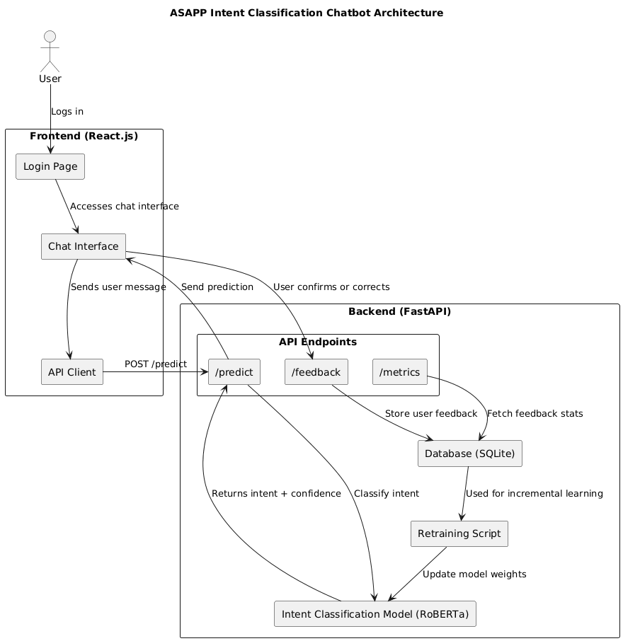
System architecture:

Slide 5
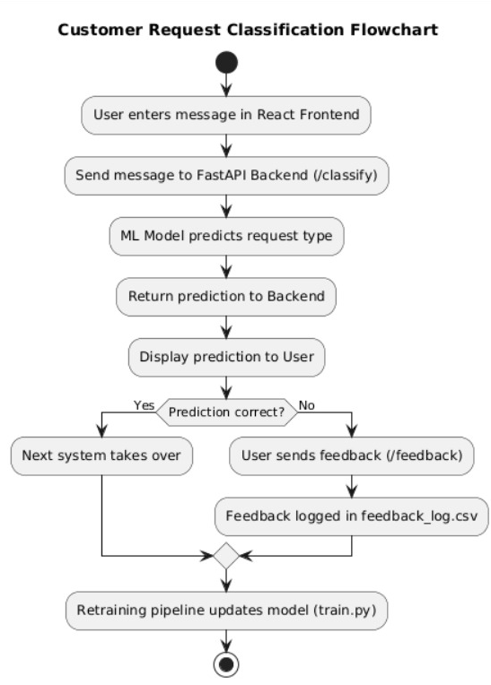
System Workflow
Submission – User enters a message in the React frontend.
Prediction – Message is sent to the FastAPI backend, which uses an ML model to predict the request type. Verification – The system shows the prediction to the user for confirmation. Feedback Loop
If correct – Request is processed automatically.
If incorrect – Feedback is saved for learning.
Retraining – The ML model is updated using feedback to improve future predictions.

Slide 6
Example Scenario:
Customer Message: “I want to cancel my ticket for tomorrow.”
Step 1: System Prediction
System predicts: Cancel Trip
Step 2: User Confirmation
System asks: “We think you want to Cancel Trip. Is this correct?”
User confirms → Request processed successfully
User rejects → Feedback is recorded for system improvement
Step 3: Continuous Improvement
System learns from feedback
Predictions improve for future customers

Slide 7
Tech Stacks Used:
1. Frontend
React.js – For building interactive chat interface and real-time display of predictions.
2. Backend
FastAPI (Python) – Exposes REST APIs (/classify, /feedback) and handles communication between frontend and ML model.
3. ML Models
RoBERTa (Transformer-based)
Single high-accuracy model for all customer request classifications.
Handles simple to complex queries with deep contextual understanding.
Eliminates the need for multiple models or separate approaches.

Slide 8
Libraries & Tools:
pandas, numpy – Data handling and preprocessing
transformers (Hugging Face) – For BERT and NLP pipelines.
SQLite database (airline_bot_enhanced.db) for all records
4. Data & Storage
Feedback Log: feedback_log for storing incorrect predictions and user feedback.
Dataset: Historical or synthetic customer messages for model training.
5. Retraining Pipeline
Combines dataset and feedback log to retrain and update the ML model.

Slide 9
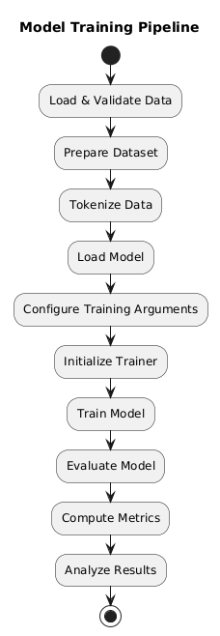
Model Training Pipeline
Start: Begin the training process.
Load & Validate Data: Load raw data and check for integrity.
Prepare Dataset: Split data into train, validation, and test sets; map labels.
Tokenize Data: Convert text into numerical tokens for the model.
Load Model: Load a pre-trained model (RoBERTa Base) for classification.
Configure Training: Set hyperparameters (batch size, learning rate, epochs).
Initialize Trainer: Set up trainer with model, data, tokenizer, and arguments.
Train Model: Train on training data, validate during training.
Evaluate Model: Test model on unseen data.
Compute Metrics: Calculate accuracy, F1-score, and other metrics.
Analyze Results: Review strengths and weaknesses.
Finish: Pipeline complete.

Slide 10
Evaluation Metrics:
Accuracy: Overall correctness of predictions.
Precision: How many predicted types were actually correct.
Recall: How many actual request types were correctly identified.
F1-Score: Balance between precision and recall.

Slide 11
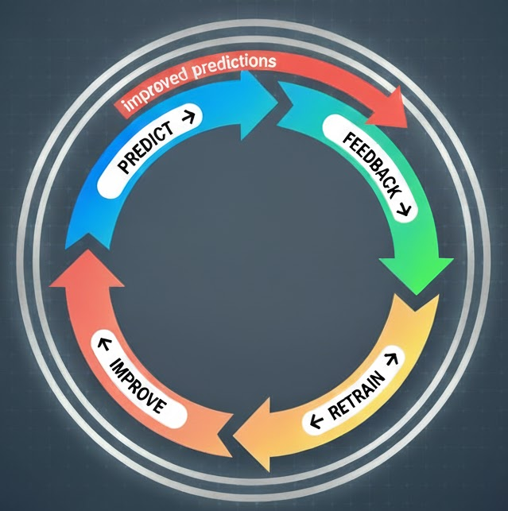
Learning from FeedBack:
Every incorrect classification → logged in feedback_log
Retraining merges this log with old dataset
Model evolves with new examples
Helps adapt to new user phrases over time

