Slide 1


JULY 2024
UDEMY PRODUCT TEARDOWN
Maximizing Customer Value
By:
Nithesh Krishna V K (DM251054)
Nivashini E (DM251055)
Great Lakes Institute of Management Chennai

Slide 2








KEY STATISTICS
WHAT WORKS FOR UDEMY
TARGET CUSTOMERS
USER PERSONA
RECOMMENDATIONS
Key Statistics
No Of Visits
Bounce Rate
Category Rank
Udemy enrollments
4.3 STARS
423K Reviews
1,50,000
Courses
9th
Traffic rank of the site compared to all other sites in its main category in the top country - Education category
37.14%
Average percentage of visitors who view only one page before leaving the website
99.9 Mn
Sum of all visits on desktop and mobile from the last month
74.6%
Contribution by Tech & Business courses
10M+ Downloads
4000+ Instructors

Slide 3
KEY STATISTICS
WHAT WORKS FOR UDEMY
TARGET CUSTOMERS
USER PERSONA
RECOMMENDATIONS
Video Length & Engagement
Course Structure
Affordability
Self paced learning
The courses feature videos that are brief and to the point, which helps maintain the viewer’s attention and makes the content easier to digest.
There are YouTube videos which go for hours and make the users lose their attention.
The courses are structured entirely around video content, with no integration of text or assignments.
This format can be highly engaging for visual learners who prefer watching and listening to reading.
For some learners, the lack of variety can be monotonous and may hinder the retention of information.
Udemy courses are generally priced lower than those on many other learning platforms, making them more accessible to a wider audience.
Most of the courses cost between 400₹ to 600₹.
Udemy offers self-paced learning without deadlines, allowing users to study at their own pace and convenience.
This flexibility accommodates diverse schedules and learning styles, enabling learners to engage deeply with course material without the pressure of fixed timelines.

Slide 4




KEY STATISTICS
WHAT WORKS FOR UDEMY
TARGET CUSTOMERS
USER PERSONA
RECOMMENDATIONS
TARGET CUSTOMER | AGE | CHARACTERISTICS | NEEDS | GOALS
COLLEGE STUDENTS | 18-24 | Undergraduate/Graduate Motivated to enhance knowledge and skills | Affordable courses flexible schedules certification | Improve grades prepare for careers gain internships or part-time jobs
PROFESSIONAL | 25-40 | White Collared Jobs Motivated to keep up with trends | Advanced courses industry-recognized certifications continuing education credits | Stay competitive earn promotions/salary increases transition to new roles
RETURN TO WORK INDIVIDUALS | 30-40 | Various backgrounds Motivated to update skills and re-enter workforce | Comprehensive courses flexible learning networking opportunities | Successfully return to work gain new qualifications/skills rebuild professional network
COURSE INSTRUCTORS | 30-60 | Subject matter experts/educators Motivated to share knowledge and earn | Platform reach course creation tools analytics | Create quality courses grow student following earn revenue

Slide 5

KEY STATISTICS
WHAT WORKS FOR UDEMY
TARGET CUSTOMERS
USER PERSONA
RECOMMENDATIONS
Goals
Successfully transition back into the workforce after her break.
Update and enhance her marketing skills to stay current with industry trends.
Regain her career momentum and work towards long-term career goals.
Challenges
Catching up with new marketing tools, technologies, and strategies that have emerged during her break.
Overcoming any loss of confidence due to time away from the workforce.
Navigating potential biases and challenges of re-entering the job market after a hiatus.
Motivation
Desire to achieve personal and professional growth and contribute to the workforce.
Re-establishing financial independence and contributing to the family income.
Being a positive role model for her child by pursuing her career ambitions.
Elisa, an experienced marketing professional, took a career break due to serious health issues. Without experience in digital marketing and brand management, she spent the last few years away from work. Now, Priya is eager to re-enter the job market and continue her professional journey.
Pain Points
Professional guidance and mentorship to navigate her return to the workforce and career advancement.

Slide 6

KEY STATISTICS
WHAT WORKS FOR UDEMY
TARGET CUSTOMERS
USER PERSONA
RECOMMENDATIONS
Goals
Transition from dentistry to a new career.
Acquire knowledge and skills in diverse fields such as marketing, finance, and management.
Identify his passion and strengths through exposure to various business domains.
Challenges
Lack of clarity about which specific field to pursue.
Need to develop foundational knowledge in business-related subjects.
Overcoming the challenge of shifting from a specialized field (dentistry) to more generic business roles.
Motivation
Desire for continuous learning and self-improvement.
Seeking a career that aligns with his interests and offers long-term satisfaction.
Interest in exploring various fields before committing to a specific career path.
Paul, a 23-year-old MBA student with a dentistry background, is transitioning to business for personal growth and career fulfillment. He actively seeks guidance and practical experiences to navigate his new path.
Pain Points
Professional advice to help identify potential career paths and areas of interest.
Opportunities to apply theoretical knowledge through internships, projects, and practical assignments.
Access to mentors and career counseling services.

Slide 7


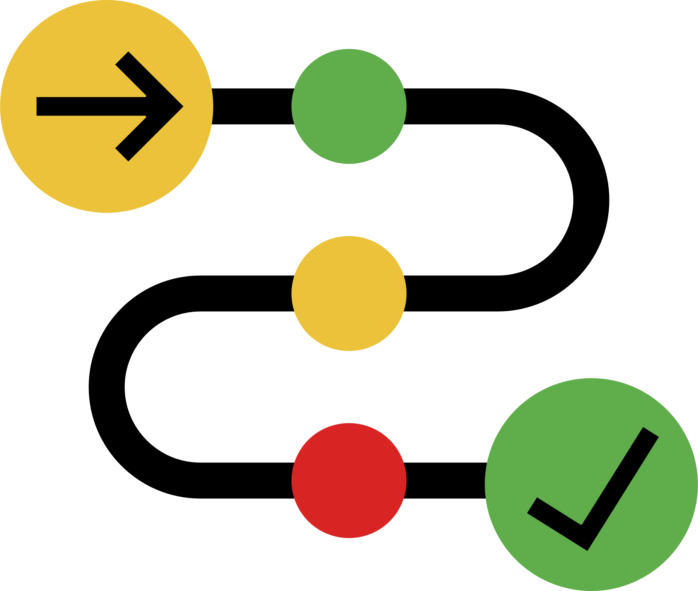
KEY STATISTICS
WHAT WORKS FOR UDEMY
TARGET CUSTOMERS
USER PERSONA
RECOMMENDATIONS
PRICING
The pricing for courses on Udemy is inconsistent, with significant variations over time and frequent discounts. This causing them to delay purchases or forget about courses altogether.
OBJECTIVE
1. Frequent Price Variations: The same course can have different prices at different times, which makes it difficult for students to understand the true value of the course. This is because of the various coupons (e.g., IND21PM, ST18MT62524).
2. Student Behavior: Students tend to wait for discounts to make a purchase, hoping to get the best deal. Due to the waiting period for potential discounts, students may delay their purchases and sometimes forget to buy the courses altogether. Students are unsure when the best time to purchase is and what the final price might be.
IDEA
IMPLEMENTATION PLAN
Constant pricing model : Each course has a fixed price, providing transparency and consistency. Instead of frequent random discounts, hold occasional sales events with clear communication about the start and end dates.
Use the survey data to understand student behavior and preferences regarding pricing and discounts. Tailor the pricing strategy to address these insights. Ensure that students have a positive and straightforward purchasing experience by providing clear and consistent pricing information.

Slide 8
KEY STATISTICS
WHAT WORKS FOR UDEMY
TARGET CUSTOMERS
USER PERSONA
RECOMMENDATIONS
QUIZZES
To enhance the learning experience on Udemy by incorporating structured assessments, practical projects, and career support.
OBJECTIVE
1. Mandatory Quizzes: Quizzes will act as checkpoints to increase the learning, ensuring that learners understand the content before moving forward. A final MCQ test or quiz evaluates learners' knowledge across the entire course.
2. Real-Time Projects: It bridges the gap between theory and practice, allowing learners to apply their knowledge in practical scenarios.
IDEA
IMPLEMENTATION PLAN
Place mandatory quizzes as required to test knowledge. Develop a system that gives instant feedback on quiz performance, explaining correct answers.
At the end of the course, place 4 levels of quiz. Create a bank of multiple-choice questions that cover all key topics in the course.
Four Levels: Easy, Intermediate, Hard, Expert Advancement Criteria can be set as needed
Example certification: Intermediate Achievement: "You succeeded in the Intermediate level of the course 'Introduction to Python' with a score of 70%."
Preferably, enable screen recording and turn on the video camera while taking the exam.

Slide 9
KEY STATISTICS
WHAT WORKS FOR UDEMY
TARGET CUSTOMERS
USER PERSONA
RECOMMENDATIONS
MENTORSHIP PLATFORM
OBJECTIVE
Offer comprehensive career guidance through mentorship, course roadmaps, and industry updates.
1. Mentorship Access: Embed Topmate's mentorship services in Udemy for seamless user experience. Create a dedicated structure for booking mentor sessions, attending webinars, and participating in forums.
2. Discount Incentives: Offer discounted mentorship sessions for users purchasing related courses. Provide course and mentorship bundles at reduced prices.
3. Support for Career Transitions: Specialized support for individuals returning to the job market, including resume reviews and interview prep. Share successful career transition stories for inspiration and practical advice.
IDEA
IMPLEMENTATION PLAN
Platform Development: Integrate Topmate or build Udemy Connect for career guidance.
Discount Strategies: Apply automatic discounts for bundled purchases and promote them through marketing campaigns.

Slide 10
KEY METRICS
L1 METRICS
L2 METRICS
Number of users who access mentorship services through Udemy.
Number of mentorship sessions booked.
User satisfaction with the quality and relevance of quizzes and projects.
Increase in knowledge retention as measured by post-mentorship assessments.
Improvement in job search outcomes (e.g., interview conversions, job offers) for career transition support participants.
Increase in learner confidence in applying course knowledge to real-world scenarios.

