Slide 1


Data Analysis

Slide 2


Today's agenda
Project recap
Problem
The Analytics team
Process
Insights
Summary

Slide 3

S
Social Buzz is a fast growing technology unicorn that need to adapt quickly to it’s globle scale.
Accenture has begun a 3 month POC focusing on these tasks:
An audit of Social Buzz’s big data practice
Recommendations for a successful IPO
Analysis to find Social Buzz’s top 5 most popular categories of content
Project Recap

Slide 4


Problem
Over 100000 posts per day
36,500,000 pieces of content per year!
But how to Capitalize on it when there is so much?
Analysis to find Social Buzz’s top 5 most popular categories of content

Slide 5



ANDREW FLEMING
Chief Technology Architect
The Analytics team
MARCUS ROMPTON
Senior Principal
Nivashini
Data Analyst

Slide 6

Process
1
Data Understanding
2
Data Cleaning
3
Data Modelling
4
Data Analysis
5
Uncover Insights

Slide 7

Insights
16
Unique Categories
75K
Reactions to “Animals” posts
May
Month with
most posts

Slide 8
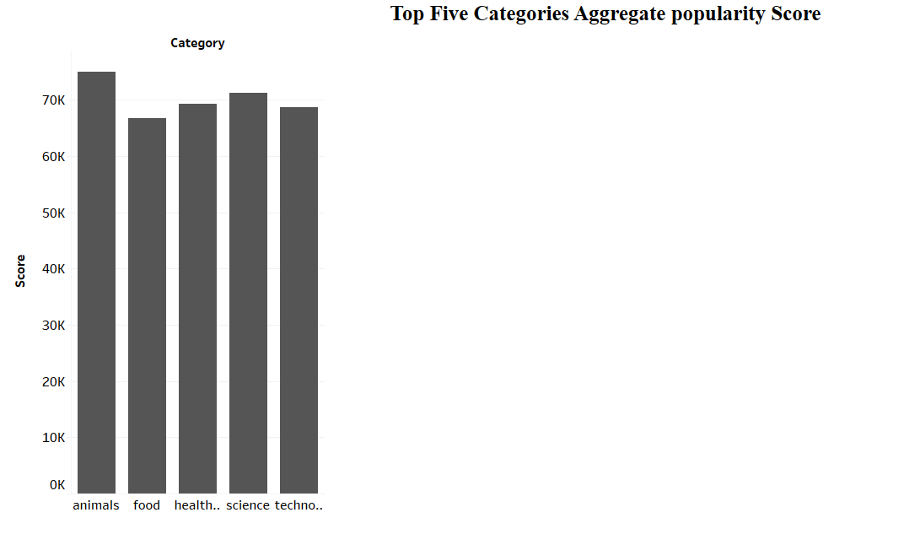

Slide 9
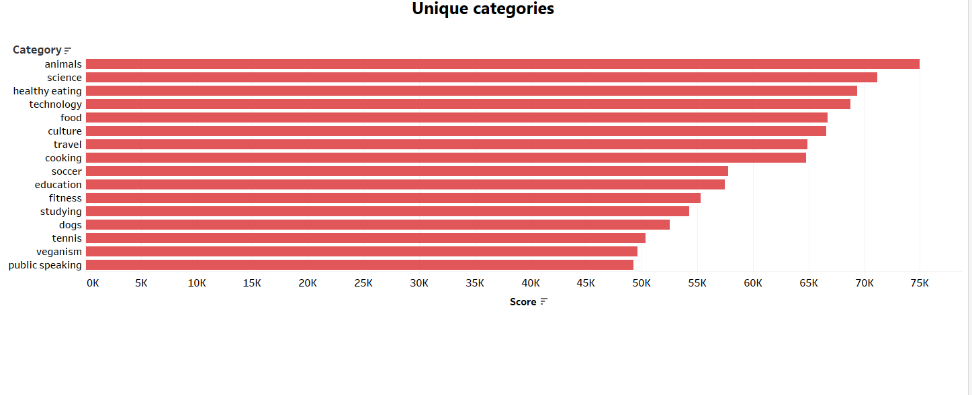

Slide 10
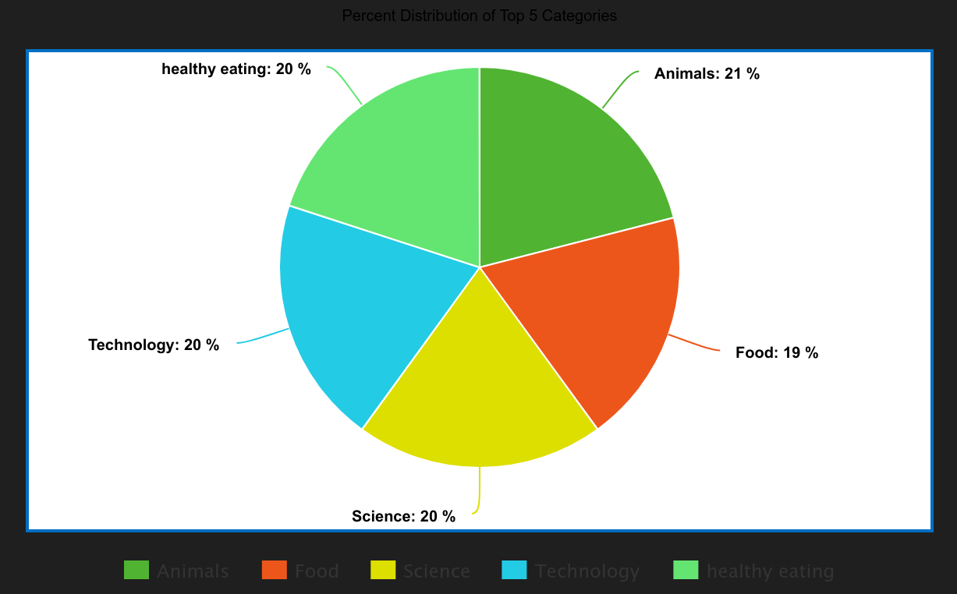

Slide 11


ANALYSIS
The analysis of content categories for “company social Buzz” reveals distinct patterns in audience engagement. Animals, Science and Eating Healthy resonate strongly with the audience , indicating informative content
INSIGHT
Food is a common theme with the top 5 Categories with “Animals” ranking the highest. This may give an indication to the audience within your user base. You could use the insight to create a campaign and work with healthy eating brands to boots user engagement.
Summary
NEXT STEPS
This ad-hoc analysis is insightful, but it’s time to take this analysis into large scale production for real-time understanding of your business. We can show you how to do this.

Slide 12

Thank you!
ANY QUESTIONS?

