Slide 1
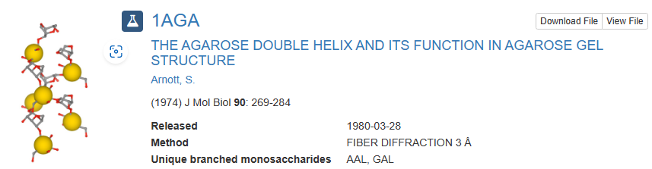
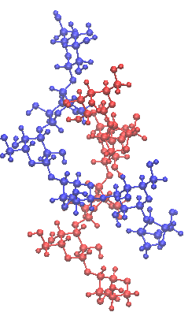
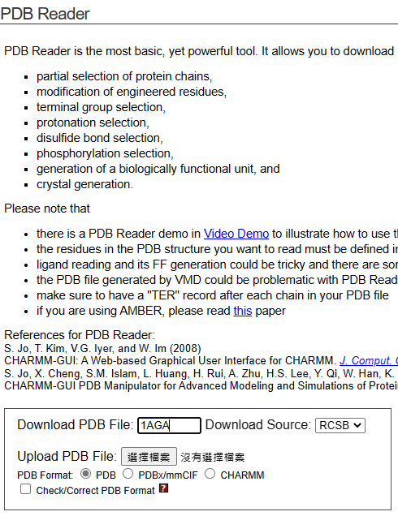
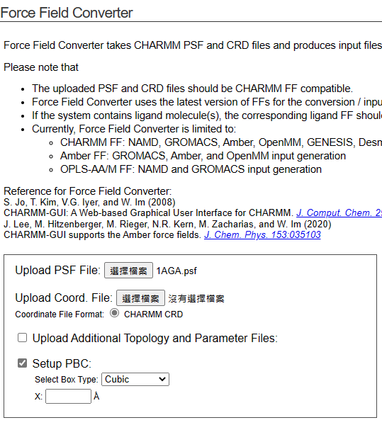
PDB database
CHARMM-GUI get 1AGA lammps data file
1AGA.crd

Slide 2
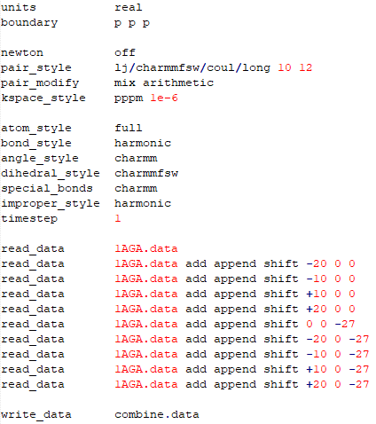
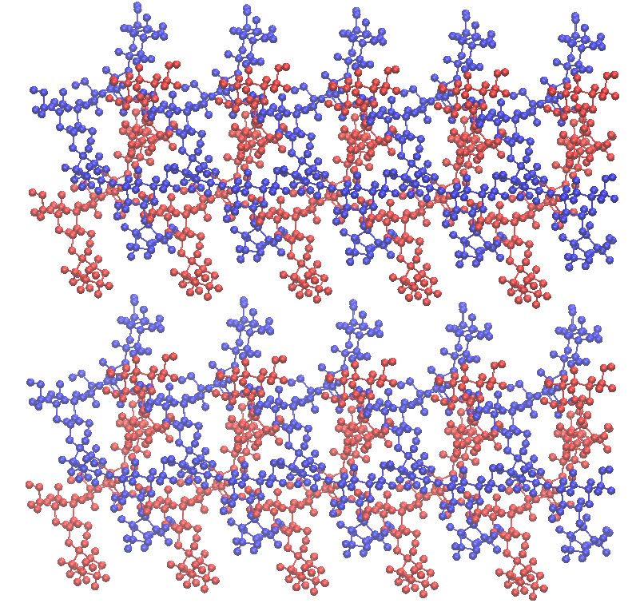
Use LAMMPS to replicate agarose

Slide 3
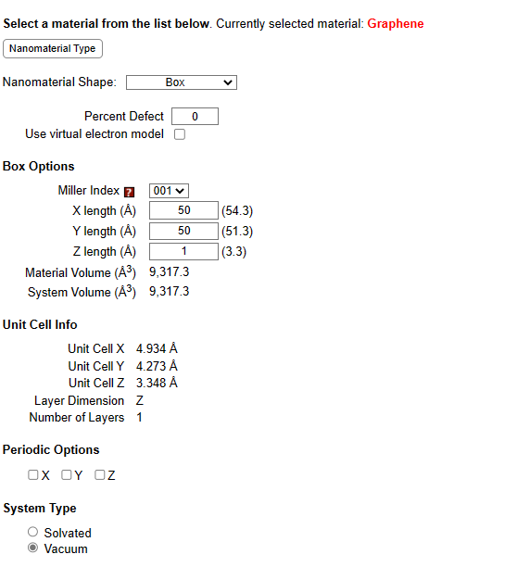
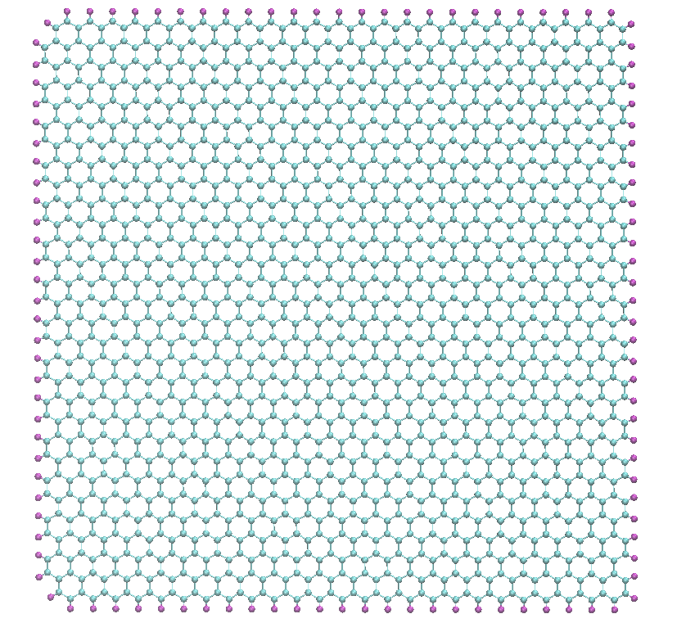
CHARMM-GUI 50A*50A single layer sheet graphene lammps data file

Slide 4
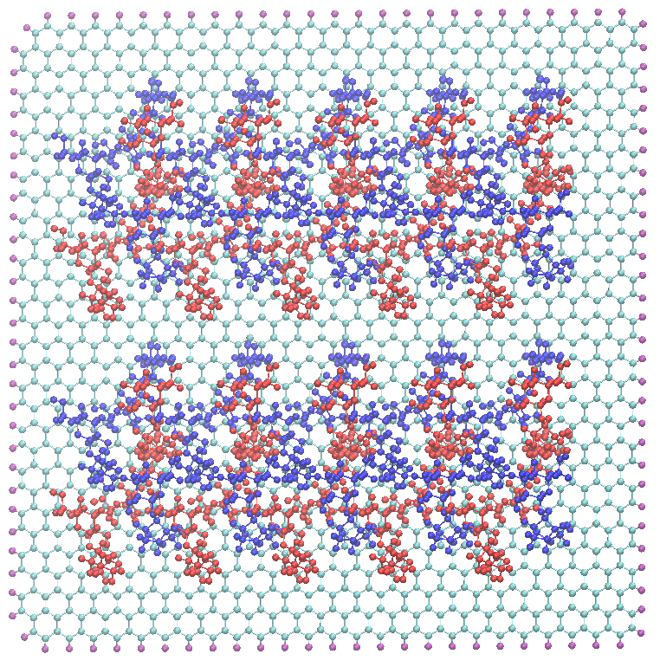
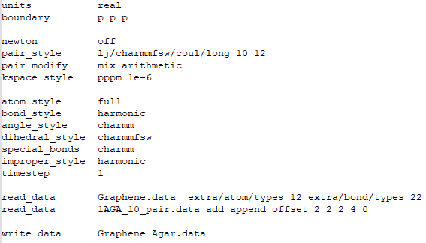
Use LAMMPS to combine graphene and agarose

Slide 5
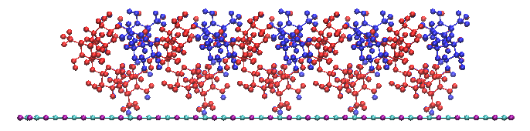
Use VMD to get min max x,y,z coordinate
z = 31
z = -33
x = -33
x = 31
y = 13
y = 0

Slide 6
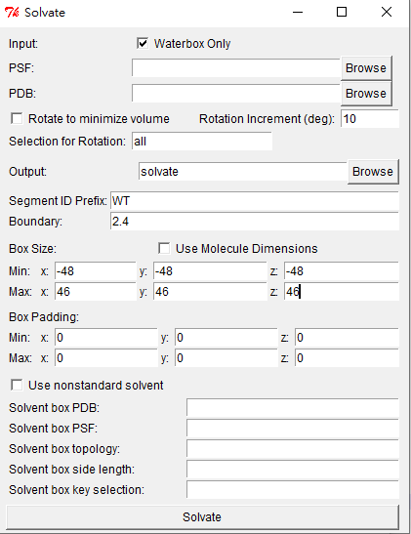
Use VMD to create water box only
1. 根據min max往外擴20A建水箱
2. topo writelammpsdata water.data
3. water.data 補上參數：
Pair Coeffs
1 0.04600000000000 0.40001352444501 0.04600000000000 0.40001352444501 # HT
2 0.15210000000000 3.15057422683150 0.15210000000000 3.15057422683150 # OT
Bond Coeffs
1 450.000 0.9572 # HT OT
Angle Coeffs
1 55.00000 104.52000 0.00000 0.00000 # HT OT HT
x,z兩側各+20A
y 要最大 避免旋轉

Slide 7
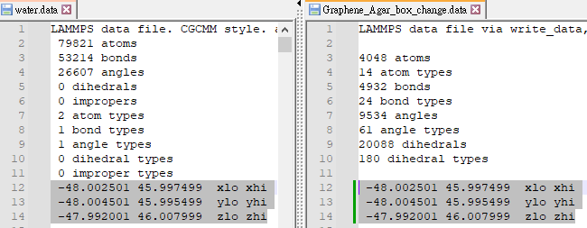
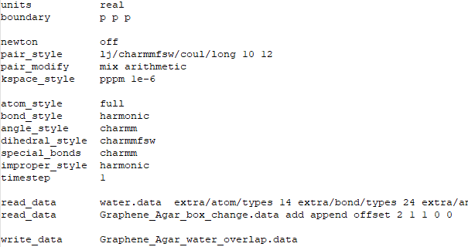
Use LAMMPS to combine water box and graphene and polymer
確定water.data和Graphene_agar.data的box size相同，如果不同，將graphene_agar.data複製一份graphene_agar_box_change.data並修改盒子大小
2. 將 water.data和graphene_agar_box_change.data丟入VMD確認構型沒問題
3. in.water_combine

Slide 8
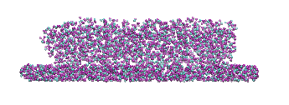
Use VMD to select waters that do not overlap graphene and polymer
> set a [atomselect top "(not fragment Graphene和polymer的fragment_ID) and (within 2.4 of fragment Graphene和polymer的fragment_ID)"]
> lsort -unique [$a get fragment]
…..跑出一堆多出來的水的fragment_ID….
> set a [atomselect top “(not fragment 26607 to 26627) and not (fragment 上面多出來的水的fragment_ID )"]
> topo writelammpsdata water_delete.data -sel $a
然後進water_delete.data一樣補上參數：
Pair Coeffs
1 0.04600000000000 0.40001352444501 0.04600000000000 0.40001352444501 # HT
2 0.15210000000000 3.15057422683150 0.15210000000000 3.15057422683150 # OT
Bond Coeffs
1 450.000 0.9572 # HT OT
Angle Coeffs
1 55.00000 104.52000 0.00000 0.00000 # HT OT HT
不要的水

Slide 9
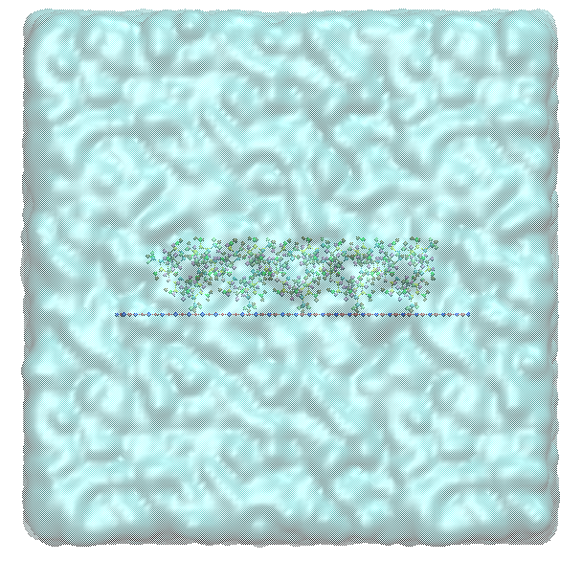
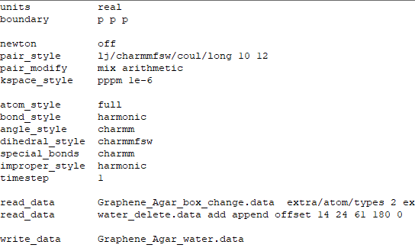
Use LAMMPS to combine selected waters, graphene and polymer

Slide 10
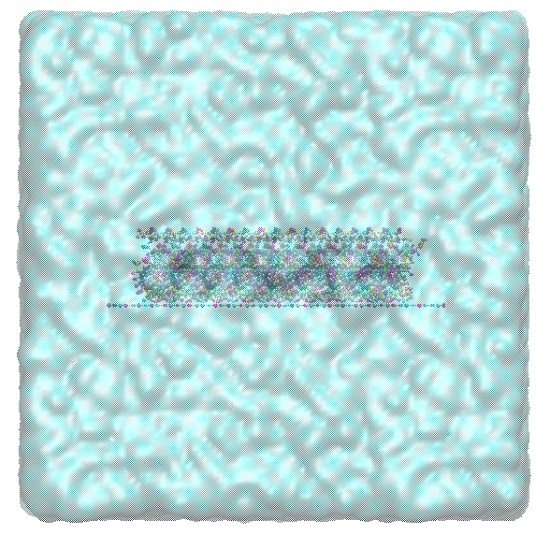
Same goes to Graphene and PAM

