Slide 1
Topology File and Parameter File Revise
Computational Mechanics and Intelligence Lab
Oct, 7, 2022
Reporter: Yu-Cheng Lai, Advisor: Chia-Ching Chou
Institute of Applied Mechanics, National Taiwan University
Stevenlai1998@gmail.com/ccchou@iam.ntu.edu.tw

Slide 2
Outline
Topology file revise
Parameter file revise

Slide 3
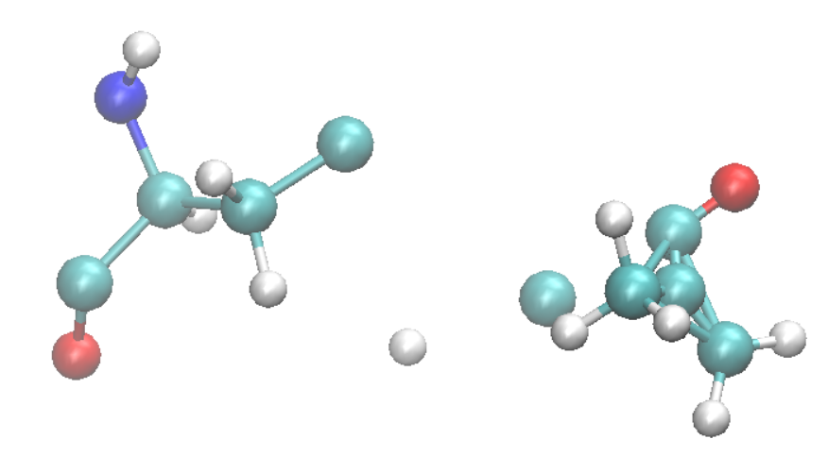
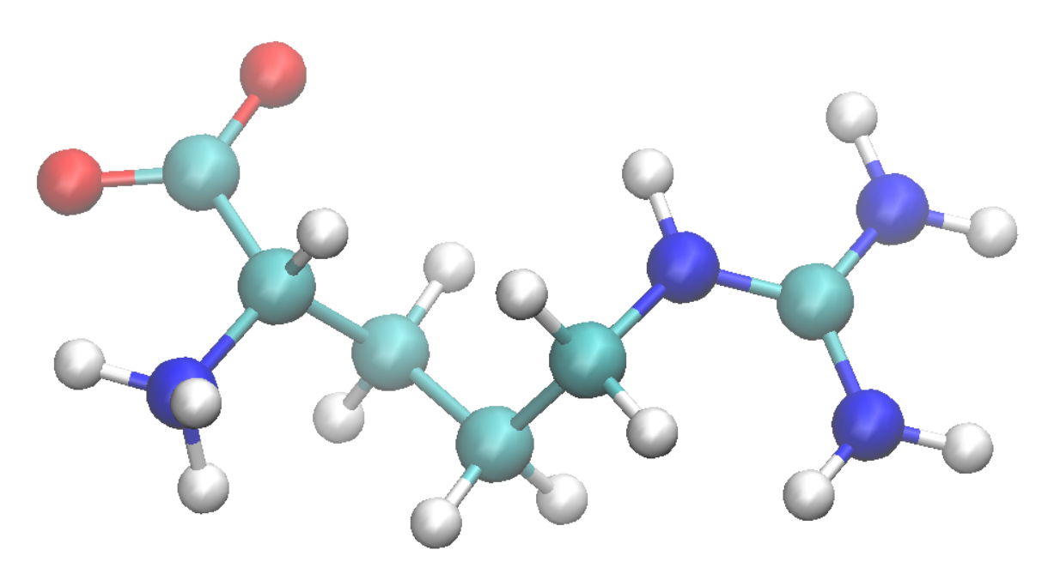
What can Autopsf do for us?
If I have a incomplete pdb file, saying that the residue is called “ARG”
Despite the wrong positions, it doesn’t even have correct atoms.
Correct ARG

Slide 4
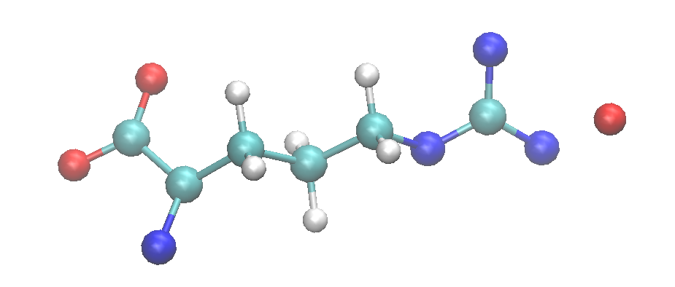
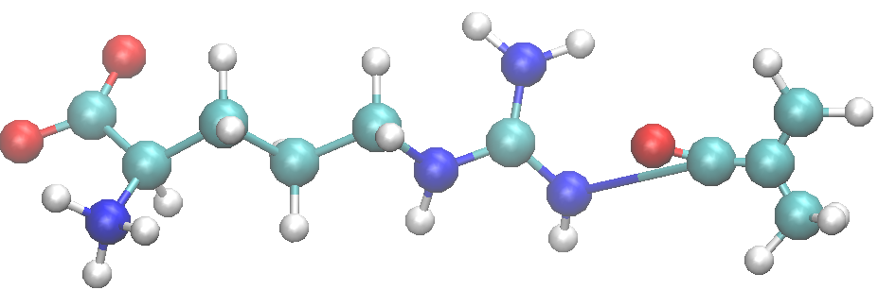
So how do I deceive Autopsf to help us create ARGMA?
If I have a incomplete pdb file, saying that the residue is called “ARG”
Despite it doesn’t even have correct atoms.
Correct ARGMA

Slide 5
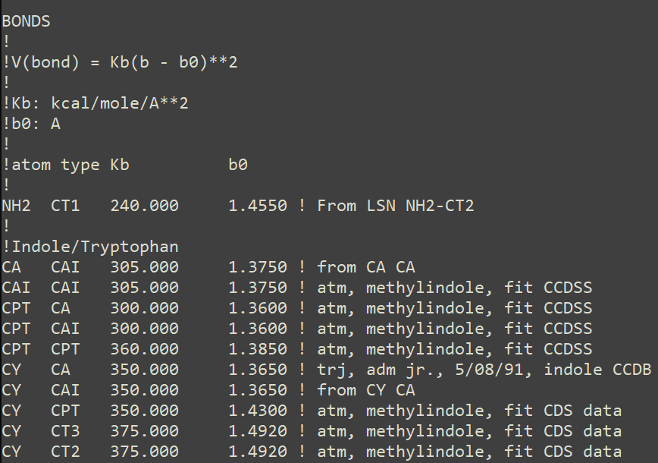
CHARMM36m Par file
CHARMM36m’s atom type is different from CgenFF’s.
The bonding parameter will also differ even if the atom type is identical.

Slide 6
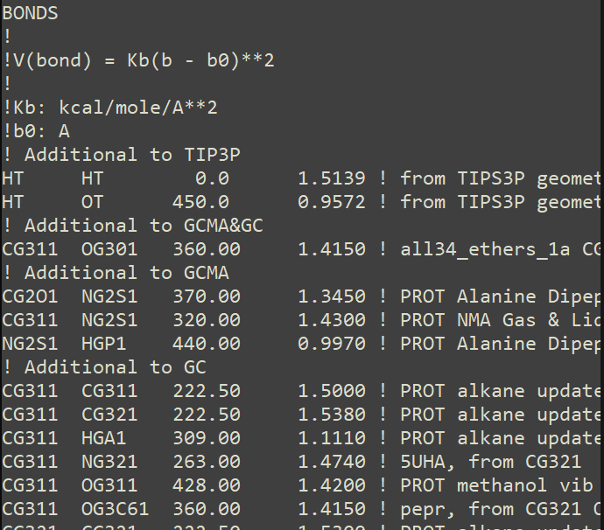
CgenFF Par file
CHARMM36m’s atom type is different from CgenFF’s.
The bonding parameter will also differ even if the atom type is identical.

Slide 7
CHARMM GUI
CHARMM-GUI：辦帳號
Winmostar：下載

