Slide 1
11th International Conference on Frontiers of Intelligent Computing: Theory and Applications(FICTA-2023)
Attention Based Deep Network Model using BERT for Sarcasm Classification
(ADN-BERT)
By- Pallavi Mishra, Omisha Sharma, Sandeep Kumar Panda
Date: 12th April 2023

Slide 2
CONTENTS
Sarcasm: Introduction
Importance of Sarcasm Classification
Challenges of Sarcasm detection
Related Works
Dataset Information
Proposed Methodology
Results
Conclusion and Future Directions
References

Slide 3
Sarcasm
Sarcasm is a form of language that uses irony to convey the opposite meaning of what is being said.
This meaning is conveyed through subtle cues such as tone of voice, facial expression and context behind the statement.
For example: “Oh, I just love getting stuck in traffic”
(the surface meaning is that the person enjoys being in traffic, which is obviously not true. However, the tone and context suggest that the person is being sarcastic, and the underlying or intended meaning is actually the opposite.)

Slide 4
Importance of Sarcasm Classification in News Headlines
In news headlines, sarcasm can be used to highlight absurdity or criticize an action or statement.
The wrong interpretation of the sarcastic news headlines on sensitive issues; especially related with global, political, social, economical, regional, social media issues may lead to serious consequences.
In the context of news headlines, sarcasm classification can provide valuable insights into the attitudes and opinions of news sources and their audiences.
It can help prevent misinterpretation of the intended message and improve the credibility of news reporting.

Slide 5
Challenges of Sarcasm detection and Classification task
Sarcasm often relies on tone, context, and nonverbal cues, which can be difficult to detect in written text alone.
The use of irony, exaggeration, or understatement, which further complicates the task of identifying it.
It is a challenging task for a machine to understand the context and tone behind the statement of a speaker.
As a result, developing robust and context-based models for sarcasm detection remains an ongoing challenge in natural language processing.

Slide 6
Related Works on News Headlines Dataset
Work | Technique | Results
Bharti et al.[1] | Implemented Voted classification using ensembled machine learning classifiers | 86.4% Accuracy
Misra et al.[2] | Bi-LSTM+ Attention+ CNN | 89.7% Accuracy
Nayak et al.[3] | compared multiple combinations of word embedding techniques and supervised classification techniques for sarcasm classification task | 89.5% Accuracy
Sharma et al.[4] | USE + BERT + LSTMAuto-Encoder | 90.8% Accuracy
Zanchak et al.[5] | Logistic regression, Naïve bayes classifier | 80.5% Accuracy
Liu et al.[6] | Bert word embedding with LSTM | 91.8% Accuracy
Sharma et al.[7] | Ensembled based technique with word-embeddings of GloVe andWord2vec with LSTM | 88.9% Accuracy
Shrikhande et al.[8] | CNN+ GloVe embedding technique | 86.13% Accuracy
Ajnadkar et al.[9] | Bi-LSTM + Attention + CNN with word embeddings deep learning based model | 89.19% Accuracy
Mandal et al. [10] | Deep learning models based on CNN and LSTM. | 86.0% Accuracy
Jariwala et al.[11] | Support vector machine (SVM) on News Headlines dataset with optimal feature selection | 78.82% Accuracy

Slide 7
Dataset
In this study, we have collected News Headline dataset from Kaggle website. This dataset contains headlines of both sarcastic and non-sarcastic category, collected from two different websites “The Onion” and “ HuffPost”, respectively.
Moreover, the total number of instances in this dataset is 28619 with no missing or null values. The values are assigned 0 to non-sarcastic sentences and 1 to sarcastic sentences in “is_sarcastic” attribute of news headline dataset.
Table 1: Descriptive Statistic of Original News Headline Dataset
# Headlines | 28619
Sarcastic headlines (in %) | 52
Non-sarcastic headlines (in %) | 47.6

Slide 8
Data Augmentation
We have newly incorporated text augmentation technique such as nlp_aug algorithm to synthesize new data from existing data.
The methods used by nlp_aug for text augmentation involve:
substituting words with their corresponding synonyms,
replacing them with words having similar word-embeddings vector,
using context-based transformer model to replace with words having similar contextual meaning,
back translation

Slide 9
Final Augmented Dataset
After incorporating nlp_aug text augmentation with the original news headline dataset, we increased our size of the dataset.
The statistic of the newly synthesized dataset is summarized below:
Table 2: Descriptive Statistic of Augmented News Headline Dataset
# Headlines | 133545
Sarcastic headlines (in %) | 56.1
Non-sarcastic headlines (in %) | 43.9
Max word length in headlines | 51

Slide 10
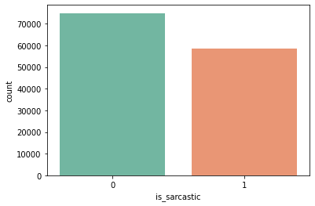
The mean value of the data column(“is_sarcastic”) is approximately 0.43, which signifies that the dataset is not heavily affected by skewness and thus, appropriated for our study.

Slide 11
PROPOSED METHODOLOGY

Slide 12
News Headlines
DATA PREPROCESSING
INPUT TEXT
Data Augmentation
Tokenization using BertTokenizer
Input ids
Input _type_ids
Attention Mask
BERT MODEL
Pooled Output
ATTENTION LAYER
ReLU Activation
DENSE LAYER
Sarcastic
Sigmoid Activation
OUTPUT LAYER
Non-sarcastic
Workflow of Proposed Model(ADN-BERT)

Slide 13
Hyper-parameters values
Hyper-parameter Variables | Values
Model | BERT base (12 encoders, 12 attention heads, 768 hidden units, 110M parameters)
Max_input_length | 60
Batch_size | 32
Optimizer | Adam
Loss Function | Binary Cross-Entropy

Slide 14
1
2
3
12
BERT MODEL
Pooled Output
(32, 768)
(batch_size, hidden units)
ATTENTION LAYER
DENSE LAYER
OUTPUT LAYER
Transformer Encoder
Transformer Encoder
Transformer Encoder
Transformer Encoder
0
0
0
0
0
0
0
0
0
Input_type_ids
BERT TOKENIZER
(bert -base uncased)
1
1
1
1
1
1
1
0
0
Attention_masks
101
146
1209
5056
508
3507
102
0
0
Input_ids
[CLS]
I
really
enjoy
traffic
jams
[SEP]
[PAD]
[PAD]
Special token
0
1
2
59
60
i
really
enjoy
traffic
jams
tokenization

Slide 15
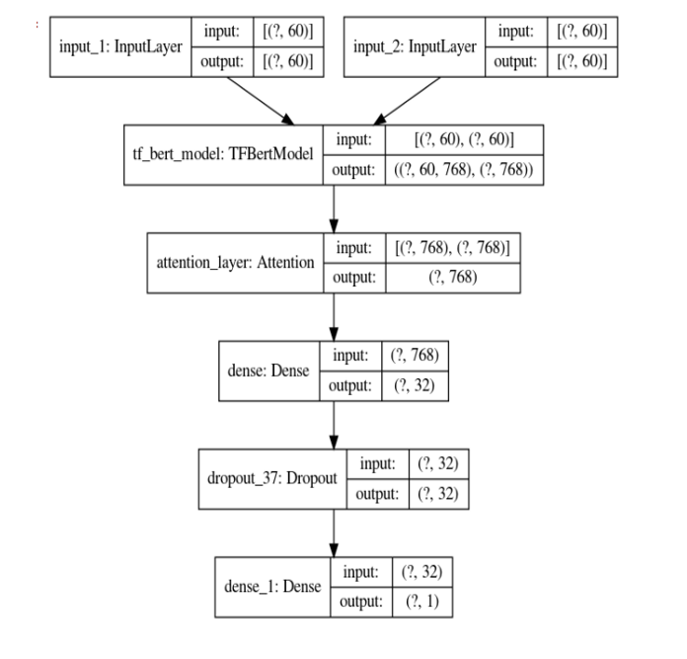
Architecture of our Proposed Model(ADN-BERT)

Slide 16
Results
Model | Accuracy | Precision | Recall | F1 Score
Nayak et al.[3] | 89.5% | 89.5% | 90.2% | 89.7%
Sharma et al.[4] | 90.8% | 92% | 91.1% | 91.5%
Sharma et al.[7] | 88.9% | 91.1% | 88.67% | 89.87%
Shrikhande et al.[8] | 86.13% | 85.4% | 86.8% | 85.6%
Proposed Model (ADN-BERT) | 94.1% | 94.5% | 95.2% | 94.8%

Slide 17
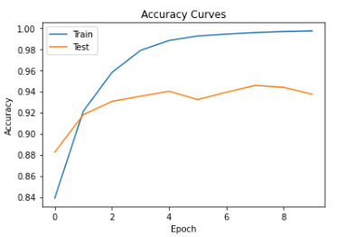
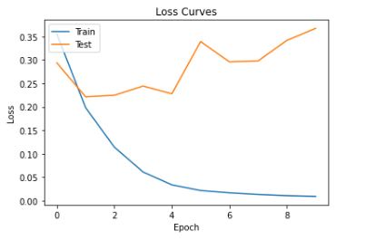

Slide 18
Conclusion and Future Directions
In our study, the proposed Attention -based deep neural model with BERT embeddings has achieved better results as compared to other recent baseline models in classifying sarcasm sentences with an accuracy of 94%.
The BERT pre-trained word embedding with the Attention model proved efficient in dealing with context-based word embeddings, which resulted in better performances.
In the future, more advanced context based deep learning models with optimization techniques can be applied for better results. Also, ensemble technique of context based deep learning models can be considered for future directions to achieve better accuracy.

Slide 19
References
1.Bharti, Santosh Kumar, Rajeev Kumar Gupta, Nikhlesh Pathik, and Ashish Mishra. "Sarcasm Detection in News Headlines using Voted Classification." In Proceedings of the 2022 Fourteenth International Conference on Contemporary Computing, 208-212(2022).
2. Misra, Rishabh, and Prahal Arora. "Sarcasm detection using hybrid neural network." arXiv preprint arXiv:1908.07414 (2019).
3. Nayak, Deepak Kumar, and Bharath Kumar Bolla. "Efficient deep learning methods for sarcasm detection of news headlines." In Machine Learning and Autonomous Systems: Proceedings of ICMLAS 2021, pp. 371-382. Singapore: Springer Nature Singapore(2022).
4. Sharma, Dilip Kumar, Bhuvanesh Singh, Saurabh Agarwal, Hyunsung Kim, and Raj Sharma. "Sarcasm detection over social media platforms using hybrid auto-encoder-based model." Electronics 11, no. 18,2844(2022).
5. Zanchak, Maria, Victoria Vysotska, and Solomiia Albota. "The Sarcasm Detection in News Headlines Based on Machine Learning Technology." In 2021 IEEE 16th International Conference on Computer Sciences and Information Technologies (CSIT), vol. 1, pp. 131-137. IEEE(2021).
6. Liu, Hongying, and Ling Xie. "Research on sarcasm detection of news headlines based on Bert-LSTM." In 2021 IEEE international conference on emergency science and information technology (ICESIT), pp. 89-92. IEEE (2021).
7. Sharma, Dilip Kumar, Bhuvanesh Singh, and Abhishek Garg. "An Ensemble Model for detecting Sarcasm on Social Media." In 2022 9th International Conference on Computing for Sustainable Global Development (INDIACom), pp. 743-748. IEEE(2022).
8. Shrikhande, Parnavi, Vikram Setty, and Ashish Sahani. "Sarcasm detection in newspaper headlines." In 2020 IEEE 15th international conference on industrial and information systems (ICIIS), pp. 483-487. IEEE(2020).
9. Ajnadkar, Omkar. "Sarcasm detection of media text using deep neural networks." In Computational Intelligence and Machine Learning: Proceedings of the 7th International Conference on Advanced Computing, Networking, and Informatics (ICACNI 2019), pp. 49-58. Springer Singapore(2021).
10. Mandal, Paul K., and Rakeshkumar Mahto. "Deep CNN-LSTM with word embeddings for news headline sarcasm detection." In 16th International Conference on Information Technology-New Generations (ITNG 2019), pp. 495-498. Springer International Publishing( 2019).
11. Jariwala, Vaishvi Prayag. "Optimal feature extraction -based machine learning approach for sarcasm type detection in news headlines." Int. J. Comput. Appl 975,p.: 8887 (2020).
12. Goel, Priya, Rachna Jain, Anand Nayyar, Shruti Singhal, and Muskan Srivastava. "Sarcasm detection using deep learning and ensemble learning." Multimedia Tools and Applications 81, no. 30, pp. 43229-43252(2022).

Slide 20
THANK YOU

