Slide 1
RPG
Von Kevin Kumar

Slide 3
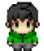
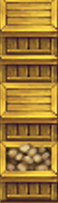
Level schema
Level 0-1
10 - 25
50x50
Chapter 0
Tutorial
Level 0-2
Level 0-3
50 - 25
40 - 25

