Slide 1

Data Analytics
for
Online Advertising Agency

Slide 2
2
OVERVIEW
Introduction
Cost Per Click
Banners
User Engagement & Revenue
Campaign ROI Analysis
Recommendation
Cost & Revenue
Effectiveness of Conversion Rate by Campaigns and User Engagement
User Engagement Weekend vs Weekday

Slide 3

3
INTRODUCTION
This project analyzes the performance of various advertising campaigns of an advertising agency by examining key metrics such as click-through rates, conversion rates, and return on investment (ROI). Using data analytics, it aims to uncover insights into the effectiveness of different banner sizes, positions, and user engagement levels so that the company can optimize future advertising strategies.

Slide 4
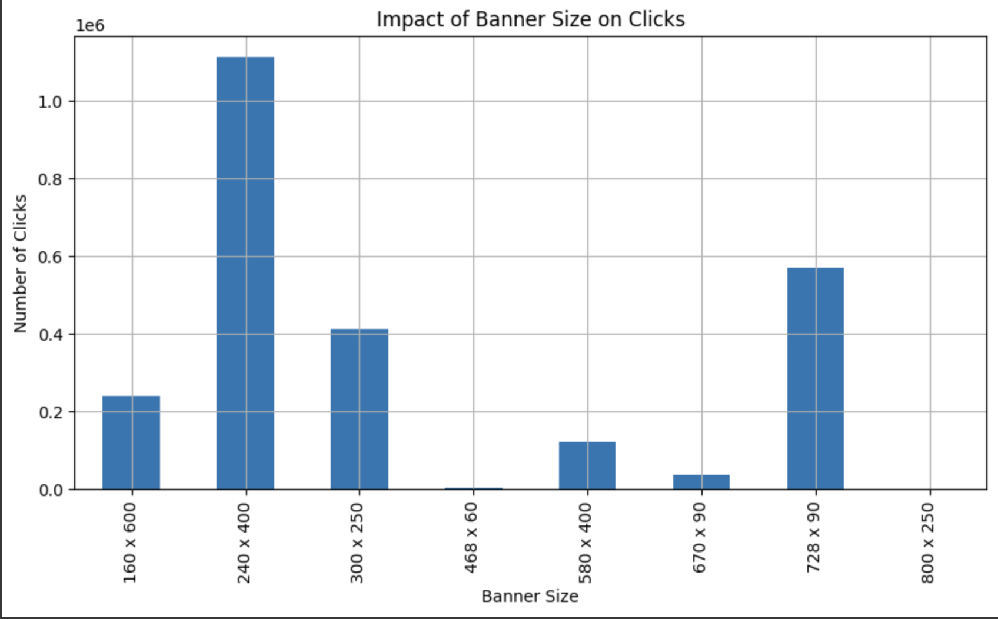
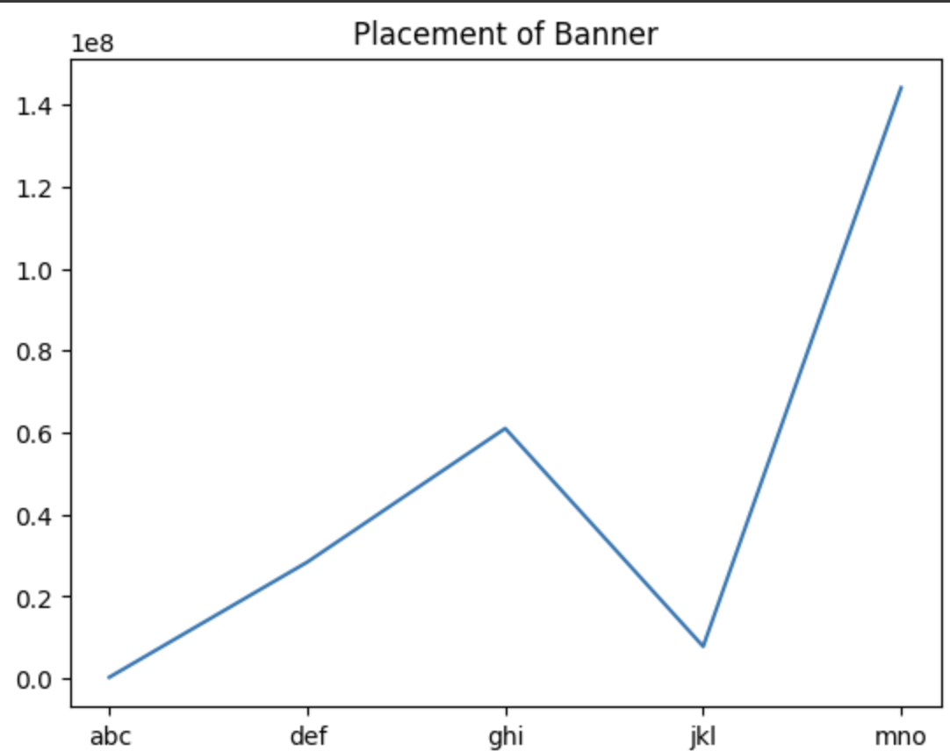
BANNERS
1
Key Finding:
Banners of size 240 x 400 placed at the ‘mno’ position yielded the maximum number of clicks.
Graph Analysis:
Click-through Rate (CTR): The 240 x 400 banners at the 'mno' position demonstrated a significantly higher CTR compared to other banner sizes and positions.
Engagement Metrics: The 'mno' position also showed increased user engagement, suggesting better visibility and attractiveness.

Slide 5
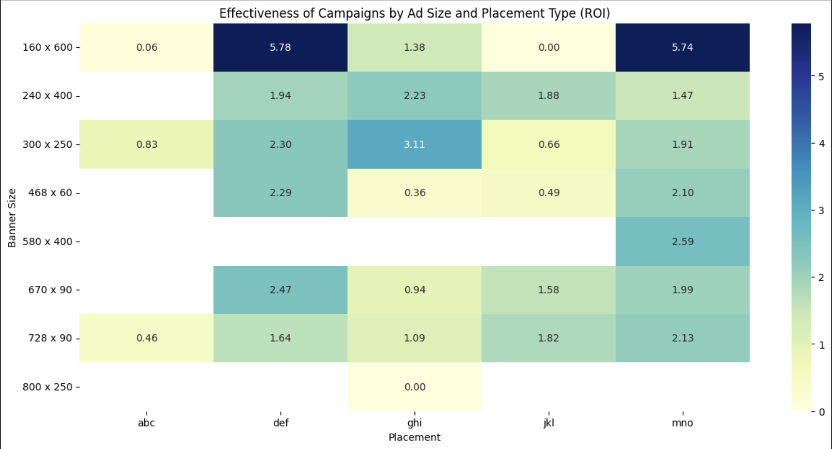
4
CAMPAIGN ROI ANALYSIS
Top Performing Campaigns by ROI:
Campaign 3 with 160 x 600 banners has the highest ROI.
Campaign 1 with 160 x 600 banners is the second highest in ROI.
Campaign 2 with 580 x 400 banners and Campaign 3 with 580 x 400
banners also show strong performance.
Campaign 1 with 240 x 400 banners rounds out the top five.
Campaign Number | Banner Size | ROI
Camp 3 | 160 x 600 | 4.097
Camp 1 | 160 x 600 | 3.932
Camp 2 | 580 x 400 | 3.114
Camp 3 | 580 x 400 | 3.004
Camp 1 | 240 x 400 | 2.531

Slide 6
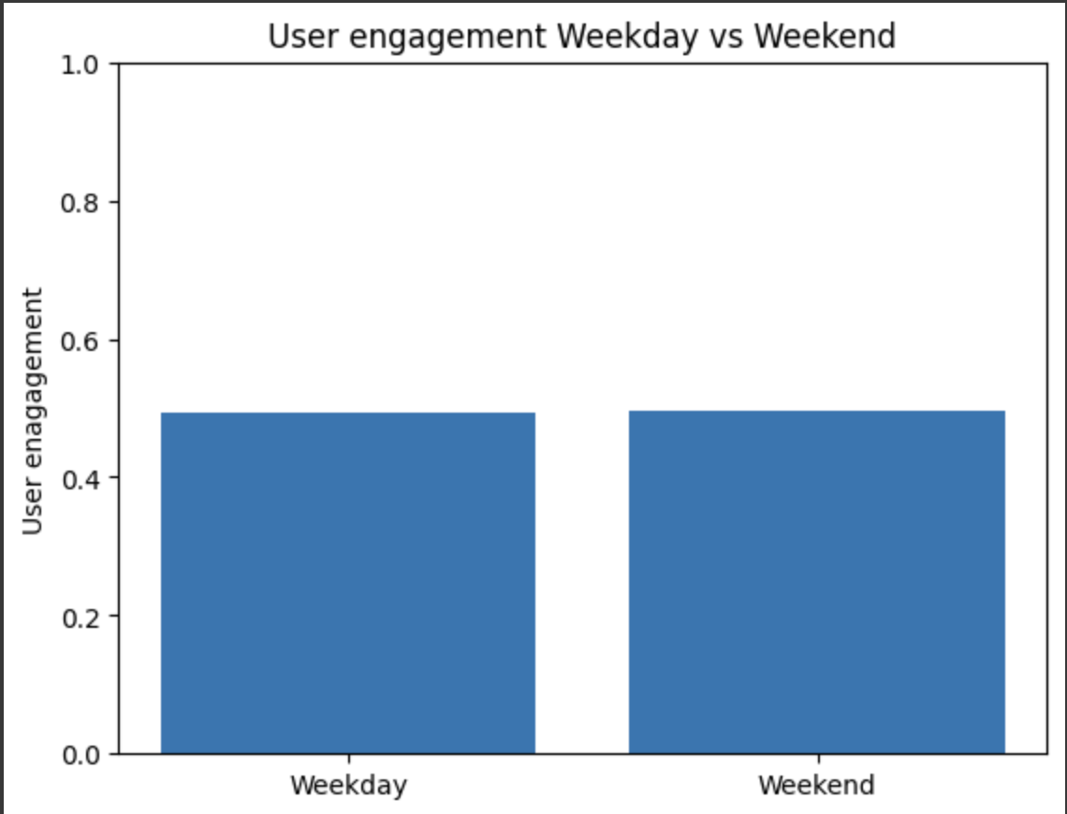
User Engagement
Weekend vs Weekday
5
Weekdays: Engagement metrics remained consistent throughout the week.
Weekends: Similar levels of engagement as observed during weekdays

Slide 7
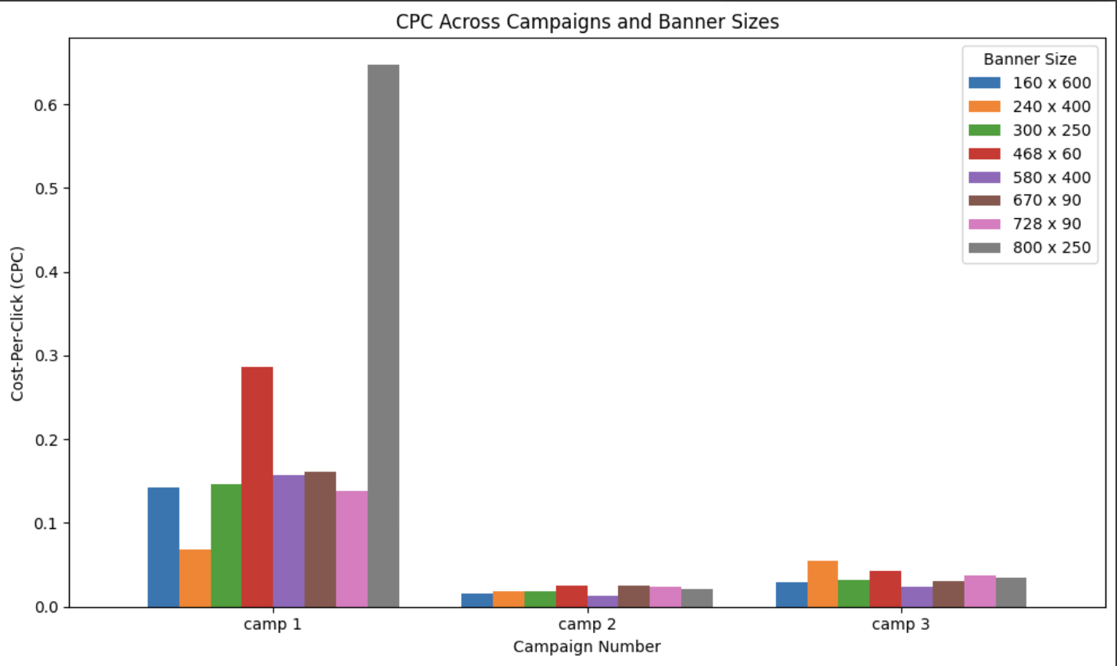
6
Cost Per Click
Insights:
Campaign 1 has the highest CPC for the 800 x 250 banner size.
Campaign 2 generally shows lower CPC across all banner sizes.
Campaign 3 has moderate CPC values, with the 240 x 400 and 728 x 90 banners performing better.
Recommendations:
Optimize Banner Sizes: Focus on banner sizes with lower CPC for cost-efficient campaigns.
Leverage Successful Campaigns: Replicate strategies from Campaign 2 to other campaigns to reduce CPC.
Monitor and Adjust: Continuously monitor CPC across different banner sizes and campaigns to adjust strategies dynamically.

Slide 8
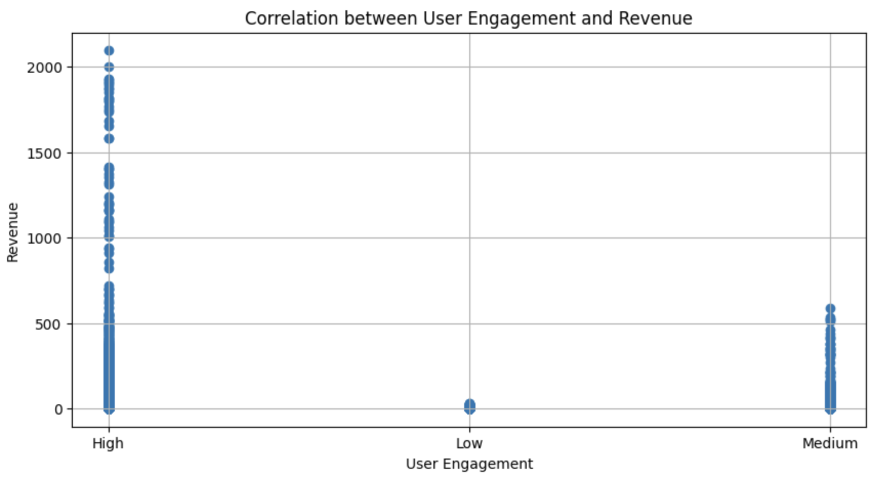
7
USER ENGAGEMENT & REVENUE
User engagement variables are limited to discrete values (0, 0.5, and 1), which may explain the weak correlation coefficient of 0.18.
Despite the weak numerical correlation, the scatter plot suggests a stronger relationship, with higher engagement associated with higher revenue.

Slide 9
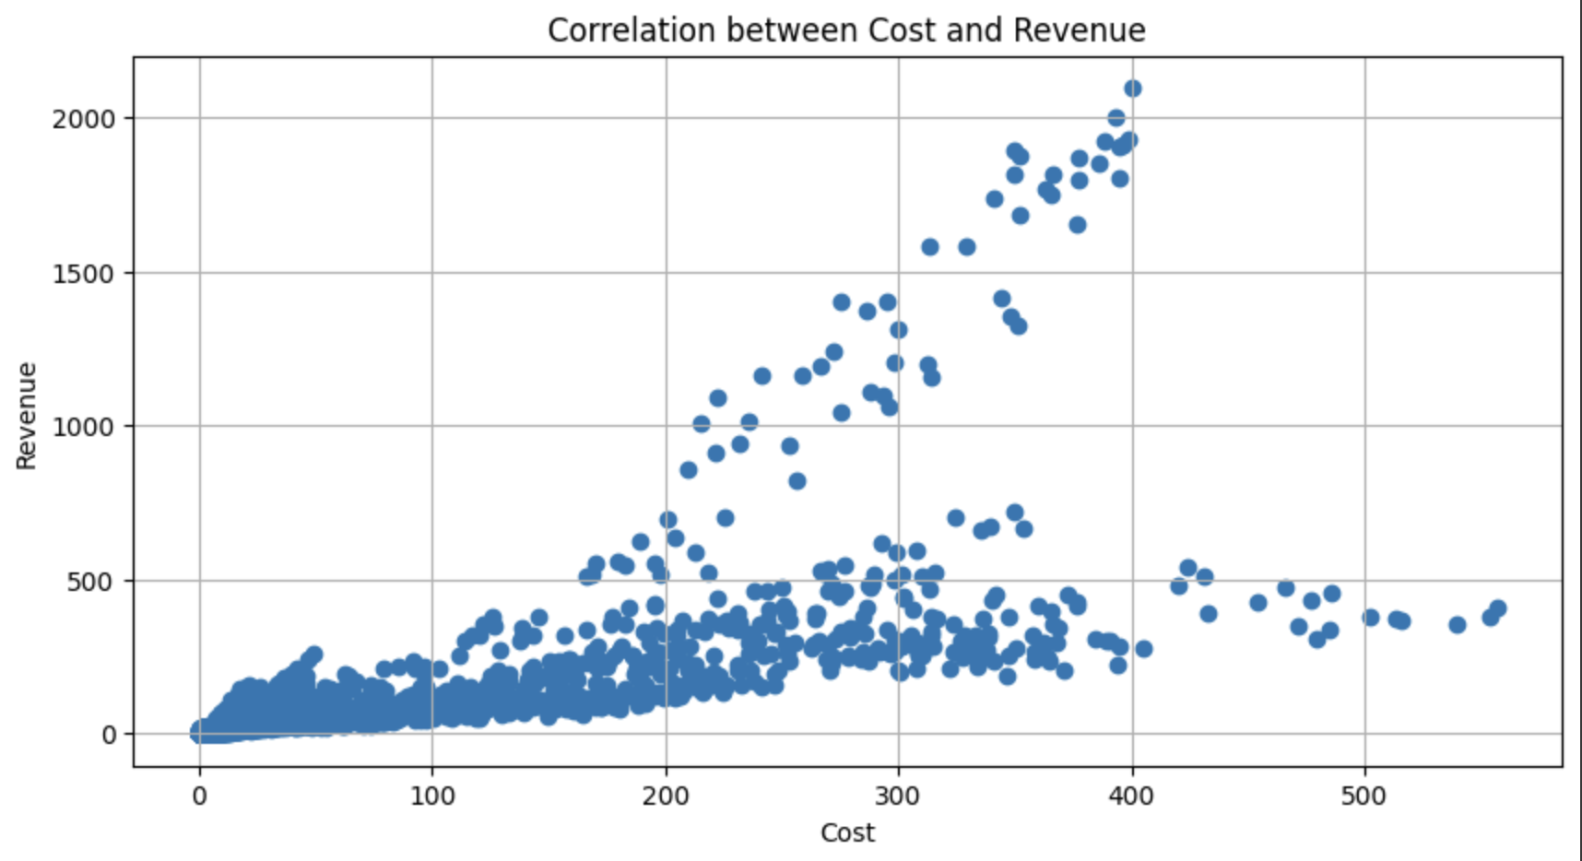
8
COST & REVENUE
The correlation coefficient of 0.76 indicates that as costs increase, revenue also tends to increase.
This means that higher investment in advertising campaigns is generally associated with higher returns

Slide 10
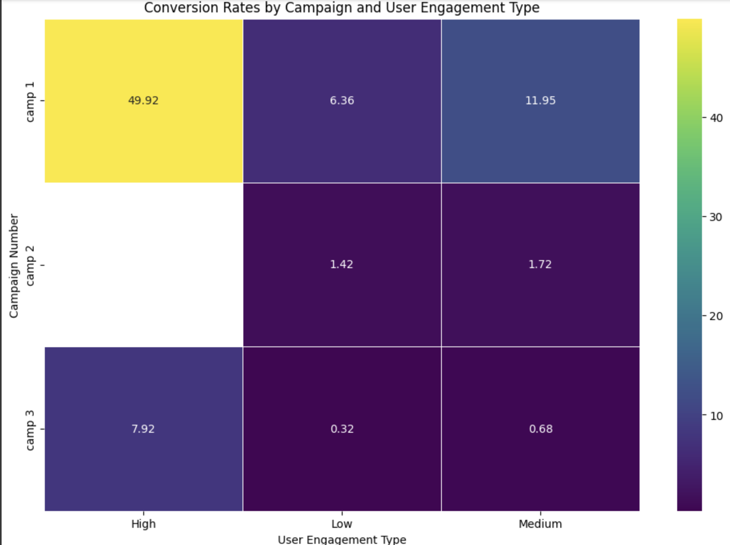
10
﻿Conversion Rate by Campaigns and User Engagement
High Engagement Impact: Camp 1 shows the highest conversion rate (49.92) with high user engagement.
Low Engagement Impact: Conversion rates are significantly lower for all campaigns with low user engagement.
Medium Engagement Impact: Medium user engagement shows moderate conversion rates, with Camp 1 again leading (11.95).

Slide 11
13
RECOMMENDATION
Recommendation 1
Develop and implement strategies aimed at increasing user engagement, such as interactive content, personalized ads, and targeted campaigns, to improve conversion rates and overall campaign effectiveness.
Recommendation 2
Prioritize and allocate more resources to campaigns and banner sizes that yield the highest ROI. Continuously monitor their performance and replicate successful strategies across other campaigns.

Slide 12
THANK YOU

