Slide 1
Java code
Python code
Byte code
Byte code
C, C++
Java virtual machine
Python virtual machine
Binary
OS
OS
OS
Hardware
Hardware
Hardware

Slide 2
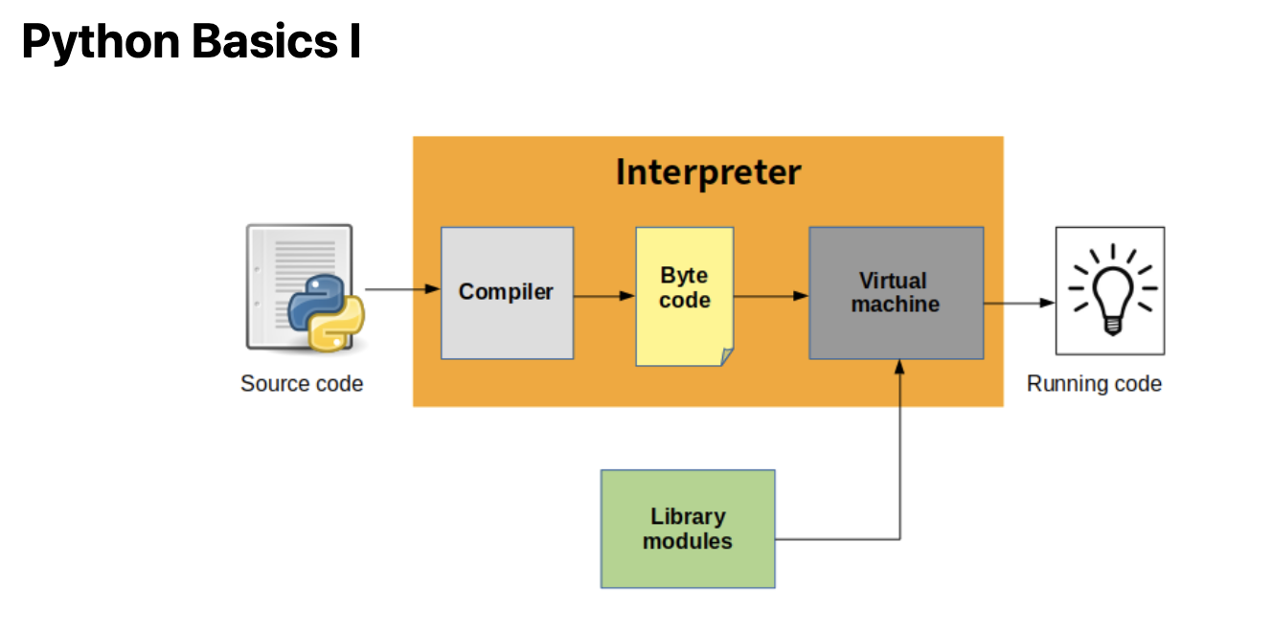

Slide 3
Java script
Java script
Browser (Java script engine)
nodejs (Java script engine V8)
Node js is a runtime env for java script.
Its not a program , not a framework
OS
OS
Hardware
Hardware
runtime environment for executing JavaScript code outside the browser, most often on servers.

Slide 4
framework
we use Framework to develop our application. Multiple frameworks are available, that help us to quickly develop the code.
Famous nodejs frameworks:
Express.js , Hapi.js, Sail.js, Nest.js, Meteor.js, etc
nodejs (Java script engine V8)
OS
Hardware

