Slide 1
Market Basket Analysis
Problem definition :
The problem is to perform market basket analysis on a provided dataset to unveil hidden patterns and associations between products.
The goal is to understand customer purchasing project involve behavior and identify potential cross-selling opportunities for a retail business.
This is using association analysis techniques, such as Apriori algorithm, to find frequently co-occurring products and generate insights for business optimization.

Slide 2
Introduction to Market Basket Analysis
Def: Market Basket Analysis (Association Analysis) is a mathematical modeling technique based upon the theory that if you buy a certain group of items, you are likely to buy another group of items.
It is used to analyze the customer purchasing behavior and helps in increasing the sales and maintain inventory by focusing on the point of sale transaction data.
Given a dataset, the Apriori Algorithm trains and identifies product baskets and product association rules

Slide 3
Definitions and Terminology
Transaction is a set of items (Itemset).
Frequent itemset : If an itemset satisfies minimum support,then it is a frequent itemset.
Strong Association rules: Rules that satisfy both a minimum support threshold and a minimum confidence threshold
In Association rule mining, we first find all frequent itemsets and then generate strong association rules from the frequent itemsets

Slide 4
Definitions and Terminology- Continued
Apriori algorithm is the most established algorithm for finding frequent item sets mining.
The basic principle of Apriori is “Any subset of a frequent itemset must be frequent”.
We use these frequent itemsets to generate association rules.

Slide 5
Apriori Algorithm
Ck: Candidate itemset of size k
Lk: Frequent itemset of size k
L1={frequent items};
For (k=1; Lk!=0; k++) do begin
Ck+1= Candidates generated from Lk;
For each transaction t in the database do
Increment the count of all candidates in Ck+1 that are contained in t
Lk+1=candidates in Ck+1 with min_support
End
Return UkLk;

Slide 6
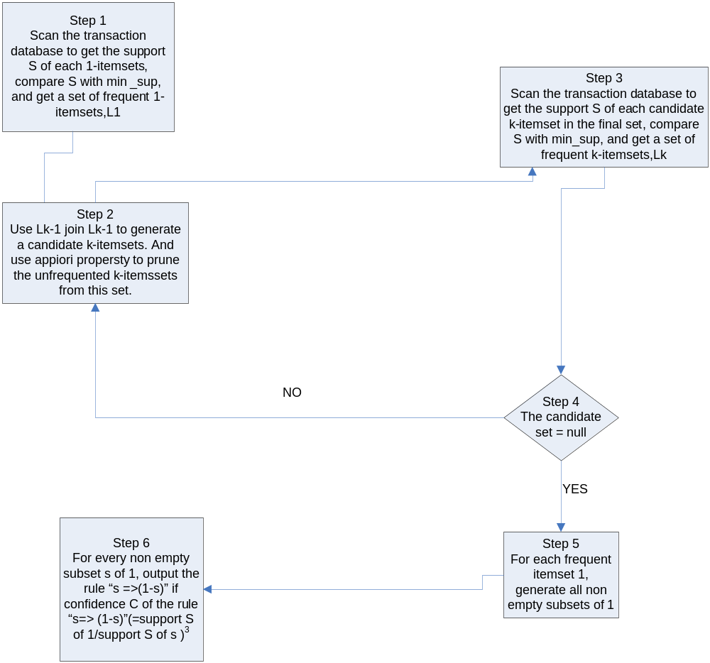
Pictorial representation of Apriori algorithm

Slide 7
Conclusion
We have shown how Market basket analysis using association rules works in determining the customer buying patterns. This can be further extended using OLAP Analytic workspace as shown in demo-3, to add dimensions and cube to identify other measures like costs, revenue and quantity.

