Slide 1

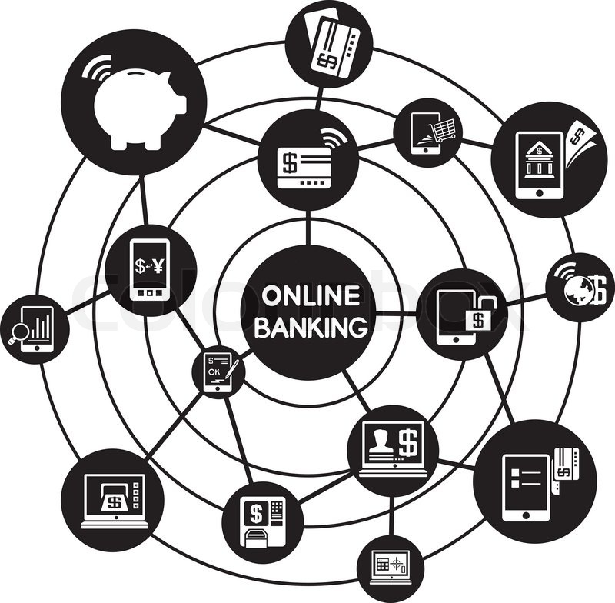
SOFTWARE REQUIREMENT SPECIFICATION FOR ONLINE BANKING

Slide 2

LMS USER NAME | NAME | BATCH
Nivedha_A7 | Nivedha | A7
Nashrinbanu_A7 | Nashrin Banu | A7
Rabiyathul hasna_A7 | Rabiyathul Hasna | A7

Slide 3
introduction
Internet banking is often referred to as e-banking, online banking, or virtual banking. A range of banking activities have benefited from this communication channel’s versatility and adaptability, as well as this its ubiquity. Electronic banking, sometimes referred to as electronic funds transfer(EFT) is simply the act of transferring money electronically rather than with a check or cash from one account to another.

Slide 4

Security system
Security plays an important role in online banking system. The risk of unapproved internet access to a customer’s records has been reduced by financial institutions by implementing a variety of security procedures, although the different methods used vary widely.

Slide 5
Criticism and problems
Those who are physically or mentally unable to use internet banking due to age or disease are discriminated against by the rise in online banking that is accompanied by the closure of nearby bank branches or a reduction in retail business hours. Internet is necessary. In the absence of a steady internet connection, your ability to access Internet banking services may be restricted.

Slide 6
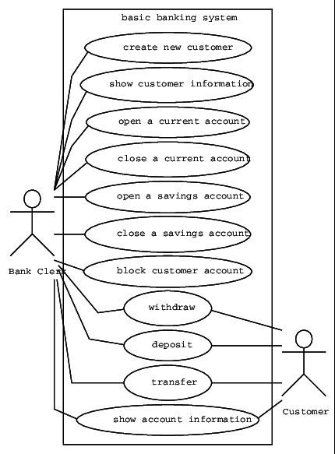
Use case diagram

Slide 7
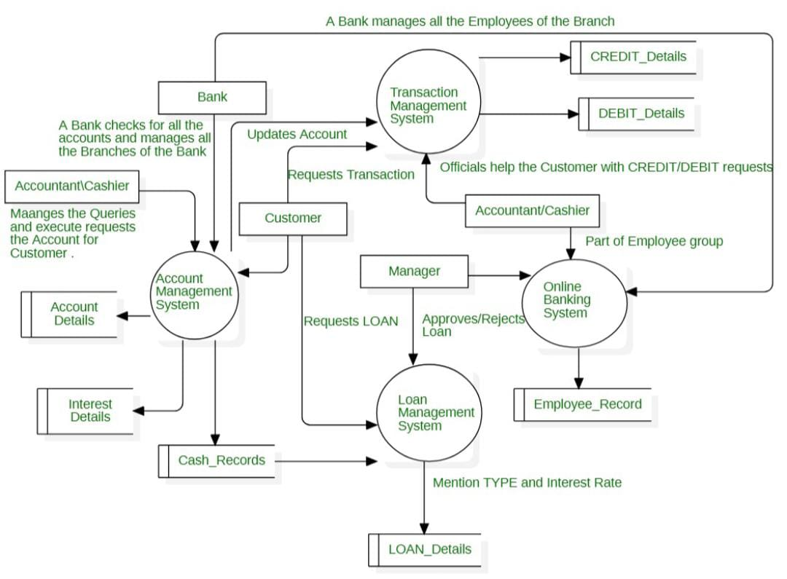
Dfd diagram

Slide 8
Evolution of online banking in future
Indian banking is serving as a model for "future banking," laying the groundwork for the success of UPI payments and QR codes. The management of data and lending both need to use this strategy. These vital drivers of growth serve as the foundation for Indian banking's digital revolution.

Slide 9
Benefits of online banking
1.Check balances
2.Pay bills
3.Transfer funds
4.Download or print statements
5.Access your account

Slide 10
Thank you !

