Slide 1
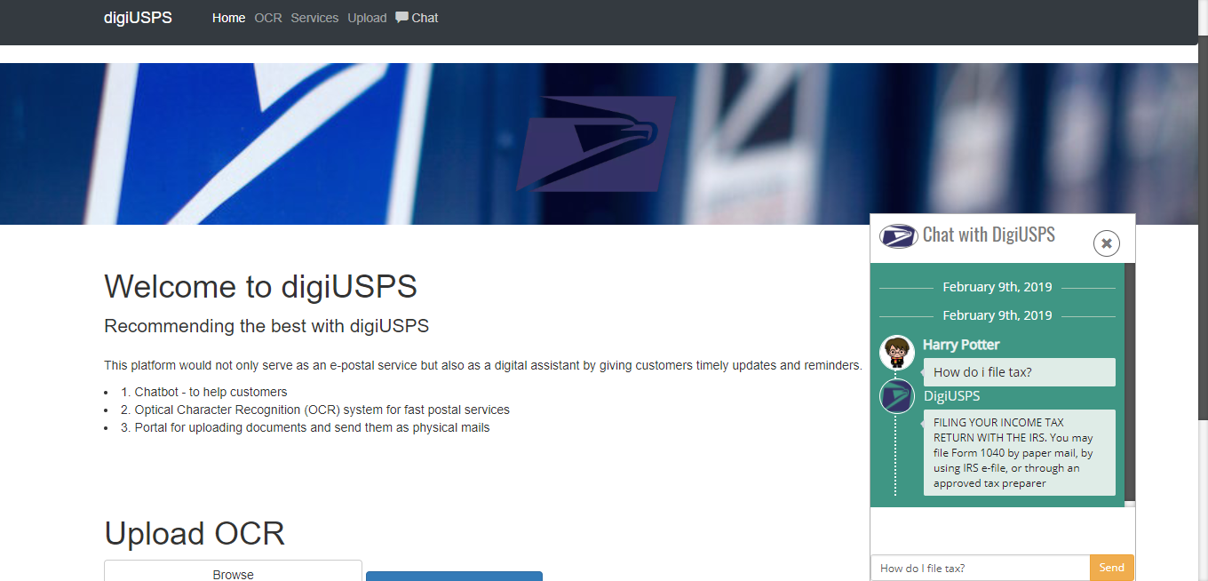
digiUSPS
-Recommending the best with digiUSPS
Team Name: Pandas
Team Members:
Gangishetty, Shreya
Sundaravaradhan, Preethi
RK, Nivedhitha

Slide 2
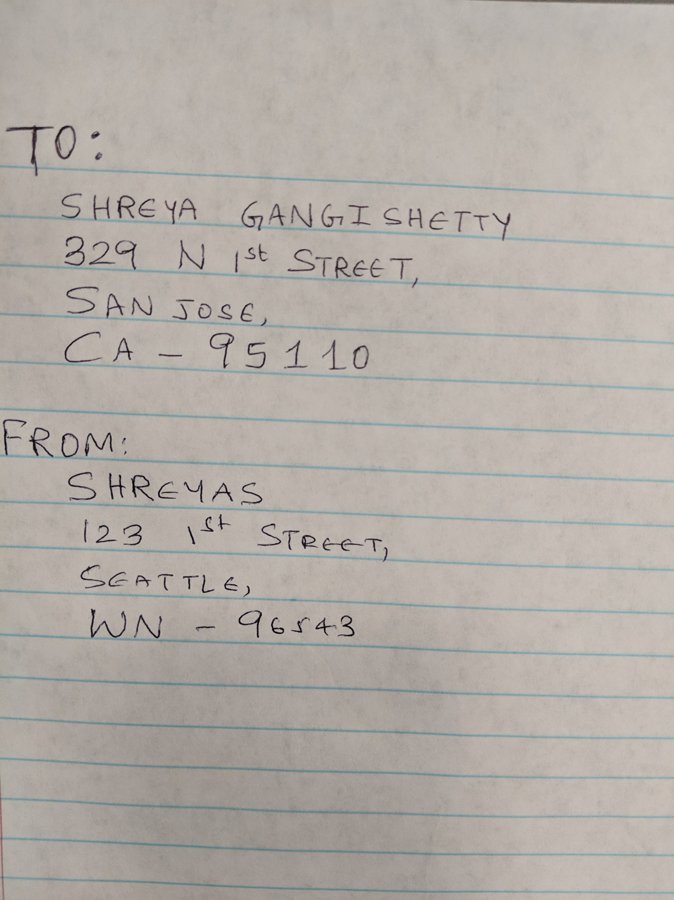
Usecase-1-OCR
USER: tired of standing in lines?
STAFF: Bored of manually typing the addresses?
OCR TO THE RESCUE!!!!

Slide 3
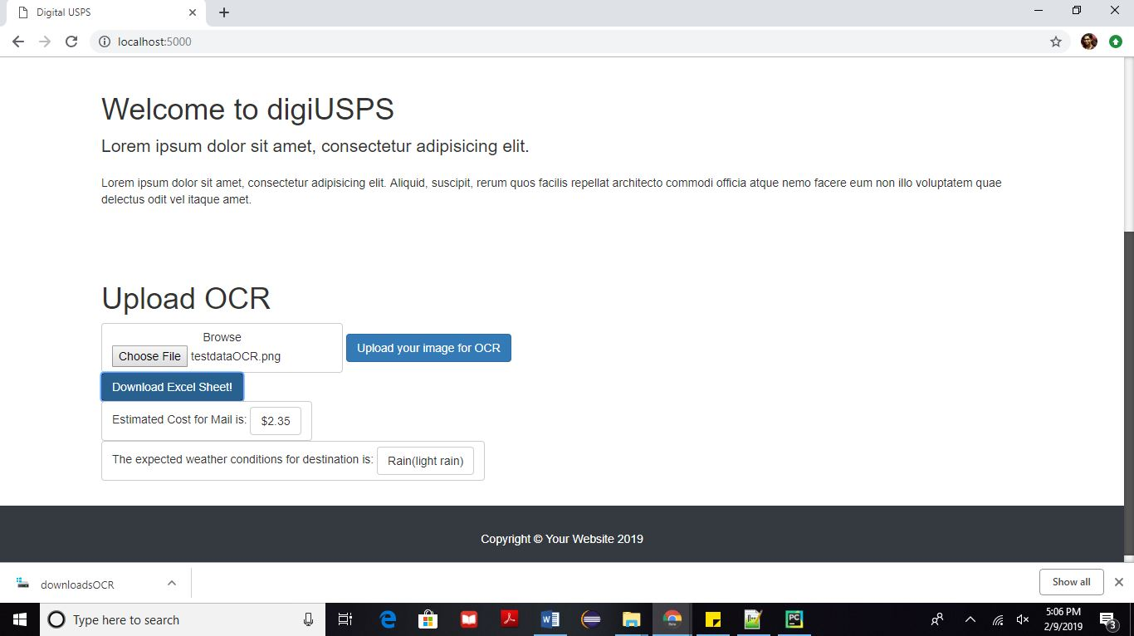
Usecase-2-Fortune Teller
What is the cost?
What would polar vortex do to my package? ☹

Slide 4
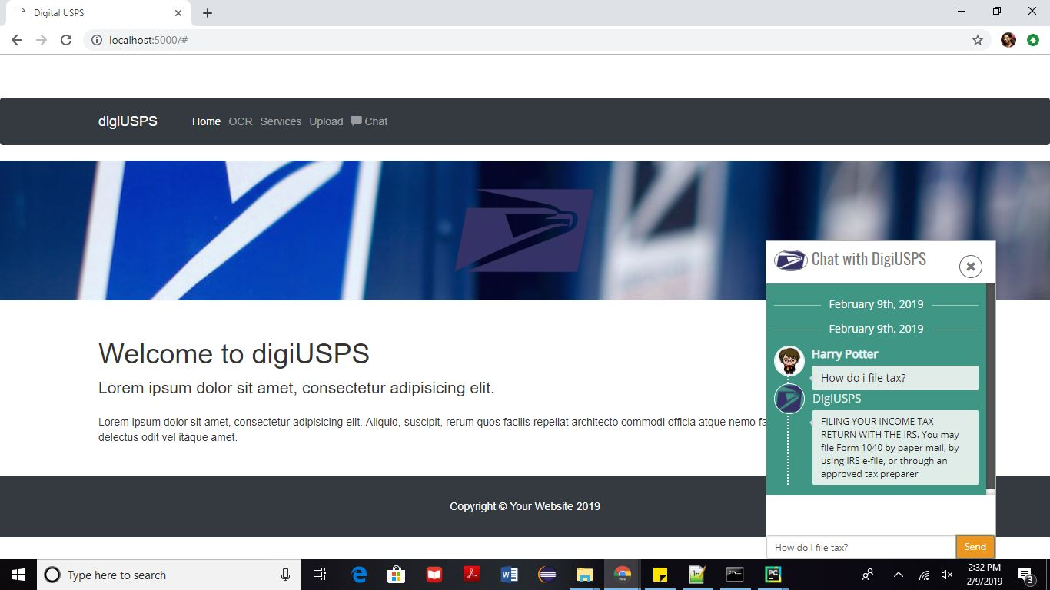
Usecase-3-DigiAssist
Need a friend who is actually useful???

Slide 5
Usecases
OCR - tired of standing in lines
physical form or tracking label USPS workflow and provide value added task
This can also be used for converting physical letter to email
Cost Estimation using USPS Price Calculator API and Address API
Weather predictions using OpenWeatherMap API
ChatBot - Provide value intelligent AI-powered chat service and suggestions

Slide 6
Tech Stack!
Python
Flask
OCR - tesseract, pytesseract libraries
ChatterBot - trainable 3rd party NLP module
SQLite
HTML, CSS
Javascript - JQuery

Slide 7
Demo

Slide 8
Additional Use cases
Chip per parcel
Fraud detection with data

Slide 9
References and APIs
ChatterBot - https://github.com/gunthercox/ChatterBot
OpenWeatherMap - https://openweathermap.org/
Pricing API and Address API - https://www.usps.com/business/web-tools-apis/documentation-updates.htm

Slide 10
Questions?

Slide 11
Thank You!

