Slide 1
MACHINE LEARNING FOR BANKING & FINANCE
Loan Default Risk
Classification
ML Model for Banking — Predict loan defaults before they happen
307,511
122
3 Models
LightGBM
Loan Records
Raw Features
Trained
Best Model
github.com/nivedhpdds25/Loan-Default-Risk-Classification-ML-Model

Slide 2
00
Table of Contents
01
Problem Definition & Objectives
06
Model Building — 3 Models
02
Dataset Description
07
Model Evaluation & Comparison
03
Data Preprocessing & Cleaning
08
SHAP Model Explainability
04
Exploratory Data Analysis (EDA)
09
Streamlit App & Conclusion
05
Feature Engineering & Selection

Slide 3
01
Problem Definition & Objectives
Problem Statement
Business Objective
Banks lose billions annually from loan defaults. The challenge is to build a predictive ML model that identifies high-risk applicants before loan disbursement — minimising credit risk and maximising portfolio health.
Classify each loan applicant as likely to Default (1) or Not Default (0) using historical application data, optimising for Recall — catching real defaulters is costlier than a false alarm.
Why Recall over Accuracy?
A False Negative (approving a defaulter) → financial loss for the bank. A False Positive (rejecting a safe applicant) → lost revenue only. Therefore, we optimise for high Recall on the Default class and tune the decision threshold accordingly.
Tech Stack:
Python
Pandas / NumPy
Scikit-learn
LightGBM
SMOTE
SHAP
Streamlit

Slide 4
02
Dataset Description
Source: Home Credit Default Risk (Kaggle) | 307,511 loan applications | 122 raw features | Target: 0 = No Default, 1 = Default
Class Distribution
Feature
Description
No Default — 91.9% (282,686 applicants)
AMT_INCOME_TOTAL
Annual income of applicant
AMT_CREDIT
Total credit amount requested
Default — 8.1% (24,825)
AMT_ANNUITY
Monthly loan repayment amount
AMT_GOODS_PRICE
Price of goods for the loan
Severe class imbalance (11.4:1 ratio) — addressed using
SMOTE oversampling on training data and scale_pos_weight in LightGBM.
DAYS_BIRTH
Age in days (negative = past)
DAYS_EMPLOYED
Employment duration in days
Dataset Profile
EXT_SOURCE_1/2/3
External credit bureau scores
Rows:
307,511 loan applications
CNT_FAM_MEMBERS
Number of family members
Columns:
122 features (65 float, 41 int, 16 object)
Duplicates:
0 duplicate rows found
NAME_CONTRACT_TYPE
Cash loan vs Revolving loan
Missing:
High missingness in property-area columns (up to 70%)
CODE_GENDER
Applicant gender

Slide 5
03
Data Preprocessing & Cleaning
01
Missing Value Imputation
Numerical columns → Median imputation. Categorical columns → Mode imputation. Result: 0 missing values across all 122 features after cleaning.
02
Duplicate Row Check
0 duplicate rows found in the 307,511-record dataset. Dataset integrity confirmed with no redundant samples.
03
Label Encoding (Categorical Features)
All 16 object-type columns label-encoded using sklearn LabelEncoder. Converts: NAME_CONTRACT_TYPE, CODE_GENDER, FLAG_OWN_CAR, and 13 other categorical features.
04
High-Correlation Feature Removal
Pearson correlation matrix computed. Features with |corr| > 0.90 dropped (one from each correlated pair). Reduces multicollinearity and noise.
05
StandardScaler Normalization
Applied to Logistic Regression pipeline. Zero mean, unit variance scaling. Tree-based models (RF, LightGBM) receive unscaled features.

Slide 6
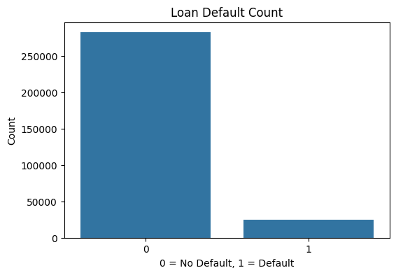
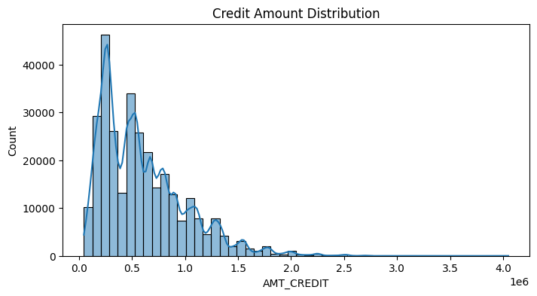
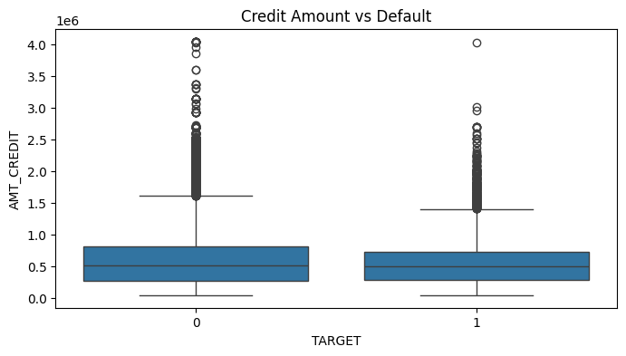
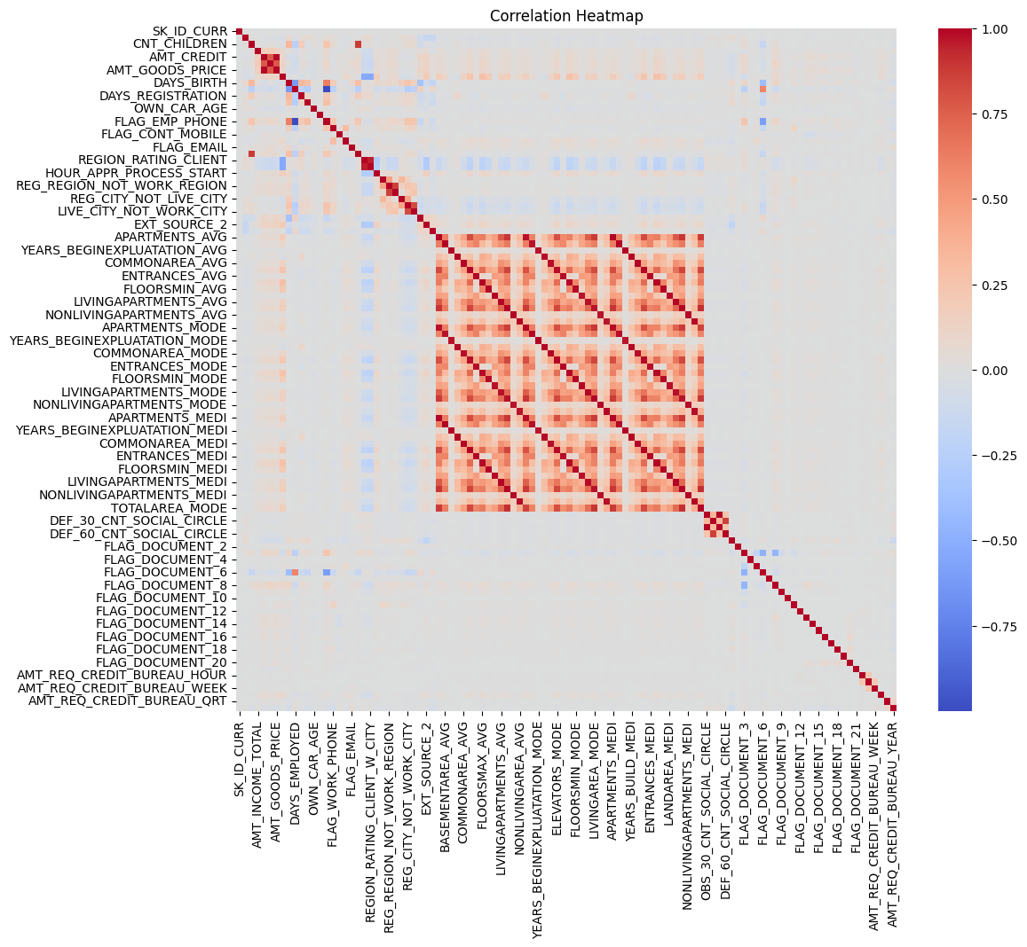
04
Exploratory Data Analysis — Plots
Loan Default Count
Credit Amount Distribution
Severe class imbalance: 91.9% No Default vs 8.1% Default
Bimodal peaks — two distinct loan product segments
Credit Amount vs Default (Boxplot)
Feature Correlation Heatmap
Defaulters (1) have slightly lower median credit amounts with more outliers
Housing features highly inter-correlated; EXT_SOURCE stands out

Slide 7
04
Exploratory Data Analysis — Key Insights
Visualizations Produced
Key EDA Insights
Loan Default Count Plot
Target class bar chart — severe 91:9 imbalance
91.9% No Default / 8.1% Default
Severe imbalance → standard accuracy is misleading; need AUC and Recall.
Income Distribution
Right-skewed histogram with KDE overlay
Low correlation with target
No single feature strongly predicts default — ensemble models essential.
Credit Amount Distribution
Bimodal distribution across loan amounts
EXT_SOURCE_1/2/3 dominate
Strongest individual predictors of loan default across all analyses.
Income vs Default (Boxplot)
Defaulters have slightly lower median income
Income is right-skewed
Most applicants earn ≤ 200K; outliers extend to millions.
Credit vs Default (Boxplot)
Higher credit amounts slightly more prone to default
Credit amounts bimodal
Two peaks suggest distinct loan product segments (personal vs property).
Correlation Heatmap
Weak target correlations — ensemble models needed
Employment days anomaly
Positive DAYS_EMPLOYED = pensioners; requires capping before modelling.

Slide 8
05
Feature Engineering & Selection
8 domain-specific financial features engineered + Top 50 selected by Mutual Information from ~120 candidates
Engineered Features
CREDIT_INCOME_RATIO
AGE_YEARS
Formula: AMT_CREDIT / AMT_INCOME
Formula: -DAYS_BIRTH / 365
ANNUITY_INCOME_RATIO
YEARS_EMPLOYED
Formula: AMT_ANNUITY / AMT_INCOME
Formula: -DAYS_EMPLOYED / 365
GOODS_CREDIT_RATIO
EMPLOYED_TO_AGE_RATIO
Formula: AMT_GOODS_PRICE / AMT_CREDIT
Formula: YEARS_EMPLOYED / AGE_YEARS
CREDIT_TERM
INCOME_PER_PERSON
Formula: AMT_CREDIT / AMT_ANNUITY
Formula: AMT_INCOME / CNT_FAM_MEMBERS
Selection: Mutual Information scoring → Top 50 features kept for modelling. High-correlation features (|r| > 0.90) removed first.

Slide 9
06
Machine Learning Models
Three models trained on SMOTE-balanced training data (307,511 → 80/20 stratified split)
01
Linear Baseline
Logistic Regression
class_weight = 'balanced'
max_iter = 1000
C = 0.1, solver = lbfgs
Scaled features required (StandardScaler). Used as baseline interpretable model.
02
Tree Ensemble
Random Forest
n_estimators = 300
max_depth = 12
min_samples_leaf = 50
class_weight = 'balanced'
No scaling needed. Handles non-linearity well. class_weight balances imbalanced target.
03
Gradient Boosted Trees
LightGBM ★ Best Model
n_estimators = 500
learning_rate = 0.05
num_leaves = 63
scale_pos_weight = 11.39
early_stopping = 50 rounds
scale_pos_weight = neg/pos = 11.39. Native imbalance handling. Optimised for ROC-AUC.

Slide 10
07
Model Evaluation & Comparison
Model
Accuracy
Precision
Recall
F1
ROC-AUC
5-Fold CV
LightGBM — ROC-AUC
Logistic Regression
75.7%
0.135
0.373
0.199
0.631
Fold 1
0.7551
Random Forest
0.150
86.2%
0.152
0.151
0.735
Fold 2
0.7649
LightGBM ★
0.280
89.5%
0.540
0.370
0.768
Fold 3
0.7566
Threshold Tuning — LightGBM (Recall Optimisation)
Fold 4
0.7624
Default threshold = 0.50 → Optimal threshold = 0.1027
At threshold 0.1027: Recall = 71.3% | Precision = 14.1% | No-Default accuracy = 62%
Strategy: catch most defaulters at the cost of some false positives — acceptable in banking risk management.
Fold 5
0.7537
Final AUC: Logistic Reg = 0.631 | Random Forest = 0.735 | LightGBM = 0.768 ★ | LightGBM wins on both AUC and Recall.
Mean: 0.7585 ± 0.0043

Slide 11
08
SHAP Model Explainability
SHAP (SHapley Additive exPlanations) — applied on LightGBM for regulatory-grade, model-agnostic explanations
Global Summary (Bar)
Top SHAP Features
Mean absolute SHAP values across all 2,000 test samples — ranks features by overall importance.
LightGBM — 2,000 test samples
Beeswarm Plot
EXT_SOURCE_3
0.122
Shows direction and magnitude of each feature's impact: red = high value increases risk, blue = decreases.
EXT_SOURCE_2
0.108
Dependence Plots (Top 3)
EXT_SOURCE_1
0.089
Feature-level: EXT_SOURCE_3, EXT_SOURCE_2, EXT_SOURCE_1 — shows how scores interact with default risk.
DAYS_BIRTH
0.071
Local Force Plot
AMT_CREDIT
Individual applicant explanation — which features pushed prediction toward Default vs No Default.
0.065
DAYS_EMPLOYED
0.058
Why SHAP Matters for Banking
CREDIT_INCOME_RATIO
Financial regulations (GDPR, Fair Lending) require lenders to explain credit decisions. SHAP provides per-applicant, per-feature attribution — enabling compliant, auditable rejection letters.
0.052
AMT_INCOME_TOTAL
0.044

Slide 12
08
Streamlit Web Application — Loan Risk Dashboard
Quad-Bento dark UI dashboard for real-time loan default risk assessment using the trained LightGBM model.
👤 Personal Profile Tile
💰 Financial Data Tile
Age slider (18–85) + Employment Tenure slider (0–50 yrs). Mapped to DAYS_BIRTH and DAYS_EMPLOYED internally.
Annual Income input + Requested Loan Amount input. Used to compute CREDIT_INCOME_RATIO dynamically.
📈 Credit Scoring Tile
🎯 Final Decision Tile
Internal Score A (EXT_SOURCE_2) + Score B (EXT_SOURCE_3) sliders (0.0–1.0). Key default predictors.
One-click GENERATE REPORT: shows default probability bar, APPROVED (green) or REJECTED (red) decision badge.
🏦 Dark Bento UI Design
📦 Model Pipeline
bg: #0f172a dot-grid. Cards: rgba glassmorphism. Result boxes color-coded by risk level.
Loads lgbm_model.pkl, scaler.pkl, top_features.pkl, threshold.json. Cached with @st.cache_resource.
Deploy: streamlit run app.py | Assets: lgbm_model.pkl · scaler.pkl · top_features.pkl · threshold.json

Slide 13
09
Conclusion & Future Work
LightGBM is the best model
Future Directions
ROC-AUC = 0.768, Recall = 54% at default threshold; 71.3% at optimal threshold 0.1027.
XGBoost / CatBoost Comparison
External scores dominate predictions
Benchmark against other gradient boosting frameworks.
EXT_SOURCE_1/2/3 are the top SHAP predictors — credit bureau data is critical for risk scoring.
Bureau & Bureau Balance Data
Incorporate Kaggle supplementary tables for richer features.
Threshold tuning is essential
Lowering threshold from 0.50 → 0.10 doubles Recall — key for banking's asymmetric error costs.
Neural Network (TabNet)
Test deep learning on structured tabular banking data.
SMOTE addressed class imbalance
11.4:1 imbalance corrected via SMOTE + scale_pos_weight; improved minority class detection.
Real-time API Deployment
FastAPI + Docker REST service for production banking systems.
Feature engineering added value
8 domain-specific ratios (CREDIT_INCOME_RATIO, CREDIT_TERM, etc.) improved model signal.
Fairness & Bias Audit
Demographic parity analysis across gender and family status.

Slide 14
Thank You
Loan Default Risk Classification for Banking
307,511
3
0.768
71.3%
Loan Records
ML Models
Best AUC
Optimised Recall
github.com/nivedhpdds25/Loan-Default-Risk-Classification-ML-Model
Python · Pandas · Scikit-learn · LightGBM · SMOTE · SHAP · Streamlit

