Slide 1



MICROSOFT ELEVATE CAPSTONE PROJECT
Education analytics dashboard: subject availability in Indian schools
Presented By:
NIVEDITA
INDIAN INSTITUTE OF TECHNOLOGY PATNA
COMPUTER SCIENCE
nivedita3121@gmail.com

Slide 2
OUTLINE
Problem Statement
Proposed System/Solution
System Development Approach
TOOLS AND TECHNOLOGY
Result (DASHBOARD OUTPUT)
Conclusion
Future Scope
References

Slide 3
Problem Statement
Educational Infrastructure and Subject Availability vary significantly across different states in India. Understanding the distribution of secondary schools, higher secondary schools, and science laboratory facilities is essential for improving education planning and resource allocation. However, without proper data visualization and analysis, it becomes difficult to identify trends and gaps in educational infrastructure. Therefore, a data analytics dashboard is required to analyze subject availability and educational resource across the Indian states.

Slide 4
Proposed Solution
Collect education dataset from NDAP (National Data and Analytics Platform).
Clean and preprocess the dataset.
Load the dataset into Power BI.
Create an interactive dashboard with charts and filters.
Analyze school distribution, science laboratory availability, and subject availability.
Provide insights for better educational planning.

Slide 5
System Approach
System Requirements
Windows computer
Power BI Desktop
NDAP dataset
Libraries / Tools Used
Power BI
Power Query
Data Visualization tools
Microsoft Power BI Desktop

Slide 6
Algorithm & Deployment
Data Processing Approach:
Data Collection from NDAP dataset
Data Cleaning using Power Query
Data Transformation for visualization
Dashboard creation using Power BI
Deployment:
Interactive Power BI dashboard
Visual charts and filters for analysis

Slide 7
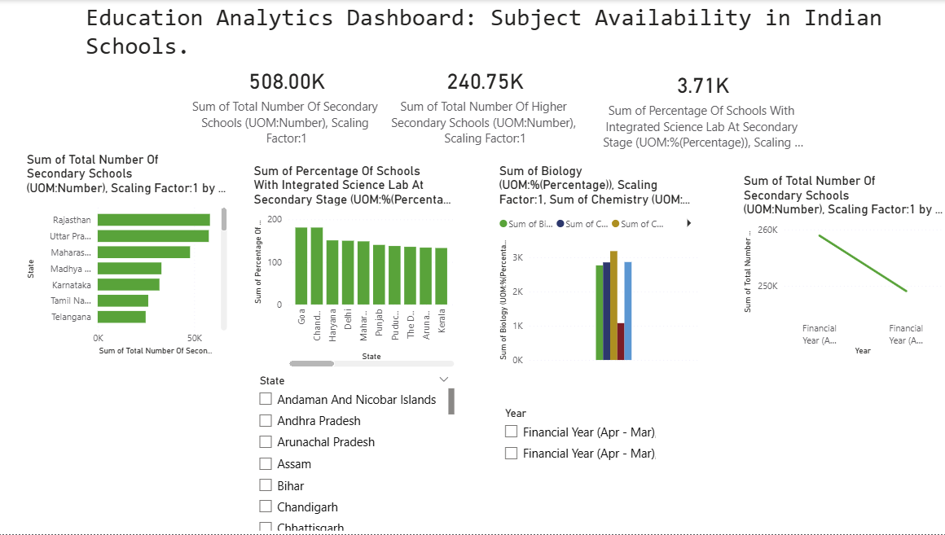
RESULT
The dashboard visualizes the distribution of secondary and higher secondary schools across Indian states.
It analyzes the percentage of schools with integrated science laboratories.
The availability of science subjects such as Physics, Chemistry, and Biology is compared across regions.
Interactive filters allow users to explore data by state and financial year.

Slide 9
Conclusion
The Education Analytics Dashboard successfully analyzes educational infrastructure and subject availability across Indian states. The interactive dashboard provides clear insights into school distribution, science laboratory facilities, and subject availability. These insights can assist policymakers and educational planners in making informed decisions to improve the education system.

Slide 10
Future scope
Integration with real-time education datasets.
District-level education analysis.
Predictive analytics using machine learning.
Expansion to other education indicators.

Slide 11
References
Power BI Documentation
Government Education Data Sources
NDAP (National Data and Analytics Platform)
GitHub Link: https://github.com/nivedita-3121/Educational-Analytics-PowerBI-Dashboard

Slide 12
Thank You

