Slide 1


CAPSTONE PROJECT PROJECT TITLE Movie recommendation using and unsupervisor learning
Presented By
Student Name: Yellanru niveditha
College Name:Sri venkateswara instution
Of technology
Department: Computer Science and
Engineer
Email ID: nivedithayellanuru4@gmail.com
AICTE Student ID : STU66ca10a1593d81724518561

Slide 2
OUTLINE
Problem Statement (Should not include solution)
Proposed System/Solution
System Development Approach (Technology Used)
Algorithm & Deployment
Result (Output Image)
Conclusion
Future Scope
References

Slide 3
Problem Statement
In the current digital age, the entertainment industry is overwhelmed with vast volumes of content and preferences.To our project proposes the development of an Intelligent Movie Recommendation System that leverages Collaborative Filtering techniques to personalize movie suggestions. By analyzing user behavior patterns, preferences, and historical ratings, the system intelligently predicts and recommends movies that a user is likely to enjoy.

Slide 4
Proposed Solution
The purpose of this project is to develop a smart and personalized movie recommendation system that helps users discover content efficiently from a vast digital library.
By analyzing user preferences and behavior through historical rating data, the system uses machine learning techniques to suggest movies that align with individual tastes.
This solution aims to:
Simplify content discovery for users.
Enhance user satisfaction and engagement on digital platforms.
Demonstrate the application of data preprocessing, collaborative filtering, model evaluation, and system deployment in solving a real-world problem.

Slide 5
System Approach
Technologies Used:
Python – The main programming language used to build the project.
Libraries:
pandas – To read and handle data (like movie details).
numpy – For math and number operations.
scikit-learn – For machine learning tasks like clustering similar movies.
matplotlib and seaborn – To create graphs and visualizations.
ast – To convert data from text to Python objects (like genres).
This project is adopts a structured machine learning pipeline to build an effective movie recommendation system:
Data Collection: Utilizes the MovieLens dataset containing user ratings and movie metadata.
Preprocessing: Cleans data, handles missing values, and filters out inactive users and low-rated movies.
Modeling: Applies Collaborative Filtering to predict user preferences based on similarities among users or items.
Evaluation: Assesses performance using RMSE and Precision to ensure recommendation accuracy.
Deployment: Demonstrates real-time movie recommendations through a user-friendly interface.

Slide 6
Algorithm & Deployment
Algorithm Used
The project implements Collaborative Filtering, a widely used machine learning technique for recommendation systems. It operates as follows:
User-Based Collaborative Filtering: Identifies users with similar preferences and recommends movies based on the ratings of similar users.
Item-Based Collaborative Filtering: Finds similarities between movies and recommends those that are similar to what the user has liked before.
Similarity Measures: Uses metrics like Cosine Similarity or Pearson Correlation to compute relationships between users or items.
Prediction: Predicts ratings for unseen movies and ranks them to recommend the top-N suggestions.
Deployment
The deployment phase ensures that the recommendation model is accessible and usable in real-time:
Interface: A simple user interface allows users to input their preferences or select their user ID.
Integration: The trained model is integrated with the interface to generate and display movie recommendations instantly.
Demonstration: The system is ready for demonstration in academic or real-world settings, highlighting the end-to-end working of a recommendation engine.

Slide 7
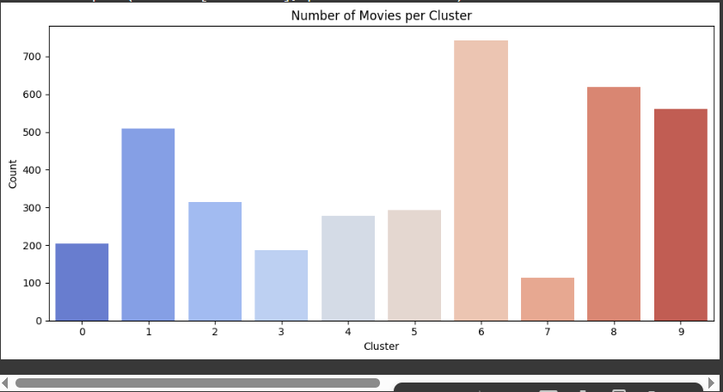
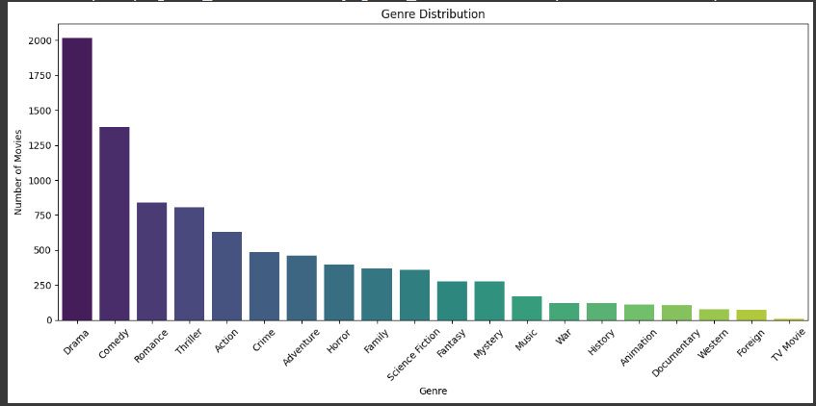
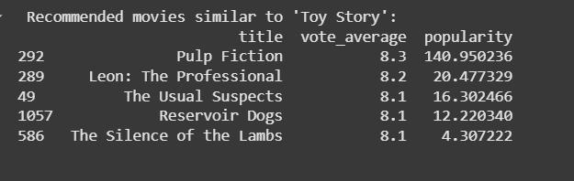
Result
This project culminated in the successful development of a Content-Based Movie Recommendation System that intelligently recommends movies based on what a user already likes. By analyzing the deeper elements of films—such as genre, storyline, cast, crew, and keywords—the system understands the "essence" of a movie and finds others with similar characteris.

Slide 8
Conclusion
This project marks the successful implementation of a Content-Based Movie Recommendation System that leverages the power of machine learning and natural language processing to transform how users discover films. The outcome showcases how intelligent algorithms can enhance user experience, reduce decision fatigue, and make content discovery both efficient and enjoyable in today’s overwhelming digital entertainment landscape.
.

Slide 9
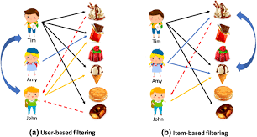
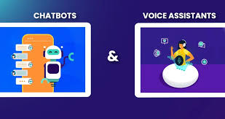
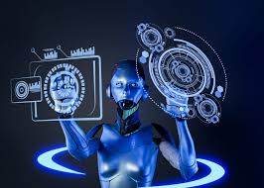
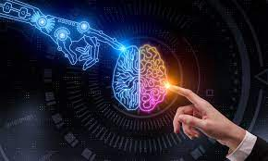
Future scope
Future Scope
While this content-based recommendation system lays a solid foundation, there is
vast potential to enhance its accuracy, adaptability, and user engagement in the future.
Some promising directions include:
Hybrid Recommendation Systems: Integrating collaborative filtering with
content-based methods to combine user behavior with content analysis,
leading to more robust and well-rounded suggestions.
Real-Time Personalization: Adapting recommendations based on a user’s
real-time interactions, watch history, and evolving preferences.
Deep Learning Integration: Leveraging advanced models like
Transformers or deep neural networks for deeper semantic
understanding of movie descriptions, reviews, and user sentiments to the
Voice and Chatbot Integration: Building conversational recommendation
agents using voice commands or chat interfaces to make movie discovery
more interactive and accessible.
By pursuing these directions, the system can evolve into a smarter, more personalized, and truly next-generation entertainment assistant.

Slide 10
References
List and cite relevant sources, research papers, and articles that were instrumental in developing the proposed solution. This could include academic papers on bike demand prediction, machine learning algorithms, and best practices in data preprocessing and model evaluation.
GitHub Link: https://github.com/niveditha04-yellanuru/Microsoft_edunet_internship_doc.git

Slide 11
Thank you
I would like to express my heartfelt thanks to EDUNET_AICTE and MICROSOFT PARTNER and its industry partner for providing me with the opportunity to work on this enriching project. This experience has greatly enhanced my understanding of machine learning, recommendation systems, and real-world problem-solving. The guidance and support received throughout this journey have been invaluable in shaping both my technical skills and professional growth.

