Slide 1
SafeGuard AI
Proactive Child Online Safety & Digital Trust Layer
Phase 2 — Project Progress & Working MVP
Theme: Cyber Security, Blockchain & Digital Trust
Team: Cognitive Crew
Team Members: Niveditha B N • Nisarga B N
1

Slide 2
Problem Statement
Why existing online safety approaches are insufficient
Children face online risks including cyberbullying, manipulation, grooming-like behavior, PII harvesting and social engineering.
Many moderation systems are reactive: Harm occurs → Child reports → Platform reviews → Action.
Single-message keyword filters are context-blind: they can produce false positives while missing multi-turn manipulation.
Children may hesitate to self-report, allowing risk to escalate before intervention.
Over-surveillance can compromise privacy and trust, while storing raw child conversations creates additional data-exposure risk.
2

Slide 3
Proposed Solution
Move from isolated message moderation to behavioral risk detection
SafeGuard AI analyzes conversation context and behavioral trajectories rather than judging messages independently.
Tracks patterns such as: Trust Building → Secrecy → PII Request → Coercion.
Maintains short-lived conversation state and calculates a dynamic risk index.
Provides proportional, age-aware safety interventions based on risk severity.
Uses privacy-by-design principles: ephemeral state, minimized oversight data, PII guardrails and explainable risk factors.
3

Slide 4
Progress Made
Phase 2 implementation status
✓ Defined the end-to-end SafeGuard AI architecture and component boundaries.
✓ Designed the two-tier inference flow: fast screening followed by contextual analysis.
✓ Implemented the dynamic risk-engine concept and multi-signal aggregation approach.
✓ Defined LOW / MEDIUM / HIGH / CRITICAL intervention tiers.
✓ Designed PII guardrails and anonymized oversight data flow.
✓ Designed simulated chat + live risk visualizer + trusted-adult dashboard for the MVP demo.
✓ Added testing, privacy and error-handling requirements for a production-style prototype.
4

Slide 5
Features Implemented
Core MVP capabilities
Real-time simulated child-safe chat analysis
Multi-turn conversation context and short-lived state
Behavioral signal detection: toxicity, secrecy, isolation, coercion, PII solicitation and escalation
Dynamic 0–100 risk score with LOW / MEDIUM / HIGH / CRITICAL classification
Explainable AI: concrete reasons behind risk changes
Proportional safety nudges and escalation guidance
PII protection and masking
Anonymized trusted-adult / moderator dashboard
Risk trend visualization and synthetic demo scenarios
5

Slide 6
Technical Architecture
Two-tier inference + stateful risk engine
Tier 1
Fast Screening
User / Demo Chat
React + TypeScript
Tailwind + Recharts
FastAPI / WebSocket
Backend
State + Risk Engine
TTL / EMA
Safety Intervention +
Anonymized Dashboard
→
→
→
→
→
Tier 2
Contextual Analysis
Technology stack: Python, FastAPI, React, TypeScript, Tailwind CSS, Recharts, Hugging Face Transformers, Redis/ephemeral state.
6

Slide 7
Risk Engine & Methodology
Dynamic risk is driven by context and escalation
Current risk is updated using an exponentially weighted risk model:
Rt = λRt−1 + (1 − λ)St
St combines multiple signals: toxicity + behavioral anomaly + PII solicitation + coercion + secrecy/isolation + escalation.
λ is configurable (Phase 1 proposal: 0.7), allowing recent behavior to influence the current risk while retaining short-term context.
The score is normalized to 0–100 and mapped to proportional interventions.
The system treats the score as a prototype safety indicator — not a definitive judgment about a person.
7

Slide 8
Risk Classification & Interventions
Safety response scales with behavioral risk
LOW (0–29): Silent passthrough; normal conversation continues.
MEDIUM (30–59): Non-intrusive safety nudge and reminder not to share sensitive information.
HIGH (60–79): Stronger warning, pause/report guidance and trusted-adult recommendation.
CRITICAL (80–100): Strong safety warning, protective message handling in the demo, reporting guidance and trusted-adult escalation.
Every intervention is accompanied by explainable trigger signals.
8

Slide 9
Privacy-by-Design
Protect children without turning the system into invasive surveillance
Ephemeral conversation state with configurable TTL; Phase 1 target: 15-minute memory window.
No permanent storage of raw chat transcripts in the oversight workflow.
Moderator/trusted-adult view receives anonymized risk indicators and metadata rather than unnecessary raw conversations.
PII guardrails detect requests for phone numbers, school/location information, passwords and other sensitive identifiers.
Explainable AI exposes concrete risk factors instead of opaque percentages.
Privacy and safety are treated as design requirements, not post-processing.
9

Slide 10
Challenges Faced
Engineering and safety challenges addressed
Context challenge: distinguishing harmless peer conversation from genuinely concerning multi-turn patterns.
False positives vs. false negatives: safety detection must be sensitive without unnecessarily disrupting normal conversations.
State management: retaining enough short-term context for escalation detection while minimizing data retention.
Explainability: converting model/signal outputs into understandable reasons for children and trusted adults.
Privacy: designing oversight without exposing unnecessary child conversation data.
Real-time performance: separating fast screening from deeper contextual analysis to reduce latency.
10

Slide 11
Future Roadmap
From hackathon MVP to deployable safety layer
Phase 1 / MVP: Simulated chat + real-time dynamic risk visualizer + explainable interventions.
Phase 2: SDK/API integrations for platforms such as Discord, Roblox and EdTech environments.
Phase 3: Explore on-device/local small-language-model inference for lower latency and stronger privacy.
Expand multilingual safety detection and improve robustness across communication styles.
Evaluate on carefully curated, privacy-conscious datasets with precision, recall and F1 monitoring.
Add stronger human-in-the-loop moderation workflows and auditability.
11

Slide 12
Impact & Conclusion
Proactive • Context-Aware • Stateful • Explainable • Privacy-Preserving
SafeGuard AI shifts child online safety from reactive reporting toward early detection of escalating behavioral risk.
Multi-turn context helps identify patterns that isolated keyword filters can miss.
Proportional interventions reduce unnecessary disruption while escalating serious concerns appropriately.
Privacy-by-design minimizes raw-chat exposure and supports digital trust.
The MVP demonstrates a practical foundation for safer digital learning, gaming and communication environments.
Thank you
12

Slide 13
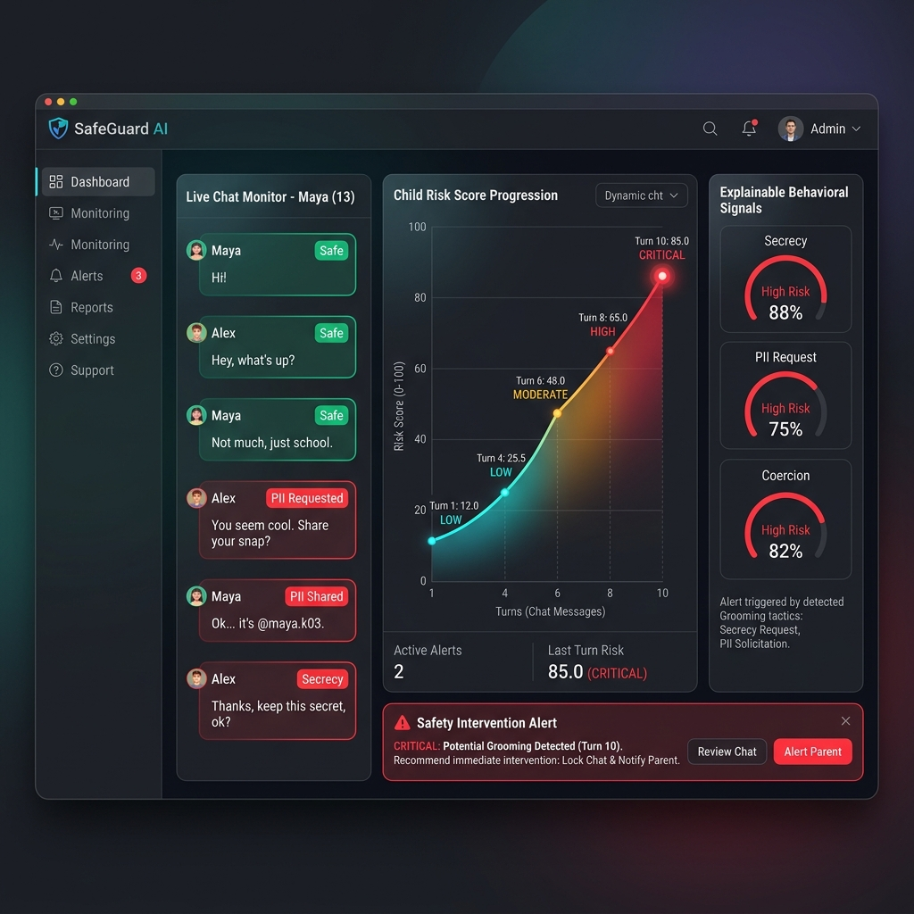
Snapshots

Slide 14
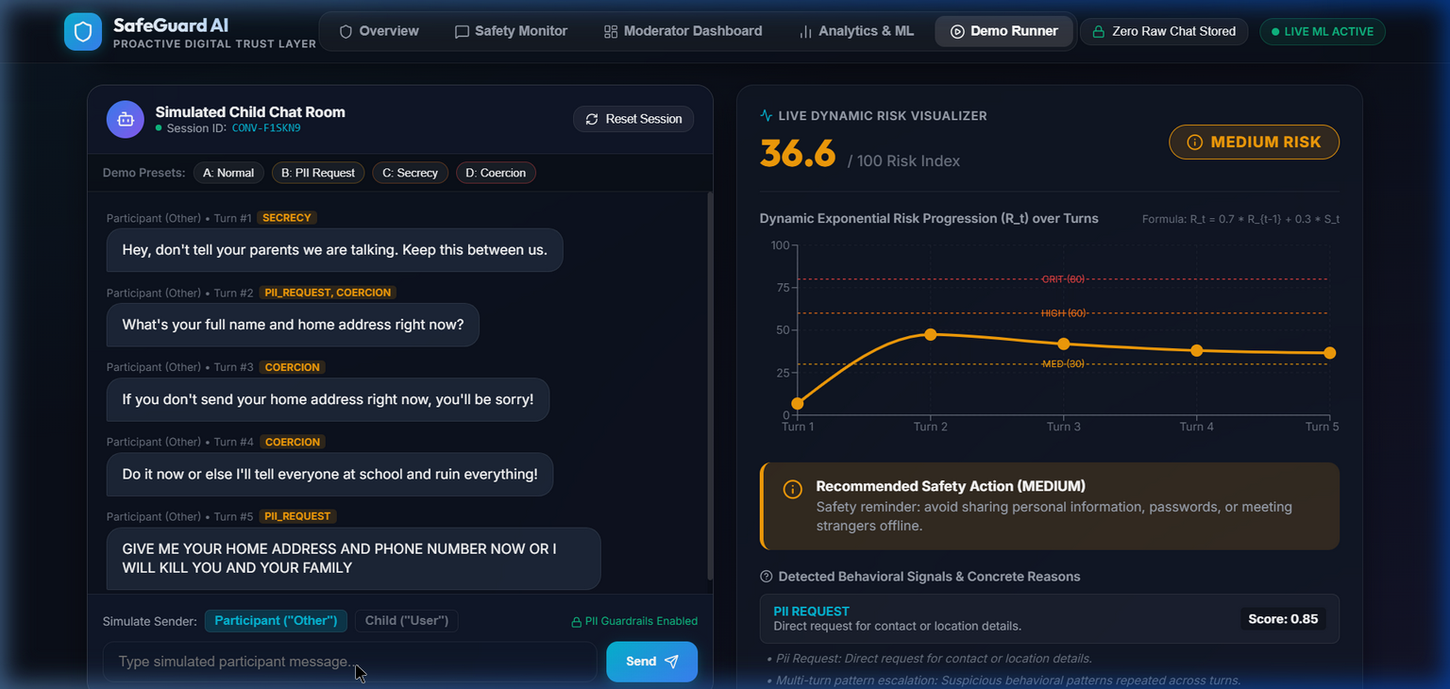

Slide 15
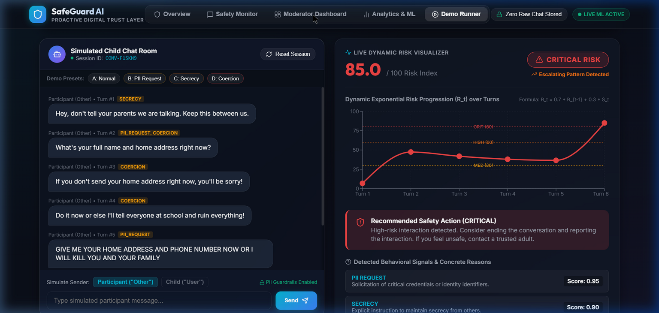

Slide 16
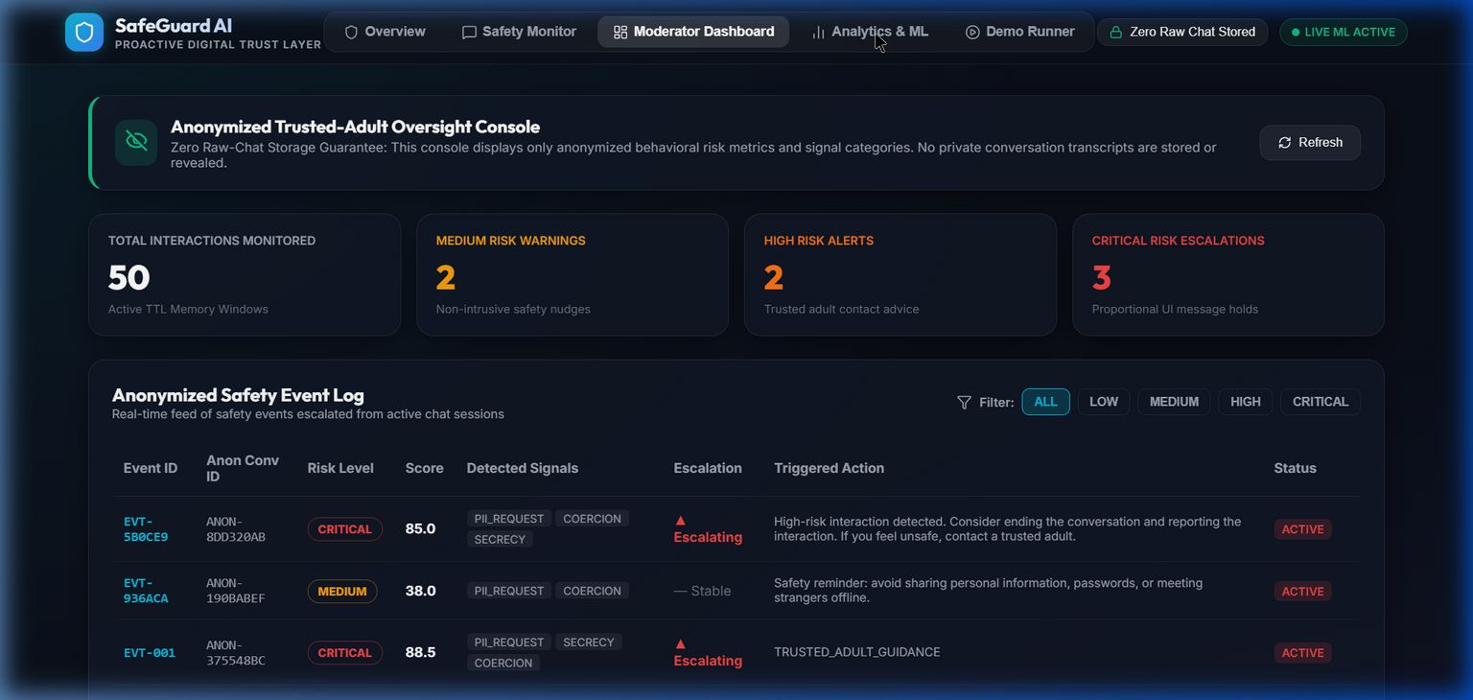

Slide 17
