Slide 1
Sales & Financial Dashboard Summary
Task 4 - Interactive Dashboard
Power BI Project

Slide 2
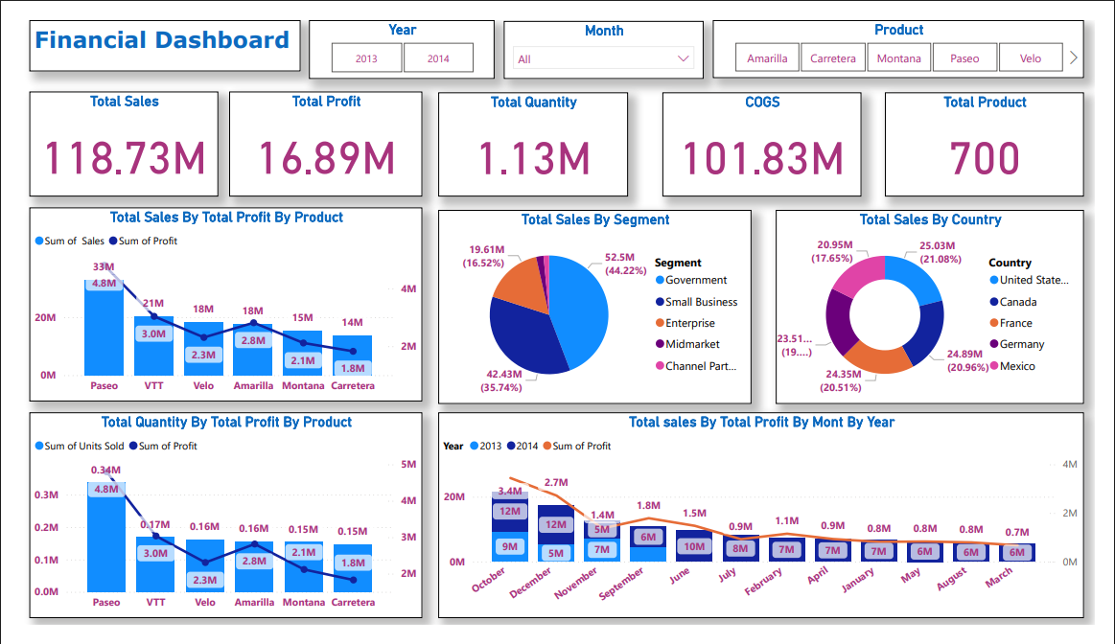
Dashboard

Slide 3
Key Performance Indicators (KPIs)
Total Sales: 118.73M
Total Profit: 16.89M
Total Quantity Sold: 1.13M
COGS: 101.83M
Total Products: 700

Slide 4
Dashboard Objectives
Provide business insights using key Sales KPIs
Enable interactive filtering using slicers
Analyze time-based performance trends
Compare product, segment & region performance
Support decision-making with visual storytelling

Slide 5
Dashboard Visual Insights
Product-wise Sales & Profit analysis
Segment contribution to total sales
Country-wise revenue performance
Monthly trend visualization across years
Card visuals for summary insights

Slide 6
Benefits to Business Stakeholders
Fast & interactive decision-making
Trend & growth monitoring
Identify top performing segments
Understand demand distribution globally
Improved product & market strategies

