Slide 1

Sprocket Central Pty Ltd
Data analytics approach
Nivetha S

Slide 2
Agenda
Introduction
Data Exploration
Model Development
Interpretation

Slide 3
Introduction
Identify and Recommend Top 1000 Customers Through Data Analysis
Problem Statement:
Sprocket Central is a company that specializes in high-quality bikes.
Their marketing team is looking to boost business by analyzing their existing customer dataset.
To recommend Top 1000 new customers to be targeted to drive the most value for the organization.
Contents:
RFM Model development – Customer Segmentation.
Getting insights from the model
Obtaining top 1000 customers from RFM scores.

Slide 4
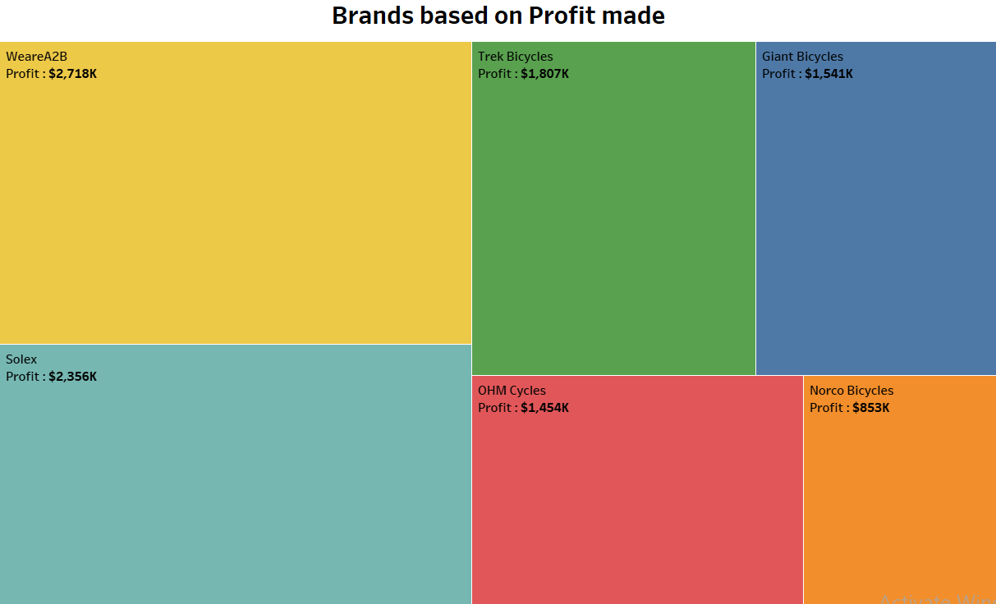
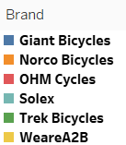
Data Exploration
Profits made by each Brand
We can see the brand “WeareA2B” has made the maximum profit.
Followed by Solex , Trek Bicycles , Giant Bicycles , OHM Cycles obtaining the next 4 places respectively.
Lastly , Norco Bicycles has the least profit made among all.
This helps understand the most loved brand among the customers.
Place any supporting images, graphs, data or extra text here.

Slide 5
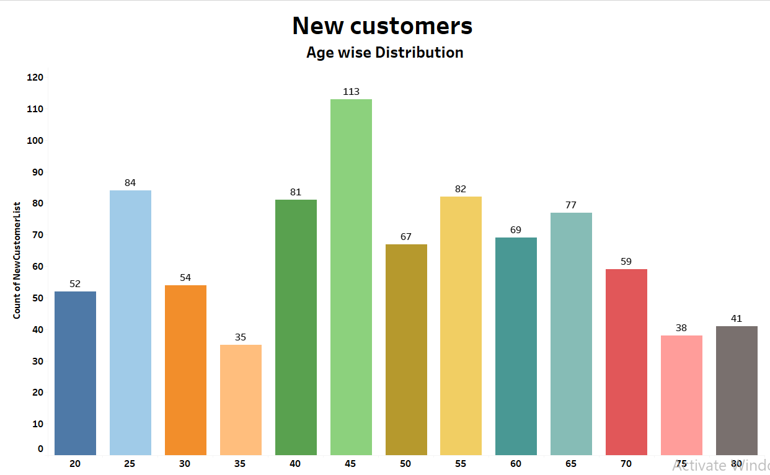
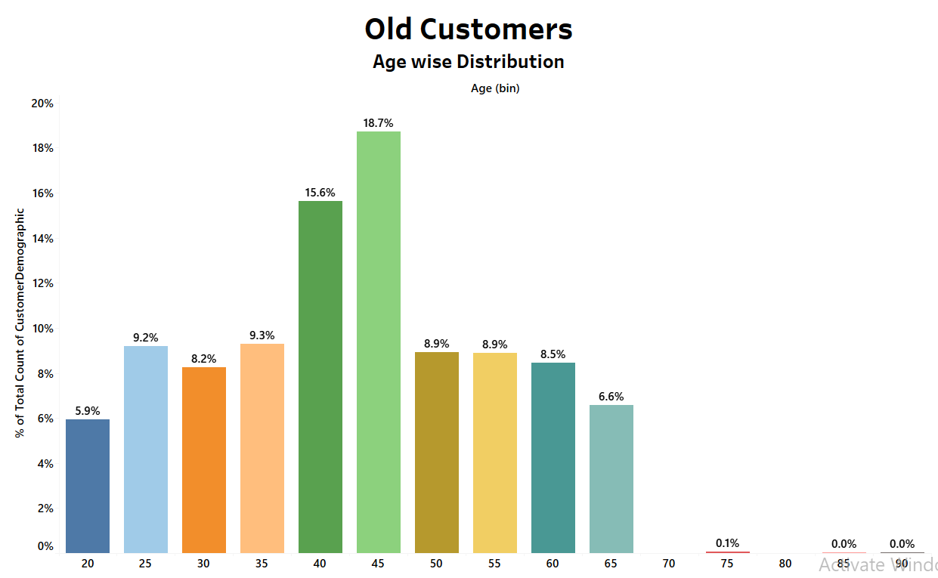

Data Exploration
Age Distribution of Customers :
Highest no.of customers are around the age group 45 – 49 in both “new” and “old”.
New customers age starts from 20 to 80 whereas old customers are only around 20-65 ages.
In new customers , the customers around 25 - 29 and 40 – 69 age group are more.

Slide 6
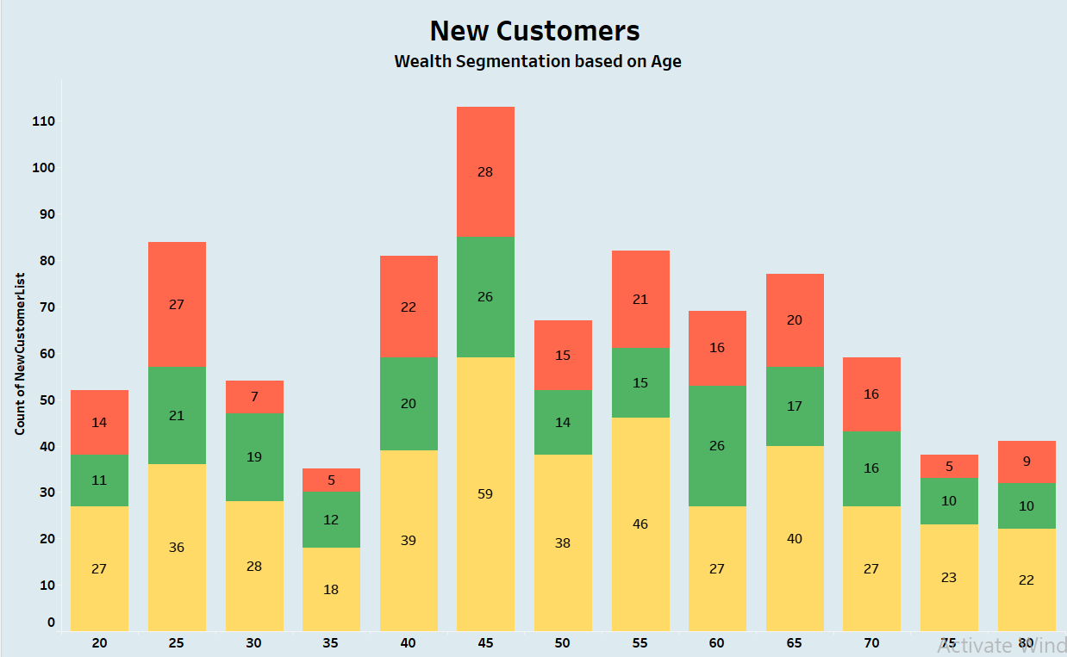

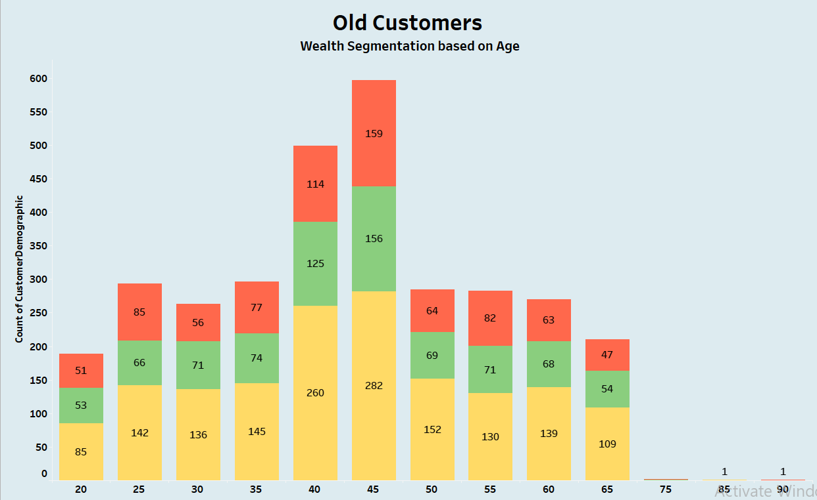
Data Exploration
Wealth Segmentation Based on Age of Customers “New” and “Old”
Customers from “Mass Customers” is comparatively more in all the age categories from other two.
Secondly , “High Net Worth” customers are more.
“Affluent Customer” are more in some age categories than “High Net Worth” customers like 25 – 29 , 45 – 49.

Slide 7
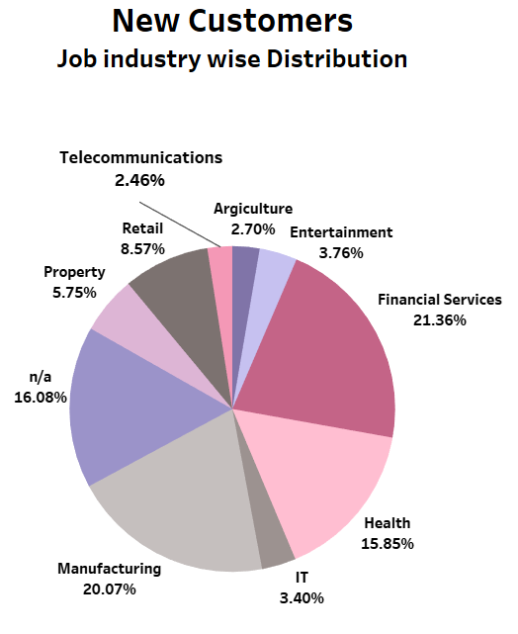
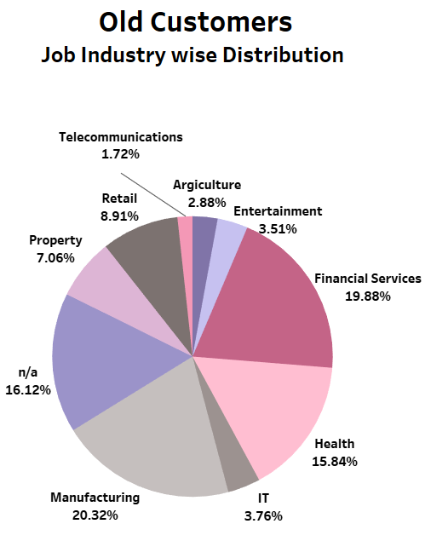
Data Exploration
Job Industry wise Distribution of Old and New Customers
20% and 21% of New customers are from “Manufacturing” and “Financial Services” field respectively.
Similarly , 20% and 19% of Old customers are from “Manufacturing” and “Financial Services” respectively.
Customers from “Agriculture” and “Telecommunications” are the least.

Slide 8
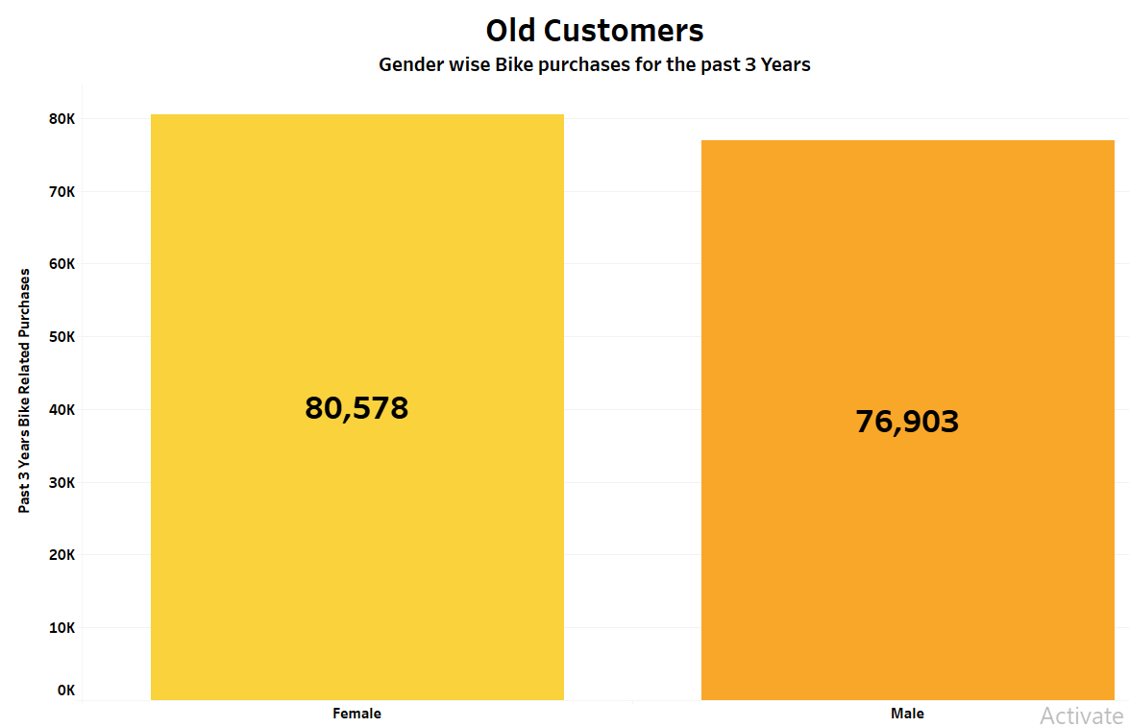

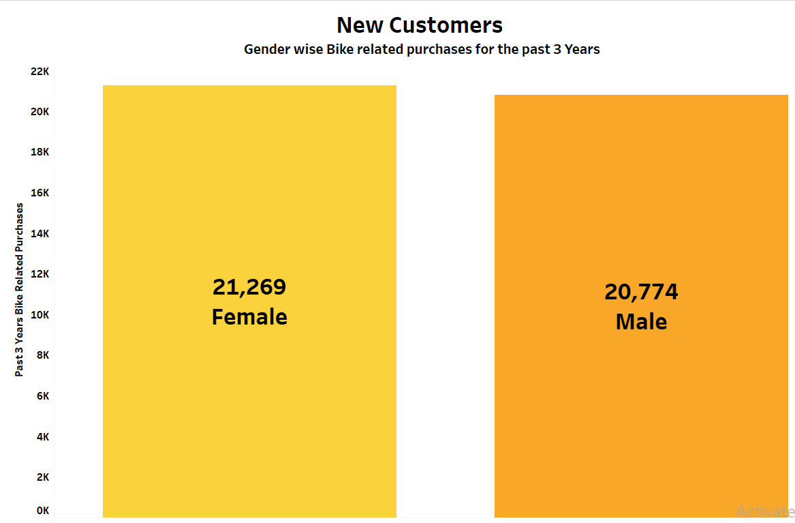
Data Exploration
Bike purchase history of customers for the past 3 years by “Gender”
Females has made the most purchases in the past three years.
A total purchase for 80k+ has been made by “Old” Female Customers and 76K+ by “Old” Male Customers .
In “New” , Female customers made purchase for 21K+ and Males for 20K+.

Slide 9
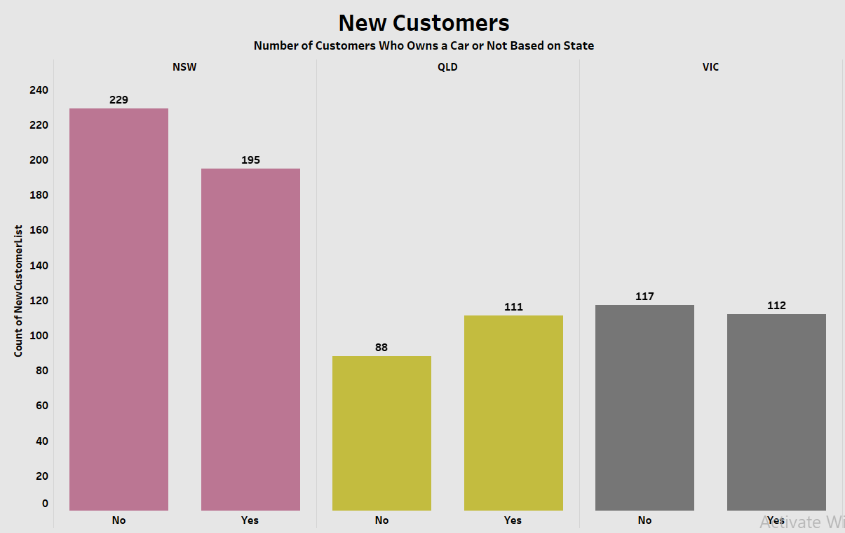
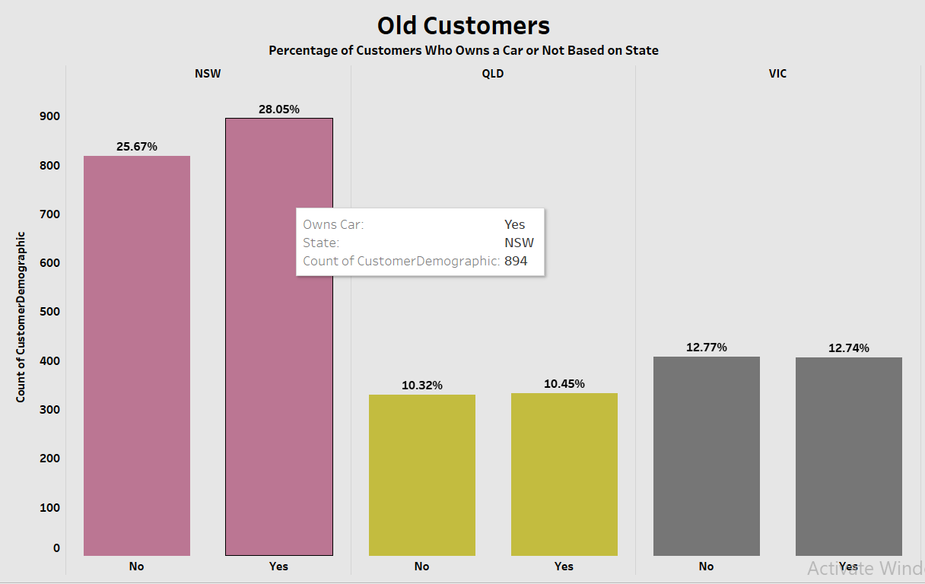
Data Exploration
Customers who owns a Car by State
In “New”, 195 and 229 Customers from “New South Whales” has owned a car and doesn’t own a car respectively.
Whereas in “Old” 28% of customers owns a car and 25% doesn’t in NSW.
QLD and VIC has almost same amount of customers in both “Old” and “New” that owns a car or not.

Slide 10
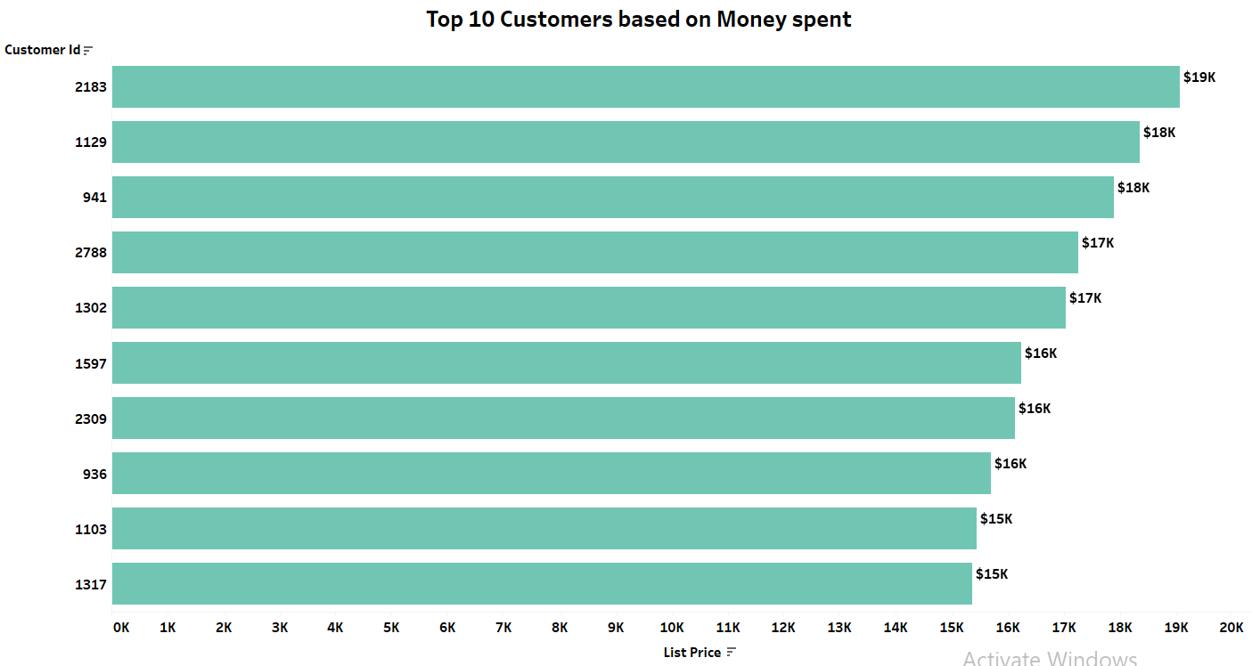
Data Exploration
Top 10 Customers who spent more Money
The Customer with ID “2183” has spent more amount that is “ $19K “ and obtains the 1st place.
The amount spent by the top 10 Customers ranges from $19k to $15K.
Place any supporting images, graphs, data or extra text here.

Slide 11
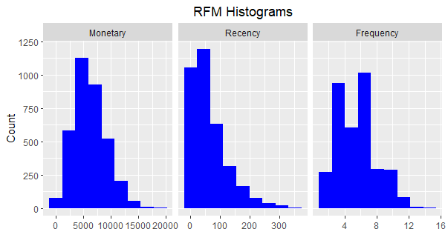
Model Development
Customer Segmentation using RFM Analysis
RFM (recency, frequency, monetary value) analysis is a marketing method used to identify the best clients based on their spending habits.
RFM helps predict which customers are likely to repurchase a company’s products and estimate its revenue from regular and new consumers.

Slide 12
Model Development
Customer Segment Titles with definition and Scores
Segment Titles | Definition | Recency | Frequency | Monetary
Champions | Recently bought , frequent purchases , most spent. | 4 - 5 | 4 - 5 | 4 - 5
Loyal Customers | Recently bought , frequent purchases , most spent. | 3 - 5 | 3 - 5 | 3 - 5
Potential Loyalist | Recently bought ,made some purchases, spent low. | 3 - 5 | 2 - 5 | 1 - 3
Recent Customers | Recently bought , buys not very often , averagely spent. | 3 - 5 | 1 - 2 | 1 - 2
Promising | Relatively recently ,bought more than once , most spent. | 3 - 5 | 1 - 2 | 1 - 5
Need Attention | Bought long back, frequent purchases , most spent. | 2 - 3 | 2 - 3 | 2 - 3
About To Sleep | Bought long back , made few purchases , averagely spent. | 2 - 3 | 1 - 3 | 1 - 3
At Risk | Purchased long back, frequent purchases , most spent. | 1 - 2 | 2 - 5 | 2 - 5
Can't Lose Them | Purchased long back, frequent purchases , most spent. | 1 - 2 | 1 - 5 | 3 - 5
Hibernating | Purchased long back, few purchases , averagely spent. | 1 - 2 | 1 - 2 | 1 - 2
Lost | Purchased very long back , less purchases , spent very less. | 1 - 1 | 1 - 3 | 1 - 1

Slide 13
Model Development
Customer count on each Segment Titles:
Segment Titles | Definition | No.of Customers
Champions | Recently bought , frequent purchases , most spent. | 532
Loyal Customers | Recently bought , frequent purchases , most spent. | 607
Potential Loyalist | Recently bought ,made some purchases, spent low. | 377
Recent Customers | Recently bought , buys not very often , averagely spent. | 441
Promising | Relatively recently ,bought more than once , most spent. | 143
Need Attention | Bought long back, frequent purchases , most spent. | 163
About To Sleep | Bought long back , made few purchases , averagely spent. | 262
At Risk | Purchased long back, frequent purchases , most spent. | 532
Can't Lose Them | Purchased long back, frequent purchases , most spent. | 53
Hibernating | Purchased long back, few purchases , averagely spent. | 378
Lost | Purchased very long back , less purchases , spent very less. | 4

Slide 14
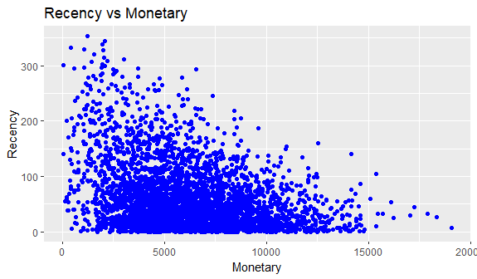
Model Development
Scatter Plot - RFM Analysis
The visuals show that the customers who visited recently contributed to more revenue.
The customers who purchased 50 – 150 days ago are also responsible for more income at an average rate.
The customers purchased very long back (almost 300 days ago) have contributed less income.

Slide 15
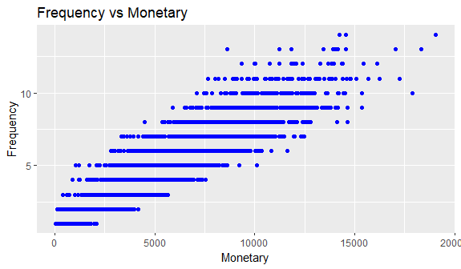
Model Development
Scatter Plot - RFM Analysis
The customers who purchased more than 5 times has higher monetary value.
The customers under “Loyal” , ”Champions” segments are the ones greatly contributed towards income.
There is a positive relationship between Frequency and Monetary values which helps in business gain.

Slide 16
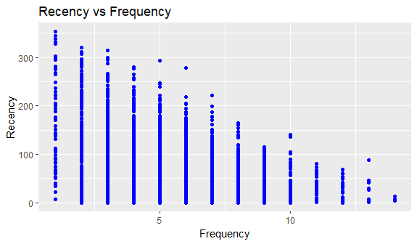
Model Development
Scatter Plot - RFM Analysis
The customers who bought more recently (0 - 10 days) also made frequent purchases (10+) .
Less frequent purchases are associated with higher recency values (more than 250 days).
Therefore very recent customers are also frequent buyers.

Slide 17
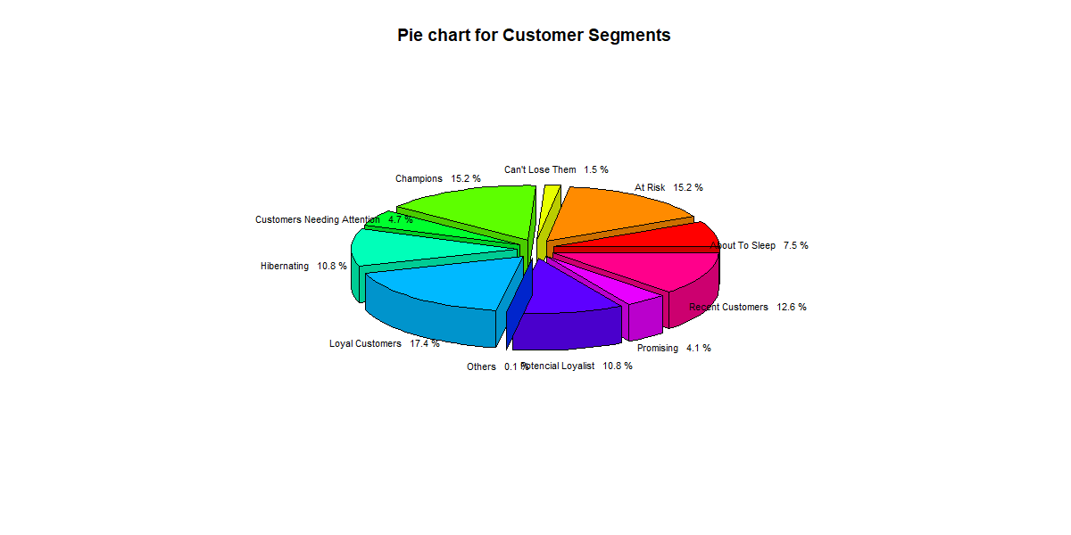
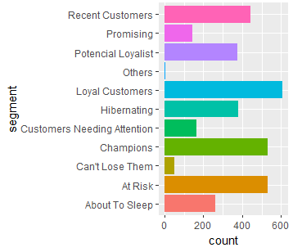
Model Development
Segment Titles Based on RFM Score:

Slide 18
Interpretation
Top 1000 Customers to target
Segment Titles | Definition | No.of Customers | Customer Selection
Champions | Recently bought , frequent purchases , most spent. | 532 | 532
Loyal Customers | Recently bought , frequent purchases , most spent. | 607 | 468
Top 1000 customers are filtered under three conditions,
1. Customers who made recent purchase
2. Customers who bought frequently
3. Customers who spent more.
The Customers satisfying all the above conditions are considered to be the “Top 1000 Customers”.

Slide 19
Appendix

