Slide 1
Digital Portfolio
STUDENT NAME: NIVETHA V
REGISTER NO AND NMID: autunm1455unm1455bca6660921
DEPARTMENT: BCA(Computer application)
COLLEGE: COLLEGE/ UNIVERSITY:Tagore college of arts and
Science, Chrompet-44 (University of Madras

Slide 2
PROJECT TITLE
Nivetha portfolio

Slide 3


AGENDA
Problem Statement
Project Overview
End Users
Tools and Technologies
Portfolio design and Layout
Features and Functionality
Results and Screenshots
Conclusion
Github Link
3/21/2024 Annual Review

Slide 4

PROBLEM STATEMENT
In today's digital world, showcasing skills and achievements online is crucial for personal branding and career opportunities. Many beginners and professionals lack a dedicated platform to present their work, skills, and contact information in an organized and visually appealing way.

Slide 5

PROJECT OVERVIEW
This project is a personal portfolio website designed and developed for Nivetha. The website serves as an online resume and professional showcase, highlighting her skills, experience, and projects. It provides an interactive and user-friendly interface where visitors can learn about her, view her work, and connect with her easily.

Slide 6

WHO ARE THE END USERS?
Recruiters looking for skilled developers Potential clients seeking freelance developers Peers and collaborators in the tech community General visitors interested in Nivetha's work

Slide 7

TOOLS AND TECHNIQUES
HTML5 For website structure CSS3 For styling and layout JavaScript For interactivity Responsive Design - Ensures mobile-friendliness

Slide 8
POTFOLIO DESIGN AND LAYOUT
Homepage Introduction with name, role, and CTA button About Section - Profile photo, short bio, skills, and frameworks Contact Section Form to connect via email
8

Slide 9
FEATURES AND FUNCTIONALITY
Responsive design compatible with mobile and desktop devices Smooth navigation with a clear menu "View My Work" button to showcase projects Contact form for direct communication Professional layout with personal branding

Slide 10

RESULTS AND SCREENSHOTS
The portfolio is successfully hosted and accessible online. It displays professional information in a simple, elegant, and user-friendly manner. (Screenshots already attached above)
3/21/2024 Annual Review
10

Slide 11
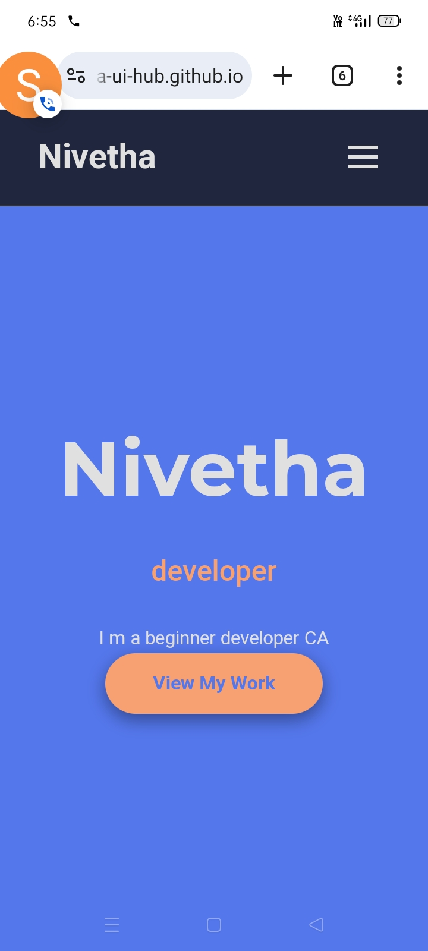

Slide 12
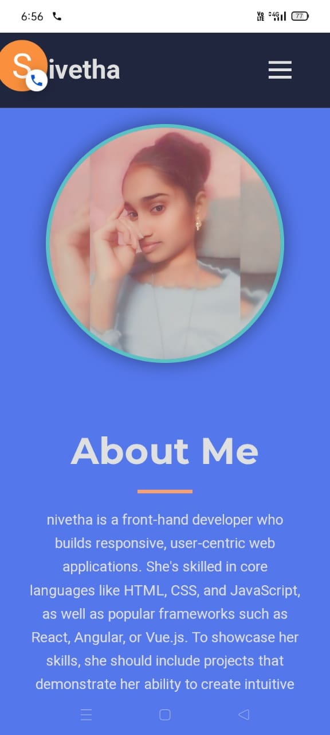

Slide 13
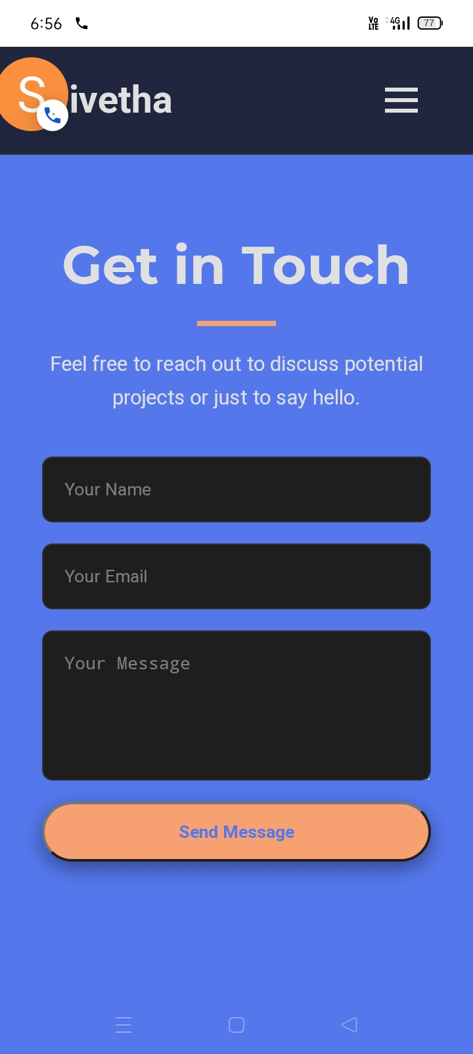

Slide 14
CONCLUSION
The portfolio website effectively showcases Nivetha's skills and personal brand. It enhances her digital presence, improves networking opportunities, and serves as a professional gateway for recruiters and collaborators.
11

