Slide 1
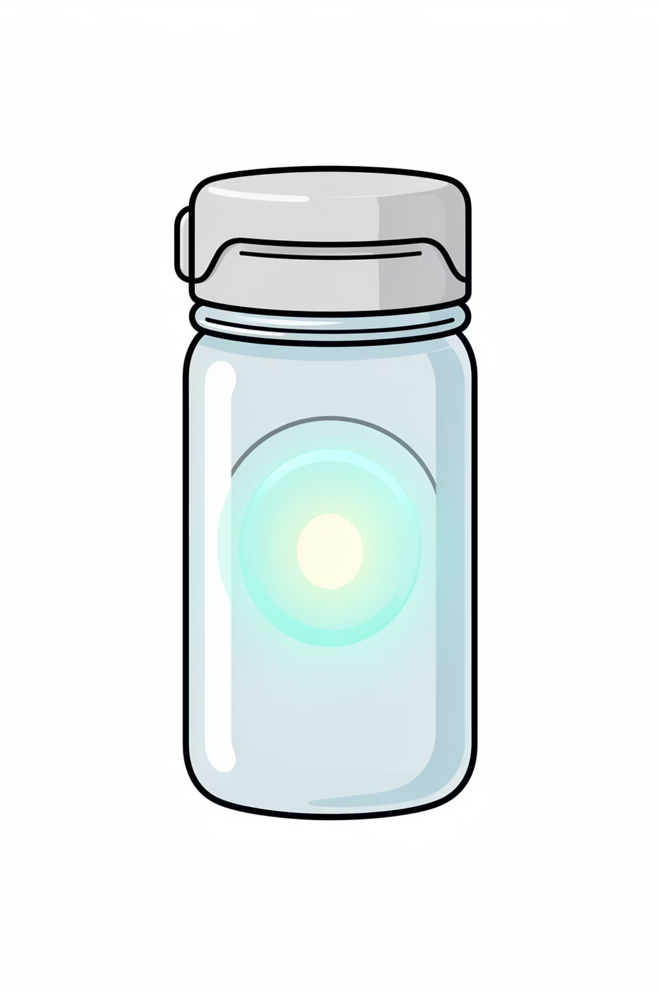
TITLE:- IoT-ENABLED SMART PILL BOTTLE FOR MEDICINE
REORDERING
BY:-
NAME | USN
G ABHIRAM | 1CR25EC073
G ABHISHEK | 1CR25EC074
G NIVETHASREE | 1CR25EC075

Slide 2
Introduction
Medication adherence is a critical challenge in healthcare systems worldwide.
Elderly patients and individuals with chronic illnesses require continuous and long-term medication.
Forgetting to monitor the remaining quantity of medicines may result in missed doses and delayed refills.
Manual checking of medicine stock is unreliable and depends heavily on user attention.
Delayed medicine intake can lead to serious health complications.
Recent advancements in Internet of Things (IoT) and embedded systems enable automation in healthcare monitoring.
Automated monitoring improves accuracy, reliability, and efficiency of medication management.
This project proposes a Smart Pill Bottle that automatically monitors pill quantity.
The system assists users by providing timely information for medicine reordering.

Slide 3
Problem Statement
Manual checking is unreliable
Reordering delays cause health issues
Manual checking of remaining medicines is unreliable and error-prone.
Delay in reordering medicines can cause serious health issues.
Existing systems are costly
Need for an affordable solution
Existing smart pill management systems are costly and complex.
There is a need for a simple, affordable, and automated solution to monitor pill quantity.

Slide 4
Literature Review
Existing smart pill boxes primarily use alarms, buzzers, or reminder mechanisms to improve medication adherence.
Mobile-based medication applications mainly focus on dose timing notifications and schedule management.
Several IoT-based healthcare systems utilize cloud platforms to enable remote patient monitoring and data storage.
Some advanced solutions integrate wearable devices and mobile applications for health data tracking.
Most existing systems depend on user interaction and do not provide automatic monitoring of medicine quantity.
Real-time pill quantity measurement is not addressed in most current solutions.
Lack of pill-level sensing limits the ability to predict refill requirements accurately.
High cost and complexity of existing systems restrict their adoption in common household environments.
Therefore, existing solutions are not effective in preventing delayed medicine reordering.

Slide 5
Research Gap
Lack of physical pill level monitoring
High cost and complexity
Lack of systems that monitor the physical pill level inside the bottle.
High cost and complexity of existing smart medication systems.
Limited focus on automatic reordering
Need for low-cost sensor-mobile integration
Limited focus on automatic medicine reordering indication.
Need for a low-cost solution combining sensor-based monitoring and mobile application support.

Slide 6
Objectives
01
02
Design for automatic monitoring
Detect pill levels with ultrasonic sensor
To design a smart pill bottle for automatic pill quantity monitoring.
To detect pill levels using an ultrasonic sensor.
03
04
Process data with Arduino
Transmit status wirelessly to mobile app
To process data using an Arduino microcontroller.
To transmit pill status wirelessly to a mobile application.
05
06
Provide timely reordering indication
Develop cost-effective and user-friendly system
To provide timely medicine reordering indication.
To develop a cost-effective and user-friendly system.

Slide 7
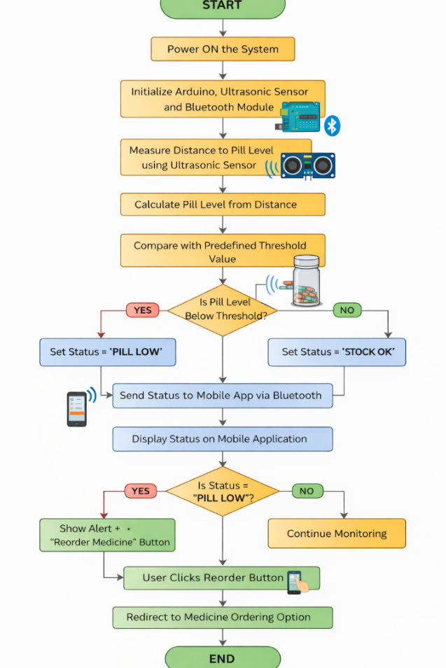
Methodology
Ultrasonic sensor measures the distance to the pill level inside the bottle.
Arduino processes the sensor data and compares it with threshold values.
Pill status is determined as sufficient or low.
Bluetooth (HC-05) transmits the data to the mobile application.
The mobile application displays pill status to the user.
Threshold values are predefined to classify pill levels accurately.

Slide 8
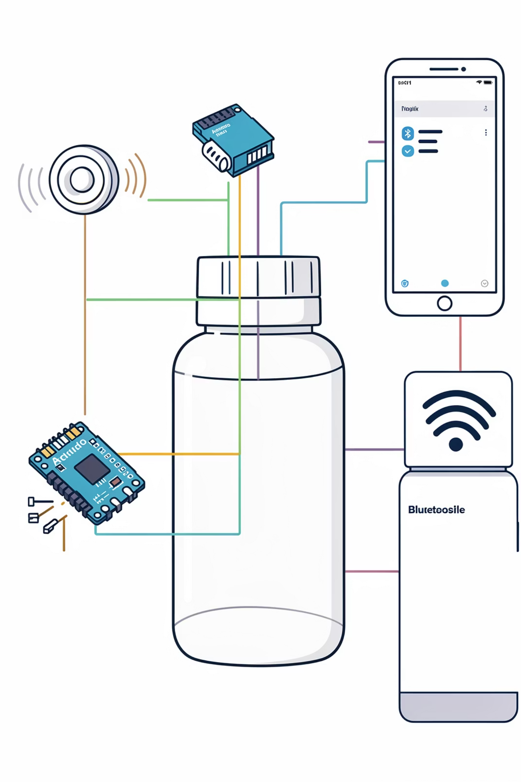
System Architecture
Ultrasonic Sensor – Detects pill level.
Arduino Microcontroller – Processes sensor data.
Bluetooth Module (HC-05) – Enables wireless communication.
Mobile Application – Displays pill status and reorder indication.

Slide 9
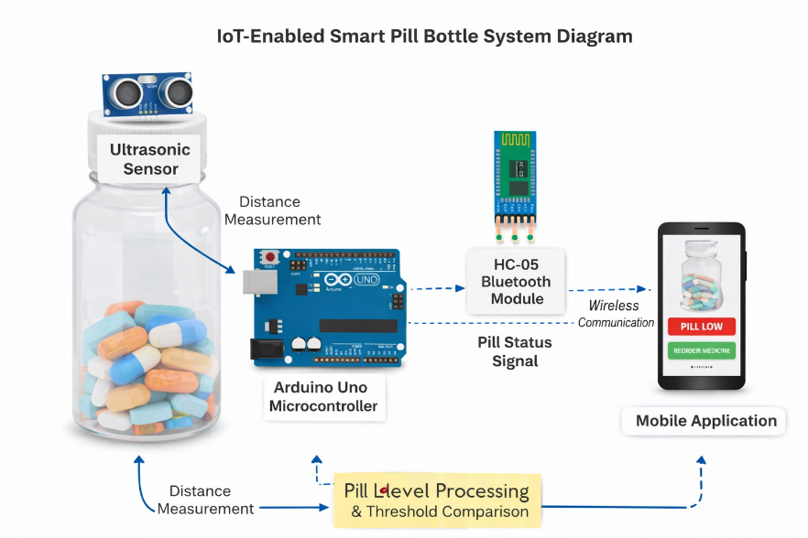
Fig:- System Architecture

Slide 10




Results
Accurate Detection
Successful Transmission
Clear Indication
Reduced Manual Monitoring
Accurate detection of pill quantity under normal operating conditions.
Clear display of pill status and reorder indication.
Successful wireless data transmission to the mobile application.
Reduction in manual medicine monitoring.

Slide 11
Conclusion
The Smart Pill Bottle provides an efficient and automated solution for monitoring medicine quantity.
Integration of hardware and software components ensures reliable and consistent system operation.
The system reduces dependency on manual checking of medicine levels.
Timely indication of low medicine levels helps prevent missed doses and delayed reordering.
The solution is affordable, user-friendly, and suitable for home healthcare applications.
The prototype demonstrates stable performance under normal operating conditions.
The project highlights the practical application of Internet of Things (IoT) in healthcare management.
The system has potential for further enhancement and real-world deployment.

Slide 12
THANK YOU

