Slide 1
Data mining

Slide 2
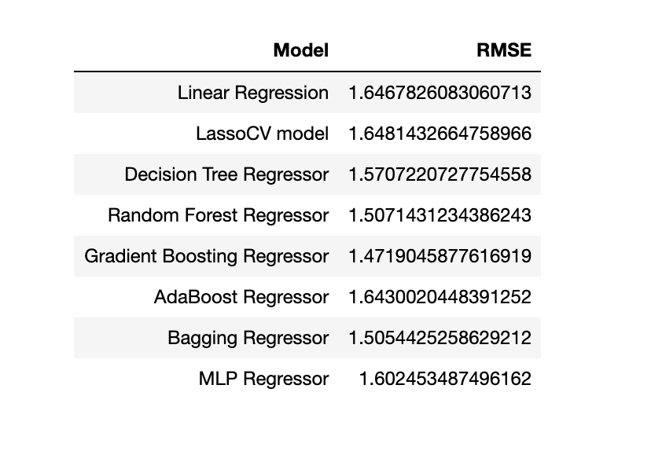
The Models and their associated RMSE values for the Wine dataset is summarized below:

Slide 3
Model Selection & Justification
The Bagging Regressor & MLP Regressor seem to have the lowest RMSE for the validation set.
They have a low implementation cost as compared to other models and can thus be used as a predictive algorithm to determine Wine sales

Slide 4
Conclusion:
Analysis of the data reveals that the chemical predictor variables do not add sufficient predictive power above the STARS ratings and Label Appeal measurement.
It is evident from this dataset that wine sales are largely dependent on the ratings of wine experts and how much customers are appealed by the Label.
Dataset has been analyzed using PCA and grouped into 4 distinct cluster. Any future prediction of a test data can classify the TARGET sales into one of these clusters.

