Slide 1
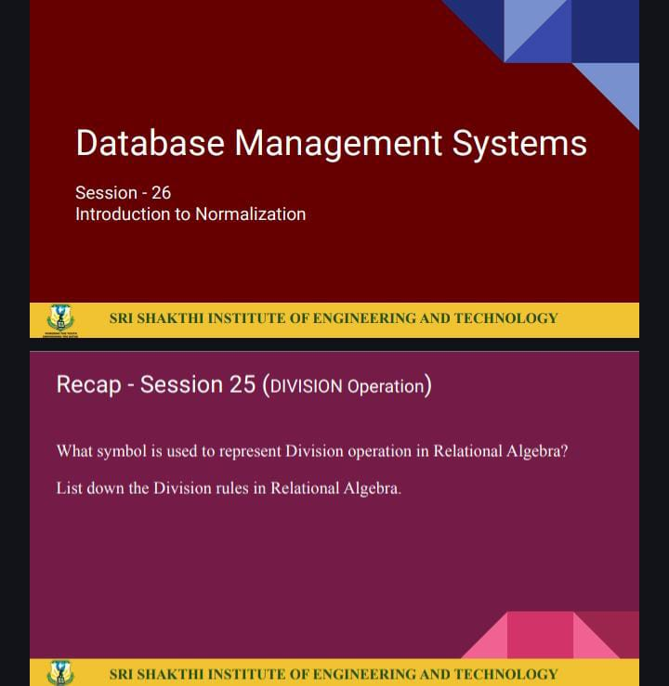
IV BAG MONITERING & ALERTING SYSTEM
Team Number: 10
MOHITHRA S | 714023149061
NIVETHIKA S | 714023149072
PRATHISHA R | 714023149082
SHAKTHI S | 714023149102
MENTOR NAME : Mr.Yaswanthraj ( Assistant Professor)

Slide 2
DOMAIN
Internet of things(IOT)
Problem Statement
Manual IV fluid level monitoring in hospitals is time-consuming and error-prone, often leading to delayed response and potential harm. An automated IV bag monitoring and alerting system is needed to ensure timely refills and prevent complications.

Slide 3
OBJECTIVE
To monitor the real-time flow rate of glucose from the IV bag using appropriate sensors (e.g., flow sensor or weight sensor).
To detect and alert when the IV bag is nearly empty or if the glucose flow stops unexpectedly.
To transmit the glucose flow data wirelessly to a central dashboard for visualization and analysis.
To provide timely alerts to medical staff through the dashboard or connected devices (e.g., mobile, buzzer).
To enhance patient safety by minimizing human error in manual IV monitoring through automation.

Slide 4
LITERATURE SURVEY
Traditional IV fluid monitoring is performed manually by healthcare staff, which can lead to delay
identifying empty IV bags or irregular flow, especially in busy hospitals.
Sensor-Based IV Monitoring Systems:
Recent research highlights the use of sensors such as weight sensors, flow sensors, and capacitive sensors to automate IV bag monitoring. These systems can detect the flow rate and remaining fluid volume, reducing the workload of healthcare providers and increasing accuracy.
Alert Mechanisms:
Various projects and research papers propose the use of buzzers, LED indicators, and mobile app notifications for alerting medical staff. Such mechanisms help ensure timely refills or interventions, reducing the risk of air embolism and other complications due to empty IV bags.
Data Visualization and Dashboards:
Dashboards provide a graphical interface to monitor the glucose flow level in real-time. They enable quick decision-making and long-term data tracking for better patient care and treatment optimization.

Slide 5
PROPOSED METHODOLOGY
1. Data Collection
Sensor Input: The system collects real-time data from sensors,
including:
1.IV fluid flow rate
2.Remaining volume in the IV bag
3. Flow interruption detection
2.Data processing & Microcontroller unit
1.Interprets flow and volume levels
2.Compares against critical thresholds
3.Controls alert mechanisms
3.Alert & Notification System
1.LED indicators
2. Dashboard warnings for nurses

Slide 6
PROPOSED METHODOLOGY
4. Dashboard Visualization:
1.Fluid flow rate
2.Current IV level
3.Alert status and logs
5. Testing
1.Sensor calibration for accurate measurements
2.Real-time simulation and response validation
3.System accuracy testing under varied conditions

Slide 7
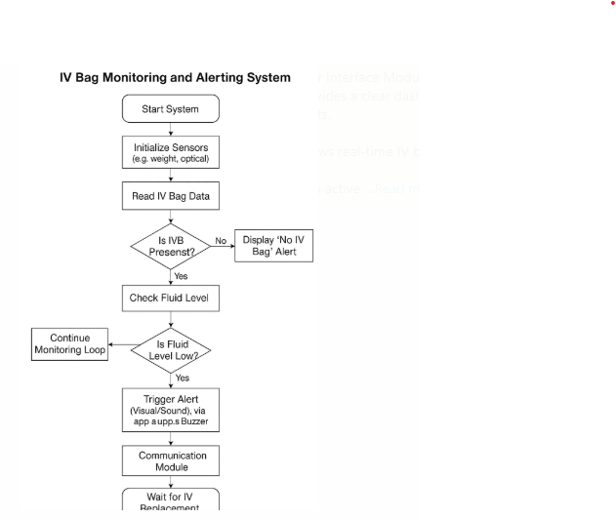
PROCESS FLOW DIAGRAM

Slide 8
REQUIREMENTS
Technical Requirements
Front-End:
HTML, CSS, and JavaScript for displaying IV status, alerts, and logs to users (nurses, staff).
Back-End:
Python with Flask or Node.js to process sensor data and manage alert logic.
Database
Firebase or MongoDB to store sensor readings, alert logs, and user activity data.
Hardware Requirements
Weight sensor or load cell for fluid level detection
Microcontroller (e.g., Arduino, ESP32, Raspberry Pi)

Slide 9
MODULES
Sensor Interface:
Initializes and calibrates sensors
Continuously reads raw sensor data
Data Processing Module:
Calculates remaining fluid volume
Flags abnormal or low‐level conditions
Alert System Module:
Displays on‐device warnings (LEDs, screen)
Triggers buzzers or alarms
User Interface Module:
Shows real‐time IV bag level and trend graph
Lists active and historical alerts

Slide 10

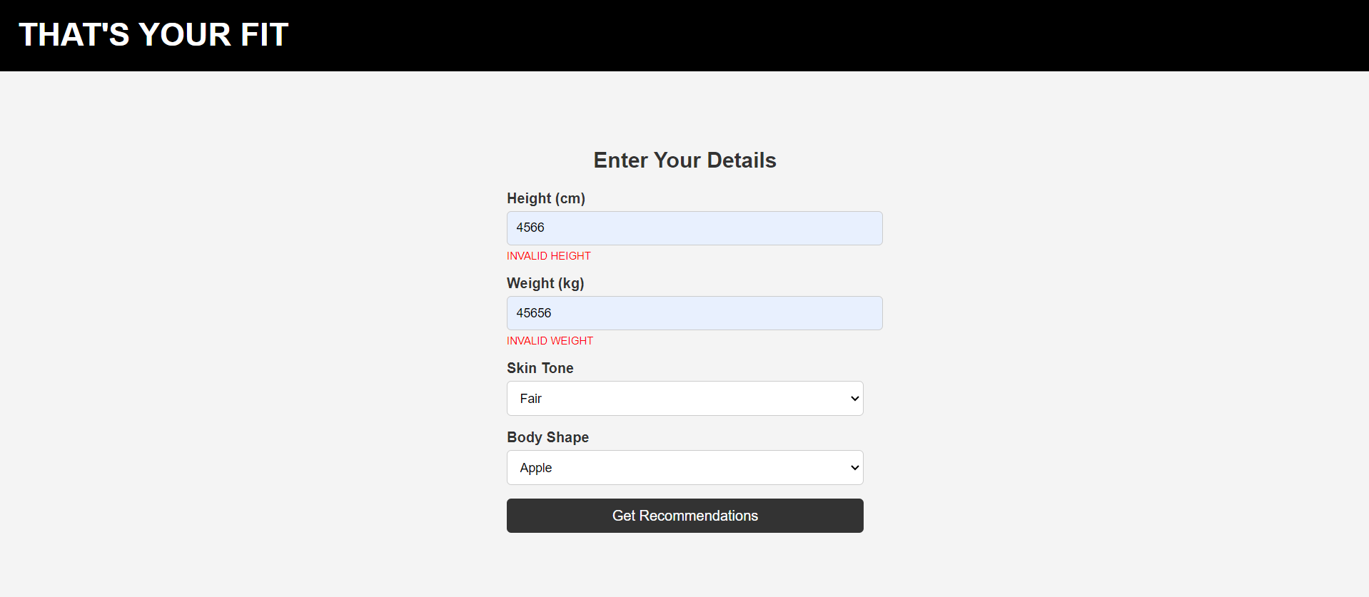

MODULES

Slide 11
REFERANCE
1. Patil, V. A., & Waghmare, R. S. (2022). Automated Intravenous (IV) Drip Monitoring System Using IoT.
International Journal of Innovative Science and Research Technology, 7(3), 145–148.
2. Rashid, M., & Ahsan, K. (2022). Smart IV Drip Monitoring System Using Load Sensor and NodeMCU.
International Journal of Engineering Research and Technology (IJERT), 11(5).
3. Sharma, P., & Verma, R. (2023). Design and Implementation of IV Fluid Monitoring with Automated Alert System.
International Journal of Scientific & Engineering Research (IJSER), 14(2), 132–136.

Slide 12
THANK YOU

