Slide 1

Vel Tech Rangarajan Dr. Sagunthala R&D Institute of Science and Technology
School of Computing
Department of Computer Science and Engineering
Academic Year – 2025-2026 (winter Semester)
10211CS224 / FULL STACK APPLICATION DEVELOPMENT (JAVA)
PROJECT REVIEW :END SEMESTER VIVA VOCE
Date: 06-05-2026
JOB PORTAL MANAGEMENT SYSTEM
SDG No: 8 – Decent Work and Economic Growth
Presented By:
P.NIVETHITHA-VTU24312
REG_NO-23UECS1157
Courses Handling Faculty:
Dr. NATTESHAN. N.V.S
ASSISTANT PROFESSOR SENIOR GRADE

Slide 2
INTRODUCTION
1
In today's fast-paced digital era, job searching and recruitment remain fragmented across multiple unorganized platforms
Job seekers struggle to find relevant opportunities while employers face difficulty discovering and managing suitable candidates efficiently
This creates a critical gap between talent and opportunity in the modern workforce
A centralized, intelligent system is needed to simplify, automate, and modernize the entire hiring process
JobSpark is a full-stack web-based Job Portal Management System that bridges this gap through a single unified platform
The system allows students to register with Email OTP Verification, create profiles, upload resumes, and apply for jobs with cover letters
Employers can post jobs with expiry deadlines, manage applications, view cover letters, download resumes, and shortlist candidates
Automated Email Notifications keep candidates instantly informed when their application status changes
A Chatbot Assistant guides users throughout their job search journey
Overall, JobSpark improves efficiency, transparency, security, and accessibility in the modern recruitment process

Slide 3
PROBLEM STATEMENT
Current job search and recruitment processes are not fully centralized
Job seekers rely on multiple platforms, causing confusion and inefficiency
Employers face difficulty in filtering and managing large numbers of applicants
Manual tracking of applications leads to delays and errors
Lack of real-time updates affects communication between candidates and employers
No proper system to track application status easily
Data management is not efficient or organized
Hence, a need exists for a reliable, automated job portal system
2

Slide 4
OBJECTIVE(S)
3
To design and develop a web-based Job Portal Management System for job seekers and employers
To implement an efficient system for job posting, application tracking, and candidate management

Slide 5
PROPOSED SYSTEM
4
JobSpark is a centralized full-stack web-based Job Portal Management System built using Java Spring Boot and MySQL
Provides a single unified platform for Job Seekers, Employers, and Administrators with role-based secure access control
New users register through a 2-Step Email OTP Verification system ensuring only valid email addresses can create accounts
Students can build complete profiles, upload resume PDFs, bookmark interesting jobs, and apply with personalized cover letters
Employers can post jobs with application deadlines, edit existing listings, view cover letters in popup modals, and download resumes directly
Automated Gmail SMTP Email Notifications are sent instantly to students whenever their application is shortlisted or rejected
A powerful Search Engine with Autocomplete allows students to find jobs by keyword, category, location, and experience level
Role-specific dashboards display real-time Chart.js Analytics showing application stats, job summaries, and platform overview
An intelligent AI Chatbot Assistant is embedded on every page to guide users with job search tips, resume advice, and interview preparation
Admin panel provides complete platform control including user management, delete spam accounts, monitor all jobs and applications with detailed analytics

Slide 6
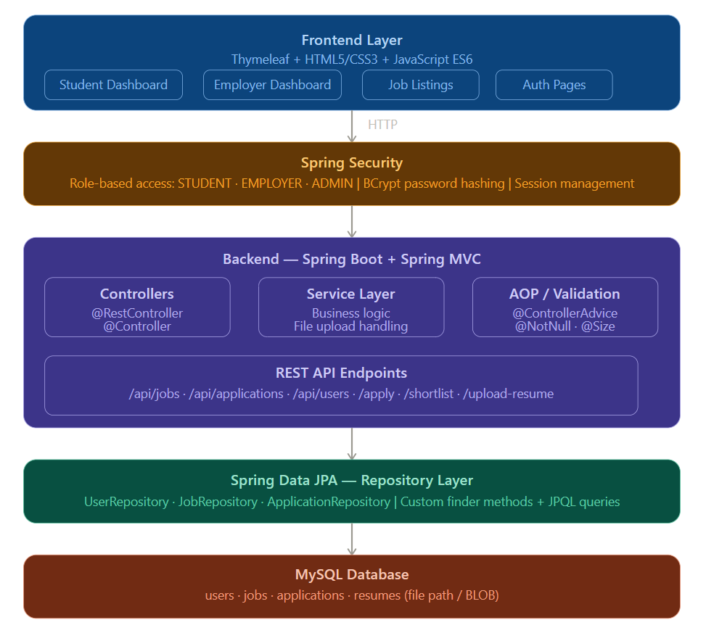
PROPOSED SYSTEM ARCHITECTURE
5
Input
User data (registration, login details)
Job search queries and filters
Resume uploads and job applications
Processing
Request handling using Spring Boot Controllers
Business logic implemented in Service Layer
Validation, authentication, and data processing
Database
MySQL database for storing system data
Tables: User, Job, Application
Efficient data retrieval using Spring Data JPA

Slide 7
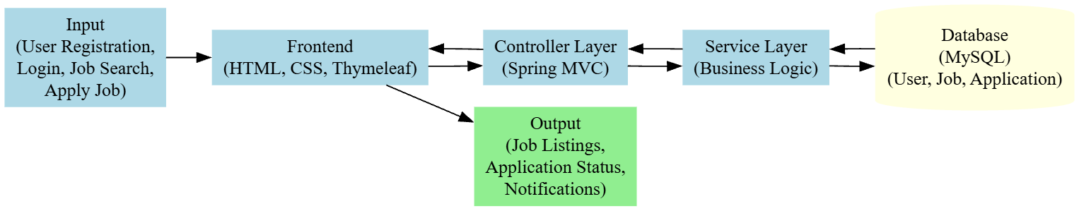
WORKFLOW
6

Slide 8
TECHNOLOGIES USED
7
Frontend:
HTML5, CSS3
Thymeleaf
JavaScript (ES6)
Backend:
Java
Spring Boot
Spring MVC
Spring Security
Database:
MySQL
Spring Data JPA (Hibernate)
Tools:
Eclipse IDE
Spring Initializr
Git (Version Control)
Postman (API Testing)
Hardware/Software Requirements:
OS: Windows/Linux
RAM: Minimum 4GB
JDK 17
MySQL Server
Web Browser (Chrome/Edge)

Slide 9
MODULE DESCRIPTION
Module 1: User Management
Handles user registration, login, and profile management with role-based authentication for Students, Employers, and Admins using Spring Security and BCrypt password hashing.
Module 2: Job Management
Implements core job posting functionality allowing employers to create, edit, and delete job listings with details like title, description, skills required, salary, location, and experience level.
Module 3: Application Processing
Manages the end-to-end job application workflow where students can apply with cover letters, and employers can shortlist or reject candidates with real-time status updates.
Module 4: Resume & File Management
Handles secure resume uploads using Spring MultipartFile, storing files in the local server directory and linking them to student profiles for employer access.

Slide 10
MODULE DESCRIPTION
Module 5: Search & Filter Engine
Provides dynamic job search and filtering by keyword, category, location, and experience level using custom JPQL queries with Spring Data JPA repository methods.
Module 6: Dashboard & Analytics
Generates role-specific dashboards displaying application statistics, job posting summaries, shortlisted candidates count, and activity tracking for Students, Employers, and Admins.
Module 7: Database Management
Manages structured data storage using MySQL with Spring Data JPA entities — User, Job, and Application — with One-to-Many and Many-to-One relational mappings.
Module 8: Security & Access Control
Implements Spring Security filter chains with role-based URL access control, CSRF protection, custom login/logout handling, and session management for all user roles.
Module 9: Exception Handling & Validation
Provides global exception handling using @ControllerAdvice with user-friendly error pages, and input validation using @NotBlank, @Email, and @Size annotations across all forms.

Slide 11
INNOVATIVE MODULE
🔐 Module 1 — Email OTP Verification System
New users receive a 6-digit One Time Password on their registered email during registration ensuring only genuine users can create accounts. OTP expires automatically after 5 minutes for security. Built using Spring Mail, OtpService with ConcurrentHashMap storage, and beautiful HTML email templates.
📧 Module 2 — Automated Email Notification System
When an employer changes a student's application status to Shortlisted or Rejected, a beautifully designed HTML email is automatically sent to the student's inbox using Gmail SMTP and Spring @Async so the page never freezes during email delivery.
🤖 Module 3 — AI Chatbot Assistant
An intelligent JavaScript-powered Chatbot embedded on every page of the portal. It understands natural language queries and responds with guidance on job searching, resume tips, interview preparation, cover letter writing, application tracking, and platform navigation. Features quick reply buttons and keyboard navigation.

Slide 12
INNOVATIVE MODULE
🔍 Module 4 — Smart Search Autocomplete
A real-time search autocomplete engine built with JavaScript ES6 that suggests matching job titles and skills as the user types in the search bar. Supports keyboard navigation with Arrow keys and auto-submits on selection. Contains 60+ predefined suggestions across IT, Finance, Marketing, Design, Healthcare, and Management domains.
🔖 Module 5 — Job Bookmark System
Students can save or bookmark any job they are interested in with a single click and view all saved jobs in a dedicated Saved Jobs page. The toggle system automatically saves or unsaves the job using a dedicated SavedJob entity with Spring Data JPA.
⏰ Module 6 — Job Expiry Date System
Employers set an application deadline when posting jobs. After the deadline passes, the job automatically shows an Expired badge, disables the Apply button, and shows an Applications Closed message — preventing students from applying to outdated listings.

Slide 13
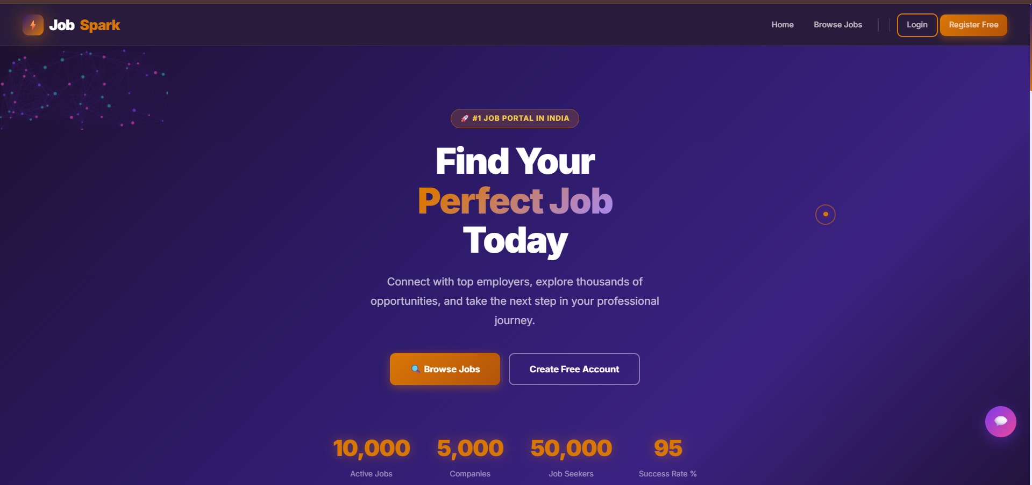
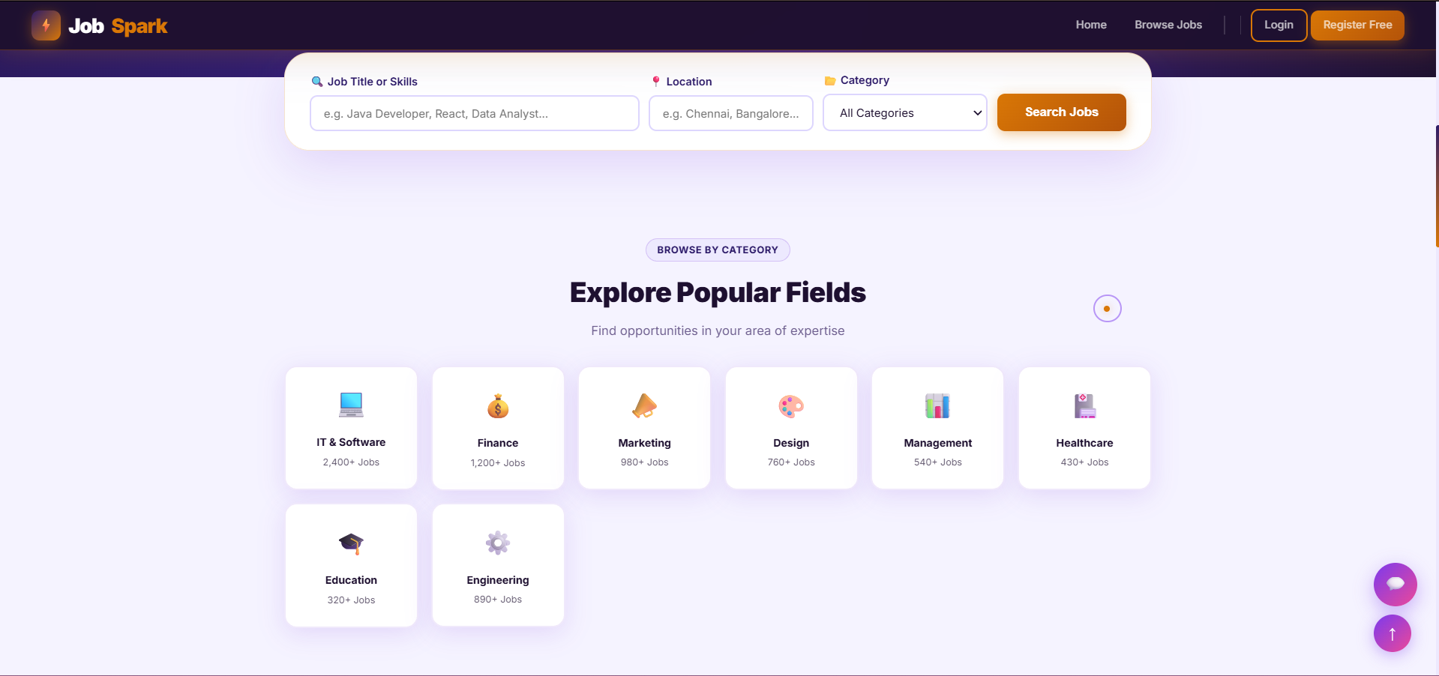
IMPLEMENTATION SCREENSHOTS
8
The Home Page welcomes users with a stunning Midnight Purple + Gold themed hero section featuring particle animations, typewriter effect, and job search bar. .
It showcases category cards, latest job listings with applicant count badges, and a glassmorphism design with smooth scroll animations throughout.

Slide 14
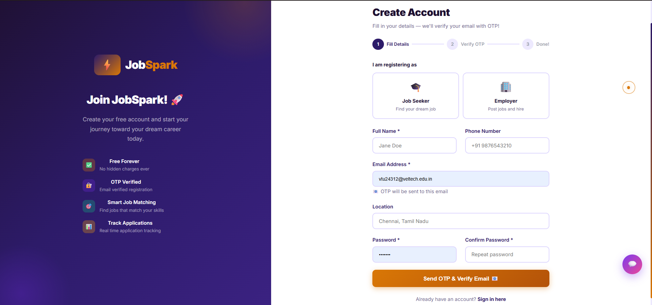
IMPLEMENTATION SCREENSHOTS
8(A)
The Registration Page allows new users to select their role as Job Seeker or Employer with interactive role selection cards and real-time skills preview.
A 2-Step Email OTP Verification system sends a 6-digit code to the user's email — the OTP page features individual digit input boxes with auto-focus, paste support, and a live 5-minute countdown timer.

Slide 15
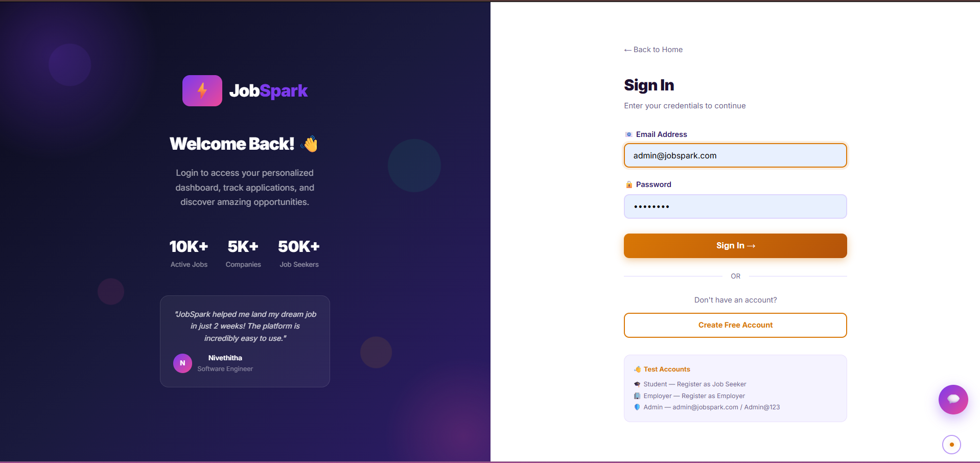
IMPLEMENTATION SCREENSHOTS
8(B)
The Login Page allows registered users to securely sign in using their verified email and password with Spring Security authentication. It supports role-based automatic redirection where Students, Employers, and Admins are instantly directed to their respective dashboards after successful login.

Slide 16
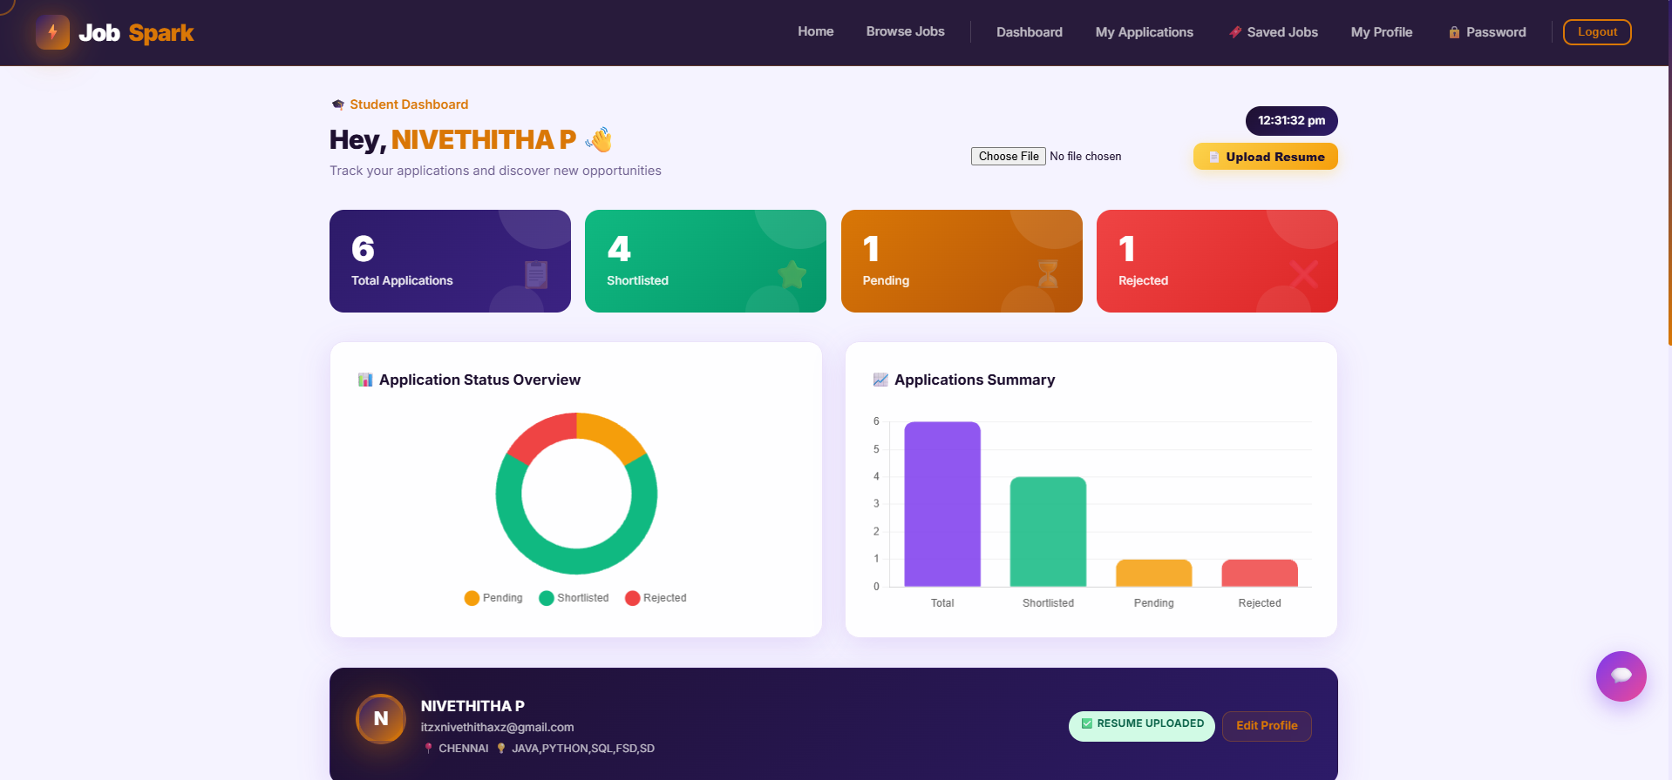
IMPLEMENTATION SCREENSHOTS
8(C)
The Student Dashboard provides a personalized overview with gradient stat cards showing total applications, shortlisted count, pending status, and rejected applications. It features Chart.js doughnut and bar charts for visual analytics, recommended job listings, resume upload, and a live clock display.

Slide 17
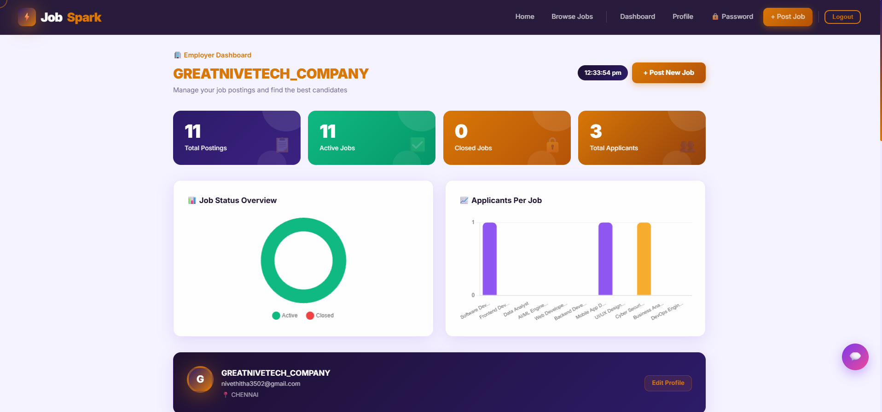
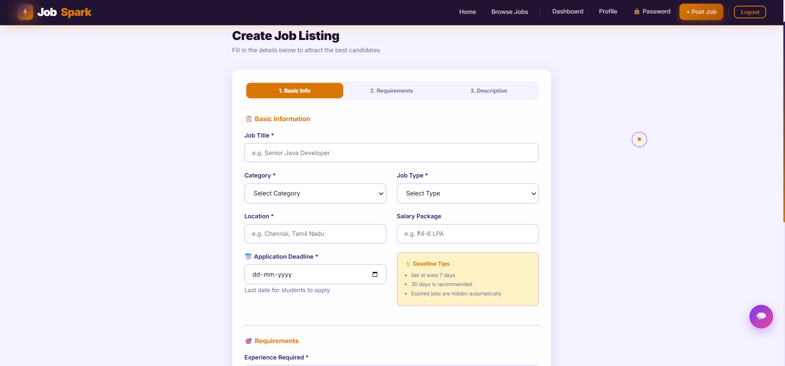
IMPLEMENTATION SCREENSHOTS
8(D)
The Employer Dashboard displays all posted jobs with applicant counts, posting dates, expiry deadlines, and job status in a clean organized table. It features Chart.js analytics showing job status overview and applicants per job bar chart, along with Edit and Delete action buttons for each listing.
The Applicants Page shows all candidates who applied for a specific job with their name, email, phone, skills, and application date in a detailed table. Employers can View Cover Letters in a popup modal, Download Resumes directly, and change application status to Shortlist or Reject — triggering automatic email notifications to students..

Slide 18
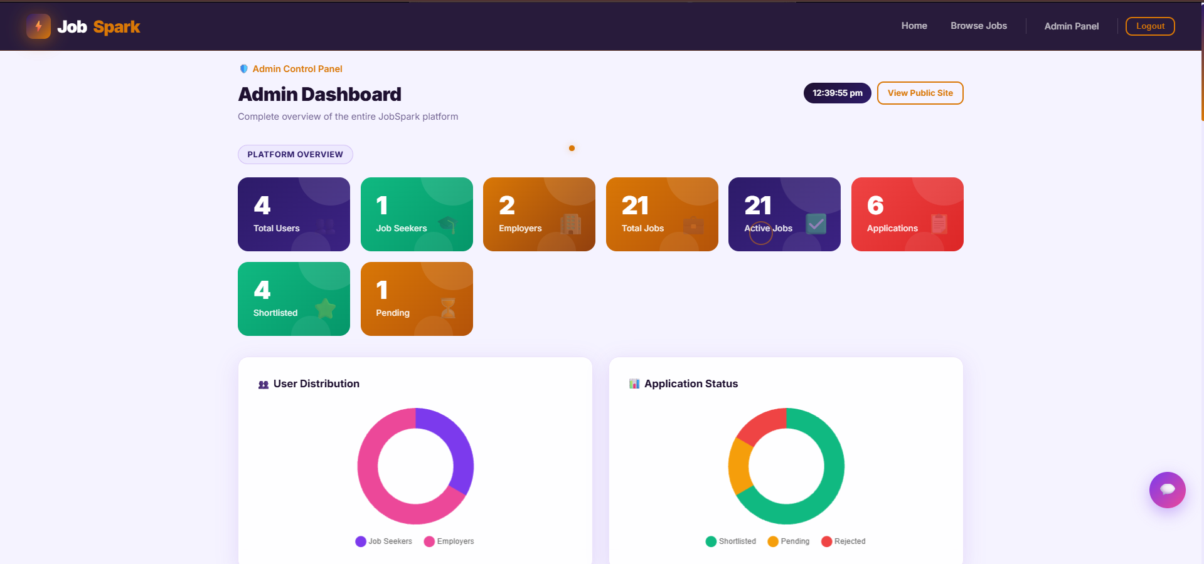
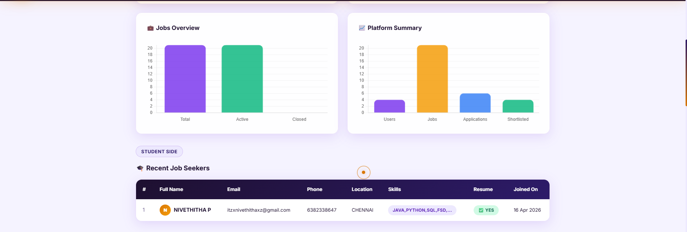
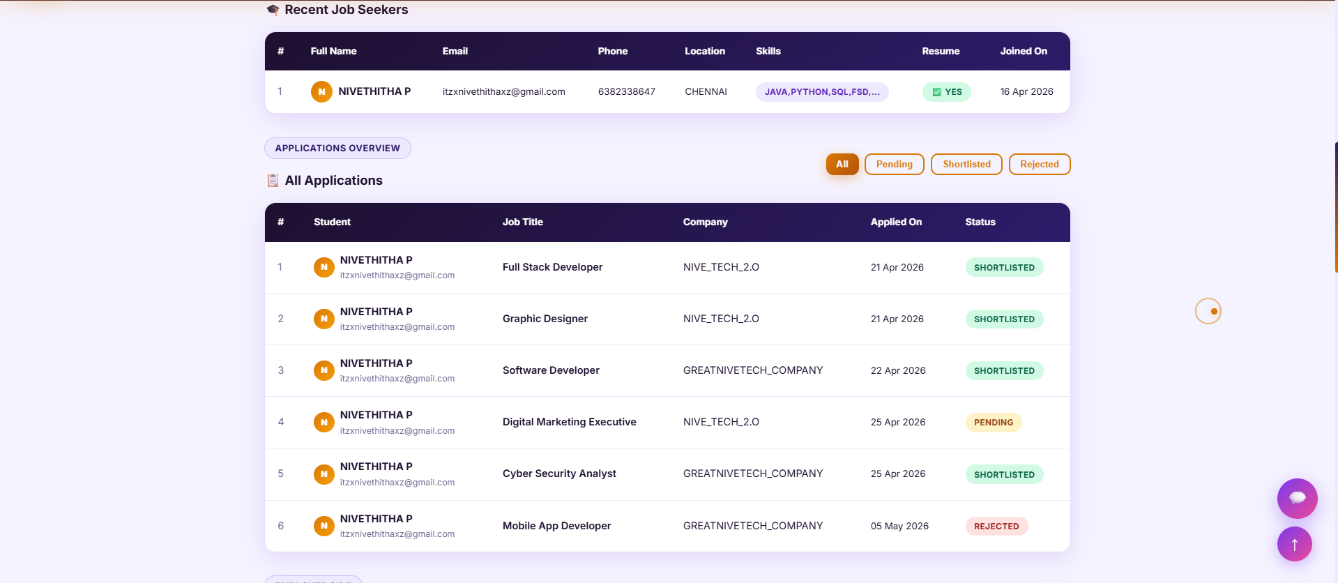
IMPLEMENTATION SCREENSHOTS
8(E)
The Admin Dashboard provides a complete platform overview with 8 stat cards showing total users, students, employers, jobs, applications, shortlisted, pending, and rejected counts. It features 4 Chart.js charts — User Distribution, Application Status, Jobs Overview, and Platform Summary — along with full tables for all users, jobs, and applications with a Delete User feature.

Slide 19
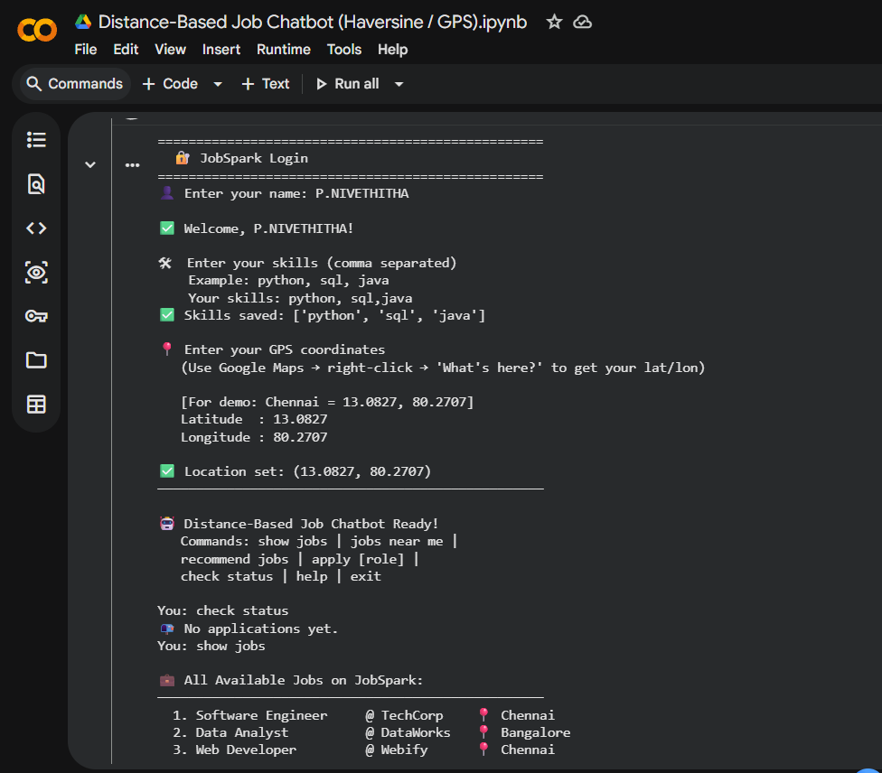
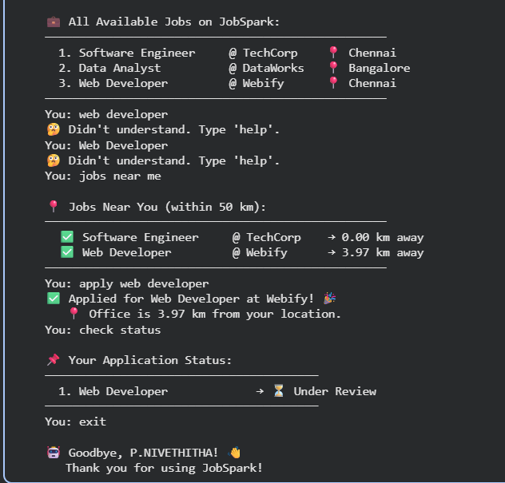
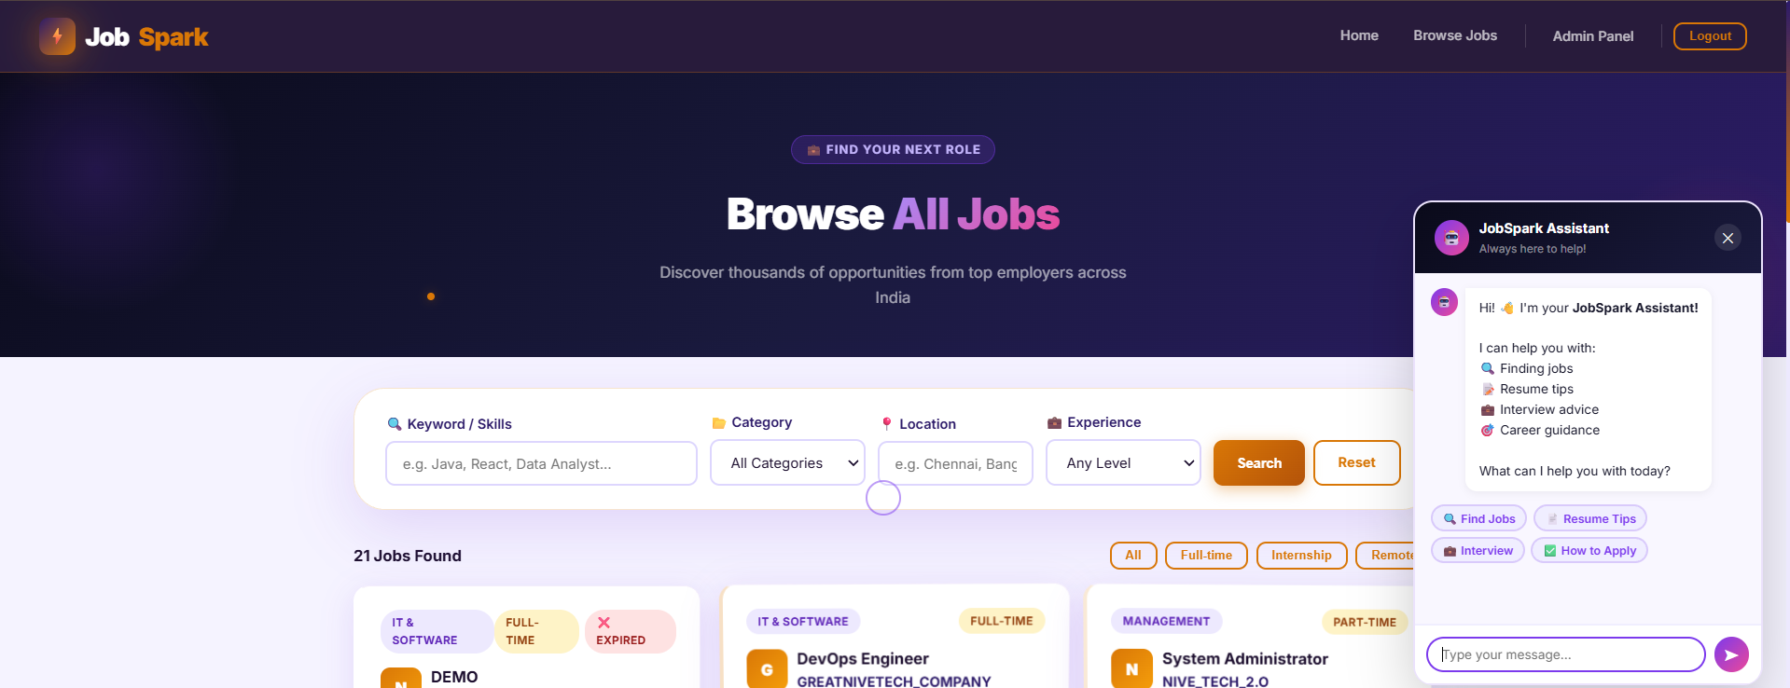
IMPLEMENTATION SCREENSHOTS
8(F)
The Chatbot floating button appears on every page providing instant assistance with job search tips, resume advice, interview preparation, and platform guidance through natural language conversation.
The future work extension of JobSpark. It uses the Haversine formula the same mathematical formula used by Google Maps to calculate real-world distance between the user's GPS coordinates and the job location

Slide 20
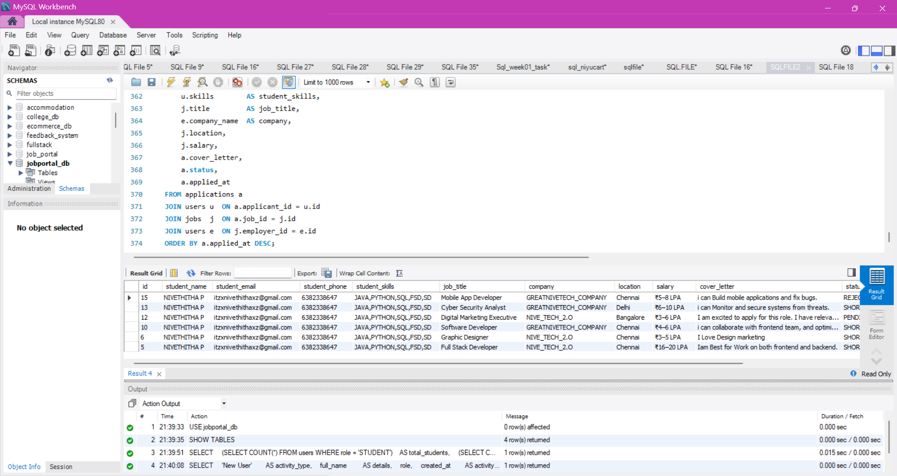
IMPLEMENTATION SCREENSHOTS
8(E)
It is used in MySQL to handle backend data of the system.
SQL supports operations like INSERT, SELECT, UPDATE, DELETE (CRUD)
Helps in efficient data management and querying.

Slide 21
SDG & CPC
SDG (Sustainable Development Goal)
Title: SDG 8 – Decent Work and Economic Growth
Promotes employment opportunities through a centralized job platform
Bridges gap between job seekers and employers
Supports fair and transparent recruitment process
Enhances economic growth by improving workforce accessibility
Encourages digital transformation in hiring systems
CPC (Cyber Practices / Professional Conduct)
Ensures data privacy and security using authentication & encryption
Maintains ethical use of user data (no misuse of personal information)
Implements secure login system (OTP verification & password hashing)
Provides fair and unbiased job listing system
Follows professional standards in system design and user interaction

Slide 22
ADVANTAGES & LIMITATIONS
9
ADVANTAGES:
Role-Based Access Control The system provides separate and secure dashboards for Students, Employers, and Admins ensuring each user only accesses features relevant to their role.
Real-Time Application Tracking Students can instantly track the status of all their job applications — Pending, Shortlisted, or Rejected — without any delay or manual update.
Powerful Search & Filter System Jobs can be filtered by keyword, category, location, and experience level making it easy for students to find the most relevant opportunities quickly.
Secure Authentication Spring Security with BCrypt password hashing ensures all user credentials are encrypted and protected from unauthorized access or data breaches.
Resume Upload & Management Students can upload and manage their resumes directly on the platform eliminating the need for external file sharing tools during the application process.
Employer Control Panel Employers have full control to post, edit, and delete jobs and can efficiently manage hundreds of applicants from a single organized dashboard.
Responsive User Interface The frontend is built with HTML5, CSS3, and Thymeleaf making it fully responsive and accessible across desktops, tablets, and mobile devices.
Scalable Database Design The MySQL database with JPA relational mappings is designed to handle large volumes of users, jobs, and applications without performance issues.

Slide 23
ADVANTAGES & LIMITATIONS
9
LIMITATIONS:
No Payment Gateway The platform does not support any premium job posting plans or subscription-based features for employers as no payment integration is implemented.
No AI-Based Job Recommendations The job recommendation system is basic and does not use machine learning or AI algorithms to match students with the most suitable job listings.
No Mobile App The platform is only available as a web application and does not have a dedicated Android or iOS mobile application for on-the-go access.
Local Deployment Only The application is configured for localhost testing only and requires additional setup like cloud hosting and domain configuration for live deployment.

Slide 24
REFERENCES
10
“Online Job Portal System,” International Journal of Computer Science and Information Technologies (IJCSIT), Vol. 5, Issue 2, 2019
“Web-Based Recruitment System,” International Journal of Advanced Research in Computer Science (IJARCS), Vol. 8, Issue 3, 2020
“Design and Development of Job Portal,” International Journal of Engineering Research & Technology (IJERT), Vol. 9, Issue 6, 2021
“E-Recruitment System using Web Technologies,” International Journal of Scientific & Technology Research (IJSTR), Vol. 10, Issue 5, 2021
“Sustainable Development Goal 8: Decent Work and Economic Growth,” United Nations, 2023
“Online Recruitment System Using Web Application,” International Journal of Emerging Technologies in Engineering Research (IJETER), Vol. 7, Issue 4, 2019
“A Study on E-Recruitment System and Its Advantages,” International Journal of Research in Engineering and Technology (IJRET), Vol. 6, Issue 5, 2018
“Job Portal System for Efficient Hiring Process,” International Journal of Innovative Research in Computer Science (IJIRCS), Vol. 8, Issue 2, 2020
“Web-Based Job Portal with Resume Management System,” International Journal of Computer Applications (IJCA), Vol. 177, Issue 10, 2019
“Secure Authentication in Web Applications Using OTP,” International Journal of Advanced Computer Science and Applications (IJACSA), Vol. 11, Issue 3, 2020
“Role-Based Access Control in Web Systems,” International Journal of Information Security Science (IJISS), Vol. 9, Issue 1, 2020

Slide 25
Thank you

