Slide 1

WhatToEat

Slide 2


What is WhatToEat?
An app that suggests what to eat, right now
Ever been confused about what to eat?
?
Do delivery apps overwhelm you?
?
Are calorie trackers too much work?
?
Breakfast, lunch, snack or dinner, and you just cannot decide.
Hundreds of choices, 20 minutes of scrolling, still hungry.
Logging every bite feels like homework, not help.
WhatToEat literally translates to what is does.
Tell it how you feel and what you are craving, by voice or a few taps. Get 3 meal picks in about 60 seconds, to cook with what you have, order in, or dine out. Every recipe has a healthy version, and veg and vegan swaps are built in.

Slide 3

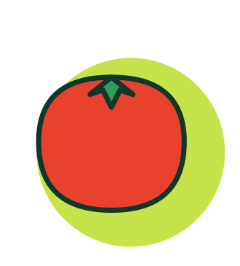

Who it is for
Urban Indians, 18-35, who are health-aware but not health-obsessed
Primary: tired decision-makers
Students
Work from home
Young professionals and postgraduates, 22-35
Living alone, with flatmates or with family
A mix of home cooking, delivery and eating out
Pain: decision fatigue, repeat meals, late heavy dinners, guilt after ordering
Tight budgets, few ingredients
Quick lunches, mindful snacks
Fitness beginners
Veg and vegan eaters
Healthy versions, protein
Automatic swaps, no mental work
Launch beachhead: Bengaluru, Mumbai, Delhi NCR, Hyderabad and Pune

Slide 4
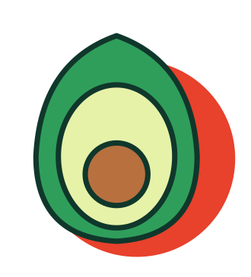

Positioning
The food decision app, not a tracker, planner or delivery app
For busy urban Indians who are health-aware but not health-obsessed, WhatToEat is the food decision app that gets you to a meal in 60 seconds, by voice or a few taps. Unlike delivery apps that overwhelm and calorie trackers that feel like homework, it starts from how you feel and what you have.
Decide in 60 seconds
Just say it
Wellness built in
Built for how India eats
Learns you
What we are not: a diet plan, a calorie counter, or a delivery platform

Slide 5
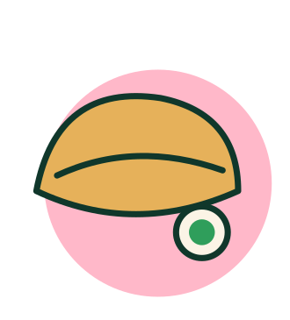
Brand personality
Calm, caring, quick and a little playful
Like a knowledgeable friend who is good at food and never judges what you pick.
Look and feel
We sound
We never sound
Chilli
Turmeric
Lime
Blush
Warm, short, encouraging
"A light, fresh option for tonight"
"Big day so far. Something light for dinner?"
Preachy or clinical
"Low-calorie meal"
"You exceeded your calories"
Cobalt
Cream
Forest ink
Line-art food doodles on offset colour blobs. Bold, clean type. Bright but grown-up.

Slide 6
Marketing: channels and why
A 60-second voice session is itself the ad
Channel | Role | Why it fits India
Instagram Reels and YouTube Shorts | Main engine | 61% of Indian internet users watch short video. Instagram sees 46% of its content consumed as short video.
Micro-creators, Hindi and English | Trust and reach | Food, fitness and student creators earn trust cheaply, and Hindi creators reach beyond metros.
WhatsApp | Sharing, retention | Over 500 million Indian users. "What should we eat?" is often decided in a group chat.
Campus and office groups | Beachhead | Hostels, PGs and offices decide meals together, so one user brings several.
Search, "what to eat" queries | Free, high intent | People search the exact question at mealtimes, and the traffic compounds.
Referral: invite a flatmate | Viral loop | Meals are shared decisions, so inviting someone makes the app better.

Slide 7
Marketing: campaigns and budget
Relatable moments, then proof
The 8:40pm question
Launch campaign. Creators go from "I do not know what to eat" to a meal in 60 seconds.
Why: the tired evening decision is universal for working people.
Fridge Challenge
Users say what is in their fridge and the app answers with a recipe. Best clips are reposted.
Why: shows the voice and ingredient feature and creates user content.
Festival and season moments
Exam season, monsoon, Diwali: quick cheap meals, soothing food, lighter options after heavy days.
Why: India's food calendar creates heavy-eating spikes where nudges are welcome.
Starting budget split, to be tested in beta
Creators 35%
Paid social 25%
Campus 15%
Content 10%
Referral 10%
PR 5%
Why creators lead: trust drives first use of a new app. Paid social then scales only what works.

